Slide 1

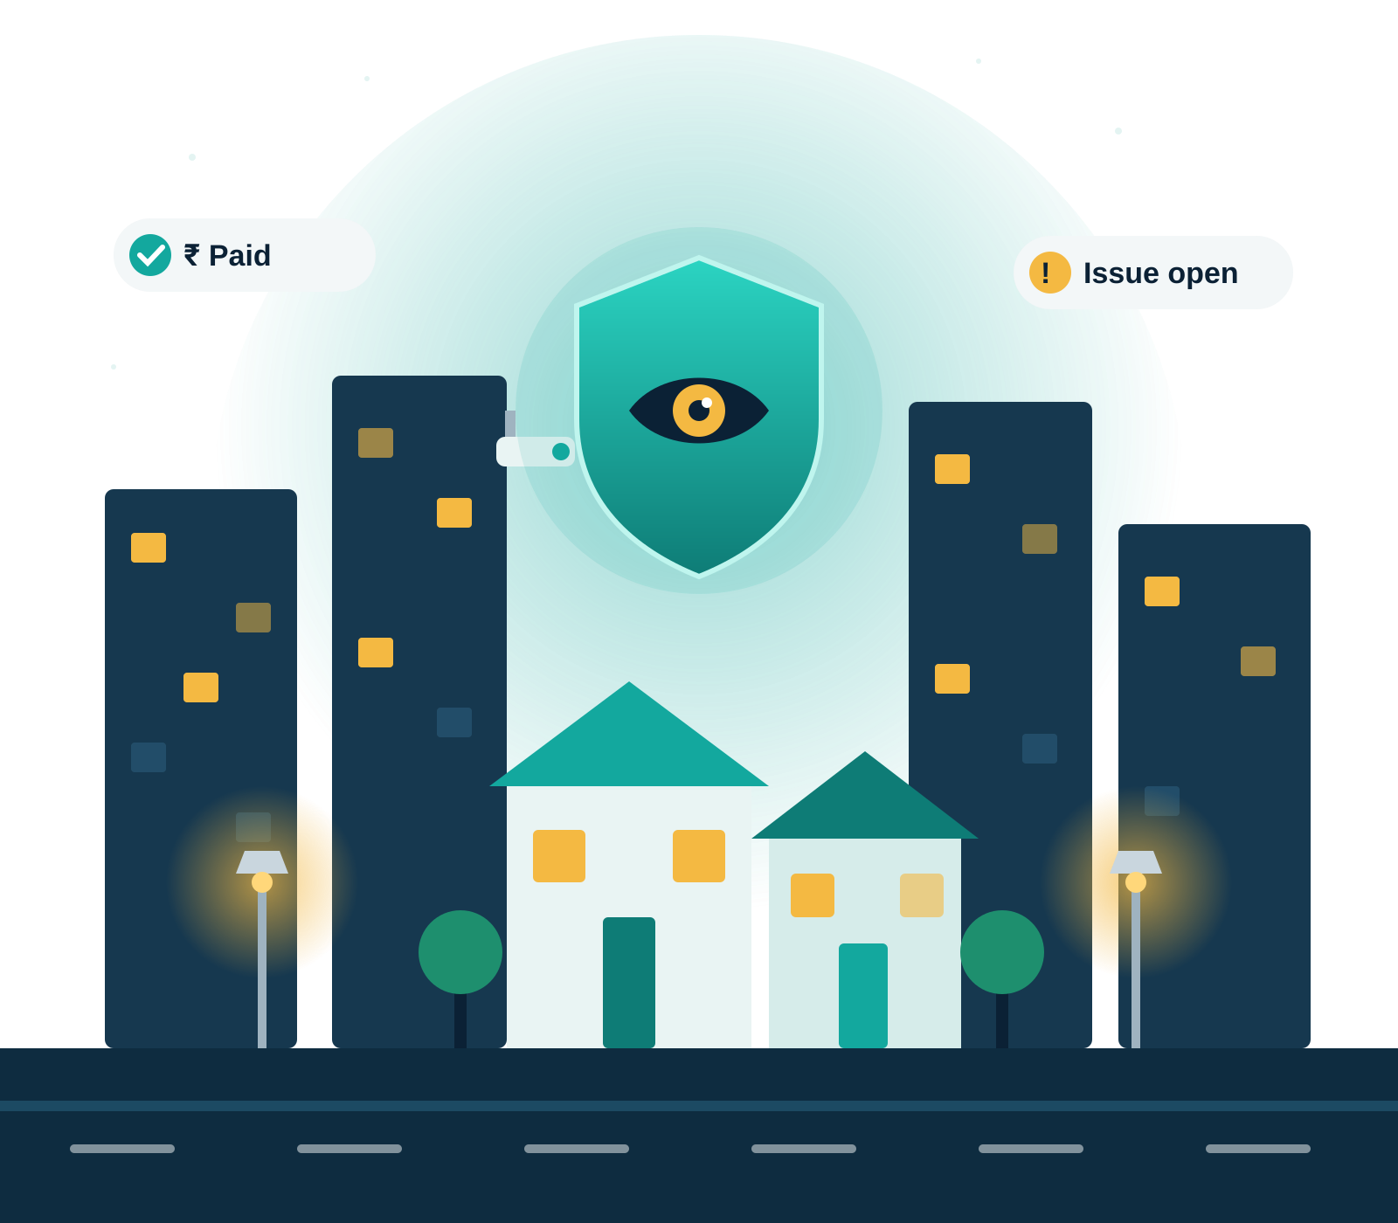
SecureComm
One transparent window into your residential community
A role-based platform that keeps residents, volunteers, security guards and the super admin on the same page — security, gate, money and notices.
Prototype walkthrough · Sudeep · October 2026
Notes:
Introduce SecureComm: a prototype web platform built to make everything happening in a residential community visible to the people who live there, not only to the committee.

Slide 2




Residents are often the last to know
THE PROBLEM
“
Where does my maintenance money go?
Did anyone act on my complaint?
Trust breaks down when information sits with only a few people.
Collections and expenses are shared once a year, if at all.
Issues get lost in WhatsApp groups with no owner or status.
Are the cameras and lights working?
Who came through the gate today?
SecureComm puts the same facts in front of every role.
Nobody knows how many CCTVs or street lights are faulty.
Paper registers at the gate are hard to check or audit.
Notes:
Four everyday questions residents ask that today have no clear answer. The common root cause: information is held by a few people and shared informally.

Slide 3

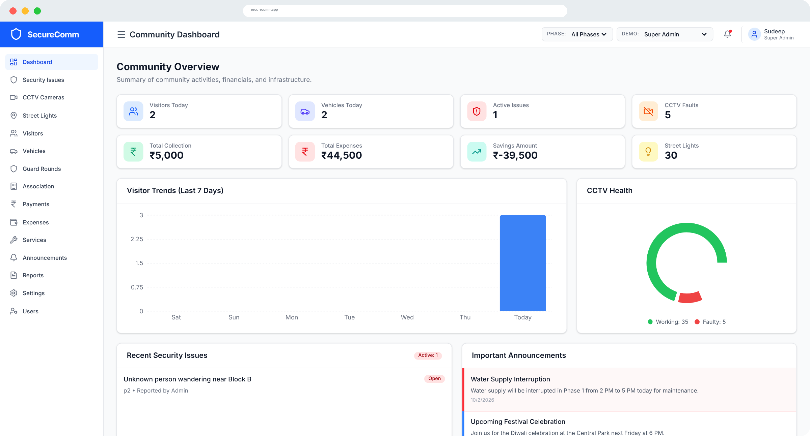


One shared source of truth
THE SOLUTION
See it
Live status of security issues, CCTV, street lights, finances and notices — for every role.
Own it
Every issue, patrol round, payment and expense is logged with status, date and who recorded it.
Act on it
Residents report issues, check dues and find verified service providers themselves.
The community dashboard, as seen by the Super Admin
Notes:
Three ideas drive the product: make information visible, make every action accountable, and let residents participate directly.

Slide 4




Four roles, one platform
WHO USES IT
Super Admin
Volunteer / Superintendent
Security Guard
Community Member
Owns the whole community
Runs day-to-day operations
Looks after the gate
Sees everything that matters
Configures community settings and gate access rules
Adds volunteers, guards and residents
Sees all 6 phases and 2 sectors
Records payments and logs expenses
Broadcasts announcements
Manages CCTV, street lights and committee
Registers visitor entry and exit
Tracks vehicles at the gate
Logs patrol rounds on Day or Night shift
Reports security issues
Views CCTV health and payment status
Reads notices and finds service providers
Notes:
The app has four roles defined in AuthContext. In the prototype a 'Demo' switcher in the header lets you change role live to see how the sidebar and permissions change.

Slide 5
Each role sees exactly what it needs
ROLE-BASED ACCESS
Module | Super Admin | Volunteer | Guard | Resident
Dashboard | ✓ | ✓ | ✓ | ✓
Security Issues | ✓ | ✓ | ✓ | ✓
CCTV Cameras | ✓ | ✓ | – | ✓
Street Lights | ✓ | ✓ | – | –
Visitors | ✓ | ✓ | ✓ | –
Vehicles | ✓ | ✓ | ✓ | –
Guard Rounds | ✓ | ✓ | ✓ | –
Association | ✓ | ✓ | – | –
Payments | ✓ | ✓ | – | ✓
Expenses | ✓ | ✓ | – | –
Services | ✓ | ✓ | ✓ | ✓
Announcements | ✓ | ✓ | ✓ | ✓
Reports | ✓ | ✓ | – | –
Settings | ✓ | – | – | –
Users | ✓ | – | – | –
Modules visible in the sidebar
15
13
Super Admin
Volunteer
7
6
Security Guard
Resident
Residents get read-only views. They can see CCTV health, security issues and finances, but edit and delete actions are hidden for them.
Notes:
This matrix comes straight from the role list on each sidebar item. Residents still see the important numbers, so transparency is kept while control stays with the right people.

Slide 6
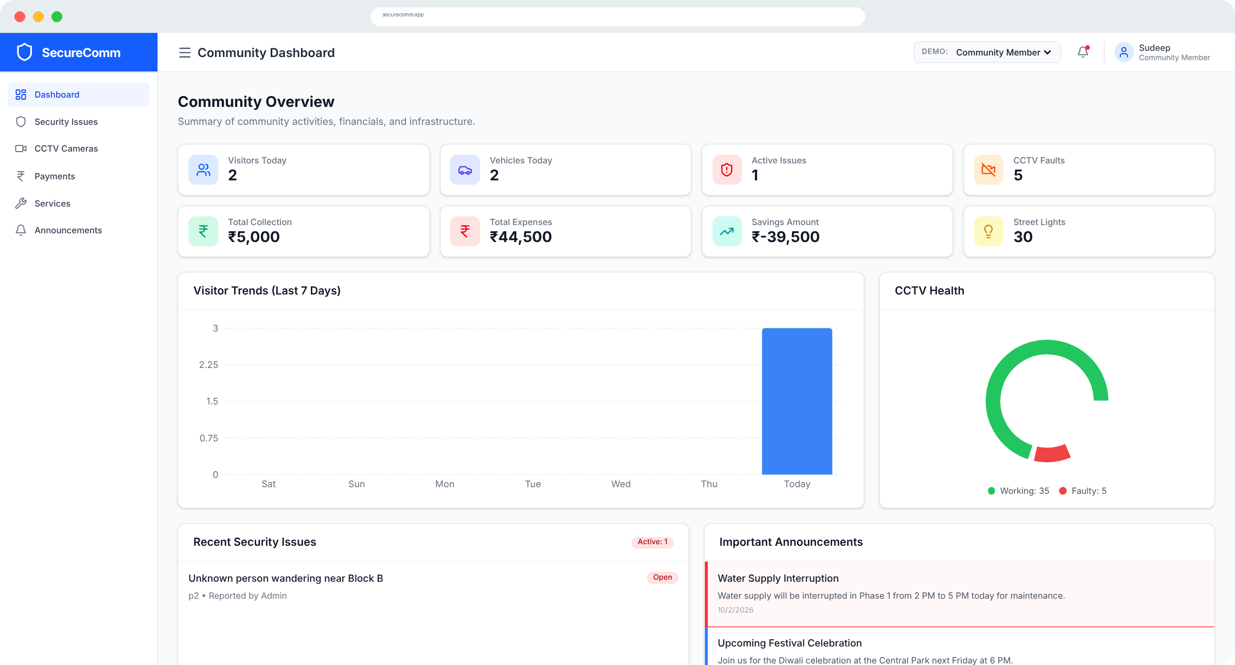




The pulse of the community at a glance
COMMUNITY DASHBOARD
8 live KPI tiles
Visitors, vehicles, active issues, CCTV faults, collection, expenses, savings, street lights
Trends & health
7-day visitor trend and a CCTV working-vs-faulty donut
What needs attention
Recent security issues and important announcements
Phase filter
Admins and volunteers can drill into any phase
Same numbers for everyone — shown here in the Community Member view
Notes:
The dashboard pulls from the same data store as every module. Savings is calculated automatically as total collection minus total expenses.

Slide 7
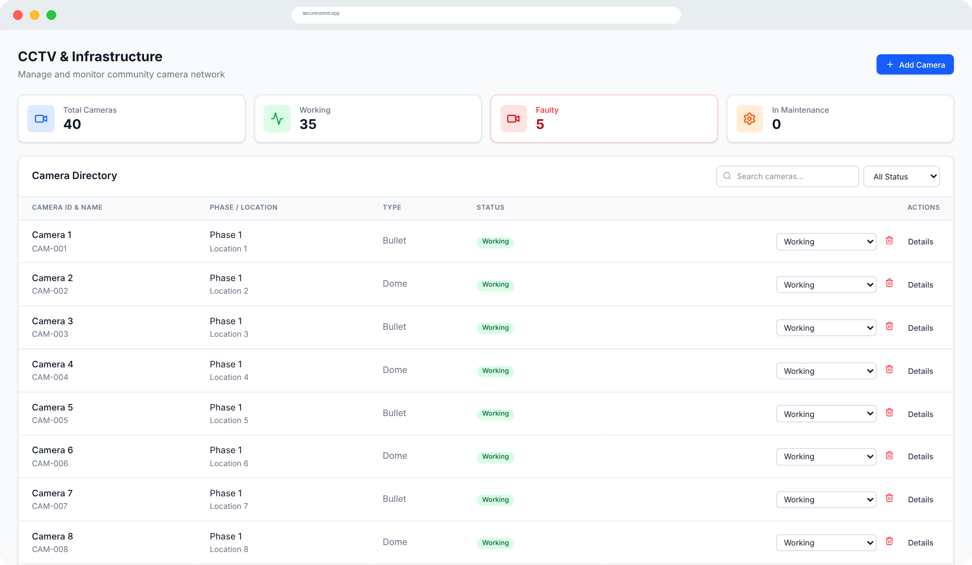




Safety you can check for yourself
SECURITY & INFRASTRUCTURE
Security issues
CCTV cameras
Report trespassing, vandalism or suspicious activity with High, Medium or Low priority; track Open → In Progress → Resolved.
Camera directory with Working, Faulty and Maintenance status for Bullet, Dome and PTZ cameras.
Street lights & assets
Guard rounds
Streetlights, generators and water pumps, with working or faulty status.
Patrol log by guard, route and time, marked Completed or Missed.
35 / 40
cameras working in the demo data — and every resident can see that number.
Notes:
Security is the core of SecureComm. Faulty cameras and lights are no longer hidden; they show up on the dashboard for everyone.

Slide 8





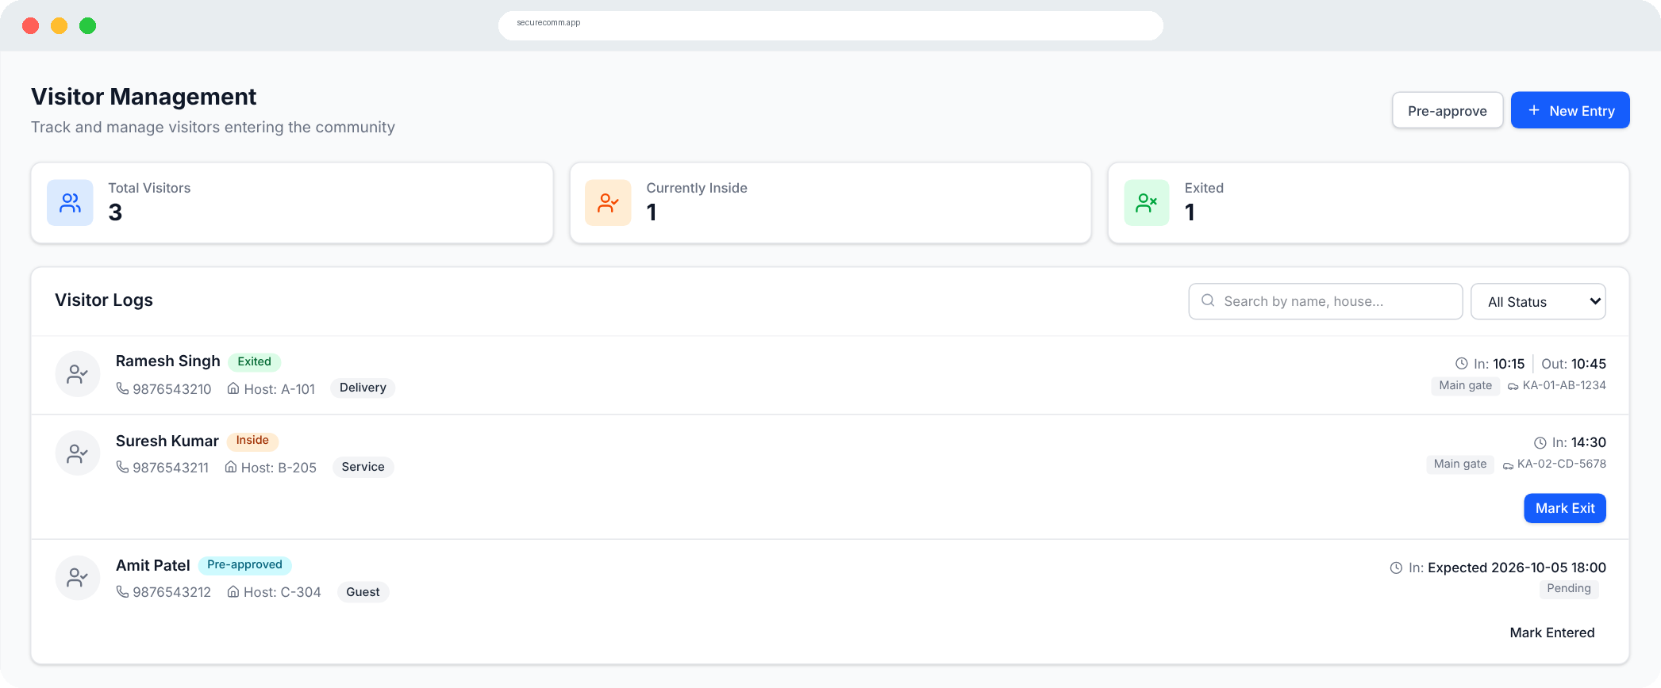


A smarter gate for visitors and vehicles
GATE MANAGEMENT
1. Pre-approve
2. Register entry
3. Currently inside
4. Mark exit
Host creates a pass with expected date and time
Guard logs name, mobile, host house, purpose, vehicle
Live count of visitors inside the community
Exit time stamped; OTP check can be required
Vehicle registry
Cars, two-wheelers and commercial vehicles linked to a house.
Access rules
Admin settings: auto-approve frequent visitors, require OTP for exit.
Notes:
The visitor lifecycle in the prototype: Pre-approved, Inside, Exited, or Denied. Guards and volunteers handle the gate; residents can pre-approve their guests.

Slide 9
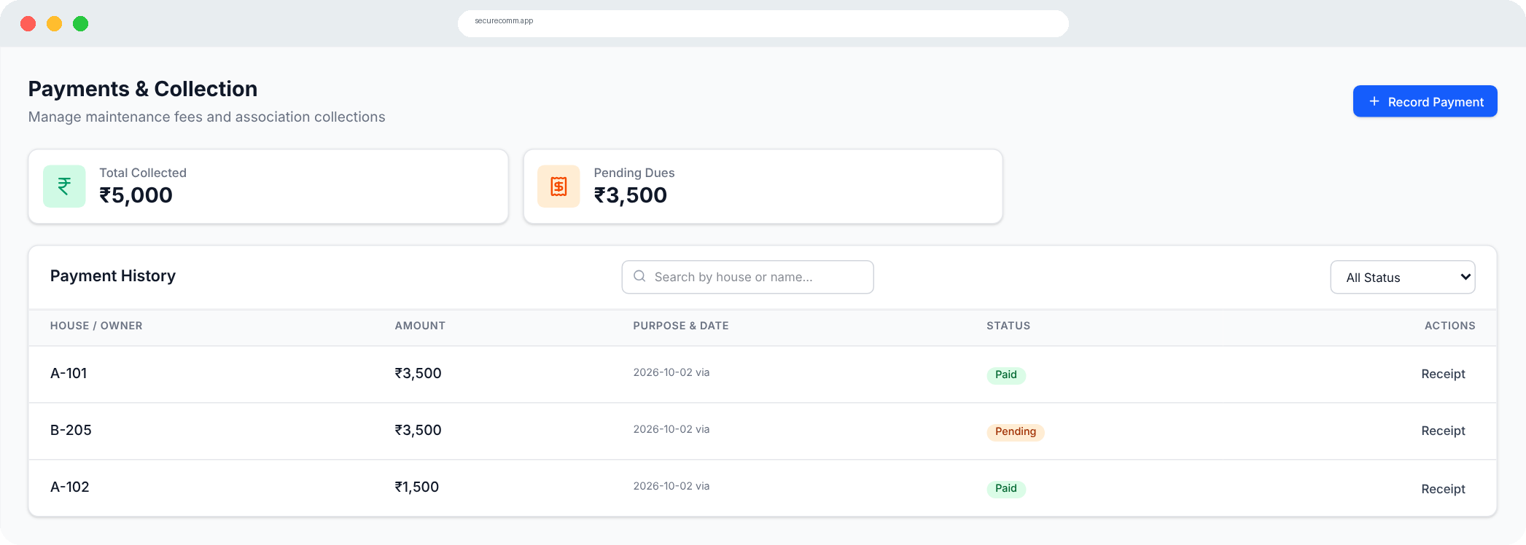


Every rupee, visible
FINANCIAL TRANSPARENCY
₹5,000
₹3,500
₹44,500
Total collected
Pending dues
Total expenses
Payments Maintenance fee, sinking fund, event contributions and fines — with payment proof upload and receipts.
Expenses Every vendor payout logged by category, with a Pending Approval stage.
Savings Collection minus expenses, calculated automatically on the dashboard.
Notes:
Figures are prototype demo data. The point is that residents see the same collection, dues and expense numbers that the committee sees.

Slide 10
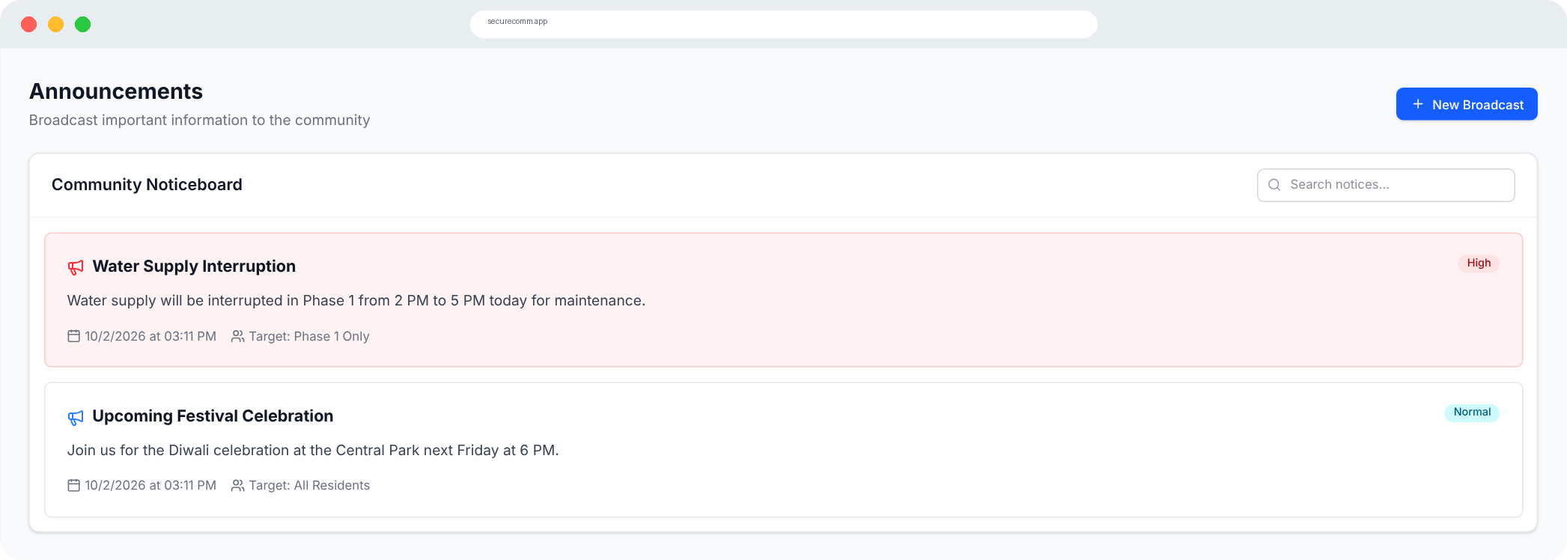


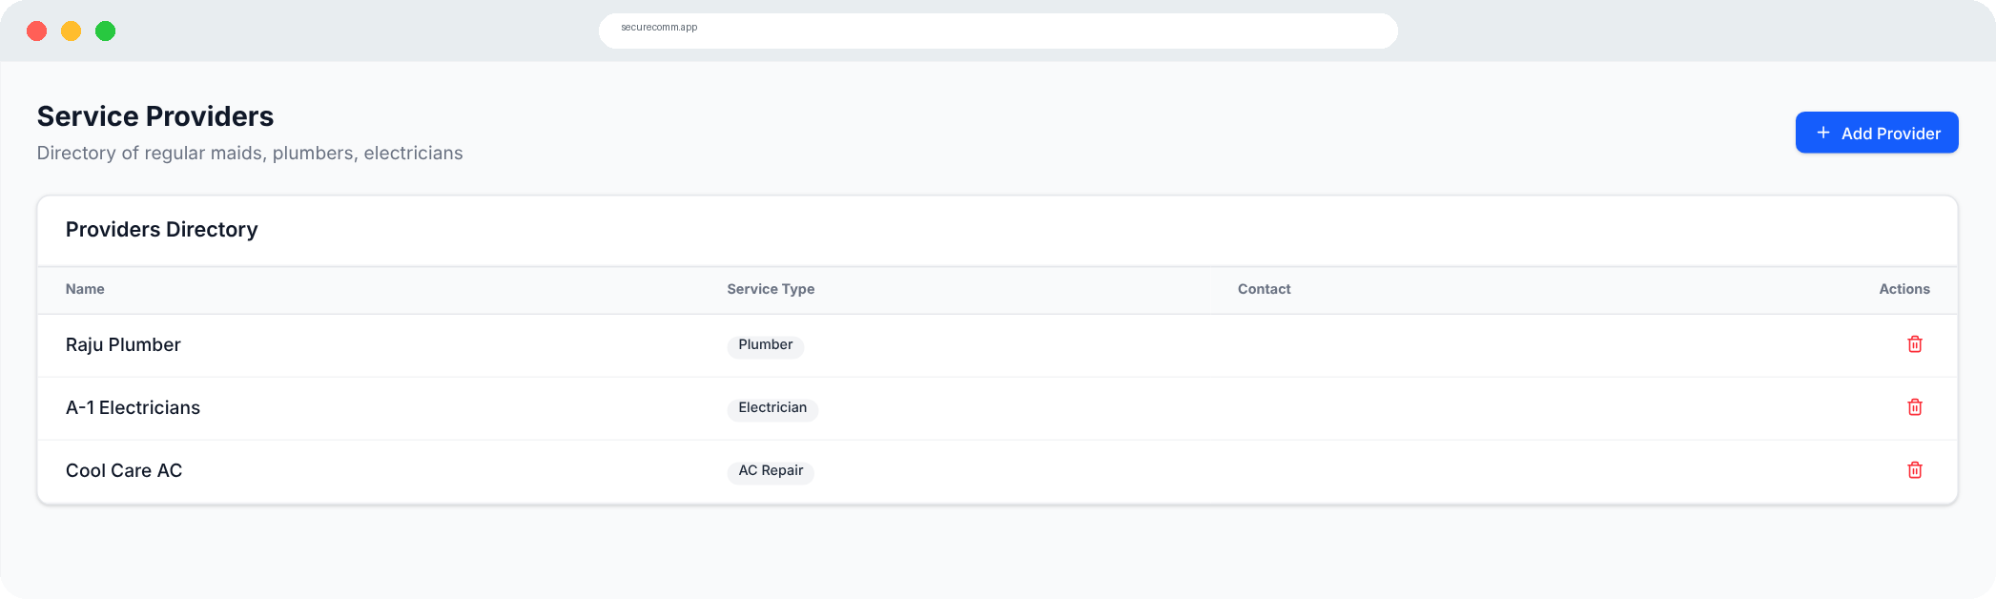

Keeping everyone informed and connected
COMMUNITY & COMMUNICATION
Announcements
Target all residents, a single phase or the security team, with High (Emergency) or Normal priority.
Association committee
Directory of the President, Secretary, Treasurer and members, with contacts.
Verified service providers
Plumbers, electricians, AC repair, pest control and more — marked verified by the association.
Notes:
Communication modules replace scattered WhatsApp forwards with a searchable noticeboard and trusted directories.

Slide 11
Built for large, multi-phase layouts
SCALE
6 + 2
phases and sectors
755
houses
2,170
residents
Every record carries a phase and optional sector, so the phase switcher filters each module to just that part of the community.
Notes:
Sample phase data from the prototype's mock data. The design supports gated layouts with many phases, each with its own volunteers and guards.

Slide 12



Records that stand up to questions
ACCOUNTABILITY
Financial reports
Security incidents
Visitor logs
Collections, pending dues and expenses
All raised issues and how they were resolved
Every visitor and service provider at the gate
CSV · PDF
CSV · PDF
CSV · PDF
Personal activity, on every profile
Click your name in the header to see the issues you reported, the visitors you hosted and the payments you made.
Issues reported
Visitors hosted
Payments made
Notes:
In the prototype the report download buttons and the profile activity are front-end only; they show the intended experience.

Slide 13









How the prototype is built
UNDER THE HOOD
UI layer
PROPOSED PRODUCTION PATH
React 19 · Vite 8 · Tailwind CSS 4 · Recharts · Lucide icons
Node.js / Express REST API
Routing & state
MongoDB for residents, logs and finances
React Router 7 (15 routes) · AuthContext for role and phase · ToastContext
Redis + WebSockets for live alerts
Service layer
dashboardService and localDb with CRUD helpers for each entity
OTP login with role-based auth
Storage
Same React UI, mobile-ready
Browser localStorage seeded with demo data (prototype only)
Notes:
Today the app is a pure front-end prototype; data lives in localStorage. The service layer is already separated, so it can be swapped for real API calls without rewriting pages. The right panel is a proposal, not built yet.

Slide 14




From prototype to production
ROADMAP (PROPOSED)
NOW
NEXT
THEN
THEN
LATER
Prototype
Backend & real login
Live alerts
Online payments
Mobile apps
15 modules, 4 roles, live role switcher, demo data
API, database, OTP login, per-user data
Push alerts for new issues and visitors at the gate
UPI / gateway payments with automatic receipts
Resident and guard apps, live CCTV feed links
Notes:
Suggested next steps to move from a clickable prototype to a product a real society can run on.

Slide 15
Transparency builds trust.
When residents, volunteers, guards and admins all see the same facts, communities run safer and fairer.
Thank you · Questions?
Notes:
Close with the core message and open for questions. Offer a live demo using the role switcher.

