Slide 1
blinkit
POWER BI PROJECT
BlinkIT Sales
Analysis
Data Cleaning · DAX Measures & Field Parameter · 2-Page Interactive Dashboard
Prepared for Category & Outlet Performance Review
Source files: BLINKIT_Sales_Analysis.pbix · BlinkIT_Grocery_Data.xlsx · 8,523 transaction rows

Slide 2
AGENDA
What This Deck Covers
1
2
3
4
Objective & Business Question
Dataset Overview
Data Cleaning
Calculated Fields
Why this dashboard exists and the sales question it answers
8,523-row, 12-column BlinkIT grocery transaction dataset
Power Query steps to fix inconsistent Item Fat Content labels & blanks
DAX measures and the Metrics field parameter behind every visual
5
6
7
Chart Specifications
2-Page Dashboard Layout
Key Insights & Recommendations
Which chart, which fields, which question it answers
Home · Matrix — plus screenshot pages
What the numbers actually tell category & outlet teams
BlinkIT Sales Analysis | Power BI Project
2

Slide 3
1
Objective & Business Question
Objective
Give category and outlet teams a 2-page Power BI dashboard that turns 8,523 raw grocery transactions into a trusted view of revenue, rating and average sale value — sliceable by item type, outlet type, location tier and fat content, with a detailed matrix for drill-down.
HEADLINE INSIGHT
1.20M
Key Business Questions
total sales across 8,523 items (avg. rating 3.92, avg. sale ₹140.99) — after standardizing 545 inconsistent Item Fat Content labels down to two clean categories.
1
Which item categories and outlet types generate the most revenue?
2
Does average sale value differ by fat content or by store tier?
3
How has revenue evolved by the year an outlet was established?
Supermarket Type1 alone drives 66% of all revenue (₹7.88L from 5,577 items) — format matters more than location tier.
4
Where is the raw data unreliable — and does cleaning it change the answer?
BlinkIT Sales Analysis | Power BI Project
3

Slide 4
2
Dataset Overview
BlinkIT_Grocery_Data.xlsx · single sheet · 8,523 rows × 12 columns · feeds the Power BI model directly
Column | Data Type | Description
Item Identifier | Text | Unique product code (e.g. FDX32)
Item Type | Text | Product category (16 categories)
Item Fat Content | Text | Regular or Low Fat — raw values needed cleanup
Item Weight | Decimal | Product weight; blank on 1,463 rows (17.2%)
Item Visibility | Decimal | Shelf-display prominence (0 for 526 rows)
Outlet Identifier | Text | Unique store code (e.g. OUT049)
Outlet Establishment Year | Whole Number | Year the outlet opened (9 distinct years, 2011–2022)
Outlet Size / Type / Location Type | Text | Store size, format (e.g. Supermarket Type1) and city tier
Sales | Decimal | Revenue for the item at that outlet
Rating | Decimal | Customer rating for the transaction (1–5)
8,523
grocery transaction rows
12
raw source columns
1,463
rows with blank Item Weight (17.2%)
545
rows with a messy Item Fat Content label
BlinkIT Sales Analysis | Power BI Project
4

Slide 5
3
Data Cleaning in Power Query
Query steps applied, in order, before loading BlinkIT Grocery Data to the model
01
Promote Headers & Set Types
02
Trim & Clean Text
First row → headers; Sales, Item Weight & Item Visibility set to Decimal Number, Rating to Decimal, Outlet Establishment Year to Whole Number.
Applied to Item Fat Content — removes stray leading/trailing spaces and casing picked up at source.
03
Standardize Categories
04
Flag Missing Item Weight
Merged "LF" (316 rows) and "low fat" (112 rows) into "Low Fat"; merged "reg" (117 rows) into "Regular" — 5 raw labels collapse into 2.
1,463 rows (17.2%) left blank rather than guessed — SUM-based measures ignore blanks automatically, so totals stay accurate.
05
Flag Zero Item Visibility
06
Close & Load to Model
526 rows (6.2%) recorded as exactly 0 — kept, but flagged as likely data-entry placeholders rather than true zero visibility.
Cleaned table loaded into the Power BI data model as BlinkIT Grocery Data for measures and visuals.
BlinkIT Sales Analysis | Power BI Project
5

Slide 6
4
Calculated Fields — DAX Measures & Field Parameter
From the report's own "Dax_Measure" table and "Metrics" field parameter — no extra numeric columns were needed since Sales, Rating and Item Weight are already at transaction grain
fx
Total_Sales
SUM( Sales )
Headline revenue KPI and the value behind every bar, area, donut and combo chart
fx
Average_Sales
AVERAGE( Sales )
Average order value; used on the funnel chart and the Matrix page
fx
Average_Rating
AVERAGE( Rating )
Customer-satisfaction KPI shown on every page's card row
Metrics (calculated table / field parameter)
A small calculated table that lets one slicer swap the Home-page area chart between Average_Rating, Average_Sales and Total_Sales — one visual doing the job of three, rather than three separate charts.
Note: DAX expressions are compiled inside the .pbix data model and are not stored as readable text in the file; formulas above reflect the standard definition implied by each measure's name, format and usage across the report.
BlinkIT Sales Analysis | Power BI Project
6

Slide 7
5
Chart Specifications
Every visual, read from the report layout — scoped to one clear question per chart
Page | Chart Type | Fields Used | Question It Answers
Home | Card | Total_Sales · Average_Rating · Average_Sales | What are the topline revenue, rating and average-order metrics?
Home | Slicers | Item Type · Outlet Type · Outlet Location Type · Metrics | How can the viewer filter the page or swap the headline metric?
Home | Funnel Chart | Item Fat Content × Average_Sales | Does average order value differ by fat content?
Home | Area Chart | Outlet Establishment Year × Total_Sales | How has revenue trended by outlet vintage?
Home | Bar Chart | Item Type × Total_Sales | Which product categories drive the most revenue?
Home | Donut Chart | Item Fat Content × Total_Sales | What share of revenue comes from each fat-content type?
Home | Line + Stacked Column Combo | Outlet Location Type × Total_Sales & Count of Item Fat Content | How do revenue and product count compare by store tier?
Matrix | Matrix / Pivot Table | Outlet Location Type (rows) × Item Fat Content (cols) × Sum of Item Weight & Average_Sales | What's the detailed weight and average-sales split by tier and fat content?
BlinkIT Sales Analysis | Power BI Project
7

Slide 8
6
2-Page Dashboard Layout
One data model, two focused pages — navigated with the Home / Matrix pill menu
Home
Matrix
Full KPI, trend & category breakdown
Detailed weight & average-sales drill-down
• Total_Sales 1.20M · Average_Rating 3.92 · Average_Sales 140.99
• Same KPI card row as the Home page
• Funnel: Average_Sales by Item Fat Content (Regular 141.50, Low Fat 140.71)
• Rows: Outlet Location Type (Tier 1 / Tier 2 / Tier 3 / Total)
• Area chart: Total_Sales by Outlet Establishment Year (2018 peak, 0.2M)
• Columns: Item Fat Content (Low Fat / Regular / Total)
• Bar chart: Total_Sales by Item Type (Fruits & Vegetables leads)
• Values: Sum of Item Weight & Average_Sales per cell
• Donut: Total_Sales share — Low Fat 64.6% · Regular 35.4%
• Grand total: 90,774.97 kg · Average_Sales 140.99 across 8,523 items
• Combo chart: Total_Sales & product count by Outlet Location Type
BlinkIT Sales Analysis | Power BI Project
8

Slide 9
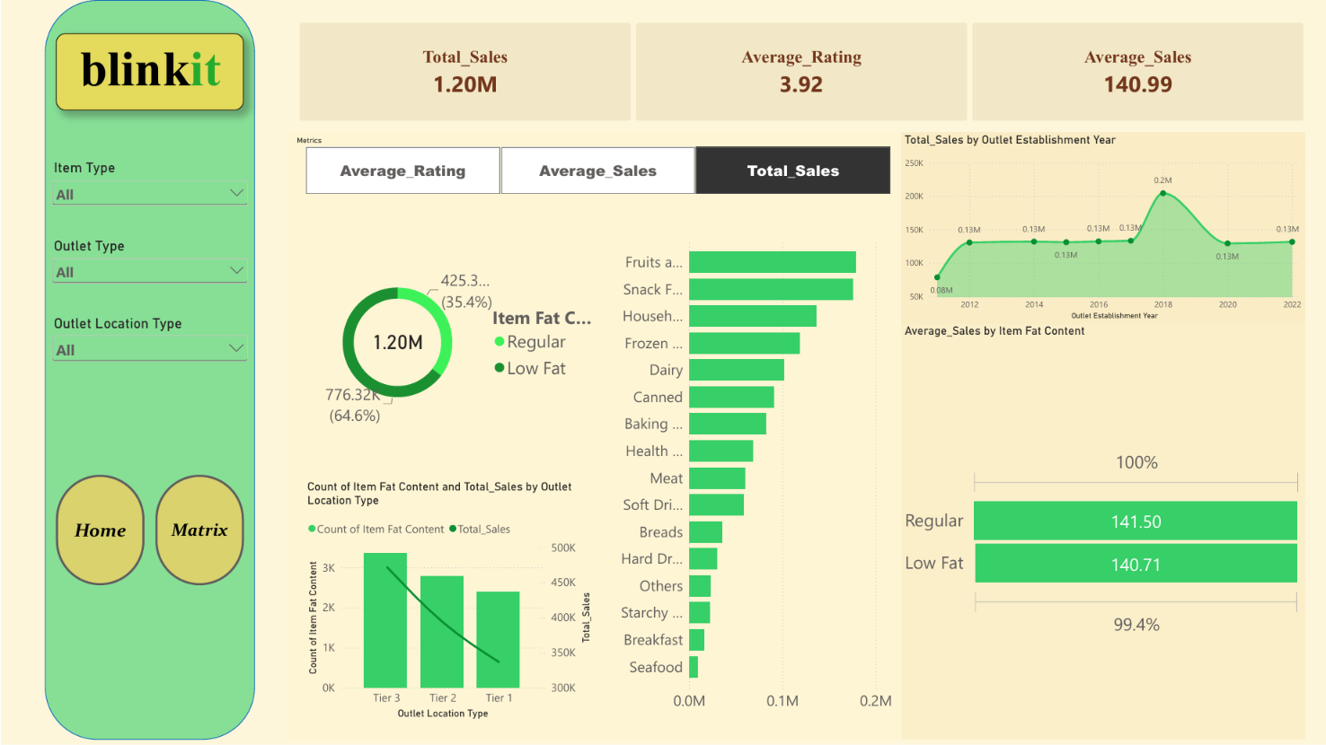
DASHBOARD PAGE
Home
Matrix
Home Page
Full KPI, trend, category and outlet-tier breakdown
Paste the Home page screenshot from BLINKIT_Sales_Analysis.pbix here
(Power BI: File > Export > PDF or a snipped screenshot, sized to fill this frame)
BlinkIT Sales Analysis | Power BI Project
9

Slide 10
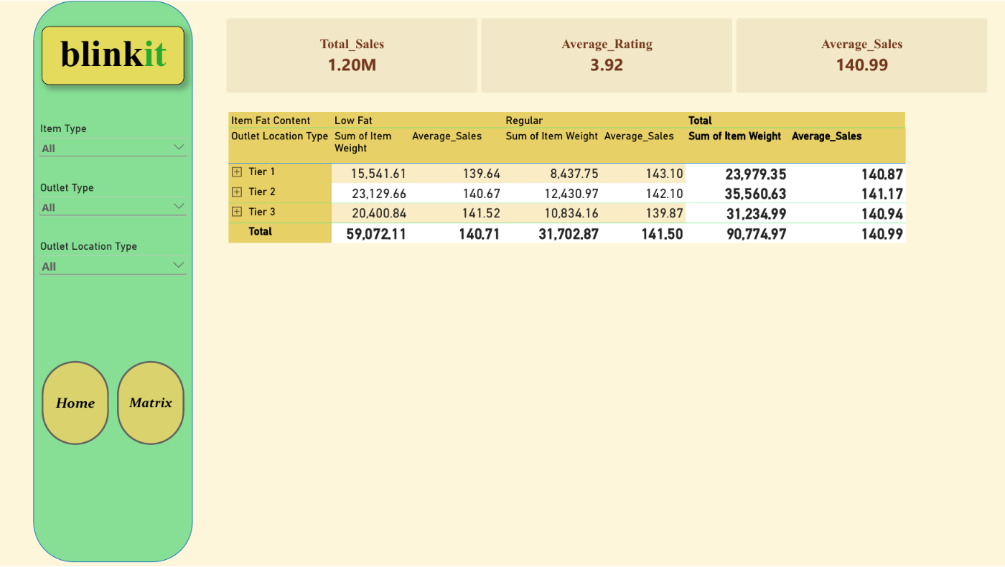
DASHBOARD PAGE
Home
Matrix
Matrix Page
Detailed weight & average-sales drill-down by tier and fat content
Paste the Matrix page screenshot from BLINKIT_Sales_Analysis.pbix here
(Power BI: File > Export > PDF or a snipped screenshot, sized to fill this frame)
BlinkIT Sales Analysis | Power BI Project
10

Slide 11
7
Key Insights & Recommendations
1
Two categories carry outsized weight
2
Format matters more than location tier
Fruits & Vegetables (₹1.78L) and Snack Foods (₹1.75L) together generate ~29% of total revenue, while Seafood trails every other category at just ₹9.1K — a 20x gap between top and bottom.
Supermarket Type1 alone drives 66% of revenue (₹7.88L from 5,577 items) versus Grocery Store's ₹1.52L from 1,083 items — outlet format predicts revenue far better than city tier.
3
Fat content barely moves order value — but volume differs a lot
4
2018 was a breakout year for outlet openings
Regular items average ₹141.50 per sale vs. Low Fat's ₹140.71 — under 1% apart. Yet Low Fat accounts for 64.6% of revenue (₹7.76L) purely because it's stocked and sold more often.
Outlets established in 2018 contribute ₹204.5K in sales — about 55% above every other vintage year's ~₹1.3L — worth understanding what was different about that year's openings.
BlinkIT Sales Analysis | Power BI Project
11

Slide 12
CONCLUSION
From Raw Transactions to a Trusted Sales Story
Deliverables
A disciplined Power Query cleanup — trimming, standardizing 5 fat-content labels into 2, and flagging (not guessing away) missing weight and zero visibility — turned a noisy 8,523-row export into a trustworthy model. Three DAX measures and a Metrics field parameter then made every KPI and chart consistent across both dashboard pages.
8,523-row source workbook
5 → 2 fat-content label cleanup
3 DAX measures + 1 field parameter
Recommendations
2-page interactive .pbix dashboard
Investigate the 2018 outlet cohort's ₹204.5K spike — more outlets, bigger stores, or a genuine lift?
Prioritize the Supermarket Type1 format in expansion — it already carries 66% of revenue
8 charts, cards & tables specified
Resolve the 1,463 blank Item Weight rows before shipping any weight-based analysis
2 screenshot pages ready to fill in
Fix Item Fat Content at the source system so LF / reg variants stop recurring on refresh
BlinkIT Sales Analysis | Power BI Project
12

Slide 13
Thank You
BlinkIT Sales Analysis | Power BI Project
13

