Slide 1
POWER BI PROJECT
HR Analytics
Dashboard
Employee Data Modeling · Calculated Columns · Attrition & Retrenchment Measures · 3-Page Interactive Dashboard
Prepared for HR Workforce Analytics Review
Source files: HR_Analytics_Dashboard.pbix · HR_Attrition_Dashboard.xlsx · 1,478 employee records

Slide 2
AGENDA
What This Deck Covers
1
Objective & Business Question
5
DAX Measures (Power BI Report)
Why this dashboard exists and the workforce question it answers
Reusable measures that power every dashboard visual
2
Dataset Overview
6
Chart Specifications
1,478-row, 41-column employee dataset behind the model
Which chart, which fields, which question it answers
3
Calculated Columns
7
3-Page Dashboard Layout
New fields engineered inside the workbook / data model
Home · Details · Action — plus screenshot pages
4
KPI & Attrition Measures
8
Key Insights & Recommendations
Verified Excel formulas driving the attrition summary
What the numbers actually tell HR leadership
HR Analytics Dashboard | Power BI Project
2

Slide 3
SECTION 1
Objective & Business Question
Objective
Give HR leadership a 3-page Power BI dashboard that turns 1,478 raw employee records into a trusted, interactive view of headcount, performance rating and promotion / retrenchment risk — down to the individual employee ID — without manual spreadsheet digging.
HEADLINE INSIGHT
1,470
Key Business Questions
employees tracked on the live dashboard (882 male / 588 female) — 117 flagged Due for Retrenchment and 72 Due for Promotion this cycle.
1
Which departments and job roles carry the most promotion vs. retrenchment risk?
2
How is the workforce performing — where does the low/high rating split concentrate?
Manager is the single highest-risk role: only 102 managers, yet 44 are Due for Retrenchment and 22 Due for Promotion — 65% of that role is flagged for action.
3
Which specific employees (by emp no) need action this cycle?
4
In the underlying HR dataset, what drives attrition and flight-risk scoring?
HR Analytics Dashboard | Power BI Project
3

Slide 4
SECTION 2
Dataset Overview
HR_Attrition_Dashboard.xlsx · HRData / Data sheet · 1,478 rows × 41 columns · feeds the Power BI model as Table1
Column | Data Type | Description
EmpID | Text | Unique employee identifier (e.g. VK2970)
Age / AgeGroup | Whole Number / Text | Employee age, and a derived 5-band age group
Attrition | Text (Yes/No) | Whether the employee has left the company
Department / JobRole | Text | Organizational unit and specific job title
MonthlyIncome / AnnualIncome | Decimal | Monthly pay, and a derived yearly figure
OverTime | Text (Yes/No) | Whether the employee regularly works overtime
JobSatisfaction / WorkLifeBalance | Whole Number (1–4) | Self-reported satisfaction and balance ratings
YearsatCompany / YearsSincePromotion | Whole Number | Tenure and time since last promotion, in years
DistanceFromHome(KM) | Whole Number | Commute distance from home to office, in km
PerformanceRating | Whole Number | Manager-assigned performance rating
1,478
employee records (rows)
41
columns — raw + engineered
239
employees with Attrition = Yes (16.2%)
₹49,514
average monthly income
HR Analytics Dashboard | Power BI Project
4

Slide 5
SECTION 3
Calculated Columns
New fields engineered inside HRData — verified against the underlying row values, not stored as raw source data
Column | Formula (verified logic) | Purpose
AnnualIncome | MonthlyIncome × 12 | Converts monthly pay to yearly, for salary banding
SalarySlab | Bucket of AnnualIncome ÷ 100,000 → 0-3 / 3-6 / 6-10 / 10+ LPA | Groups employees into pay bands for attrition-by-pay analysis
AgeGroup | Bucket of Age → 18-25 / 26-35 / 36-45 / 46-55 / 55+ | Demographic banding for age-based slicing
TenureBand | Bucket of YearsatCompany → 0-1 / 2-3 / 4-5 / 6-10 / 10+ yrs | Groups employees by length of service
AttritionFlag | IF(Attrition = "Yes", 1, 0) | Numeric flag so attrition can be summed / averaged
PromotionOverdue | IF(YearsSincePromotion ≥ 3, "Overdue", "Recent") | Flags employees waiting too long for advancement
IncomeVsRoleAvg | (MonthlyIncome − AVERAGEIF(JobRole, MonthlyIncome)) ÷ AVERAGEIF(JobRole, MonthlyIncome) | % an employee's pay sits above / below their role's average
FlightRiskScore | (OverTime=Yes) + (WorkLifeBalance≤2) + (JobSatisfaction≤2) + (YearsSincePromotion≥3) | Composite 0–4 count of retention risk flags
FlightRiskTier | Bucket of FlightRiskScore → Minimal / Low / Medium / High Risk | Turns the numeric score into an actionable risk tier
HR Analytics Dashboard | Power BI Project
5

Slide 6
SECTION 4
KPI & Attrition Measures
Live Excel formulas on the Summary sheet — recalculated from the Data sheet on every refresh
fx
Total Employees
fx
Avg Tenure (yrs)
=COUNTA(Data!G2:G1479)
=AVERAGE(Data!AE2:AE1479)
fx
Employees Left
fx
Avg Tenure – Left
=COUNTIF(Data!D2:D1479,"Yes")
=AVERAGEIF(Data!D2:D1479,"Yes",Data!AE2:AE1479)
fx
Attrition Rate
fx
Avg Tenure – Active
=Employees Left / Total Employees
=AVERAGEIF(Data!D2:D1479,"No",Data!AE2:AE1479)
fx
Avg Monthly Income
fx
Attrition Rate by Category
=AVERAGE(Data!S2:S1479)
=IFERROR(Left / Total, 0) — reused for Department, OverTime, Age Group, Job Role, Work-Life Balance, Marital Status & Salary Slab
HR Analytics Dashboard | Power BI Project
6

Slide 7
SECTION 5
DAX Measures — Power BI Report
From the report's own "Dax Measure" table — used across every card, chart and table on all 3 pages
Total_Employees
Headcount measure shown on every KPI card; the base for all dashboard totals
Male / Female
Gender split measures shown on the Home-page headcount cards
Due for Promotion
Count of employees flagged ready for advancement this cycle
Due for Retrenchment
Count of employees flagged at risk of role reduction this cycle
Not Due For Promotion
Complement of Due for Promotion, shown on the Details page
Active_Workers
Count of currently active (non-exited) employees
Low Rating / High Rating
Share of employees at each performance-rating tier
Note: DAX expressions are compiled inside the .pbix data model and are not stored as readable text in the file; names, formats and usage above are read directly from the report's visual definitions.
HR Analytics Dashboard | Power BI Project
7

Slide 8
SECTION 6
Chart Specifications
Every visual, read from the report layout — scoped to one clear question per chart
Page | Chart Type | Fields Used | Question It Answers
Home | Card | Total_Employees · Male · Female | What's our current headcount and gender split?
Home | Clustered Column | Department × Due for Retrenchment / Promotion | Which department carries the most action cases?
Home | Column Chart | Job Satisfaction Level × Total_Employees | How satisfied is the workforce overall?
Home | Pie Chart | Over Time × Total_Employees | What share of staff regularly work overtime?
Home | Pivot Table | Job Role × Total_Employees / Promotion / Retrenchment | Role-by-role breakdown of headcount and action counts
Details | Card | Low Rating · High Rating | How is performance rated across the company?
Details | Bar Chart | Years At Company × Total_Employees | How is tenure distributed across the workforce?
Details | Column Chart | Job Level × Total_Employees | How is seniority distributed?
Details | Donut Chart | Distance From Office × Total_Employees | How far do employees commute?
Action | Table | emp no × Due for Promotion | Exactly who is due for promotion?
Action | Table | emp no × Due for Retrenchment | Exactly who is due for retrenchment?
HR Analytics Dashboard | Power BI Project
8

Slide 9
SECTION 7
3-Page Dashboard Layout
One data model, three focused pages — navigated with the Home / Details / Action pill menu
Home
Details
Action
Headcount, satisfaction & action snapshot
Tenure, seniority & commute profile
Named employees requiring a decision
• Total_Employees 1.47K · Male 882 · Female 588
• Due for Promotion 72 · Not Due 1.398K
• Emp-no list — Due for Promotion (72 employees)
• Retrenchment / promotion by Department (R&D highest)
• Due for Retrenchment 117 · Active Workers 1.233K
• Emp-no list — Due for Retrenchment (117 employees)
• Job Satisfaction split: Low / Medium / High
• Years at Company: 5-yr band leads at 196 employees
• Callout: "the set of employees that would either
need to be promoted or retired"
• Over Time share: 71.7% No · 28.3% Yes
• Job Level: levels 1–2 hold the bulk of headcount
• Low Rating 84.63% · High Rating 15.37%
• Distance from Office: 63.95% live Very Close
• Job Role pivot: headcount, promotion & retrenchment
HR Analytics Dashboard | Power BI Project
9

Slide 10
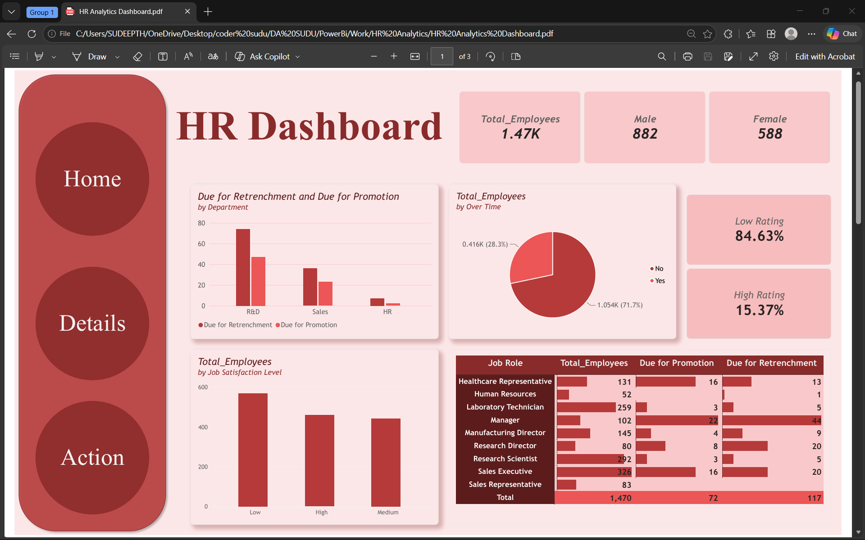
DASHBOARD PAGE
Home
Details
Action
Home Page
Headcount, satisfaction and department-level action snapshot
HR Analytics Dashboard | Power BI Project
10

Slide 11
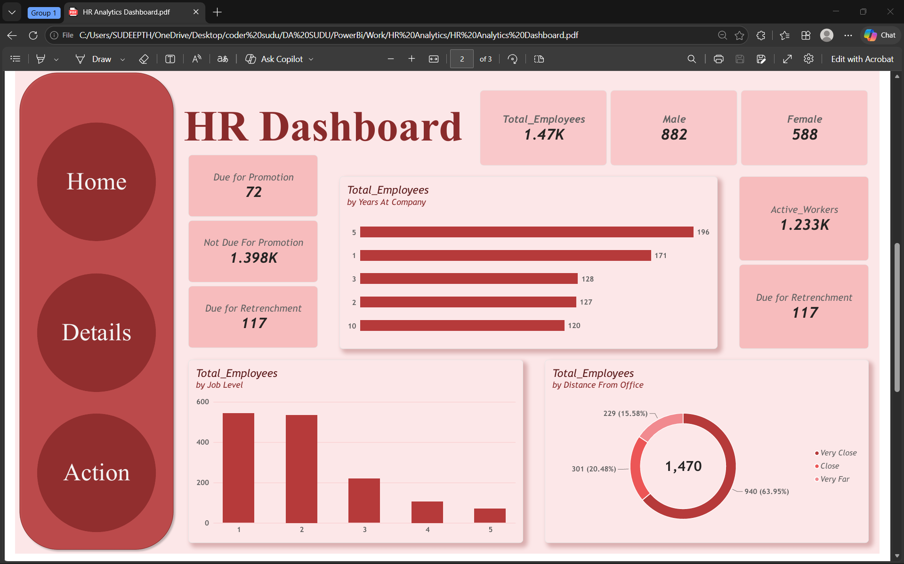
DASHBOARD PAGE
Home
Details
Action
Details Page
Tenure, seniority and commute-distance profile of the workforce
HR Analytics Dashboard | Power BI Project
11

Slide 12
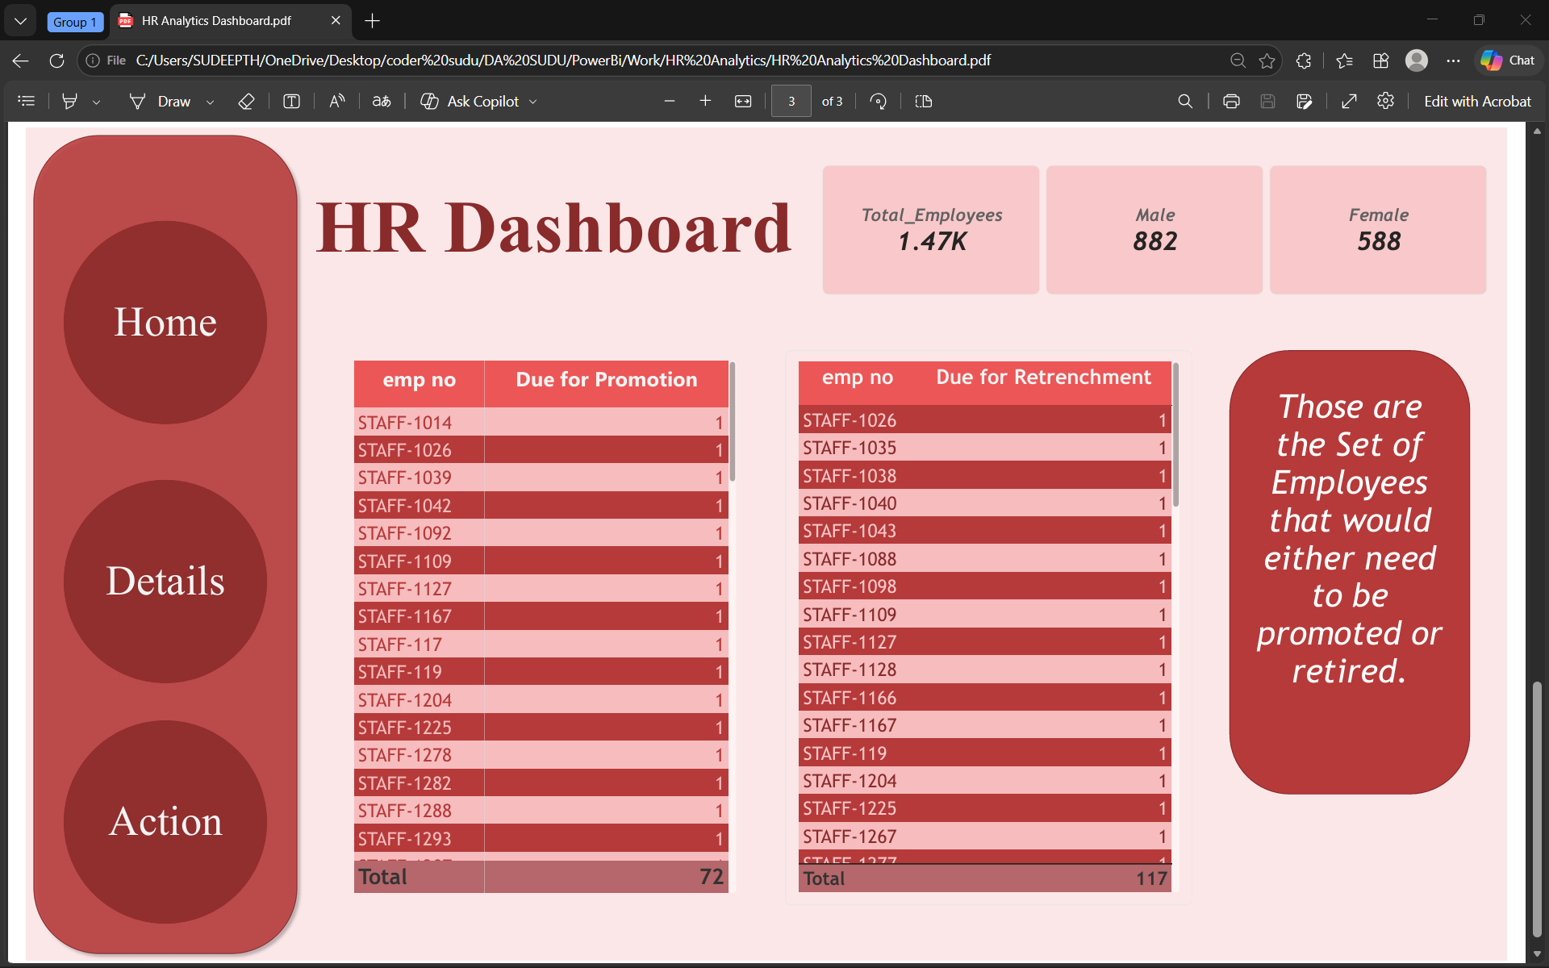
DASHBOARD PAGE
Home
Details
Action
Action Page
Named employee lists for promotion and retrenchment decisions
HR Analytics Dashboard | Power BI Project
12

Slide 13
SECTION 8
Key Insights & Recommendations
1
Retrenchment risk is concentrated, not spread evenly
2
Performance ratings skew heavily low
R&D shows the highest combined action count by department, and Manager is the single riskiest role: 44 of 102 managers (43%) are Due for Retrenchment and a further 22 Due for Promotion — 65% of the role is flagged.
84.63% of employees carry a Low rating vs. just 15.37% High — a workforce-wide pattern that points to a rating-scale or calibration issue, not a handful of isolated cases.
3
Overtime and flight risk move together
4
Commute distance is not the constraint
28.3% of staff (416) regularly work overtime. In the underlying attrition dataset, OverTime = Yes employees leave at 31.0% vs. 10.3% for those who don't — and overtime is one of the four flags inside FlightRiskScore.
63.95% of employees (940 of 1,470) live Very Close to the office, so proximity is unlikely to explain the promotion / retrenchment split — the model should weight role, tenure and rating more heavily than location.
HR Analytics Dashboard | Power BI Project
13

Slide 14
CONCLUSION
From Raw Employee Rows to a Trusted Action List
Deliverables
Nine engineered columns — from AnnualIncome to FlightRiskTier — turned a flat 1,478-row export into a model that can bucket, score and rank every employee. Verified Excel measures and Power BI DAX measures then made every KPI, chart and named-employee table consistent across all three dashboard pages.
1,478-row source workbook
9 verified calculated columns
8 Summary-sheet KPI formulas
Recommendations
3-page interactive .pbix dashboard
Audit the Manager role first — highest combined promotion + retrenchment rate
Review the rating scale — an 85/15 low/high split is unlikely to be purely performance-driven
11 charts, cards & tables specified
Cross-reference FlightRiskTier with the Action page before finalizing retrenchment decisions
3 screenshot pages ready to fill in
Automate the Summary-sheet refresh so attrition KPIs update the moment Data is refreshed
HR Analytics Dashboard | Power BI Project
14

Slide 15
Thank You
HR Analytics Dashboard | Power BI Project
15

