Slide 1
BANK RISK CONTROLLER SYSTEMS
Using the given data, Do the prediction of whether the customer will get default or not. The column which you are going to predict in dataset is “TARGET”.

Slide 2
Logo
Home
OVERVIEW about the Project
Data Showcase
ML Prediction
Data Visualization
Live Updates
About
CHATBOT

Slide 3
Logo
Data Used
C1 | C2 | C3 | C4 | C5 | C6 | C7 | C8 | C9 | Cn
Home
Data Showcase
ML Prediction
Data Visualization
Model Performance
Algorithm | Accuracy | Precision | Recall | F1 Score
RF | 0.99 | 0.98 | 0.97 | 0.96
DT | 0.96 | 0.96 | 0.95 | 0.94
KNN | 0.95 | 0.93 | 0.94 | 0.95
Live Updates
About
CHATBOT
Selected Algorithm and it’s accuracy

Slide 4
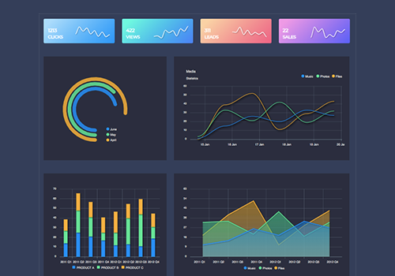
Logo
Profile
Name
Logo
EDA
Enter Age
23
Enter Value
67
Enter Value
88
Distribution
Comparision
F1 vs F2
Home
Data
Data Showcase
Enter Value
90
Enter Value
12
Enter Value
65
EDA - Visual
ML Prediction
BOX plots
Pair plot
Normal Dist.
Normal – 2 F
Prediction
Data Visualization
NLP
Enter Value
34
Live Updates
Recommendation
About
BOX plots
Repay or Not Repay
Corr Plot
Normal Dist.
Normal – 2 F
Predict
CHATBOT

Slide 5
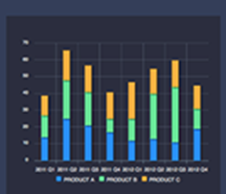
Profile
Name
Logo
Logo
EDA
EDA
Distribution
BOX Plot
Pair Plot
Distribution
Comparision
F1 vs F2
Home
Data
Data Showcase
EDA - Visual
ML Prediction
BOX plots
Pair plot
Normal Dist.
Normal – 2 F
Prediction
Data Visualization
NLP
Live Updates
Recommendation
About
BOX plots
Corr Plot
Normal Dist.
Normal – 2 F
CHATBOT

Slide 6
Profile
Name
Logo
Logo
EDA
Sensex Data Updates and Live Chart
Line Chart
Distribution
Comparision
F1 vs F2
Home
Data
Data Showcase
EDA - Visual
ML Prediction
BOX plots
Pair plot
Normal Dist.
Normal – 2 F
Prediction
Data Visualization
NLP
Live Updates
Recommendation
Currency Details
About
BOX plots
Corr Plot
Normal Dist.
Normal – 2 F
CHATBOT

Slide 7
Logo
Profile
Name
Logo
EDA
Distribution
Comparision
F1 vs F2
Home
ABOUT
Data
Data Showcase
EDA - Visual
ML Prediction
BOX plots
Pair plot
Normal Dist.
Normal – 2 F
Prediction
Data Visualization
NLP
Live Updates
Recommendation
About
BOX plots
Corr Plot
Normal Dist.
Normal – 2 F
CHATBOT

Slide 8
Logo
Profile
Name
Logo
EDA
CHATBOT
Distribution
Comparision
F1 vs F2
AI
Ask me a question
AI
Home
Data
Data Showcase
User
enter your question
EDA - Visual
ML Prediction
BOX plots
Pair plot
Normal Dist.
Normal – 2 F
Prediction
Data Visualization
NLP
Chat
Live Updates
Recommendation
About
BOX plots
Corr Plot
Normal Dist.
Normal – 2 F
CHATBOT

