Slide 1
Performing Daily System Administration Tasks

Slide 2
Working with Links
In a Linux file system, we can access a single file from different locations using links.
• Because of this we need not copy files to different locations and make versions.
• A link looks like a regular file, but it’s more like a pointer that exists in one location to show you how to get to another location.
• In Linux, there are two different types of links.
Symbolic link
Hard link.

Slide 3
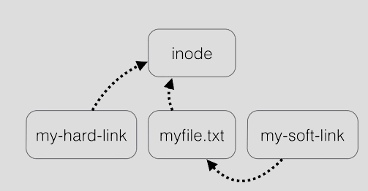

Slide 4
Symbolic link are links between files. It is nothing but a shortcut of a file(in windows terms)
You can delete the soft links without affecting the actual file or directory it is pointing to. The reason is because the inode of the linked file is different from that of the inode of the symbolic link. But if you delete the source file of the symlink , symlink of that file no longer works
Soft link can span across filesystem
Soft links can link both files and directories.
To create Symlink
ln -s <source> <linkname>

Slide 5
Hard link is the exact replica of the actual file it is pointing to .Both the hard link and the linked file shares the same inode .
If the source file is deleted ,the hard link still works
Hard links cannot span across file system
Hard links can link only files ,not directories.
To create Hard link,
ln <source> <linkname>

Slide 6
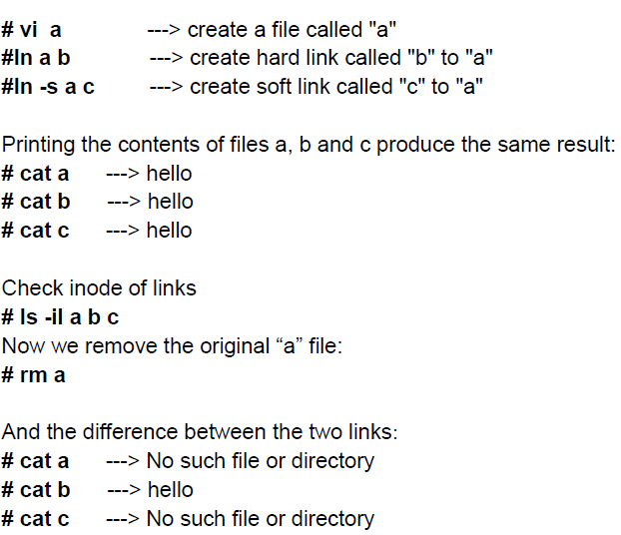

Slide 7
Creating Backups
tar command is used to take backup of important files on your computer.
• It is used for creating and extracting backups on Linux.
• Three major tasks are involved in using tar:
creating an archive
verifying the contents of an archive
extracting an archive.
• You can write the archive to multiple destinations, but the most common procedure is to write it to a file.
• While using tar, use the f option to specify which file to work with.

Slide 8
To create an archive of all configuration files in the /etc directory,
tar cvf /tmp/etc.tar /etc.
Once you have created an archive file using the tar command, you can verify its contents.
tar tvf /tmp/etc.tar
Finally, the third task to accomplish with tar is the extraction of an archive
tar xvf /tmp/etc.tar

Slide 9
$tar cvf /dev/rmt/0 *
c -> create ; v -> Verbose ; f->file or archive device ;
* -> all files and directories .
Together the commands means create a tar file on /dev/rmt/0 from all file and directories in the current directory.
t option is used to see the table of content in a tar file.
$tar tvf /dev/rmt/0
view files backed up on a tape device.

Slide 10
When working with tar, you can also specify that the archive should be compressed or decompressed.
To compress a tar archive, use either the z or j option.
The z option tells tar to use the gzip compression The j option tells it to use bzip2.

Slide 11
1. Creating an uncompressed tar Archive using option -cvf : This command creates a tar file called file.tar which is the Archive of all .c files in current directory.
$ tar cvf file.tar *.c
Output :
os2.c
os3.c
os4.c
2. Extracting files from Archive using option -xvf : This command extracts files from Archives.
$ tar xvf file.tar
Output :
os2.c
os3.c
os4.c
3. gzip compression on the tar Archive, using option -z : This command creates a tar file called file.tar.gz which is the Archive of .c files.
$ tar cvzf file.tar.gz *.c

Slide 12
4. Extracting a gzip tar Archive *.tar.gz using option -xvzf : This command extracts files from tar archived file.tar.gz files.
$ tar xvzf file.tar.gz
5. Creating compressed tar archive file in Linux using option -j : This command compresses and creates archive file less than the size of the gzip. Both compress and decompress takes more time then gzip.
$ tar cvfj file.tar.tbz example.cpp
Output :
$tar cvfj file.tar.tbz example.cpp
example.cpp
$tar tvf file.tar.tbz
-rwxrwxrwx root/root 94 2017-09-17 02:47 example.cpp

Slide 13
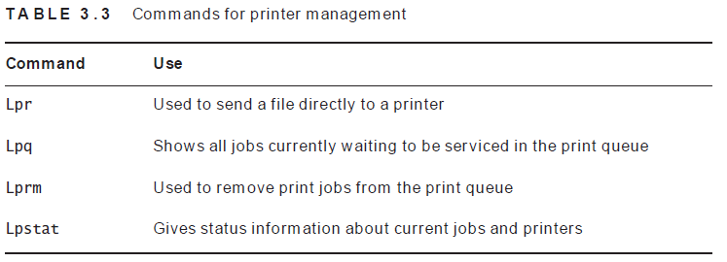
Managing Printers
The easiest way to setup a printer is by using the graphical system-config-printer utility. This utility helps in setting up a local printer that is connected directly to your computer. It also gives you access to remote print queues.

Slide 14
Setting Up System Logging
Everything from kernel events to user actions are logged by Linux, allowing you to see almost any action performed on your servers.
Linux has a special directory for storing logs called /var/log

Slide 15
Setting Up Rsyslog
The rsyslogd process is started automatically to log all important events to log files and other log destinations, most of which exist in the /var/log directory
Rsyslogd uses its main configuration file, /etc/rsyslog.conf, to determine what it has to do.

Slide 16
/var/log/syslog and /var/log/messages store all global system activity data, including startup messages.
/var/log/auth.log and /var/log/secure store all security-related events such as logins, root user actions, and output from pluggable authentication modules (PAM)
/var/log/kern.log stores kernel events, errors, and warning logs, which are particularly helpful for troubleshooting custom kernels.
/var/log/cron stores information about scheduled tasks (cron jobs). Use this data to verify that your cron jobs are running successfully.
/var/log/dmesg: a repository for device driver messages.

Slide 17
Priorities are used to define the severity of the message. In ascending order, the following priorities can be used:
1. debug
2. info
3. notice
4. warning
5. err
6. crit
7. alert
8. emerg
eg : kern.=!info;mail.=!debug /var/log/my_special_messages
Log all kernel messages except with priority info and all mail messages other than debug to the file my_special_messages.

Slide 18
Setting Up Logrotate
The logrotate command runs as a cron job once a day from /etc/cron.daily, and it helps you define a policy where log files that grow beyond a certain age or size are rotated.
Rotating a log file basically means that the old log file is closed and a new log file is opened
The logrotate configuration for specific services is stored in the directory /etc/ logrotate.d.

Slide 19
