Slide 2
Configuring a Quorum Disk
quorum is an important mechanism in the cluster that helps nodes determine whether they are part of the majority of the cluster.
By default, every node has one vote, and if a node sees at least half of the nodes plus one, then there is quorum.
A quorum disk involves two parts.
A shared storage device that can be accessed by all nodes in the cluster.
Heuristics testing. Heuristics testing consists of at least one test that a node has to perform successfully before it can connect to the quorum disk

Slide 3
To set up a quorum disk, you have to perform these steps:
1. Create a partition on the shared disk device.
2. Use mkqdisk to mark this partition as a quorum disk.
3. Specify the heuristics to use in the Conga management interface.

Slide 4
Creating a Quorum Disk
On one cluster node, use fdisk to create a partition on the iSCSI device.
On the other cluster node, use the partx -a command to update the partition table
On one of the nodes, use the following command to create the quorum disk:
mkqdisk -c /dev/sdb1 -l quorumdisk
On the other node, use mkqdisk -L to show all quorum disks

Slide 5
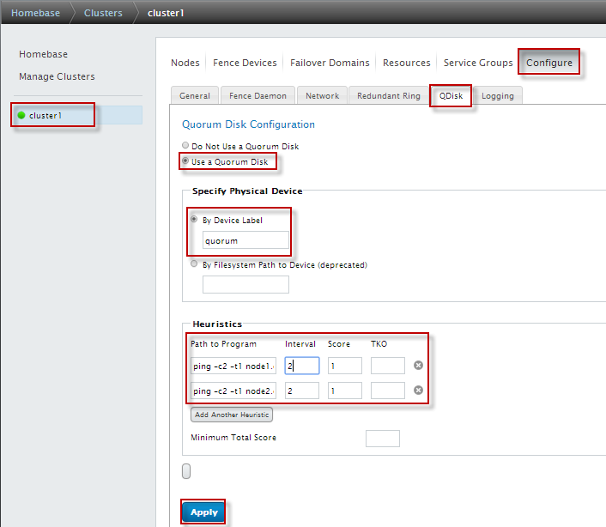
In Conga, open the Configuration > QDisk tab. On this tab, select the option Use A Quorum Disk.

Slide 6
Setting Up Fencing
Fencing is needed to maintain the integrity of the cluster. If the Totem protocol packets sent out by Corosync can no longer reach another node, before taking over its services, you must make sure that the other node is really down. The best way to achieve this is by using hardware fencing.
Hardware fencing means that a hardware device is used to terminate a failing node.
Typically, a power switch or integrated management card, such as HP ILO

Slide 7
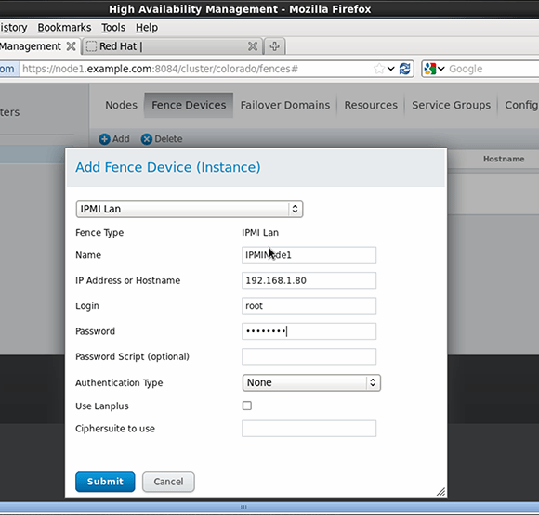

Slide 8
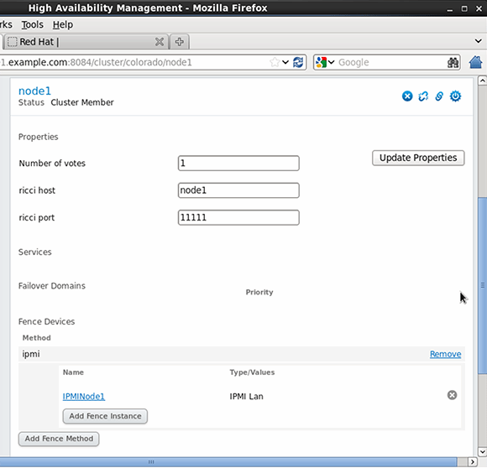

Slide 9
Creating Resources and Services
When creating a high-availability solution for a service .this consists of three things:
The service itself
An IP address
A location where the configuration file and data for the service are stored

Slide 10
Creating HA service for Apache
To create a service for Apache in the cluster, you start by adding the resources for the individual parts of the service.
In the Conga management interface

Slide 11
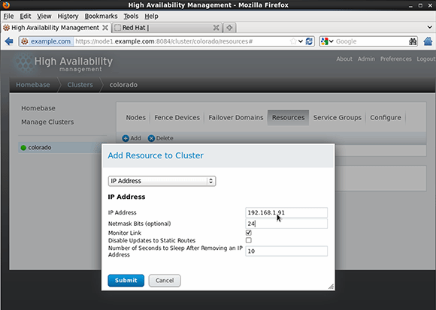

Slide 12
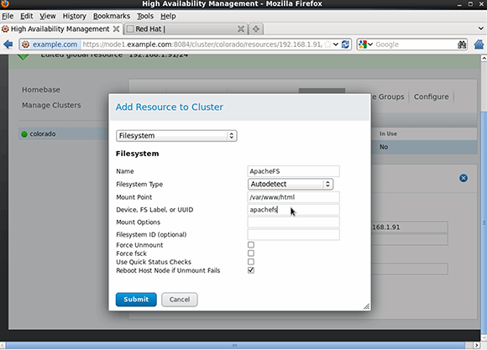

Slide 13
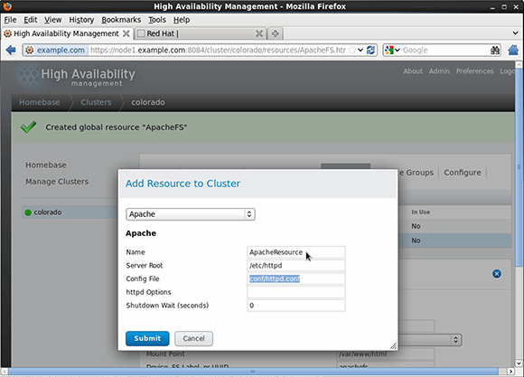

Slide 14
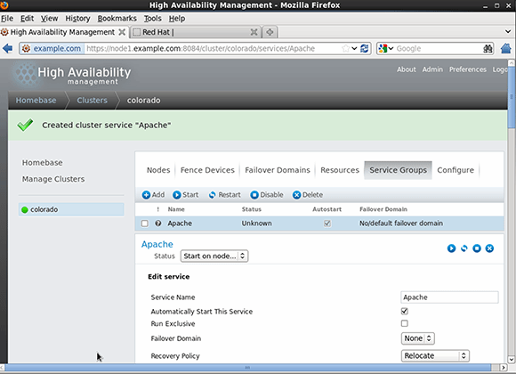

Slide 15
Troubleshooting a Nonoperational Cluster
Check the log files. The cluster writes many logs to /var/log/cluster
use clustat on both nodes to check the current service status, and verify that individual components have actually been started or not.
try to activate everything manually-Use mount to mount the file system, and use service httpd start to start the Apache service
If a service appears as disabled in both Conga and in clustat, use clusvcadm –e servicename to enable it.

Slide 16
Configuring GFS2 File Systems
Red Hat offers the Global File System 2 (GFS2) as the default cluster file system
Used when multiple nodes need to write simultaneously
Create GFS2 on top of LVM only
Make sure clvmd is running

Slide 17
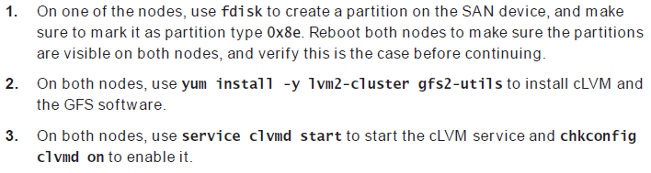
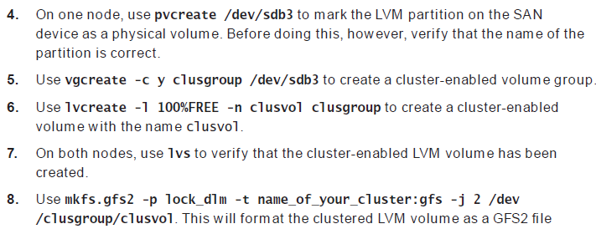

Slide 18
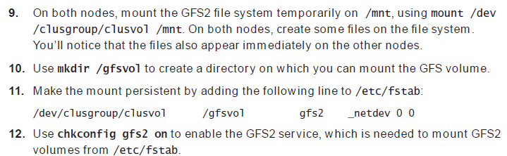

Slide 19
Chp 21
Setting Up an Installation Server

Slide 20
Configuring a Network Server As an Installation Server
The first step in setting up an installation server is to configure a network server as an installation server.
This involves copying the entire installation DVD to a share on a network server.
use a client computer to access the installation files

Slide 21
1. Insert the Red Hat Enterprise Linux installation DVD in the optical drive of your server.
2. Use
mkdir /www/docs/server1.example.com/install
to create a subdirectory in the Apache document root for server1.example.com.
3.Use cp -R * /www/docs/server1.example.com/install from the directory where the Red Hat Enterprise Linux installation DVD is mounted

Slide 22
Modify the configuration file for the server1 vir tual host in /etc/httpd/conf.d/ server1.example.com, and make sure that it includes the line Options Indexes.
Use service httpd restart to restart the Apache web server.
6. Start a browser, and browse to http://server1.example.com/install. You should now see the contents of the installation DVD

Slide 23
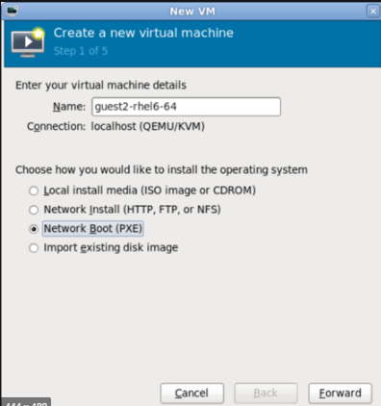

Slide 24
https://www.youtube.com/watch?v=Dm2k4H03L0s

Slide 25
Setting Up a TFTP and DHCP Server for PXE Boot
This allows you to boot a server you want to install from the network card of the server.
Two steps are involved:
1. You need to install a TFTP server and have it provide a boot image to PXE clients.
2. You need to configure DHCP to talk to the TFTP server to provide the boot image to PXE clients.

Slide 26
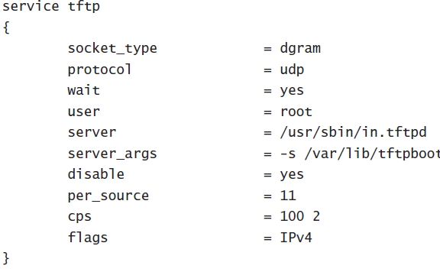
to install the TFTP server package using
yum -y install tftp-server
open the /etc/xinetd.d/tftp file and
Change the disabled parameter from Yes to No
restart the service using service xinetd restart

Slide 27
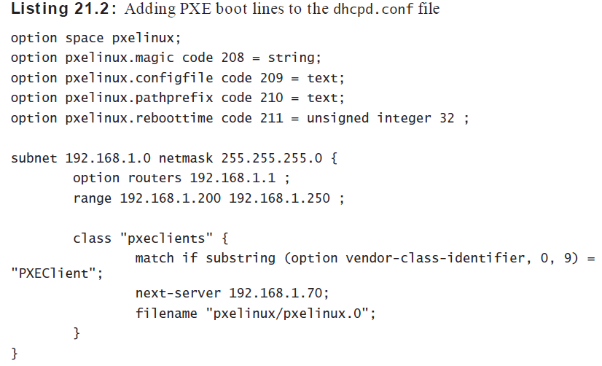
Configuring DHCP for PXE Boot

Slide 28
Configuring the TFTP Server for PXE Boot
Use yum install -y tftpserver to install the TFTP server. Because TFTP is managed by xinetd, use chkconfig xinetd on to add xinetd to your runlevels.
Open the configuration file /etc/xinetd.d/tftp with an editor, and change the line
disabled = yes to disabled = no.
Open the configuration file /etc/dhcp/ dhcpd.conf, and give it the exact contents

Slide 29
Copy syslinux<version>.rpm from the Packages directory on the RHEL installation disc to /tmp. You’ll need to extract the
file pxelinux.0 from it.
This is an essential file for setting up the PXE boot environment.
Copy the /usr/share/syslinx/pxelinux.0 file to /var/lib/tftpboot/pxelinux.
Use mkdir /var/lib/tftpboot/pxelinux/pxelinux.cfg to create the directory in which you’ll store the pxelinux configuration fi le.

Slide 30
In /var/lib/tftpboot/pxelinux/pxelinux.cfg, create a file with the name default that contains the following lines

Slide 31
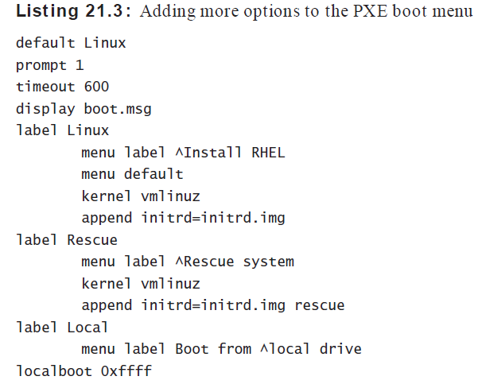

Slide 32
Creating a Kickstart File
A kickstart file is used to perform a completely
automated installation

Slide 33
Using a Kickstart File to Perform an Automated installation
On the installation server, copy the
anaconda-ks.cfg file from the /root directory to the /www/docs/server1.example.com directory. You can just copy it straight to the root directory of the Apache virtual host

Slide 34
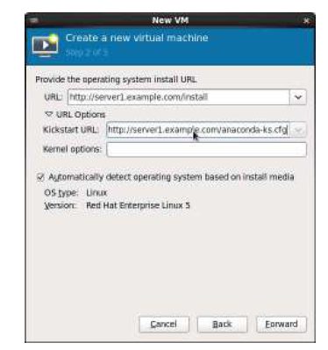

Slide 35
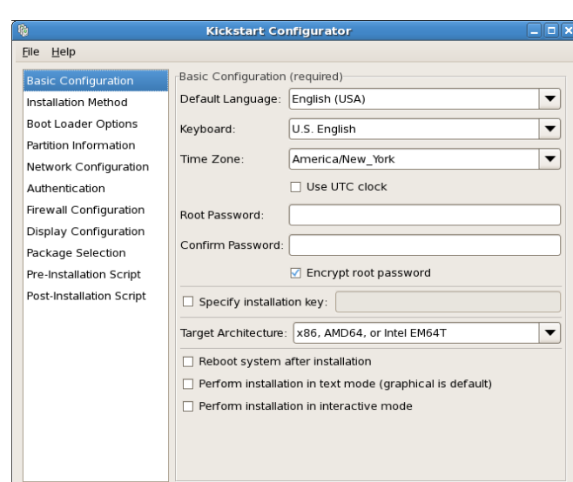
Modifying the Kickstart File with system-config kickstart

Slide 36
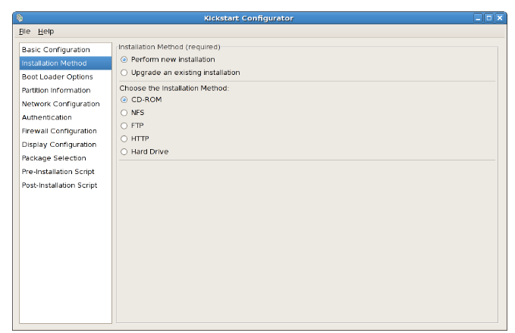

Slide 37
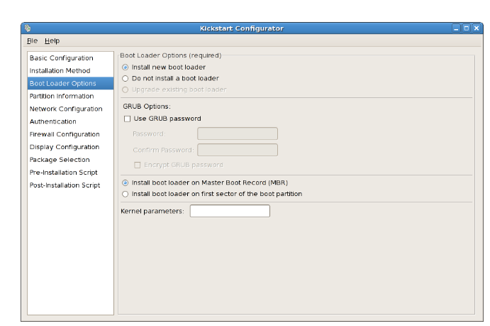

Slide 38
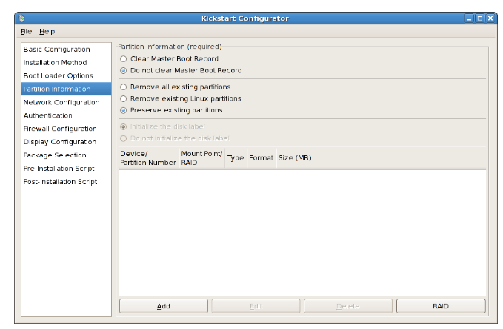

Slide 39
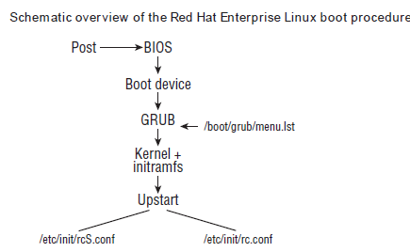
Configuring Booting with GRUB

Slide 40
GRUB is the boot loader that is installed on the bootable disk in your server.
It takes care of starting the Linux kernel. Once successfully loaded, GRUB will start a kernel and all of the associated drivers.
Once this is complete, Upstart is started. Upstart is responsible for starting all the services on your server.
An important part of GRUB is the configuration fi le /boot/grub/grub.conf

Slide 41
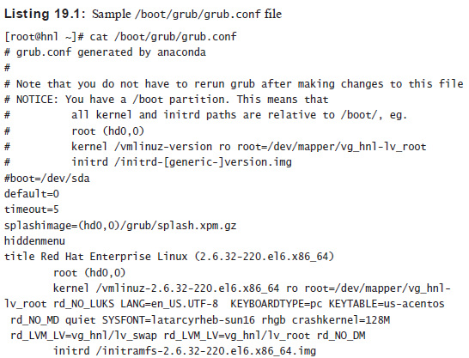

Slide 42
The purpose of GRUB is to load the kernel and the initial RAM file system
The root device is referred to by its BIOS name, which in this case is hd0,0. This refers to the first partition on the first hard disk.
the kernel is loaded on the line that starts with kernel /vmlinuz..., and it is followed by a number of options that specify exactly how the kernel should be loaded

Slide 43
ro This parameter indicates that the root file system should be mounted as read-only.
root= This parameter specifies the name of the device that contains the root file system.
quiet This parameter hides the messages that are generated while booting. For better insight into what your server is doing when it boots, consider removing it.
rhgb This parameter loads the Red Hat Graphical Boot, which displays a logo graphic when booting. Because this hides the messages that are generated while your server is booting, consider removing

Slide 44
The parameter name is initrd, and the name of the file is initramfs.
default This specifes which of the proposed operating systems to load
timeout - During boot, the user can press Tab to open the GRUB menu and add or change kernel parameters. The timeout boot option is used to specify how much time a user has to get into the GRUB menu.
splashimage -This parameter refers to a file containing a graphical background, which is loaded while GRUB is displayed.
hiddenmenu - This option makes sure that no GRUB menu is shown while booting. To enter the GRUB menu, the administrator has to press the Enter key at the right moment

