Slide 1
SEO Planning: Customizing Your Strategy

Slide 2
SEO
Search engine optimization is a technical marketing function that is reliant upon both content creation and technological development, and success in organic search is greatly dependent upon various technical and analytical tools that provide access to valuable data necessary for ongoing SEO and website improvement, as well as overall user experience optimization.

Slide 3
Strategic Goals SEO Practitioners Can Fulfill
Organic search is one of many viable online marketing channels as a source of highly targeted traffic
Visibility (Branding)
Many consumers assume that top placement in the search engines is like a stamp of approval on a brand.
Website Traffic
Today’s search environment is highly competitive, and you need great SEO to capture targeted, high-quality traffic to your site.
Experienced SEO professionals understand that users search for products, services, and information using an extraordinarily wide variety of search queries and query types. Developing an SEO strategy involves performing extensive keyword research

Slide 4
High ROI
Increasing online visibility and driving targeted traffic are the first steps to success with SEO – the next step is measuring the performance of that traffic to determine whether the overall website and business objectives are being achieved.
For most organizations, goals are defined as generating sales, leads, or advertising revenue. For others, it may mean the promotion of a particular message, the consumption, sharing, or perhaps the creation of specific types of content, or the simple signup for a newsletter. An important component of SEO is to deliver not just traffic, but targeted traffic that has the possibility of converting into these actions
SEO generally brings a higher ROI when compared to TV, print, and radio advertising campaigns; and while traditional media is not in danger of being replaced by SEO

Slide 5
Every SEO Strategy Should be Customized
The following factors must be taken into account when developing your SEO strategy:
• What the organization is trying to promote (service, product, content)
• Who the target market is (can be as simple as “women” or as detailed as personas)
• Brand (includes copy & messaging)
• Website structure (includes site architecture, navigational elements, and file/URL naming conventions)
• Current site content assets (includes images, videos, PDF files, white papers, case studies, articles)
• Ease with which the content and site structure can be modified (involves the CMS & web development teams)
• Editorial resources and calendar for content development (what content is developed, by whom, and on what timeline)
• Competitive landscape

Slide 6
Understanding Search Engine Traffic and Visitor Intent
Searchers enter many different types of queries. These can generally be classified into three major categories:
Navigational query :This is a query with the intent to arrive at a specific website or page (e.g., the person types in your company domain name, www.companyname.com, or simply types in the word facebook).
Informational query :This is a search performed to receive an answer to a broad or direct question, or to research and explore information around a specific topic with no specific source in mind (e.g., yoga poses)

Slide 7
Transactional query :A person who types in digital camera may be looking to buy one now, but it is equally possible that she is researching digital cameras to learn about how they are different from film cameras. This is an example of an initial transactional query, which can evolve in stages.
For example, below are some other types of transactional queries that occur at a later stage in the buying cycle:
• The user types in best online digital camera store. Although there is no information in the query about which one she wants to buy, the intent is clearer that the searcher is seeking a store, not simply information about types of digital cameras.
• The searcher types in “mobile at lowest price”. The chances are very high that this user is looking to buy that particular mobile.

Slide 8
Developing an SEO Plan Prior to Site Development
Business Factors That Impact Your SEO Strategy
Revenue & business models
Target customer
Competitors
Branding goals
Content development
How people search for products like yours

Slide 9
Understanding Your Audience and Finding Your Niche
Mapping Your Products and Services
Yes, Content Is King
on-site content also affects content marketing and link development. Content marketing can be very similar to PR in that the success of your efforts is integrally related to what you are promoting
i.e., what type of content, and of what quality, are you hoping others will link to?

Slide 10
Scenario
Consider Site A, a site that has built a substantial, well-researched and well-written set of articles on a
specific topic. However, 20 other sites out there have equally substantial sets of articles on the same topic,
and many of these other sites have been in the major search engine indexes for much longer than Site A.
Site A has a content quality concern – namely, why would someone link to their articles over the articles
from any of the other 20 websites? There is nothing new there. Chances are that Site A will succeed in
getting some links to its articles; however, it will likely never be able to establish itself as a leader if it has
nothing new, or unique, to offer.
To establish itself as a leader, Site A must create fresh, unique, engaging content that differentiates the site
from its competitors. Perhaps it can offer a solution to a problem that no one else has been able to solve
before, or perhaps it focuses on a specific vertical niche and establishes itself as a leader in that niche—for
example, by being the first to release a high-quality video series on the topic it covers.

Slide 11
Segmenting Your Site’s Audience
The target audience for Site A (the over-50 crowd) may use different search terms than the younger generation to search for gadgets, which means Site A may well be bringing in search traffic from people who are not interested in its products, and not bringing in traffic from those who might be!

Slide 12
Context: Market Competitiveness
To get a very quick read on keyword competitiveness, use the Google AdWords Keyword Planner (https://adwords.google.com/KeywordPlanner) to see what your cost per click could be if you bid on your target phrase in a PPC campaign
https://www.wordstream.com/ppc#:~:text=PPC%20stands%20for%20pay%2Dper,of%20their%20ads%20is%20clicked.

Slide 13
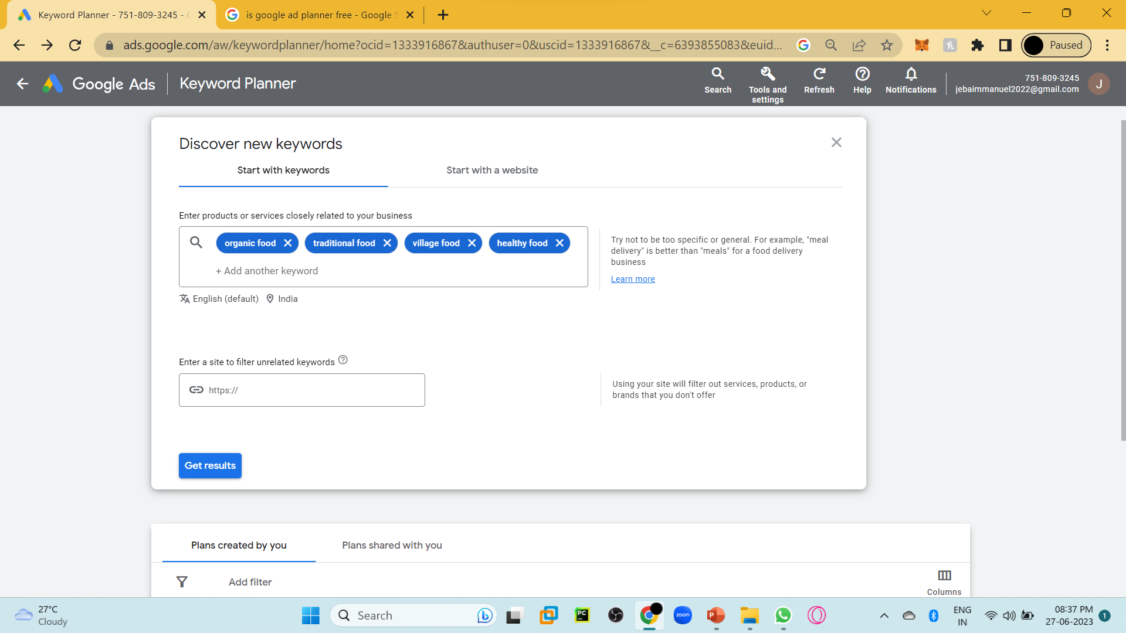

Slide 14
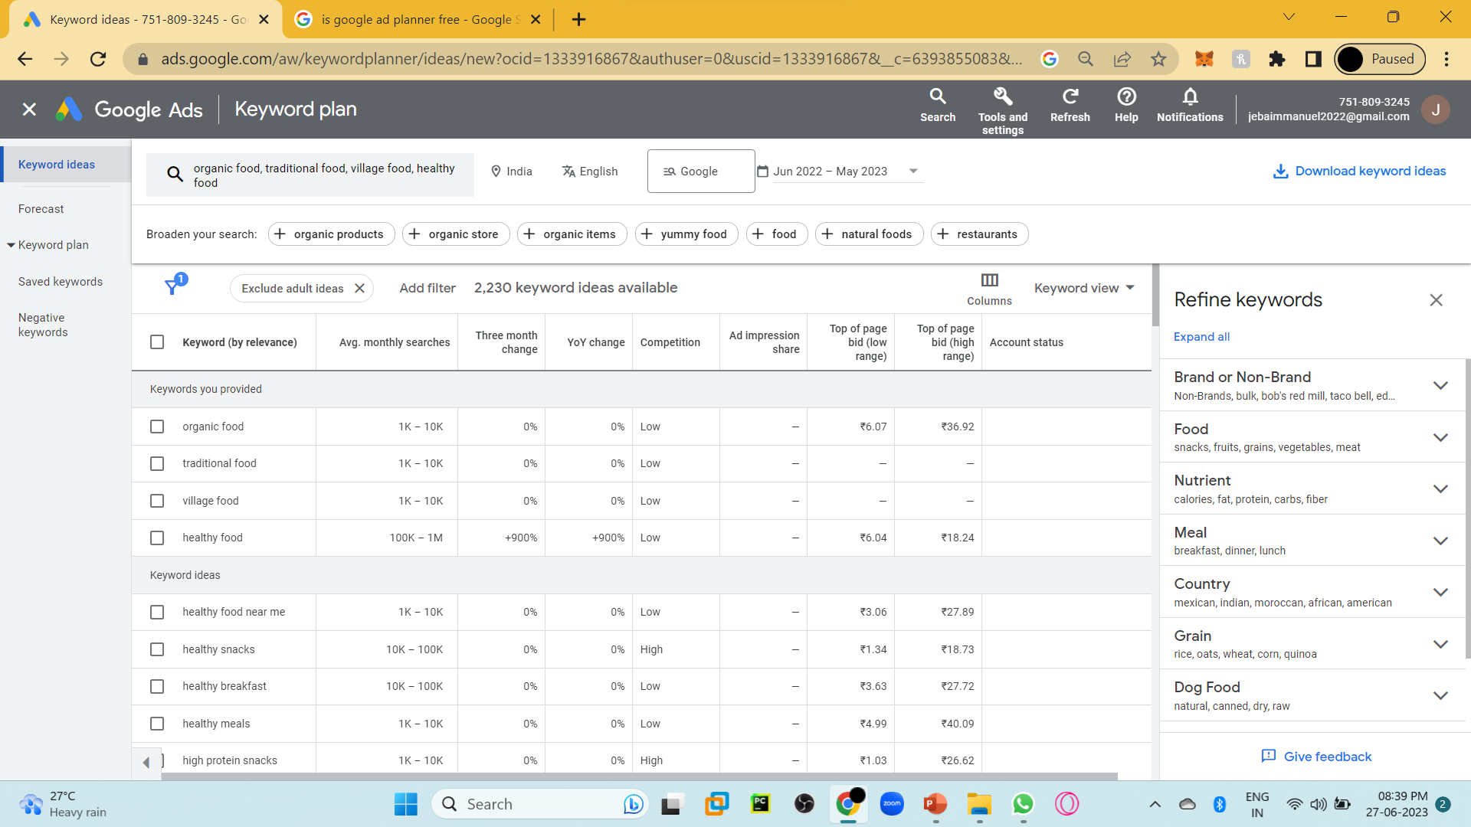

Slide 15
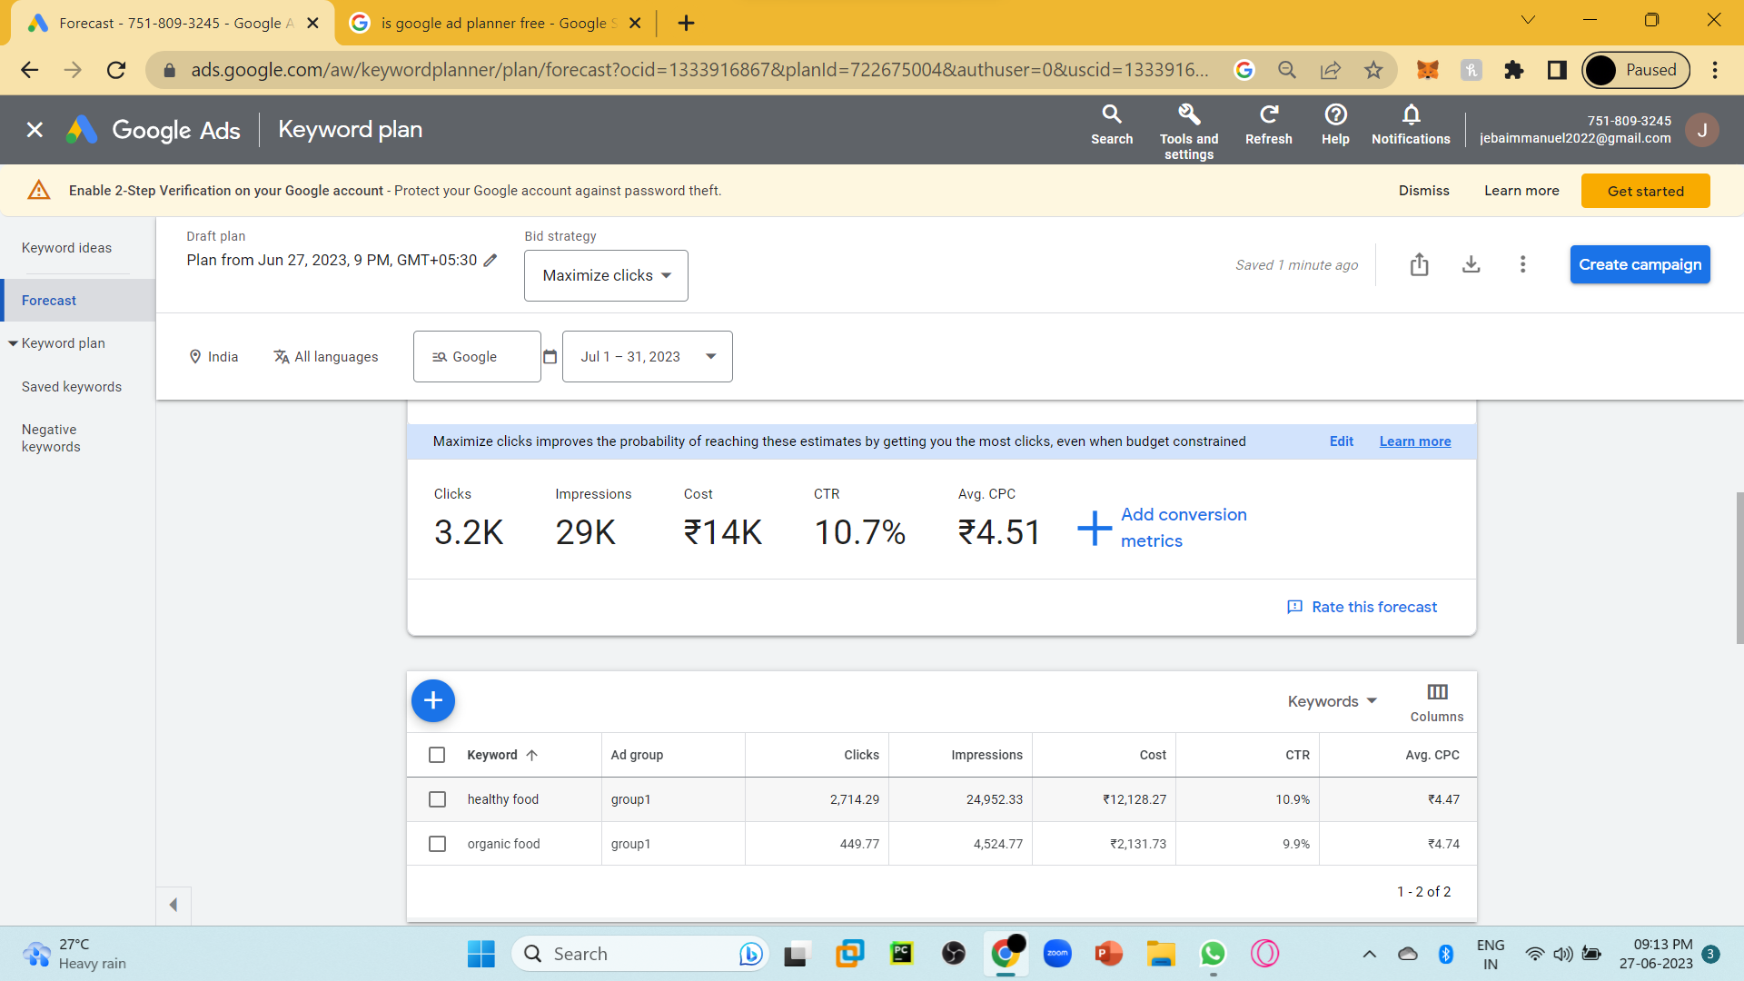

Slide 16
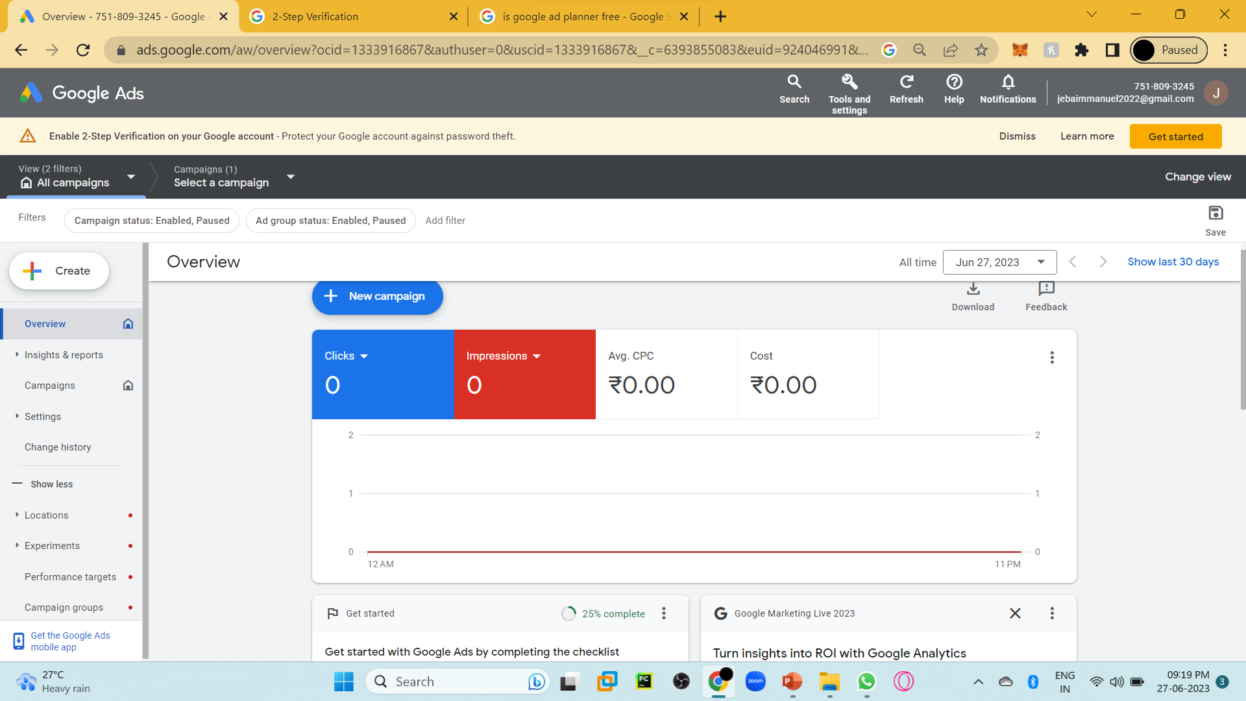

Slide 17
SEO for Raw Traffic
Here are some factors to think about when considering SEO for raw traffic:
When to employ SEO for raw traffic:
Use it when you can monetize traffic without actions or financial transactions taking place on your site (usually through advertising).
Keyword targeting:
Keyword targeting in this scenario can be very broad. The goal here isn’t typically to select specific keywords, but rather to create high-quality content that naturally targets interesting, searched-for terms.
Instead of singular optimization on specific terms Page and content creation/optimization A shallow, highly crawl-able link structure is critical to getting all of your content indexed—follow good information architecture practices and use intelligent, detailed category and subcategory structures to get the most benefit out of your work.

Slide 18
SEO for Ecommerce Sales
Search traffic is among the highest quality traffic on the Web, primarily because a search user has expressed a specific interest through his or her query, and when this matches a service, product, or brand a website carries, conversion rates are often extremely high.
When to employ SEO for ecommerce sales Use it when you have products/services that are directly for sale on your website.
Keyword targeting Pay per click (PPC) advertising is an excellent way to test the efficacy and potential ROI of keyword targets. Find those that have reasonable traffic and convert well, and pursue them further. the more specific the query is—brand-inclusive, product-inclusive, and so on

Slide 19
Quality content creation & optimization
Your site will need to provide interesting, unique, and accessible content for both users and search engines in order to begin gaining traction in organic search.
The links and social sharing that come from such content are highly influential in increasing overall site traffic, as well as improving organic search performance

Slide 20
SEO for Mindshare & Branding
An equally powerful application of SEO is to use it for branding purposes. Bloggers, social media platforms, community websites, content producers, news outlets, and dozens of other web publishing outlets have found tremendous value in appearing atop the SERPs and using the resulting exposure to bolster their brand recognition and authority

Slide 21
Here are some factors to think about when considering SEO for mindshare and branding:
When to employ SEO for mindshare/branding
Use it when branding or communicating a message is your goal.
Keyword targeting
A keyword focus is less critical here—you’ll likely have a few broad terms that receive the high traffic you want, but the long tail may be far more achievable and the better target. Focus on keywords that are going to bring you visitors who are likely to be interested in and remember your brand.
Page and content creation/optimization
Make your site content easily crawled by the search engines, intuitively navigable for users with intelligent linking structures, and implement SEO best practices.

Slide 22
SEO for Lead Generation and Direct Marketing
Here are some factors to think about when considering SEO for lead generation and direct marketing:
When to employ SEO for lead generation and direct marketing
Useful for non-ecommerce products/services/goals that you want users to accomplish on your site, or for which you are hoping to attract inquiries and/or direct contact over the Web.
Keyword targeting
As with ecommerce, choose phrases that have measurable traffic and have previously converted well in PPC campaigns.
In a “considered sale” or enterprise-scale business decision for users, include longtail keywords that might pertain to customer research activities or pain points, to educate and persuade via content.
Avoid arcane jargon terms that aren’t typically understood outside your company.
Page and content creation/optimization
Although you might think it would be easier to rank high in the SERPs for lead-generation programs than for ecommerce, it is often equally challenging. A solid combination of content development and on-site optimization are necessary to be competitive in the more challenging arenas.

Slide 23
Advanced Methods for Planning and Evaluation
One of the better-known ones is the SWOT (Strengths, Weaknesses, Opportunities, Threats) analysis.
There are also methodologies for ensuring that the plan objectives are the right type of objectives, such as the
SMART (Specific, Measurable, Achievable, Realistic, Time lined) plan

Slide 24
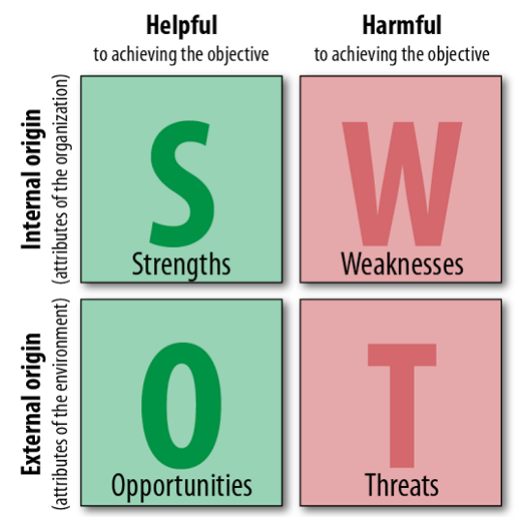

Slide 25
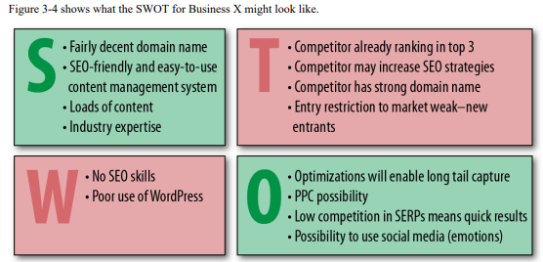

Slide 26
SWOT Guidelines
Identifying strengths is typically one of the easier objectives:
• What sources of traffic are working well (converting on established site goals) for your site/business?
• Which projects/properties/partnerships are driving positive momentum toward traffic/revenue goals?
• Which of your content sections/types produces high traffic, conversions, and ROI?
• What changes have you made historically that produced significant value?

Slide 27
Determining the weaknesses can be tougher (and requires emotional separation from the data):
• What content is currently driving low levels of search/visitor traffic?
• Which changes that were intended to produce positive results have shown little/no value?
• Which traffic sources are underperforming or under-delivering?
• What projects/properties/partnerships are being leveraged poorly, or not at all?

Slide 28
Parsing opportunities requires a combination of strength and weakness analysis. You want to find areas that are doing well but have room to expand, as well as those that have yet to be explored:
• What brainstormed but undeveloped or untested projects/ideas can have a significant, positive impact?
• What traffic sources currently sending good-quality traffic could be expanded to provide more value?
• What areas of weakness have direct paths to recovery?
• Which website changes have had positive results? Can these be applied more rigorously or to other areas for increased benefit?
• What new markets or new content areas are potentially viable/valuable for expansion?
• What sources of new content/new links have yet to be tapped?
• What third party platforms (social media, content curators, etc.) can be utilized to expand reach and increase engagement?

Slide 29
Determining threats can be the most challenging of the tasks.
• In your areas of weakness, which players in your market (or other, similar markets) are strong? How have they accomplished this?
• What shifts in human behavior, web usage, or market conditions could dramatically impact your business/site?
• Which competitors have had the most success in your arena? How have they accomplished this? Where do they intersect with your business/customers?
• Are there any strategies implemented by start-ups in similar businesses that have had massive success in a particular arena that could be dangerous to your business if they were replicated in your market?

Slide 30
SMART
One way to start a new project is to set SMART objectives.
Specific objectives- more leads, more page views, more customers
Measurable objectives – grips with analytics
Achievable objectives- check for feasibility
Realistic objectives - are about context and resources
Time-bound-deadline

