Slide 2
Optimizing PPC Campaign Through Quality score optimization
https://blog.hubspot.com/marketing/google-adwords-ppc
https://blog.hubspot.com/marketing/ppc

Slide 3
Tracking Results and Measuring Success

Slide 4
Why Measuring Success Is Essential to the SEO Process
Baseline data points for the website includes the following:
• Quantifying organic search traffic by search engine
• Quantifying a breakout of what site content areas are getting the current organic search traffic by search engine
• Quantifying data on conversions broken down by search engine
• Identifying poorly performing pages
• Identifying best-performing pages (in terms of traffic and conversions)
• Tracking search engine crawler activity on the site
• Determining the number of indexed pages
• Determining whether the indexed pages are getting search traffic
• Determining whether best-selling product pages are indexed and getting search traffic
• Identifying 404 error pages and external sites linking to these pages, if any
• Determine whether you've been hit by a search engine penalty or algorithm update

Slide 5
The Tracking Cycle: Produce, Launch, Measure, Refine
Define an SEO strategy,
Determine an implementation schedule, and establish a clear understanding of goals. What are you going to accomplish, and what is the strategy for accomplishing it? How will you measure progress?
2. Discuss your strategy.
The marketing and business development teams are your allies here—you want to ensure that your SEO objectives are based on the overall business and site objectives, both long- and short-term.
3. Establish a baseline.
Now that you are about to start and you have decided how you are going to measure progress, establish a baseline by recording the current stats prior to beginning work. Make sure you don’t get a false baseline due to seasonal factors or some other unusual event. Comparing year-over-year data will usually eliminate fluctuation due to seasonality. However, you must also consider how changes in the market, new competition, elimination of competition, industry consolidation, changes in your business strategy, and changes in the search engines themselves may have affected that year-over-year data.

Slide 6
4. Proceed with your project.
Implement the SEO strategy - new URLs, technical site changes, new content development, etc.
5. Collect data.
Collect the newest data for each metric you decided to focus on. Many factors could influence the length of time you should wait. Here are some of them:
• If your site is brand new, it may take longer for your changes to take effect.
• If the scope of the change is drastic (such as a complete redesign incorporating new information
architecture, new URLs, etc. vs. a simple visual re-skinning), the time to see results will probably
be longer.
• Sites that get crawled at great depth and frequency will probably yield visible results faster.
• Sites seen as authoritative may also show faster results.

Slide 7
6. Compare the baseline data to the new data.
The new data has little meaning unless it is compared to your baseline. This is the time when you can really assess your progress.
7. Refine your campaign.
Now that you have compared your old data with your new data, you can make some decisions. Is the campaign a bust? If so, abandon it and move on to the next one. The faster you diagnose a failure and move on to the next thing, the better.

Slide 8
How to Establish a Proper Baseline
• Google Analytics (http://www.google.com/analytics)
• Woopra (https://www.woopra.com)
• Clicky (http://www.clicky.com)
• Piwik (http://www.piwik.org)
• Crazy Egg (http://www.crazyegg.com/)
• Adobe Analytics (http://www.adobe.com/solutions/digital-analytics.html) (enterprise level solution)
• IBM Digital Analytics (http://www-03.ibm.com/software/products/en/digital-analytics) (enterprise
level solution)
• Webtrends (http://www.webtrends.com) (enterprise level solution)

Slide 9
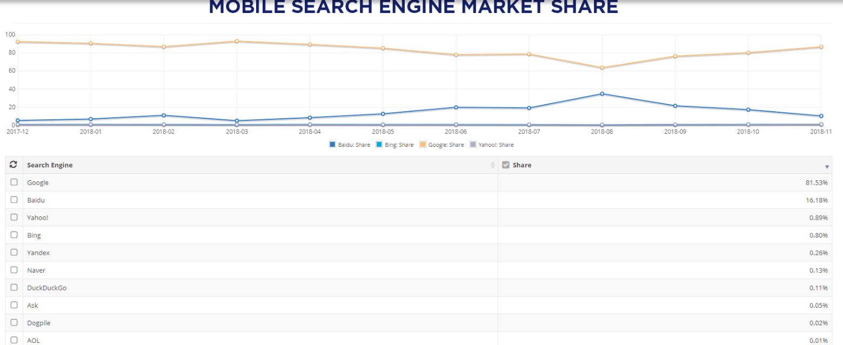
Valuable SEO Data in Web Analytics
Traffic by search engine

Slide 10
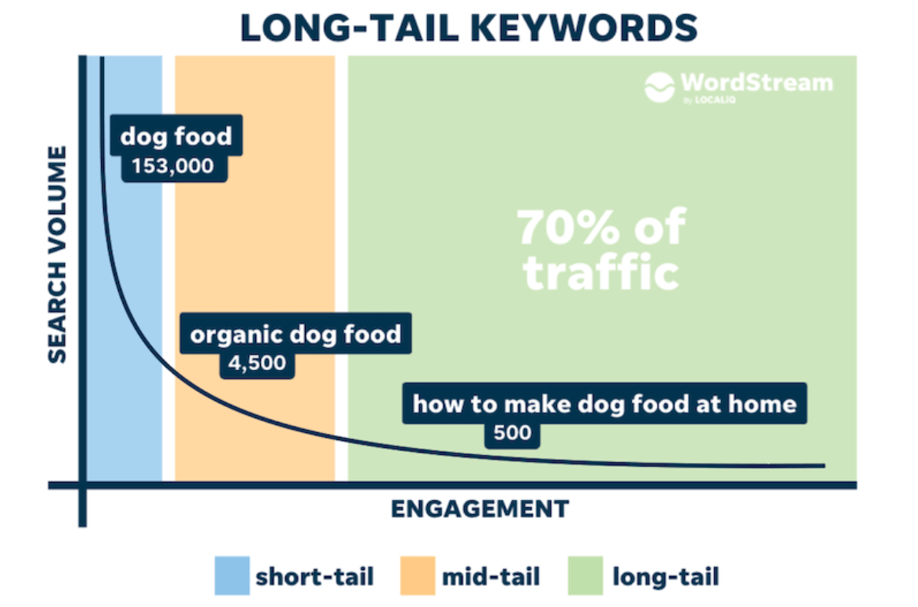
Traffic by keyword

Slide 11
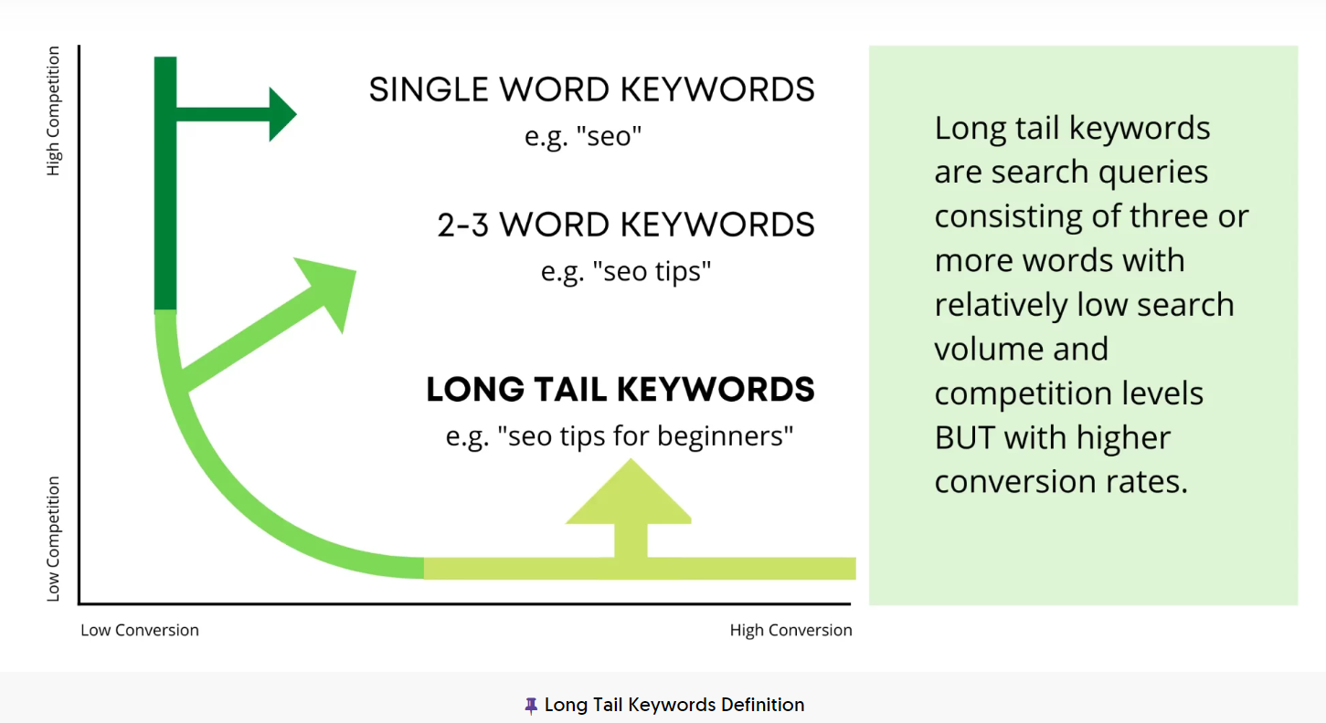

Slide 12
How to Use Long Tail Keywords
Put the keyword at the start of the headline (and title tag!)
Use the only the keyword as the slug (the part of the URL after the domain — com/this-is-the-slug)
Make sure your title is in an H1 tag
Use the keyword throughout your H2 subheadings
Use the keyword in the first 100 words
Use a few variations of the keyword throughout the body of the article

Slide 13
A Deeper Look at Action Tracking
E-commerce site:
Add to Cart button:
Studies have shown us that users who “add to cart,” even if they do not complete the checkout process, are more likely to return to make a purchase.
Complete checkout
An obvious one; this action will show you what percentage of each user group is converting into sales. It is also of interest to measure what percentage of people start the checkout process but do not complete it.
Save to wish list
E-commerce sites offering wish lists are still in the minority, but wish lists are a great way to track interest that isn’t quite a purchase.
Send this to a friend
Many sites offer a “share this page” function, and it is a great action to be aware of. If folks are
sending out your link, you know you have a hit.

Slide 14
B2B
Subscribe to newsletter
A subscription is a tacit endorsement of your brand and a desire to stay in contact. It may not be a conversion, but for B2B, it may be the next best thing.
Contact form submission
Filling out a contact form can be even more valuable than newsletter subscription, in some cases. Though some of these forms will report support issues, many may contain questions about your products/services and will indicate a desire to open a sales conversation.
Email link
As with contact forms, direct email links have the possibility of becoming a sales contact. The best
thing you can do is clearly label sales emails and track them separately from support or business issues

Slide 15
Blog:
Subscribe to RSS feed
An RSS feed subscriber
Add comment
Sign up for an account
These users are active contributors; you need to know where they come from.
Contribute content
When a user publishes, discovering her path is important (especially if it is not from a bookmark/type in).
Add comment
As in the preceding list item, comments are a great predictor of engagement.
Vote/rate
Even low levels of participation, such as a rating or a vote, are worth tracking when every piece of participation counts.
Social shares

Slide 16
Tying SEO to Conversion and ROI
Sales/sales revenue
Email/blog/newsletter subscriptions
Sign-ups
Downloads
Visitors who share
Visitors who link
Contact forms and phone calls

Slide 17
Attribution
Attribution - identifying user actions that led to specific outcome. The issue is that there is a tremendous amount of interaction between types of media.
A user does a search, clicks on an organic search result, and then reads a few things and leaves. The next day, she remembers what she read, does another search, and this time clicks on a paid search ad for the site and buys a product (organic search should receive some credit).
• A user does a search, clicks on an organic search result, and leaves. A few days later, because of what she learned, she goes into a store and buys a product (organic search should receive some credit).
• It goes in the other direction too: a user sees a TV ad, then does an organic search to find the website, and buys the product (the TV ad should get some credit for the sale!).

