Slide 2
Critical Components of a Successful Web Analytics Strategy?
Focus on Customer Centricity
Solve for Business Questions
Follow the 10/90 Rule
Hire Great Web Analysts
Identify Optimal Organizational Structure and Responsibilities
Centralization
Decentralization
Centralized Decentralization

Slide 3
Focus on Customer Centricity
Measuring how your website is delivering for your customers will help focus your web analytics program and cause you to radically rethink the metrics that you needs to measure to rate performance of the website.
Following metrics to help them understand how they are doing in terms of delivering for customers:
Primary purpose (Why are you here?)
• Task completion rates (Were you able to complete your task?)
• Content and structural gaps (How can we improve your experience?)
• Customer satisfaction (Did we blow your socks off as a result of your experience today?)
Bounce rates (Can the customers quickly find what they are looking for?)
• Conversion rates (Are those who come to buy able to accomplish that task?)
• Revenue (Is revenue in line with our goals for the websites?)
• Multichannel impact (Are we funneling more customers to our retail partners or our phone channel?)

Slide 4
Solve for Business Questions
Business questions have these three characteristics:
• They are usually open-ended and at a much higher level, leaving you room to think and add value.
• They likely require you to go outside your current systems and sources to look for data and guidance in order to measure success.
• They rarely include columns and rows into which you can plunk data you already have.

Slide 5
Here are some examples of solid business questions:
• How can I improve revenue by 15 percent in the next three months from our website?
• What are the most productive inbound traffic streams and which sources are we missing?
• Have we gotten better at allowing our customers to solve their problems via self help on the website rather than our customers feeling like they have to call us?
• What is the impact of our website on our phone channel?
• What are the most influential buckets of content on our website?
• Are we building brand value on our website?
• Do fully featured trials or Flash demos work better on the website?
• What are the top five problems our customers face on our website?
• What is the cost for us to earn $1.00 on our website?
• What is the effect of our website on our offline sales?

Slide 6
Follow the 10/90 Rule
10 percent of the budget should be spent on tools, and 90 percent spent on people (brains) who will be
responsible for insights.
You will need people who are smart and have business acumen, who can tie clickstream behavior to other sources of information
Hire Great Web Analysts:
They have used more than one web analytics tool extensively
They frequent the Yahoo! web analytics group and the top web analytics blogs
Before doing any important analysis, they visit the website and look at the web pages.
Their core approach is customer centric (not company centric)
They understand the technical differences between page tagging, log files, packet sniffing,and beacons.

Slide 7
They are comfortable in the quantitative and qualitative worlds.
They are avid explorers.
They are effective communicators.
They are street smart.
They play offense and not just defense.
Bonus: They are survivors.-A key skill of a great analyst is the ability to have patience, survive, and stay motivated in a world where people might ask for suboptimal things (such as reports listing the top exit pages or hits or home page conversion etc

Slide 8
Identify Optimal Organizational Structure and Responsibilities
Traditionally, web analytics has been a part of the IT team. It has been one of the functions of the chief information officer (CIO) or chief technical officer (CTO) and usually has been supported by the IT team that works with web servers, databases,web logs, and Apache HTTP Server or/ Microsoft Internet Information Services (IIS).
Accountability for the Web has shifted from the CTO/CIO to the CMO.
There will be significant benefits from this shift:
• There is a fundamental difference in the use of data on the IT and business sides, almost as stark as the difference between reporting (the most frequent IT function) to analysis (the most frequent need of the business).
• The IT team, for very good reasons, solves for stability, scalability, repeatability, and process. The mindset required in web analytics is to solve for flexibility, agility, use and throw (short life cycle), and fast movement. Having business ownership will increase the chance of these latter goals coming true (of course every company’s mileage will vary).
• In cases where ASP-based JavaScript tagging is being used for data collection and reporting, business ownership will shorten the loop to action because the business owners can now directly work with the vendor as they need to

Slide 9
There are three ownership models: centralization, decentralization, and centralized
Centralization
In the centralization model, web analytics is centralized in a corporate function (IT or marketing, for example). The role of the team is to build a common platform for the entire company. Their responsibilities include providing reporting, training, and best practices, and managing the vendor relationships.
The challenge with centralization is that far from the actual decision makers and marketers, the team in short order transforms into the IT-driven analytics teams

Slide 10
Decentralization
Decentralization is observed in action either in larger companies that are just getting started or those that have gotten to a tipping point with the centralized model.
Under this model, web analytics is completely decentralized, and the various business units are empowered to pursue any strategy that works for them. The result is potentially optimized business units or teams that are each running a different tool and using their own unique set of metrics and strategy.
Because of the use of multiple potential vendors, this is also often an expensive strategy.

Slide 11
Centralized Decentralization
Under the centralized decentralization model, the company has a central team that is more like a center of excellence for web decision making. The team is typically responsible for implementing a standardized web measurement system across the company in partnership with other business and functional units in the company.
The central team is also responsible for establishing various contracts, selecting technology solutions (web analytics or others such as testing and research), creating best practices and, most of all, as the center of excellence, keeping the company on the cutting edge.

Slide 12
Although the analyst works as part of the business unit, the analyst still taps into and uses the centralized standard web analytics platform and hence has to worry about only data analysis and not data capture, processing, and storage.

Slide 13
Actionable Outcome KPIs
Task Completion Rate: Task Completion Rate is the percentage of Visitors to your website who rate if they were able to complete the primary purpose for their visit
These surveys let your Visitors give you a qualitative perspective on whether they were able to complete their tasks

Slide 14
Share of Search
Share of Search is the percentage of traffic you get from search engines compared to your key competitors. You are doing search engine optimization, and you have invested in paid searches.
Tools such as Hitwise, Compete, and Google Insights for Search help you compute this fantastic Outcome metric

Slide 15
Visitor Loyalty and Recency
Visitor Loyalty measures the distribution of the number of Visits by each Visitor to your site; that is, it answers this question: “How many times did Avinash come to my website?” Recency measures the gap between two Visits by the same Visitor.
But creating a value proposition on your website that makes someone come back again and again is where all the real work

Slide 16
RSS/Feed Subscribers
RSS/Feed Subscribers measures the raw number of people who have signed up for your website or blog’s RSS feed.
RSS (which stands for “really simple syndication”) started getting popular with blogs, but it is now ubiquitous. I can grab the feed from CNN and get just the types of stories I want or grab the feed from my wireless router manufacturer’s website and know when the latest software patch has been released so I can keep my gear current.
Measuring Feed Subscribers is key because the content from your site is being consumed off-site, in feed readers that might be web-based or software-based. This activity is usually invisible to your web analytics tool.

Slide 17
% of Valuable Exits :The % of Valuable Exits metric measures the percentage of people who leave your website by clicking something of value to you

Slide 18
Moving Beyond Conversion Rates
Cart and Checkout Abandonment
Before someone converts on your site, you must get them through the checkout process. Even before checkout, though, you need to convince them to add your product to the shopping cart.
focusing on this metric is that you improve revenue not by spending more money on advertising or marketing but by fixing a few small elements on your site

Slide 19
You should instead measure two different rates:
Cart Abandonment (percentage) This is 1 minus (the total Visitors who start checkout divided by the total number of add to cart clicks).
Checkout Abandonment (percentage) This is 1 minus (the total Visitors who complete checkout divided by the total number of people who start checkout). By measuring these rates separately, you can more efficiently isolate your focus.
Cart Abandonment is a much bigger problem to understand and solve; each element is better done separately. Any improvement in either of these two Abandonment Rate metrics is money directly into your pocket.

Slide 20
Days and Visits to Purchase
Days to Purchase shows the distribution of the number of days it takes someone to make a purchase on your website. Visits to Purchase shows the number of Visits until purchase
Based on what the data reveals, you would change your marketing, messaging, and calls to action.
For example, if it takes multiple days to make a purchase, then you need to focus on giving more information to your Visitors, helping them research and make their purchase decision at their own pace

Slide 21
Can you improve your Conversion Rate yet reduce your revenue? Of course. When you get 200 Orders from 10,000 Unique Visitors, you get a 2 percent Conversion Rate.
But if you reduce the amount of traffic to 100 Unique Visitors and get 20 Orders, you get a 20 percent conversion rate. That’s a vast improvement, but the revenue from 20 orders is typically less than from 200 orders.
Average Order Value is a simple metric. It’s the total amount of revenue divided by the total number of orders received

Slide 22
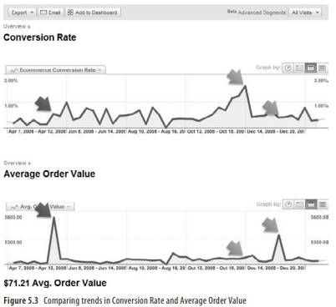

Slide 23
Primary Purpose (Identify the Convertible)
You can do this by analyzing the content Visitors consume on your website. For example, 20 percent of the Visitors went only to Jobs, 20 percent downloaded your press releases, and the last 60 percent went to your product pages. There you go: a primitive realization that your opportunity pie is no
With the survey, you get a much more robust understanding of the intent of your Visitors. You can see that people who come to learn about investing in your company (7%) did not come to buyt 98; it’s 60.

Slide 24
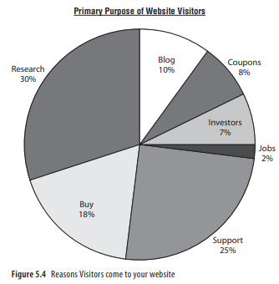

Slide 25
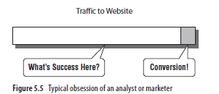
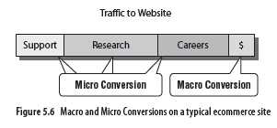
Measuring Macro and Micro Conversions
The one primary goal of your site is the Macro Conversion. But, all the other jobs your site does are Micro Conversions

Slide 26
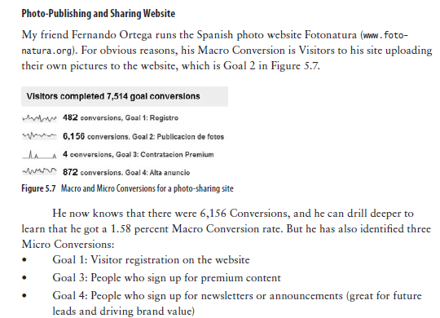

Slide 27
Technical Support Website
The main job of a tech support website is to solve someone’s problem. So, its Macro Conversion is the Task Completion Rate. But a typical tech support site also does other jobs.
Here are suggestions for Micro Conversions:
• Call Avoidance: This is the amount of Visitors who see the phone number page
(hypothesis: if the site is good, this amount goes down over time).
• Content Consumption: This is the number of Visits over time to each technical
support core area (for example, different products or types of problems).
• Tickets Opened: This is the number of technical support tickets opened on the
website (and over time compared to those opened over the phone).

Slide 28
Sales: This is the Revenue from referrals from the tech support site to the ecommerce site (sometimes the best solution to fix a problem is to buy the latest version of the product or an upgrade).
• Net Promoters (or Likelihood to Recommend): This is the percentage of people (or an indexed representation) who will recommend the company products after an experience on the tech support site.

Slide 29
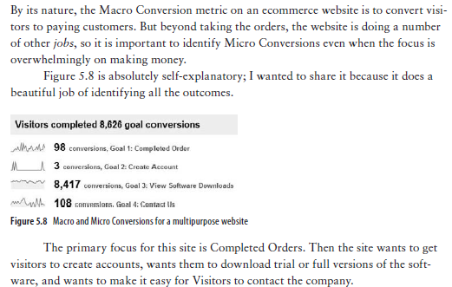
Multipurpose Ecommerce Website

Slide 30
Measuring Success for a Non-ecommerce Website
Visitor Loyalty
Visitor Recency
Length of Visit
Depth of Visit.

Slide 31
Measuring B2B Websites

