Slide 1


DEVELOPMENT OF AN AI BASED FERTILIZER PREDICTION SYSTEM
DEPARTMENT OF INFORMATION TECHNOLOGY
MCKV INSTITUTE OF ENGINEERING
(NAAC ACCREDIATED “A” GRADE AUTONOMOUS INSTITUTE)
243, G.T. ROAD(NORTH), LILUAH
HOWRAH-711204
SUBMITTED BY
Name | Univ. Roll No
Achisman Basu | 11600721003
Anushka Nath | 11600721012
Nilanjan Dubey | 11600721028
Parambrata Chatterjee | 11600721032
Srijoni Chakraborty | 11600721055
Sudeshna Ghosh | 11600721057
UNDER THE GUIDANCE OF
DR. SHAMPA SENGUPTA
(Associate Professor)

Slide 2
CONTENTS
Abstract
Introduction
Literature Review
Proposed Methodology
Working of System
Result Analysis
Conclusion
Future Work
Acknowledgement
References

Slide 3
ABSTRACT
Fertilizer prediction is foundational for sustainable agriculture, optimizing resource use to enhance productivity while promoting environmental and economic health. This AI-powered Fertilizer Prediction System leverages machine learning to recommend optimal fertilizer types and predict soil moisture based on various crop and soil conditions. By processing inputs like soil type, crop type, and nutrient levels, the system delivers precise recommendations to maximize crop yield and ensure balanced nutrient management.
This solution is built using machine learning models in Python, hosted via Flask, and connected to a MySQL database through Spring Boot, ensuring seamless data handling and integration. The Flask API processes requests and performs predictions in real-time, while Spring Boot manages robust backend operations and database interactions. Integrating AI with agricultural practices ensures that resources are utilized effectively, promoting balanced nutrient management and enhancing crop yield.

Slide 4
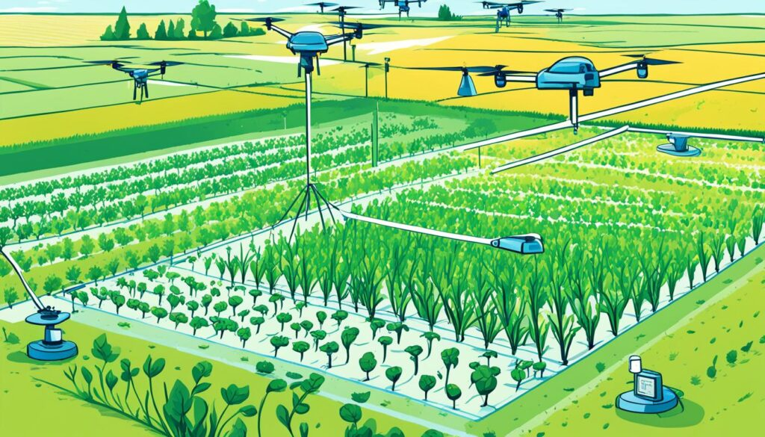
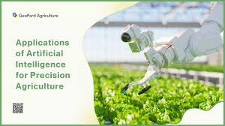
INTRODUCTION
AI has revolutionized modern agriculture by enabling data-driven decision-making.
AI-based systems optimize crop yield, resource management, and environmental sustainability.
Fertilizer prediction is a key application of AI in agriculture.
AI models analyze factors such as soil conditions, crop types, and environmental data to recommend ideal fertilizers and their quantities.
Benefits include precise fertilizer application, increased productivity, reduced wastage, and minimized environmental impact.
The "AI-Based Fertilizer Prediction System" project aims to: Predict the type and quantity of fertilizer needed based on input parameters like temperature, humidity, soil type, crop type, and nutrient levels.
The system utilizes:
Flask for machine learning model deployment.
Spring Boot for API management.
A database for storing and managing fertilizer data.

Slide 5
LITERATURE REVIEW
Here, are some papers regarding Fertilizer prediction proposed by some of the scholars,
[1] The title "Damaged apple detection with a hybrid YOLOv3 algorithm" by Meng Zhang, Huazhao Liang, Zhongju Wang, Long Wang, Chao Huang, Xiong Luo was accepted on 3rd December, 2022.This paper was available online from 11th December, 2023.This paper proposed an improved You Only Look Once (YOLOv3) algorithm for the automatic detection of damaged apples. The main moto was to promote the automation of the fruit processing industry.
[2] The research article "Soil Nutrient Analysis Using Machine Learning Techniques" by Madhumathi R,Arumuganathan T, Sneha Iyer R, Shruthi R, Shruthhi K proposed a method to help the farmers in choosing the right crop and fertilizer for having better harvest of crops. This paper aimed to provide a solution obtained through the machine learning model.
[3] The title "Variable rate fertilizer application technology for nutrient management: A review" by Pranav Pramod Pawase, Sachin Madhukar Nalawade, Girishkumar Balasaheb Bhanage, Avdhoot Ashok Walunj, Pravin Bhaskar Kadam, Anil G Durgude, Mahesh R Patil was published on 2023. The paper proposed two approaches for implementing VRT, one was sensor based and another was map based. In sensor based approach suitable sensors measured the soil and crop characteristics by calculating the nutrients needed per unit area.In map based approach

Slide 6
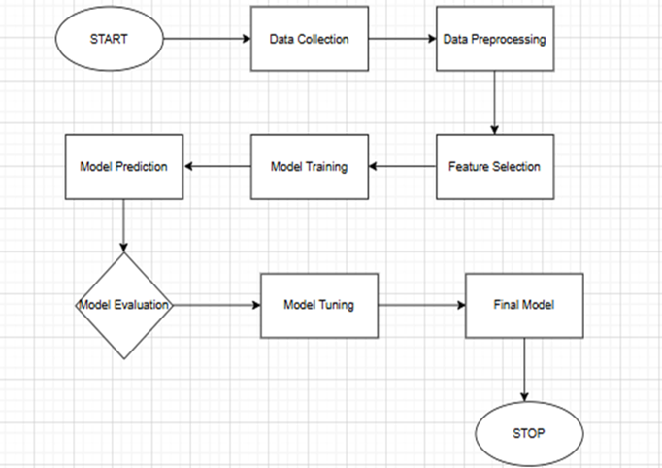
PROPOSED METHODOLOGY
Flowchart representing the Working of Machine Learning Models:

Slide 7
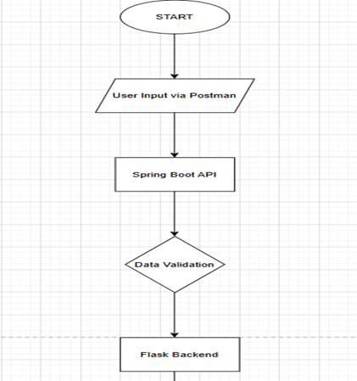
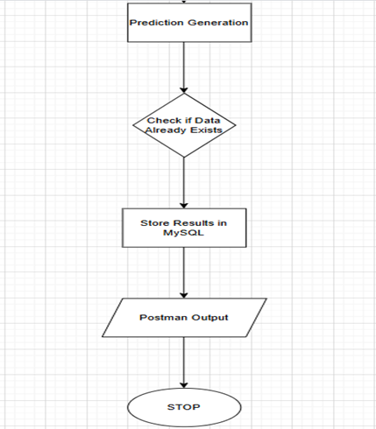
Overall System Flowchart:

Slide 8
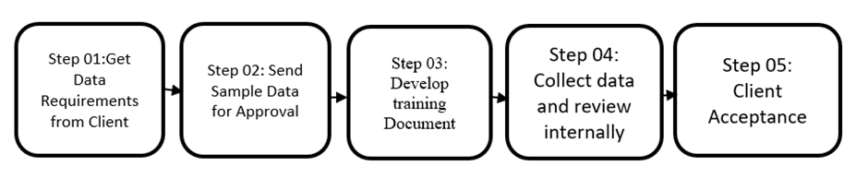
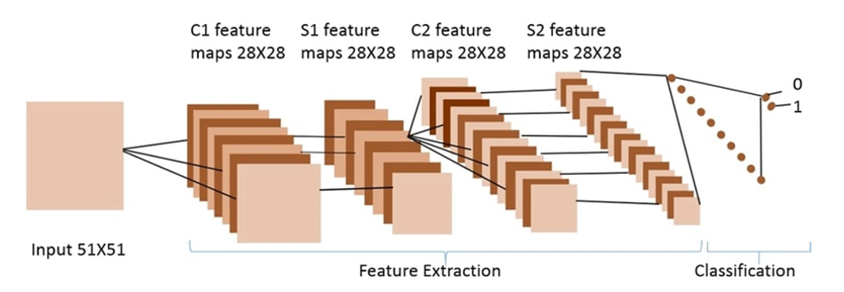
Steps involves for Fertilizer Prediction
The steps that involves to predict the proper fertilizer are as follows:
Data Collection
Feature Extraction

Slide 9
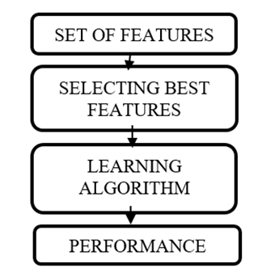
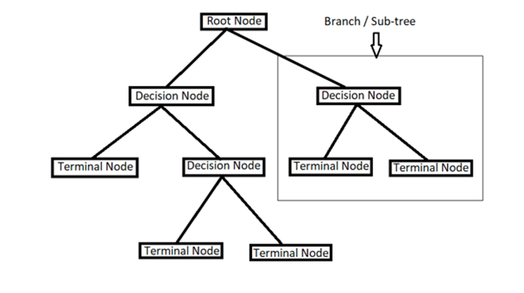
Feature Selection
Model Building

Slide 10
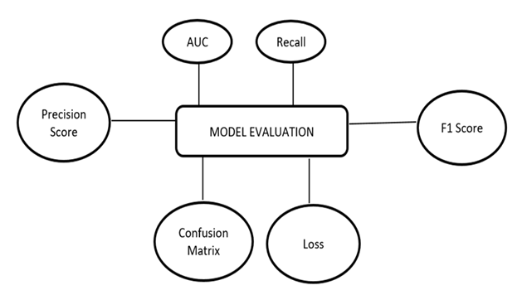
Model Evaluation

Slide 11
Working of System
In this project for predicting fertilizer, we used different machine learning models as follows-
Implementation of Random Forest Classifier:
Initialize the Random Forest Classifier
Train the model
Make predictions on the test data
Implementation of Logistic Regression:
Initialize Logistic Regression with increased maximum iteration
Train the model
Make predictions on the test data

Slide 12
Implementation of Support Vector Machine (SVM):
Initialize Support Vector Classifier with probability output
Train the model
Make predictions on the test data
Implementation of K-Nearest Neighbors (KNN):
Initialize K-Nearest Neighbors Classifier with k=5
Train the model
Make predictions on the test data

Slide 13
Implementation of Decision Tree Classifier:
Initialize Decision Tree Classifier
Train the model
Make predictions on the test data
Implementation of Gradient Boosting Classifier:
Initialize Gradient Boosting Classifier
Train the model
Make predictions on the test data

Slide 14
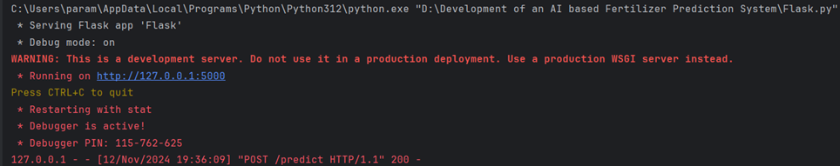
Result Analysis
Model Accuracy and Precision
Performance on Test Data
User Feedback and Usability
System Efficiency
Flask Output:

Slide 15
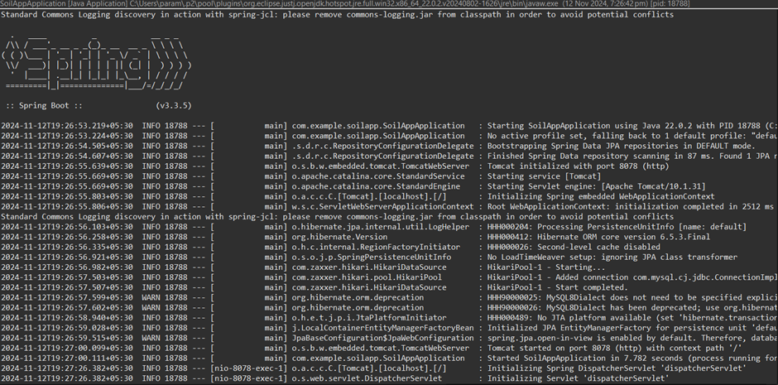
Output of Spring:

Slide 16
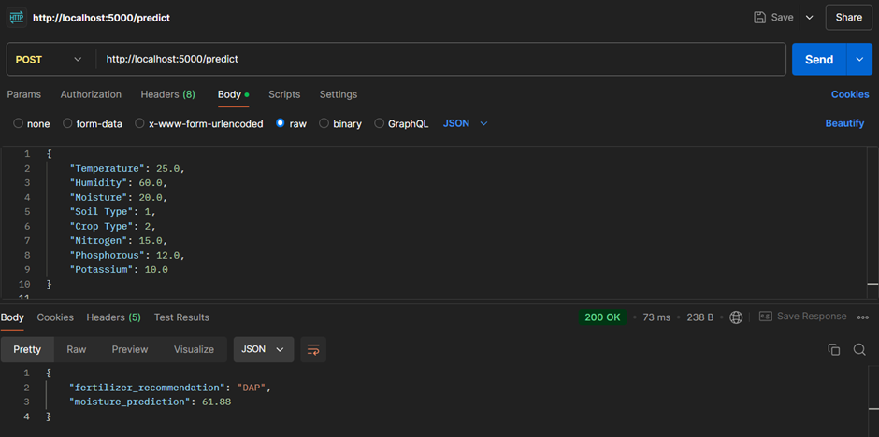
POST Mapping:

Slide 17
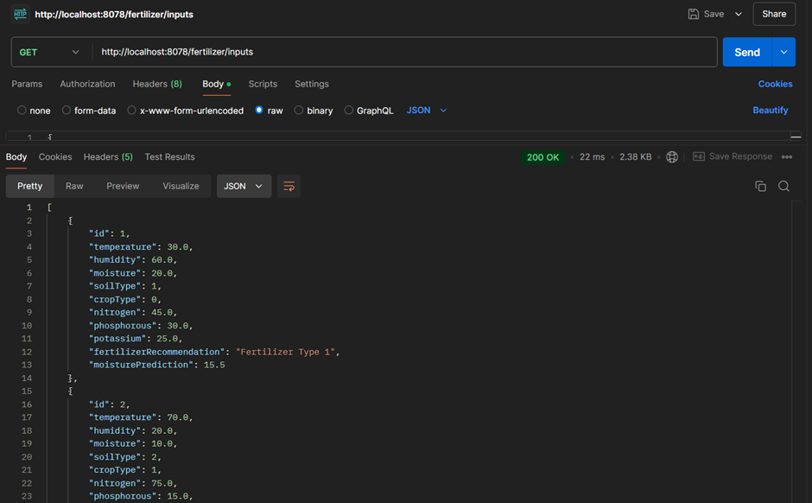
GET Mapping:

Slide 18
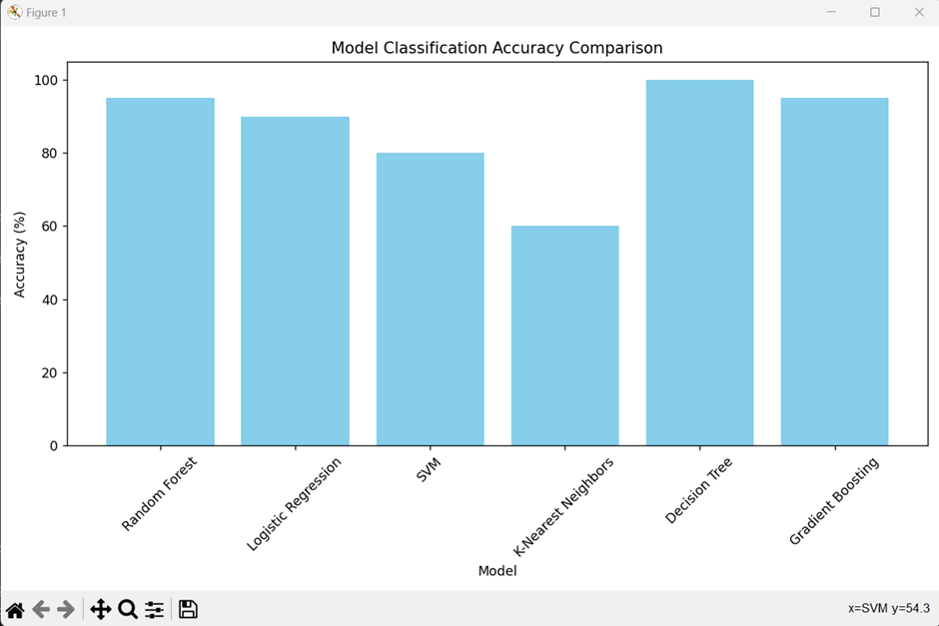
Model Accuracy Comparison using bar chart:

Slide 19
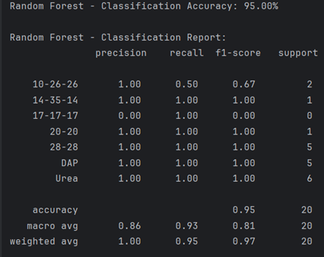
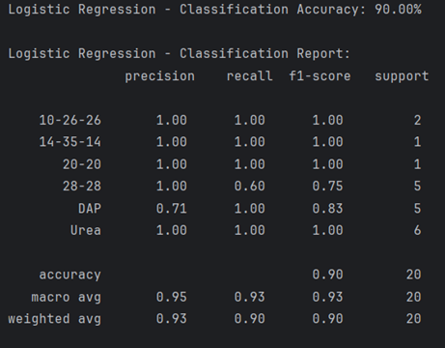
Reports:
Random Forest Classifier
Logistic Regression

Slide 20
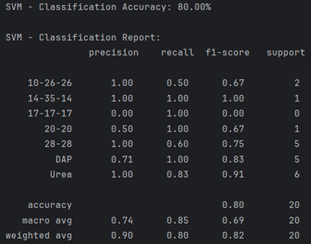
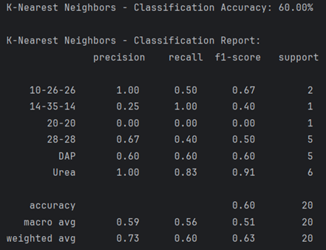
Reports:
Support vector Machine
K-Nearest Algorithms

Slide 21
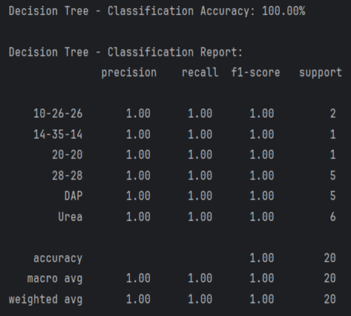
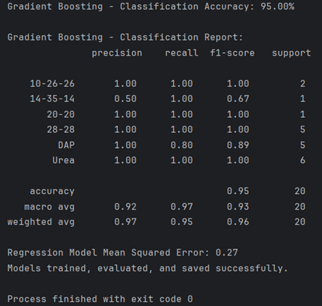
Reports:
Decision Tree
Gradient Boosting

Slide 22
CONCLUSION
In conclusion, the AI-Based Fertilizer Prediction System provides an innovative approach to enhancing sustainable agriculture through data-driven insights. By leveraging machine learning and AI models, this system predicts optimal fertilizer recommendations based on diverse environmental and soil conditions, such as temperature, humidity, and nutrient content. The integration of Flask and Spring Boot enables seamless API interactions for data input, prediction, and historical tracking, enhancing accessibility and user experience.
The system not only improves the efficiency of fertilizer usage but also contributes to economic and environmental sustainability by minimizing overuse and waste. This project addresses critical issues in modern agriculture, like resource optimization and crop productivity, by guiding farmers toward balanced nutrient application tailored to specific crops and soil types.
This system serves as a foundation for broader IoT integration, where real-time data from sensors or satellite imagery could lead to more dynamic and precise fertilizer recommendations. The System signifies a step forward in smart farming, offering practical solutions to improve food security and agricultural sustainability.

Slide 23
Future Work
In future we would like to expand our project by adding these few more tasks:
Integration with IoT Devices
Fertilizer Scheduling and Tracking
Integration of Real-Time Weather Data

Slide 24
ACKNOWLEDGEMENT
It is our great privilege to express our profound and sincere gratitude to our Project Supervisor, Dr. Shampa Sengupta for providing us a very cooperative and precious guidance at every stage of the present project work being carried out under her supervision. Her valuable advice and instructions in carrying out the present study has been a very rewarding and pleasurable experience that has greatly benefited us throughout the course of work.
We would like to convey our sincere gratitude towards Head of the Department of Information Technology of MCKV INSTITUTE OF ENGINEERING for providing us the requisite support for timely completion of our work. We would also like to pay our heartiest thanks and gratitude to all the teachers of the INFORMATION TECHNOLOGY for various suggestions being provided in attaining success in our work

Slide 25
REFERENCES
Meng Zhang, Huazhao Liang, Zhongju Wang, Long Wang, Chao Huang, Xiong Luo, Damaged apple detection with a hybrid YOLOv3 algorithm, 3rd December 2022.
Madhumathi R,Arumuganathan T, Sneha Iyer R, Shruthi R, Shruthhi K , Soil Nutrient Analysis Using Machine Learning Techniques.
Pranav Pramod Pawase, Sachin Madhukar Nalawade, Girishkumar Balasaheb Bhanage, Avdhoot Ashok Walunj, Pravin Bhaskar Kadam, Anil G Durgude, Mahesh R Patil, Variable rate fertilizer application technology for nutrient management: A review, 2023.
ChatGPT
Kaggle
THANK YOU!

