Slide 1

Analysing the Impact of
Climate Risk on Business Survival
A Data Mining-Based Predictive Model
Sudeshna Das | SAP ID: 590010583
MBA – Business Analytics | School of Business, UPES
Supervisor: Dr. Sajad Hussain Bhat | April 2026

Slide 2
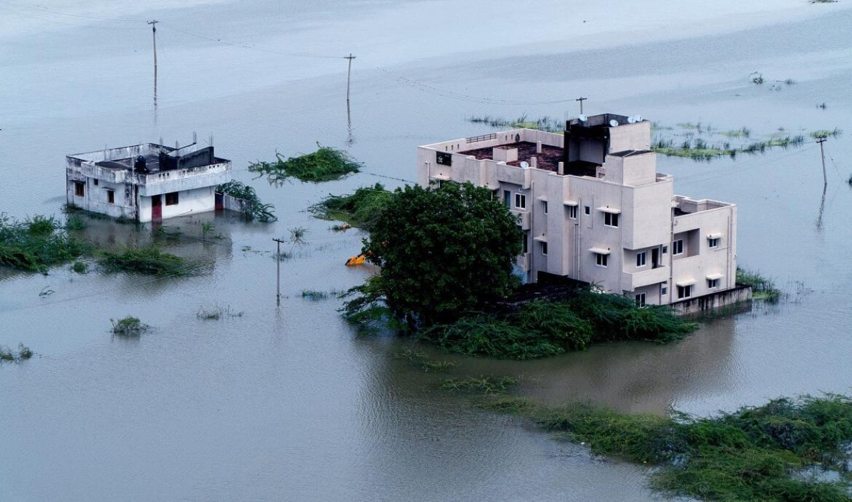
Introduction & Background
Climate change is increasing extreme events
India faces heatwaves, floods, cyclones
SMEs are the backbone of the economy
Climate risk ignored in decision-making
Lack of data-driven models
6.3 Cr+
SMEs in India
30%+
GDP Contribution
~45%
Industrial Output

Slide 3
Why SMEs Are Most Vulnerable
Limited Financial Resources
Geographic Concentration
SMEs lack capital buffers to absorb climate shocks, unlike large corporates
Clustered in specific regions without diversified operations, raising exposure
Weak Risk Management
Supply Chain Dependence
Low awareness and absence of climate risk assessment & insurance tools
Reliance on local suppliers and regional demand creates fragile networks

Slide 4
Problem Statement
Climate change in India is driving increased temperatures, irregular precipitation, and extreme weather events
These environmental shifts cause direct business damage — asset destruction, inventory loss, supply chain disruption
Existing research on business survival focuses primarily on financial and operational factors — ignoring environmental risks
Studies are mostly aggregated at the national level, lacking district-specific analysis for SMEs
There is urgent need for a data-driven predictive model integrating climate and business data to forecast survival rates
Key Gap: No quantitative district-level framework exists to predict climate-driven SME failure in India

Slide 5
Research Objectives
01
To analyze the impact of climate factors (temperature, rainfall, floods) on SME survival
02
To develop predictive models using Machine Learning techniques (Random Forest, XGBoost, LightGBM)
03
To estimate SME survival probability under different climate scenarios
04
To identify key risk drivers using SHAP and propose a climate risk scorecard

Slide 6
Research Methodology
Data Sources
Analytical Models
Scope
Cox Proportional Hazard Model (Survival Analysis)
Random Forest — ensemble prediction
XGBoost — gradient-boosted trees
SHAP — Explainability & Feature Importance
IMD / NASA — Temperature & Rainfall data
NDMA — Flood incident records
MSME / Udyam — Business registrations & closures
RBI / NITI Aayog — GDP, inflation, unemployment
500–600 Indian districts
10 years of panel data
~2,500–4,200 records
Multi-region diversity
Python (pandas, sklearn, SHAP, lifelines)
Fig: Data Integration Framework — Climate + MSME + Economic data merged by district & year (see Chapter 3, Fig 3)

Slide 7
Key Findings
🌡 Temperature Anomaly
🌧 Rainfall Deviation
Strongest predictor of SME failure
Non-linear (drought + excess risky)
🌊 Flood Events
📈 GDP as Buffer
Increase damage & disruption
Limited protection against climate risk
Insert Figure: SME Closure vs Climate Trend (Chapter 4, Fig 8) — shows closure rates rising alongside climate disruptions

Slide 8
ML Model Performance
Best Model
XGBoost
87% accuracy
Runner-up
LightGBM
85% accuracy
Why ML Wins
Non-linear
captures complex variable interactions
Feature Importance Plot (Chapter 4, Fig 11) — shows top variables driving predictions

Slide 9
SHAP Explainability Analysis
Top Climate & Economic Drivers (SHAP Feature Importance)
Temperature Anomaly
95%
Unemployment %
88%
Heatwave Days
75%
Rainfall (mm)
65%
Active MSMEs
82%
SHAP Insight: Rising temperature anomaly consistently pushes distress probability HIGHER — directional impact confirmed across all observations
SHAP Summary Plot (Chapter 4, Fig 12) & SHAP Dependence Plot (Fig 13)

Slide 10
Scenario Analysis — Future Climate Projections
↑ 2°C Rise
Distress rates increase noticeably across all districts in the +2°C scenario
Compounding
Heat + drought together amplify failure risk beyond individual effects
Long-term Risk
Cumulative climate exposure — not single events — drives SME closure
Scenario Impact Graph (Chapter 4, Fig 14) — shows distress distribution shift under +2°C warming

Slide 11
Conclusion & Recommendations
Core Conclusions
Policy & Managerial Actions
Temperature anomaly & heatwaves are top predictors of SME failure
Extreme rainfall (too much or too little) compounds risk non-linearly
XGBoost outperforms traditional survival models in prediction accuracy
GDP growth offers limited protection against environmental shocks
Embed climate risk in SME strategic planning & financial budgeting
Develop district-level Climate Risk Scorecard for credit & insurance decisions
Diversify supply chains geographically to reduce weather disruption risk
RBI / SEBI: Mandate climate risk disclosures for financial institutions
Future Research: Firm-level primary data · Transition risk integration · Neural networks · Cross-country comparisons

Slide 12
Thank You

