Slide 1



Minesweeper
Game App
Unlock the Thrill of Puzzle-Solving with Minesweeper!
The Minesweeper Game App brings the classic puzzle game to your fingertips, Whether for casual fun, strategic brain training, or competitive play, Explore the thrill of uncovering hidden mines while testing your logic and strategy skills

Slide 2


Abstract
1
Comprehensive Overview
2
Gameplay Mechanics
This presentation provides a detailed overview of the Minesweeper Game App, including its purpose, key features, and technical requirements.
Discover the intriguing gameplay mechanics that make Minesweeper a beloved and timeless classic.
3
Technical Specifications
Learn about the hardware and software requirements to ensure optimal performance and enjoyment of the app.

Slide 3
Introduction
Minesweeper Game
Historical Context
Purpose of the App
Minesweeper is a classic logic-based puzzle game that has captivated players for decades. The objective is to uncover all the safe cells on a grid while avoiding the hidden mines.
The game was originally developed in the 1960s and has since become a staple on personal computers and mobile devices, offering a fun and challenging experience for players of all ages.
The Minesweeper Game App aims to bring this beloved game to a wider audience, providing an engaging and user-friendly platform for players to enjoy the thrill of uncovering hidden mines.

Slide 4
Requirements - Hardware
Minimum Specifications
Recommended Specifications
The Minesweeper Game App is designed to run on a wide range of devices, with the following minimum hardware requirements:
For the best possible gameplay experience, we recommend the following hardware specifications:
Processor: 1 GHz or higher
Processor: 2 GHz or higher
RAM: 1 GB or more
RAM: 2 GB or more
Storage: 50 MB or more
Storage: 100 MB or more

Slide 5
Requirements - Software
Supported Operating Systems
Windows
The Minesweeper Game App is compatible with the following operating systems:
Windows 11,Windows 10, Windows 8.1, Windows 7.
macOS
Required Libraries
macOS 10.14 (Mojave) or later
The app requires the following software libraries and dependencies to function properly:
.NET Framework 4.7.2 or later
OpenGL 3.3 or later

Slide 6
Features
Classic Minesweeper gameplay with intuitive controls and a clean user interface.
Customize the game board size, mine density, and visual themes to personalize
your Minesweeper experience.
Choose from multiple difficulty levels, ranging from beginner to expert,
to challenge your skills.
Grid Generation: Generates a grid with a customizable size and number of mines.
Tile Reveal: Allows players to click or tap tiles to reveal either a number
(indicating adjacent mines) or a mine.
Win/Lose Conditions: Automatically determines win or loss when all non-mine tiles are
revealed or a mine is detonated.
Scoreboard: Records best times and scores for replayability and competition.

Slide 7
Technologies Used
Android Studio: For building and testing the Android version.
Java: For core game development and logic
Firebase: For real-time database, user authentication, and cloud storage

Slide 8
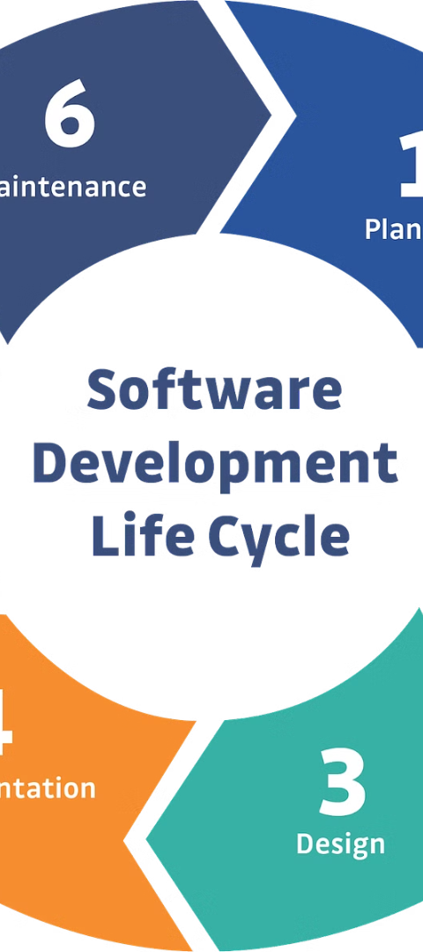

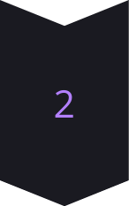
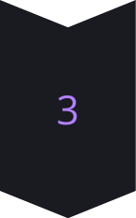
Development Process
Design
The app's user interface and gameplay mechanics were carefully designed to provide an intuitive and enjoyable experience for players.
Coding
The Minesweeper Game App was developed using a robust codebase that ensures reliability, performance, and scalability.
Testing
Extensive testing, both automated and manual, was conducted to ensure the app's functionality, stability, and adherence to quality standards.

Slide 9



Conclusion
Captivating Gameplay
Seamless Performance
Exciting Future Ahead
The Minesweeper Game App offers an immersive and thrilling experience that will keep players on the edge of their seats, challenged and entertained with every move.
Designed to run flawlessly on a wide range of devices, the app ensures a smooth and lag-free experience, allowing players to focus on the game without any disruptions.
With a dedicated team constantly working to enhance and expand the app's features, the Minesweeper experience is only going to get better, ensuring players have a fresh and captivating challenge with every session.

Slide 10
-
Thank You
FROM -
SUDEV BASTI
SIDDHALING S PADANUR
SIDDU GOULI
SHIVASHANTVEER R N

