Slide 1
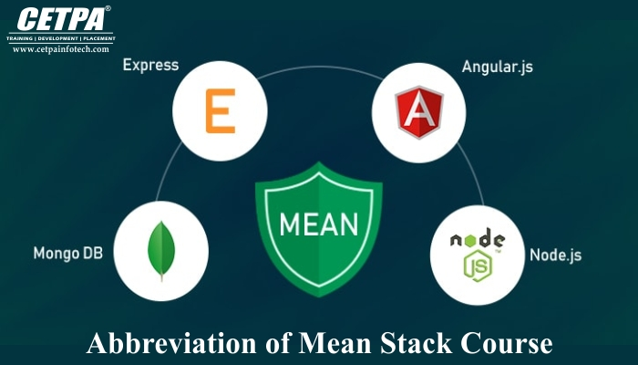
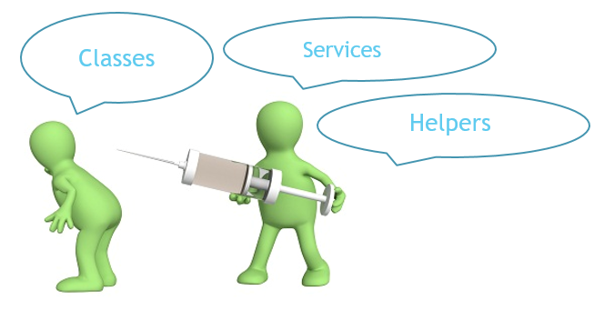
Session10 – Services &
Observables
Sudha Agarwal
info@4kitsolutions.com

Slide 2

Index
Dependency Injection
Introduction to Services in Angular
Using Observables
HTTP Client
REST APIs

Slide 3

Dependency Injection
CHAPTER 1

Slide 4
Dependency Injection
Dependency or dependent means relying on something for support.
When class A uses some functionality of class B, then its said that class A has a dependency of class B.
Before we can use methods of other classes, we first need to create the object of that class (i.e. class A needs to create an instance of class B).

Slide 5
Dependency Injection
So, transferring the task of creating the object to someone else and directly using the dependency is called dependency injection.
Dependency Injection (DI) is a technique in which a class receives its dependencies from external sources rather than creating them itself.

Slide 6
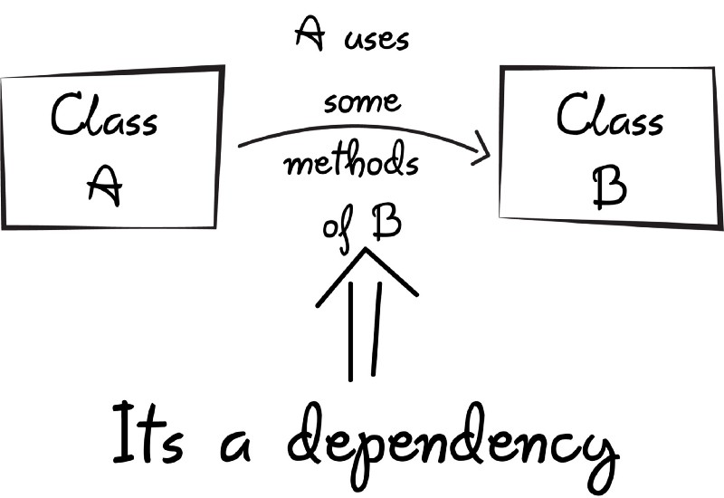
Dependency Injection

Slide 7
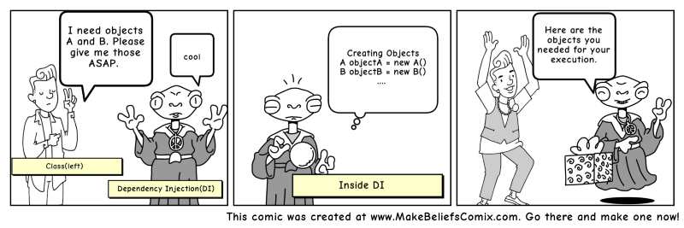
Dependency Injection

Slide 8
Types Of Dependency Injection
constructor injection: the dependencies are provided through a class constructor.
setter injection: the client exposes a setter method that the injector uses to inject the dependency.

Slide 9
Dependency Injection
So now its the dependency injection’s responsibility to:
1. Create the objects
2. Know which classes require those objects
3. And provide them all those objects

Slide 10
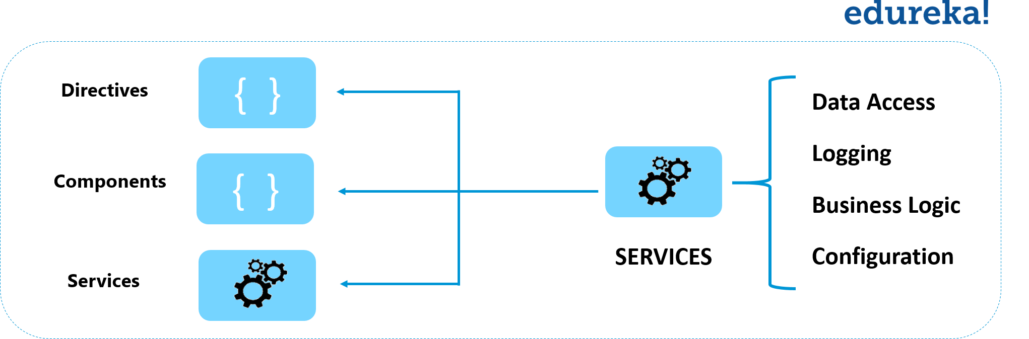
Introduction To Services
CHAPTER 2

Slide 11
What Are Angular Services?
As the name suggests, Angular Services are used to offer “services” to various components.
These services could range from simple data entry to other complex functionalities.
Services avoid rewriting of code. A service can be written once and injected into all the components that use that service

Slide 12
What Are Angular Services?
The main objective of a service is to organize and share business logic, models, or data and functions with different components of an Angular application.
They are usually implemented through dependency injection.

Slide 13
Building A Service
Services in Angular are simply typescript classes with the @injectible decorator.
To create an Angular Service class, you need to run the following command via Angular CLI.
A new service imports the Angular Injectable symbol
ng generate service crud

Slide 14
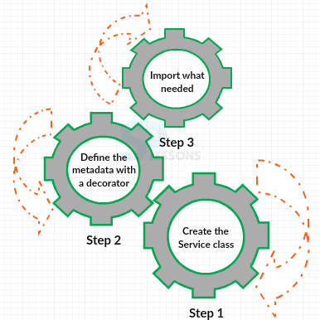
Building A Service

Slide 15
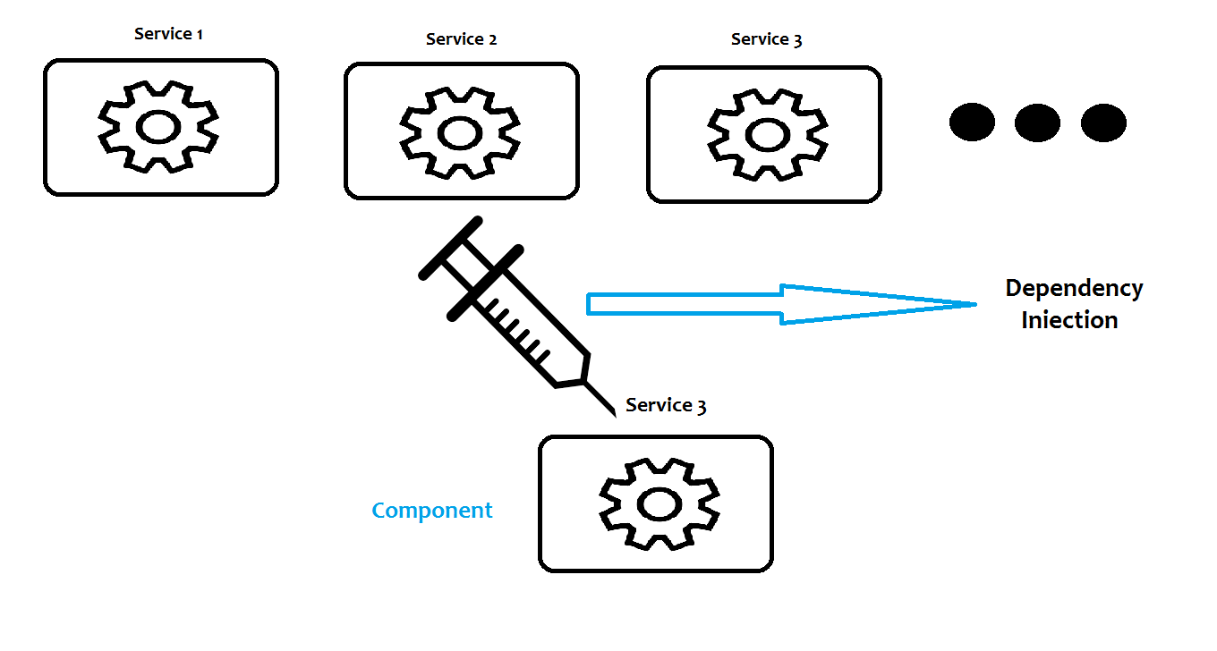
Injecting Services

Slide 16
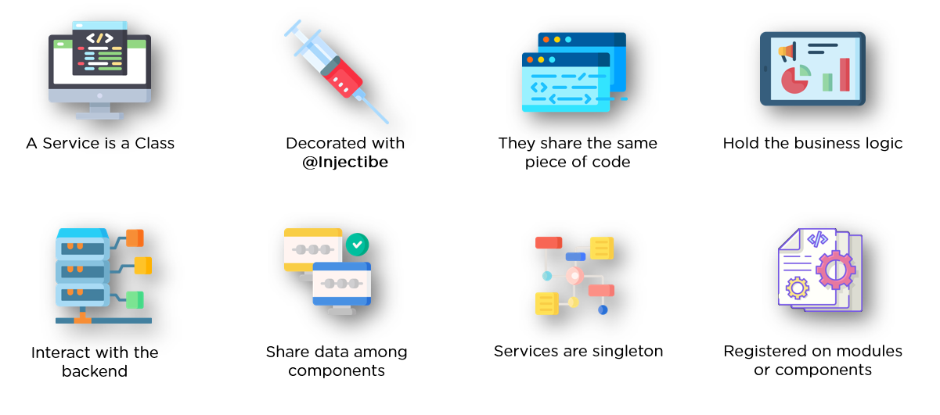
So A Service Is:

Slide 17

Observables
CHAPTER 3

Slide 18
What is an angular observable?
Observable are just that — things you wish to observe and take action on.
Observable is a function that converts the ordinary stream of data into an observable stream of data.
Observable stream emits the value from the stream asynchronously.

Slide 19
What is an angular observable?
Observable objects are registered, and other objects observe (in Angular using the subscribe method) them and take action when the observable object is acted on in some way.
While subscribing it optionally passes the three callbacks. next(), error() & complete().

Slide 20
What is an angular observable?
The observable starts emitting the value as soon as observer or consumer subscribes to it.
The observer receives the data from the observer via the next() callback.
They also receive the errors and completion events from the Observable via the error() and complete() callbacks.

Slide 21
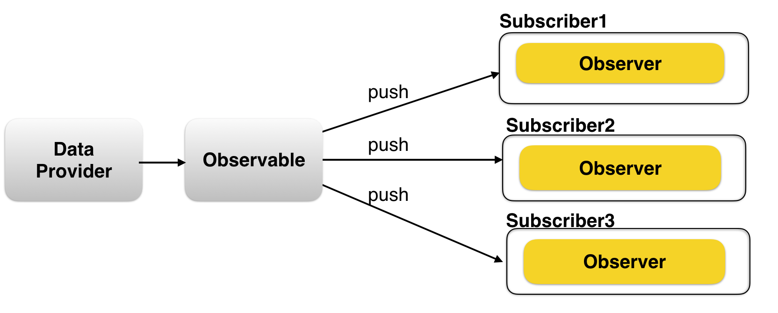
Observables

Slide 22
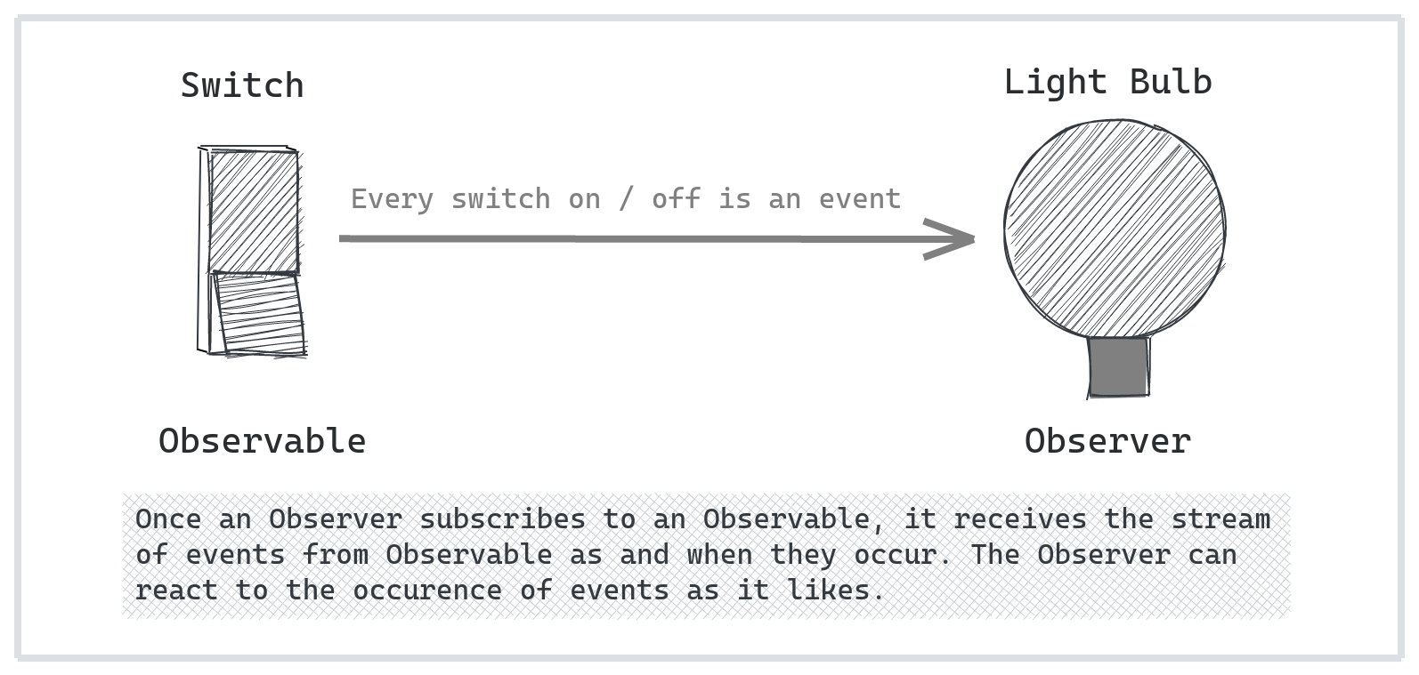
Observables

Slide 23
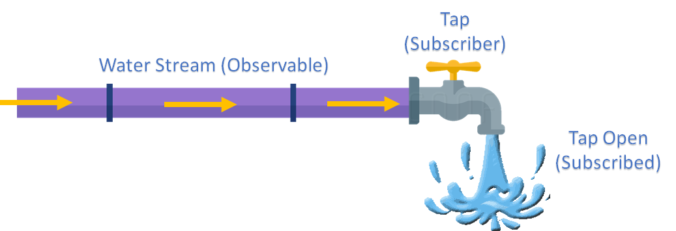
Observables

Slide 24
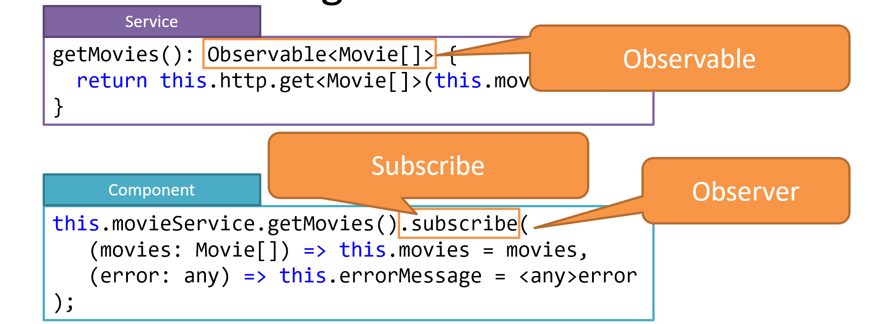
Observable And Observer

Slide 25
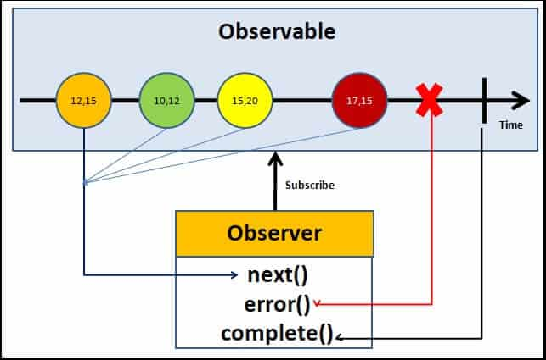
Observables

Slide 26
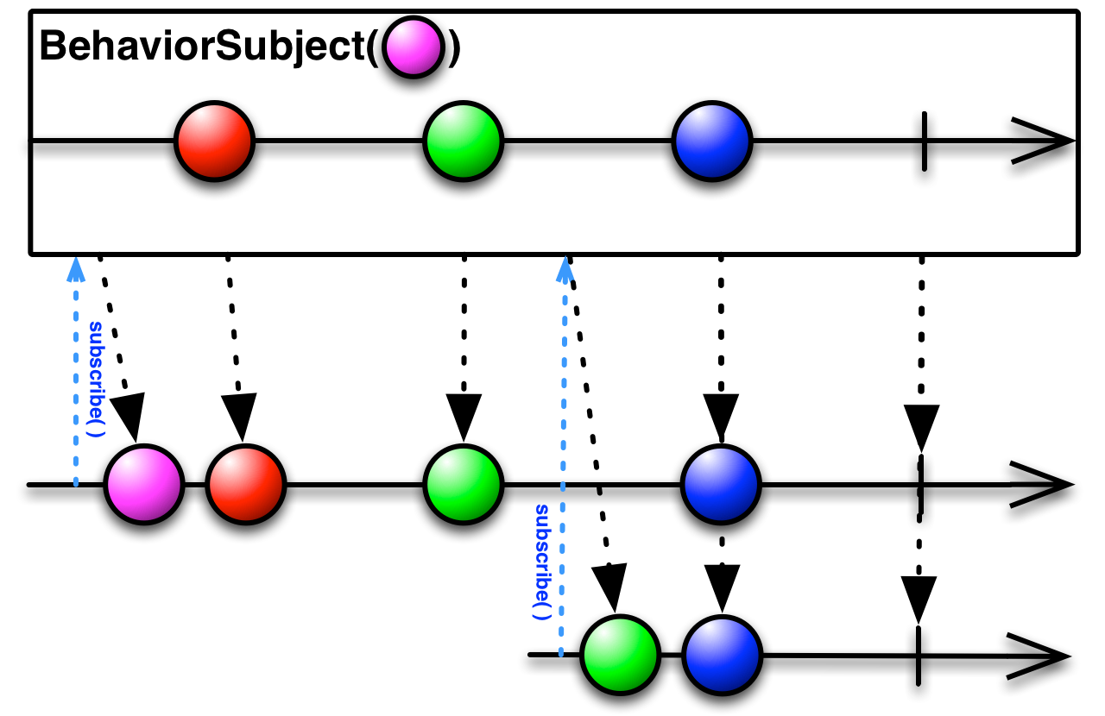
BehaviorSubject

Slide 27
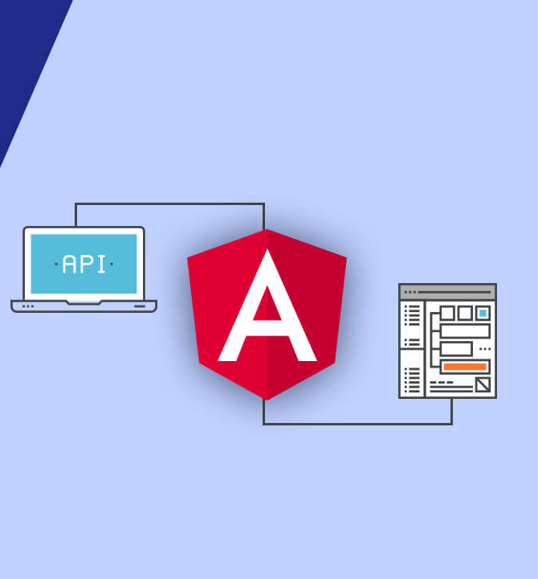
HTTP Client
CHAPTER 4

Slide 28
HTTP Client
Most front-end applications need to communicate with a server over the HTTP protocol, in order to download or upload data and access other back-end services.
Angular provides a client HTTP API, the HttpClient service class in @angular/common/http
The HTTP client service offers the following major features:
1. Observable paradigm 2.Better Error Handling 3.Request and response interception

Slide 29
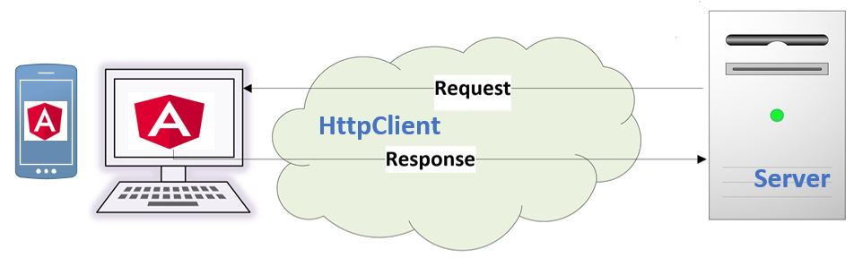
HTTP Client

Slide 30
Request And Response
HttpRequest represents an outgoing request, including URL, method, headers, body, and other request configuration options.
Angular requests return an Observable . The response is wrapped in the callback function, which takes the observables returned by the API method

Slide 31
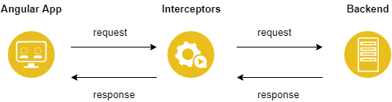
Request And Response

Slide 32
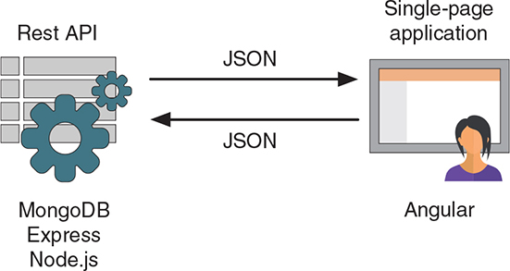
Communicating With Backend

Slide 33
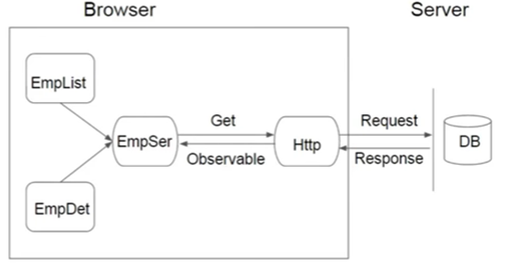
How HTTP and Observable Work

Slide 34
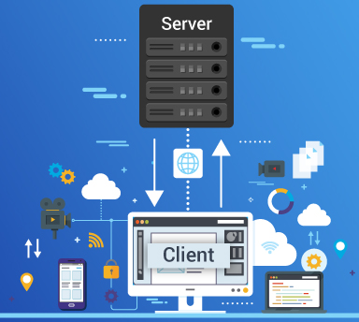
REST APIs
CHAPTER 5

Slide 35
What Are REST APIs
REST APIs are used to access and manipulate data using a common set of operations.
A RESTful API uses HTTP verbs like GET, PUT, POST, and DELETE to operate data.
Using these HTTP operations and a resource name as an address, we can build a REST API by creating an endpoint for each operation.

Slide 36
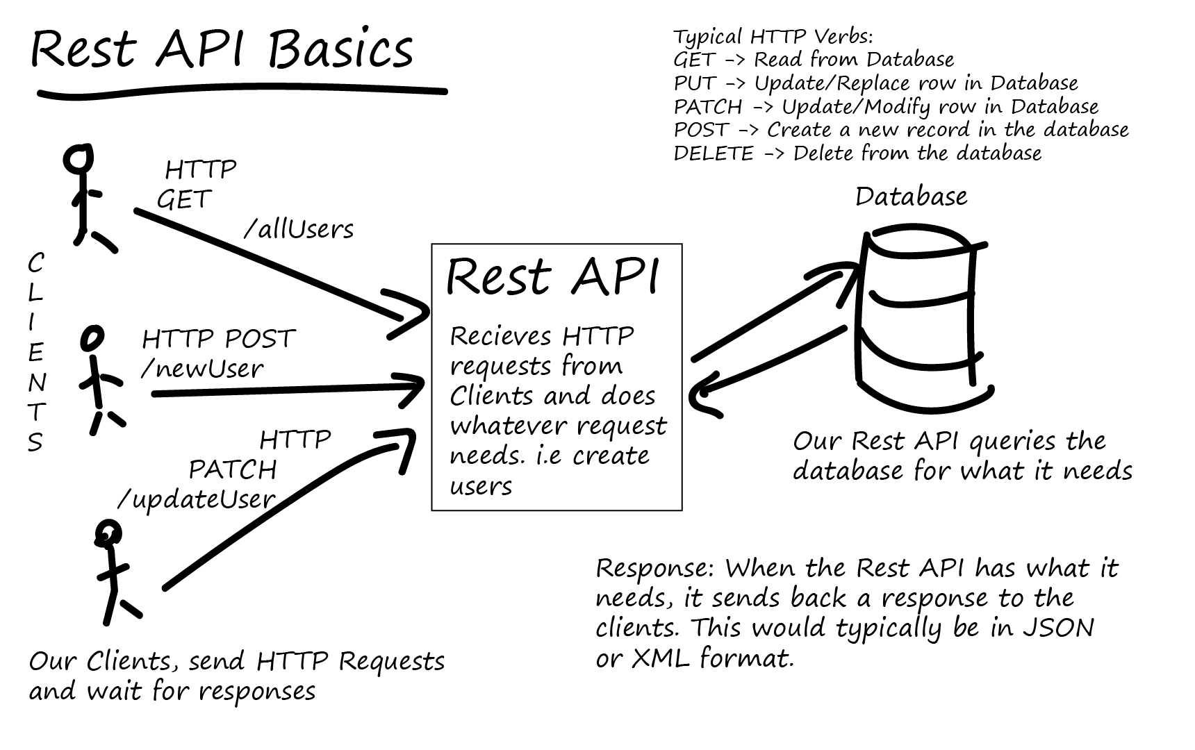
How HTTP and Observable Work

Slide 37
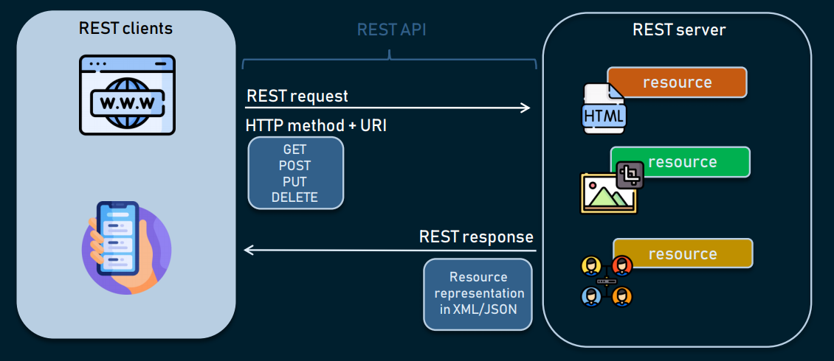
How HTTP and Observable Work

Slide 38
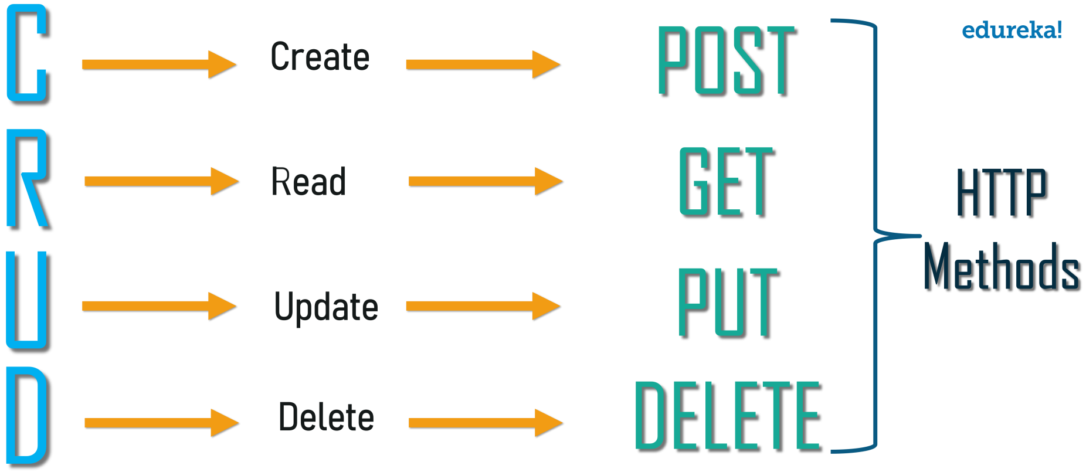
How HTTP and Observable Work

Slide 39
Thank You
HAPPY LEARNING!!
info@4kitsolutions.com
Sudha Agarwal

