Slide 1
PRODUCT DB
{ RW }
OR 2
Authoritative Source
Eventual Consistency
PRODUCT MS
Projection
1
Projection
PRODUCT DB
{ RO }
OR 3
PRODUCT DB
{ RO }
MESSAGING SYSTEM
INVENTORY MS
ORDER MS
ORDER DB
INVENTORY DB
CART MS
CART DB

Slide 2

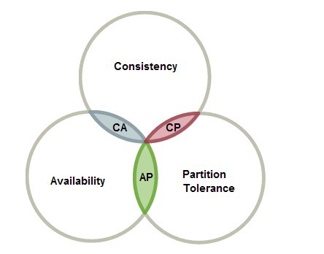

Slide 3
Client Side Service Discovery
discountms
discountms
Ip:port
Ip:port
Ip:port
Ip:port
Registry
{Eureka/Consul}
Ip:port
discountms
Ip:port
1. Need to talk to discountms
discountms
productms
Ip:port
Ip:port
Ip:port
Ip:port
discountms
Ip:port
discountms
Registry
{Eureka/Consul}
Registry
{Eureka/Consul}
discountms

Slide 4
FEIGN
HYSTRIX
auditms
apigateway
productms
discountms
RIBBON
Configuration Server
Zipkin
RabbitMQ
Eureka Server
git

Slide 5
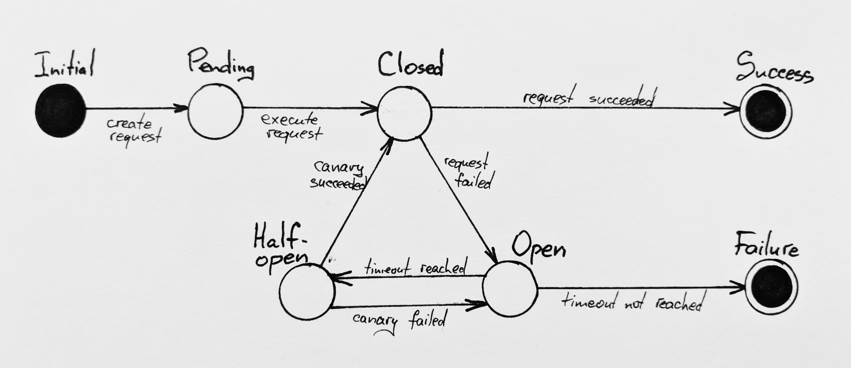

Slide 6
.war
IMAGE
IMAGE
VM
QA VM
.war
.war
TOMCAT
TOMCAT

Slide 7
WINDOWS VM
DOCKER_HOST
(docker-vm1:192.168.99.105)
DOCKER_HOST(docker-vm2)
Docker service
Image cache
Docker service
Image cache
:80
80:80
client
docker-machine
docker.exe

Slide 8
WINDOWS VM
K8S Cluster
Worker01 (Node01)
Worker02 (Node02)
NP
NP
kubectl
Master
(Master : 192.168.56.105)
kubectl
client

