Slide 1
Bellabeat Smart Device Usage Analysis
Analyzing Activity & Sleep Patterns
Presented by : Sudha Singh

Slide 2
Business Task:
Objective:
Analyze Fitbit smart-device usage data to understand activity and sleep patterns and develop marketing recommendations for the Bellabeat App.
Key Questions
What are the main trends in smart-device usage?
How could these trends apply to Bellabeat customers?
How could these trends influence Bellabeat's marketing strategy?
Deliverable
Use the analysis to provide data-driven marketing recommendations for Bellabeat.
Tools used: Python, Pandas, Tableau, SQL

Slide 3
About Bellabeat:
Bellabeat is a high-tech manufacturer of health-focused products for women.
Its products are designed to support health and wellness tracking.
The Bellabeat App provides insights into areas such as:
Activity
Sleep
Stress
Menstrual cycle
Mindfulness
The app connects with Bellabeat's smart wellness products.
Why the App?
This project focuses on the Bellabeat App because it can use user activity and sleep data to provide personalized wellness insights.

Slide 4
Data Source:
Dataset:
FitBit Fitness Tracker Data
Source:
Public dataset provided for the Bellabeat case study
Data Includes:
Daily activity
Steps and distance
Calories
Activity intensity
Sleep duration
Time in bed
Heart-rate and minute-level data
Data Used in This Project:
dailyActivity_merged.csv
sleepDay_merged.csv
Analysis Period:
April 12 – May 12, 2016
Public dataset with limitations in sample size and representation.

Slide 5
Data Cleaning & Preparation:
Python & Pandas were used to:
Load the activity and sleep datasets
Check missing values and duplicate records
Convert date columns to the correct datetime format
Remove 3 exact duplicate sleep records
Check data consistency and possible data-quality issues
Merge activity and sleep data using User ID + Date
Create analysis categories for:
  Activity level
  Sleep duration
  Sedentary time
Final Analysis Dataset
410 matched activity + sleep records

Slide 6
Data Analysis:
Using Python, Pandas :
Analyzed daily steps, activity levels, calories, and sedentary time
Compared activity patterns across days of the week
Analyzed sleep duration and time in bed
Combined activity and sleep data to identify relationships
Compared activity and calorie patterns across sleep-duration groups
Used descriptive statistics and correlation to identify patterns
Visualization
Tableau was used to create interactive visualizations and the final dashboard.

Slide 7
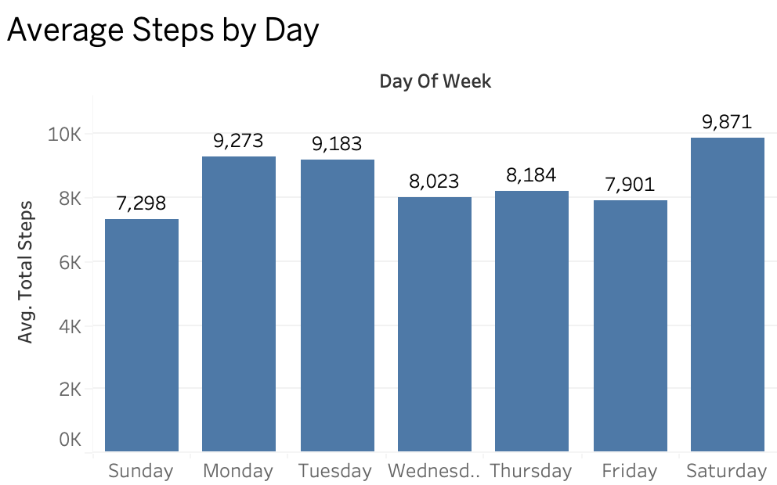
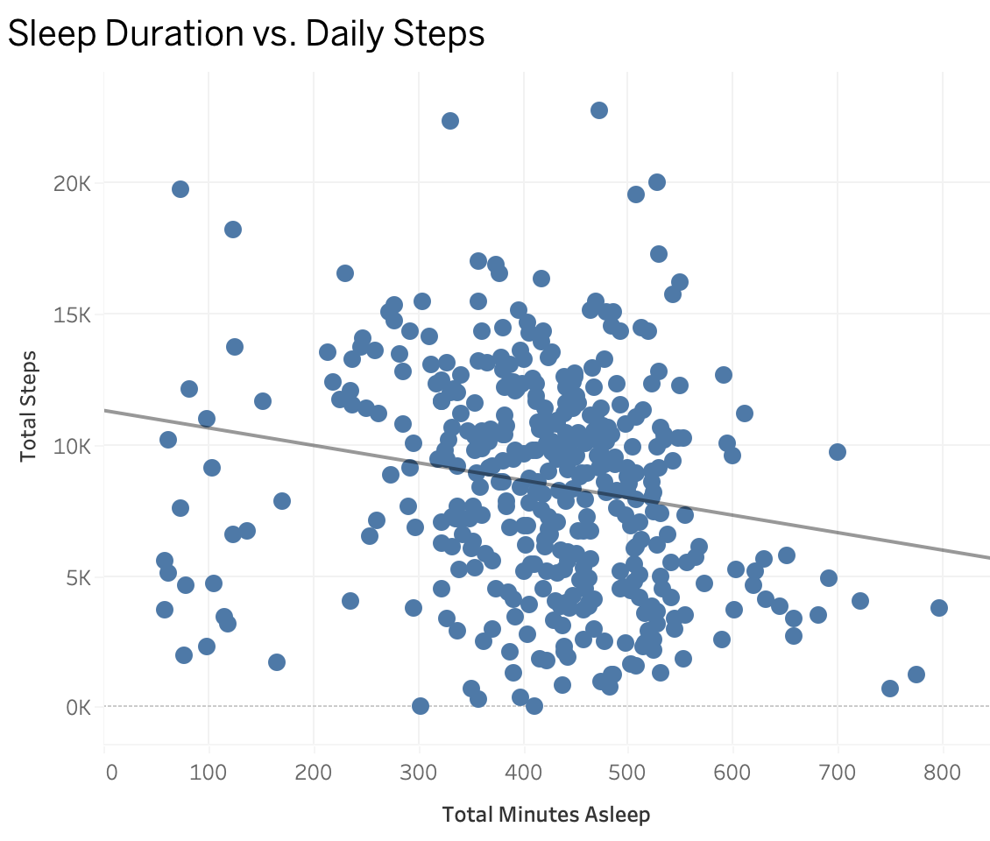
Key Findings:
Weekly Activity
Saturday had the highest average steps: ~9,871
Sunday had the lowest average steps: ~7,298
Sleep & Activity
Sleep duration and daily steps showed a weak negative correlation (-0.19)
This indicates a weak relationship, not causation.

Slide 8
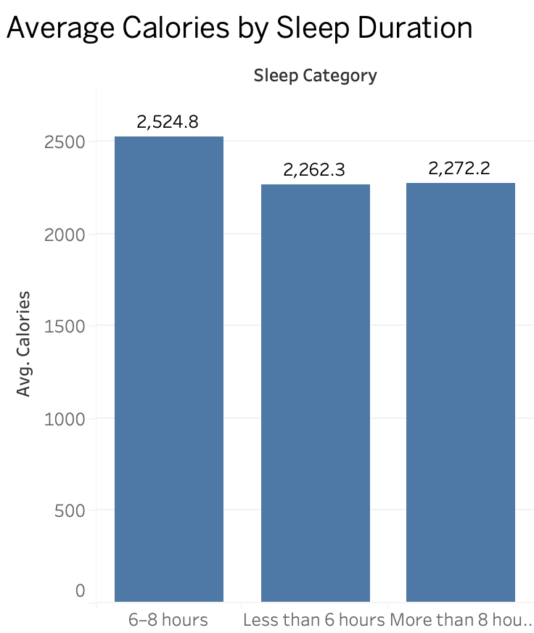
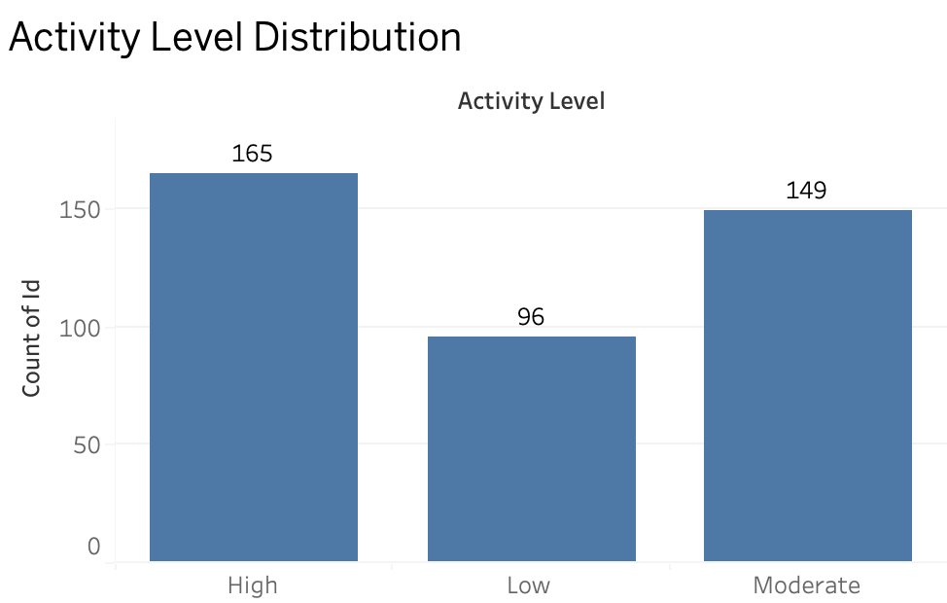
Sleep & Calories
The 6–8 hour sleep group had the highest average calories: ~2,525
Activity Levels
High activity: 165 records
Moderate activity: 149 records
Low activity: 96 records

Slide 9
Insights & Interpretation:
1. Weekly activity varies
Activity levels differ across days of the week.
Bellabeat can use weekly tracking to help users maintain consistent activity.
2. Sleep and activity are weakly related
The analysis found a weak negative relationship between sleep duration and daily steps.
This suggests sleep and activity should be viewed together rather than assuming one causes the other.
3. Sleep duration and calories vary
The 6–8 hour group recorded the highest average calories in the analyzed data.
Bellabeat can provide users with combined sleep and activity insights.
The app can use activity and sleep tracking to provide personalized wellness insights.

Slide 10
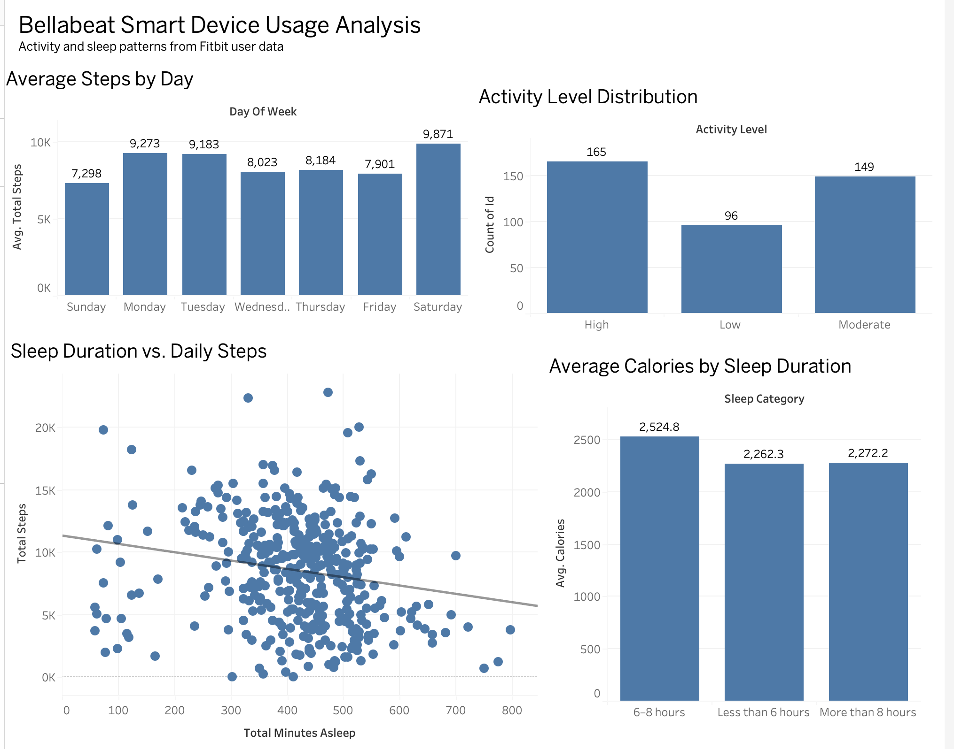
Interactive dashboard analyzing activity and sleep patterns of Fitbit users

Slide 11
Marketing Recommendations:
1. Encourage consistent weekly activity
Use weekly goals, activity reminders, and short challenges to help users maintain regular activity throughout the week.
2. Combine sleep and activity insights
Show users their sleep and activity patterns together to support personalized wellness tracking.
3. Encourage breaks from prolonged inactivity
Use gentle movement reminders and short activity challenges to encourage users to break up periods of inactivity.
Key message
Use the Bellabeat App to turn activity and sleep data into personalized wellness insights

Slide 12
Limitations & Conclusion:
Limitations
The dataset has a small sample size and may not represent all Bellabeat customers.
Activity and sleep data were available for different numbers of users.
Fitbit data may contain tracking and measurement limitations.
The analysis shows patterns and relationships, not causation.
Conclusion
The analysis identified differences in activity, sleep, and sedentary behavior within the available Fitbit data.
These findings suggest opportunities for Bellabeat to use its app to provide personalized activity and sleep insights, weekly goals, and movement reminders.
Final line
Data-driven insights can help Bellabeat develop more personalized wellness experiences.

