Slide 1
Employee Data Analysis using Excel
STUDENT NAME : N Sudharsan
REGISTER NO : 312210660
DEPARTMENT : Commerce
COLLEGE : SRM Arts and science College

Slide 2
PROJECT TITLE
Employee Performance Analysis in each department using Ms excel

Slide 3


AGENDA
Problem Statement
Project Overview
End Users
Our Solution and Proposition
Dataset Description
Modelling Approach
Results and Discussion
Conclusion
3/21/2024 Annual Review

Slide 4

PROBLEM STATEMENT Employee Performance analysis is calculated for each department to increase the fundings and necessary measures to improve the performance of lowest performing department.

Slide 5

PROJECT OVERVIEW
Employee performance analysis was done over various factor to identify the trends and pattern of employee performance for each department. Using this performance scale the exact situation and considerations needed for each department can be planned and executed to improve the performance by next term cycle.

Slide 6
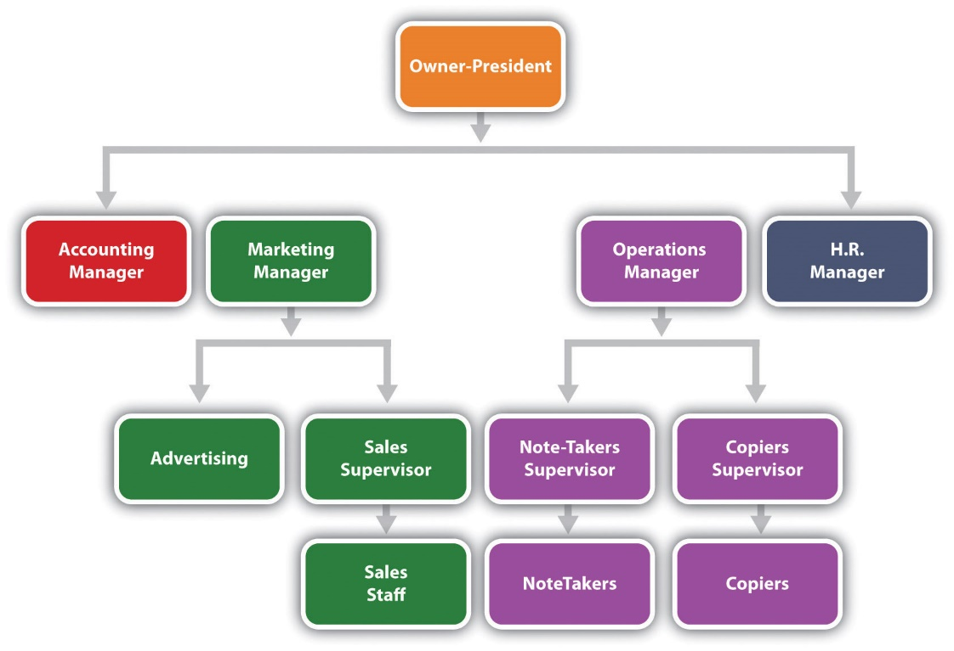

WHO ARE THE END USERS?
Employees
Employers
Managers
Business Person (Analyst)
Organization

Slide 7

OUR SOLUTION AND ITS VALUE PROPOSITION
Conditional Formatting- for missing data
Filter – to remove unnecessary data
Formula – to calculate the performance of the employee
Pivot – to get the summary about the classified data
Pie Chart – a visual representation about the desired data

Slide 8
Dataset Description
Employee Dataset sourced from Kaggle
The dataset consists of 26 features
Features considered for the classification
Employee Id – Numeric
Employee Name – Text
Employee Type
Performance Level
Gender – Male, Female
Employee Rating - Numeric

Slide 9

THE "WOW" IN OUR SOLUTION
Performance Factor Formula = =IFS(Z2>=5,"Very High",Z2>=4,"High",Z2>=3,"modrate",Z2>=2,"low",Z2>=1," Very low")
3/21/2024 Annual Review
9

Slide 10
MODELLING
Data Collection
1) Employee dataset was downloaded from edunet dashboard sourced from Kaggle
Feature Selection
Features were selected based on the performance analysis
Performance Factor, Work type, Department were selected to analyse the data and find the desired classification.
Data Cleaning
Identified the missing values in the dataset
Filtered out the missing values in the dataset
Performance level
1) Performance level was calculated based on their Current Employee Rating for each employee.
Summary
1) For Summarization Pivot table was created with selected features like Gender and Employee Type as Filter, Employee Rating as Column, Job Description and Business Unit as Rows and Count of Performance levels as Values.
10

Slide 11
RESULTS
11

Slide 12
conclusion
Performance analysis is a crucial role that each organization has to follow to identify the trends and patterns of each department.

