Slide 1
“BERT-Driven Sentiment Analysis: Automated Course Feedback Classification and Ratings”
Presented By
Sudha Chandrika Yadlapalli
Student ID: 3097401
Committee
Dr. David O. Johnson (Advisor & Chair)
Dr. Prasad Anil Kulkarni
Dr. Hongyang Sun

Slide 2
Motivation - Why this Project?
Problem statement
Understanding and analyzing large volumes of unstructured textual data (like student feedback) manually is inefficient and prone to bias
Solution
Automate the process using sentiment analysis to help students and the department
Implementation
Fine-tuned BERT to classify sentiments and built a user-friendly platform

Slide 3
Project Overview
Objective
Develop a sentiment analysis model to classify course reviews into positive and negative sentiments on a 1-5 scale
Dataset
Source: A dataset of 100k+ course reviews from Kaggle
Structure: Two columns - Review (text) and Label (1-5 stars)
Preprocessing:
Removed duplicates and invalid entries
Tokenized reviews for model training
Balanced the dataset to handle label imbalance.
Key Features
Automated sentiment classification using the BERT model
Real-time predictions integrated into the web interface
Basic visualizations for course review insights

Slide 4
Technical Stack
Frontend: HTML, CSS, and JavaScript for the UI
Backend: Python with Flask for API and data handling
Database: SQLite for managing course data and reviews
Model: DeBERTa (variant of BERT) for Sentiment Analysis
Hosting/Development
Model training: Google Colab Pro (A100 GPU)
Application: Local (VS Code)

Slide 5
Flow Chart
Start
Initiate DB with course data
Database
Sends sentiment with rating
Sends new or updated data
Updates the course rating
Flask
Valid review
Preprocess Review
BERT Sentiment Model
Yes
Course Reviews Page
Is Valid?
Submit Review Page
Trained on a 100k+ Dataset
No
No
Is Admin ?
Student submits review
Yes
Passcode Validation
Verified
View All Reviews Page
View all visualizations

Slide 6
Initial Attempts with Traditional Models
Models Tested
Challenges
Poor performance on validation data
Limited ability to handle context or nuanced language
Struggled with imbalanced classes and overfitting
Logistic Regression | Decision Tree | SGD Classifier
Assumes a linear relationship between input features (TF-IDF) and sentiment Fast, interpretable, but struggles with complex language | Captures non-linear relationships. Prone to overfitting and doesn’t generalize well on new reviews | Efficient for large datasets with sparse features Limited by inability to model contextual dependencies in text

Slide 7
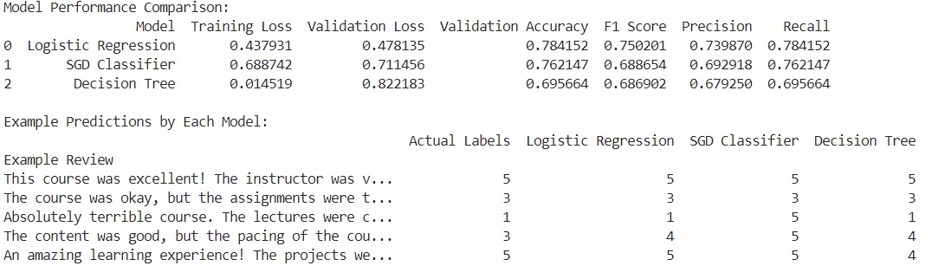
Results - Traditional Models
Models | Limitations
LR | Unable to capture language nuances and context
SGD | Slightly better generalization but lacked depth in feature representation
DT | High overfitting; struggled with new reviews
Observation: All models provided acceptable baselines but failed to understand contextual meaning

Slide 8
Sentiment Analysis using BERT
Why BERT?
Understands context better than simpler models
Pretrained on large corpora for excellent language understanding
Advantages Over Simpler Models
Logistic Regression, SDG Boost, and Decision trees struggled with context
BERT uses a transformer architecture for better performance at capturing subtle nuances in text, crucial for sentiment analysis

Slide 9
Implementation – BERT Model
Model Used
Fine-tuned DeBERTa-v3-base (state-of-the-art BERT variant)
Pretrained on general corpora; fine-tuned on course review dataset (100k reviews)
Training Setup
Dataset split: 80% training, 20% validation
Epochs: 3 (with batch size 32 for training, 64 for evaluation on A100 GPU)
Tokenization: Reviews split into word tokens with padding/truncation
Saves the best-performing model during training
Challenges
High computational requirements
Addressed using Google Colab Pro (significant speed-up)

Slide 10
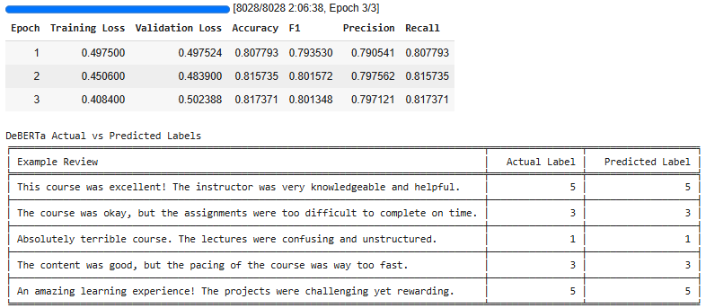
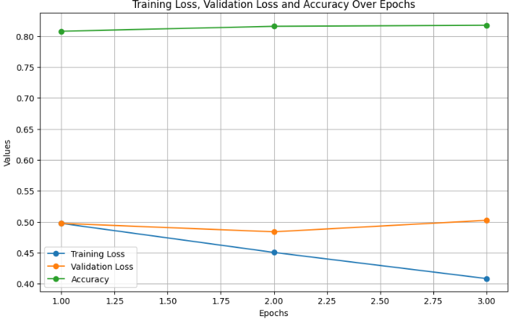
Results – BERT (3 Epochs)
Observations
The model correctly predicts the sentiments for all the provided examples
Training Loss: Steadily decreases, indicating that the model is learning from the training data
Validation Loss: Decreases initially (epoch 2) but increases slightly in the third epoch
Accuracy: Improves marginally over epochs, reaching 81.73% by the epoch 3

Slide 11
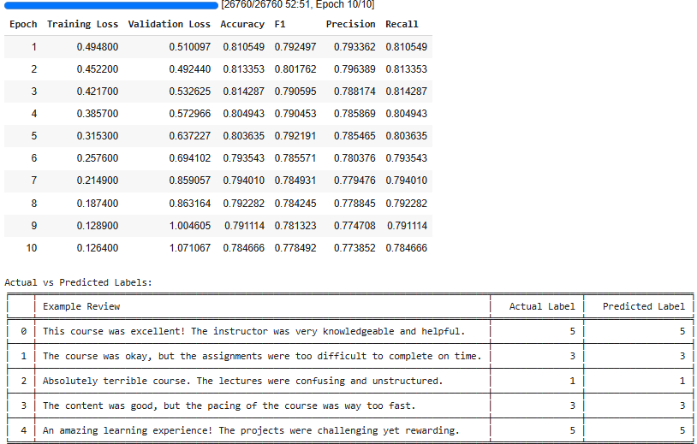
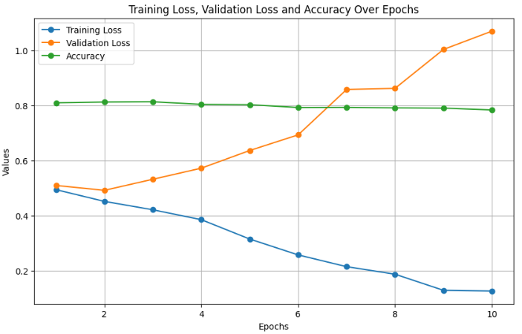
Results – BERT (10 Epochs)
Observations
Low training loss but high validation loss –> Overfitting
Optimal performance achieved at 3 epochs
Predicted sentiments align with actual ratings for most test cases

Slide 12
Comparison – BERT (3 vs 10 Epochs)
Aspect | 3 Epochs | 10 Epochs
Training Loss | Gradual decrease | Continuous decrease (risk of overfitting)
Validation Loss | Minimum at epoch 2 | Increases steadily after epoch 2
Accuracy | Peaks at 81.73% | Drops to 78.47%
F1, Precision, Recall | Peaks early, remains stable | Declines after epoch 3
Confusion Matrix | Better overall balance across classes | Skewed performance
Generalization | Good balance between training and testing | Overfits to training data after epoch 3
The 3-epoch model is clearly better for this project!

Slide 13
Implementation - Frontend
Tools Used
HTML for structure and CSS for styling (responsive design)
JavaScript for interactive elements
High charts for data visualization
Key Features
Course Overview Page: Displays course ratings and review counts dynamically
Submit Review Page: Dropdown menu for course selection (auto-fetched from the database) and validations to ensure meaningful reviews
View Reviews Page: View all reviews with positive/negative sentiment rates and accessible only for admins

Slide 14
Implementation - Backend
Framework
Built using Flask (lightweight Python web framework)
Handles API calls, database interactions, and template rendering
Key Functionalities
Model Integration
Loads the fine-tuned BERT model for predictions
Tokenizes input and returns sentiment scores (1-5)
API Endpoints
Accepts course reviews, validates content, predicts sentiment, and saves to the database
Returns course list dynamically for dropdowns
Provides aggregated sentiment data for visualizations
Data Handling
Connects to SQLite database to manage courses and reviews
Ensures efficient read/write operations and maintains data integrity

Slide 15
Implementation - Database
Database Used: SQLite
Lightweight, easily integrates with Flask and ideal for small-scale projects
Schema:
Courses Table: Stores course details (code, name)
Reviews Table: Stores student reviews with sentiment scores
Features
Course data populated from a CSV file (EECS_Course_Data.csv)
Reviews linked to courses via foreign keys
Aggregation queries for calculating Average ratings, Positive and negative sentiment counts

Slide 16



Results – UI (students)

Slide 17
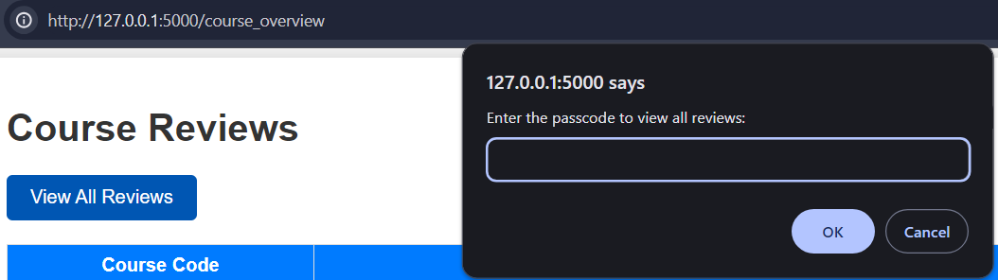
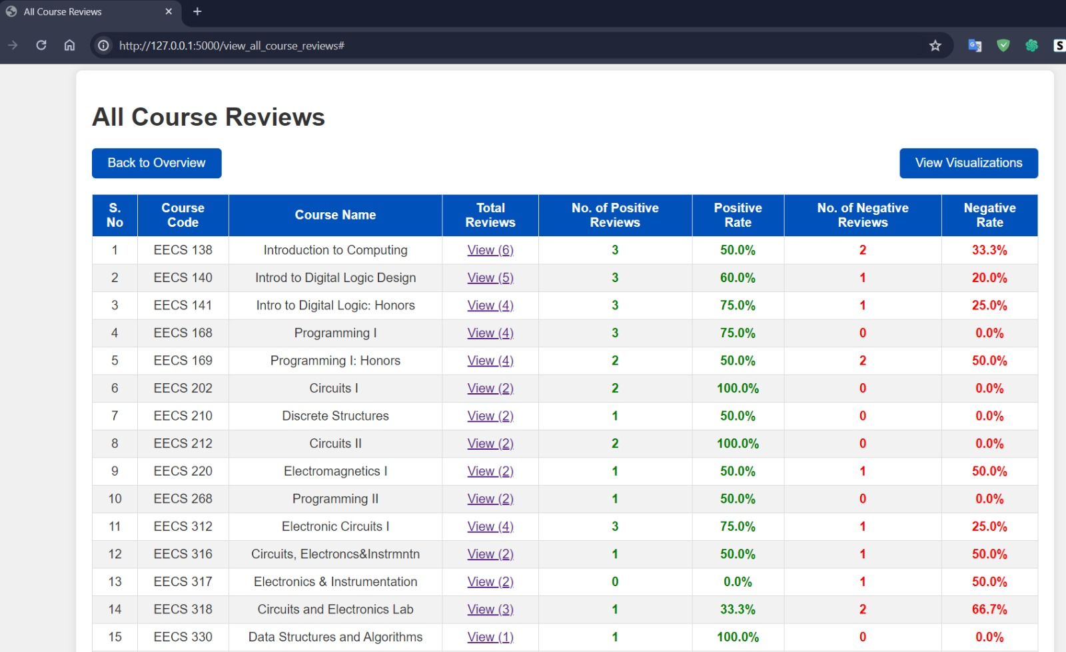

Results – UI (Department only)
From Course Reviews Page, only after validation, the department/admin would be able to view the reviews for the individual courses or the overall results

Slide 18
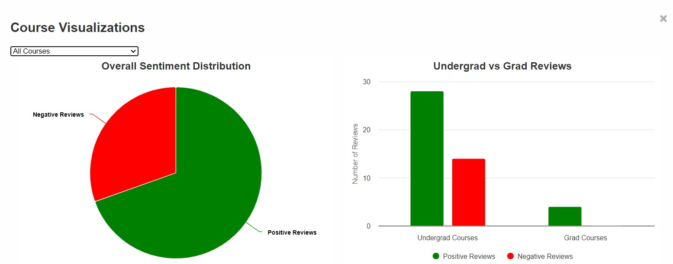
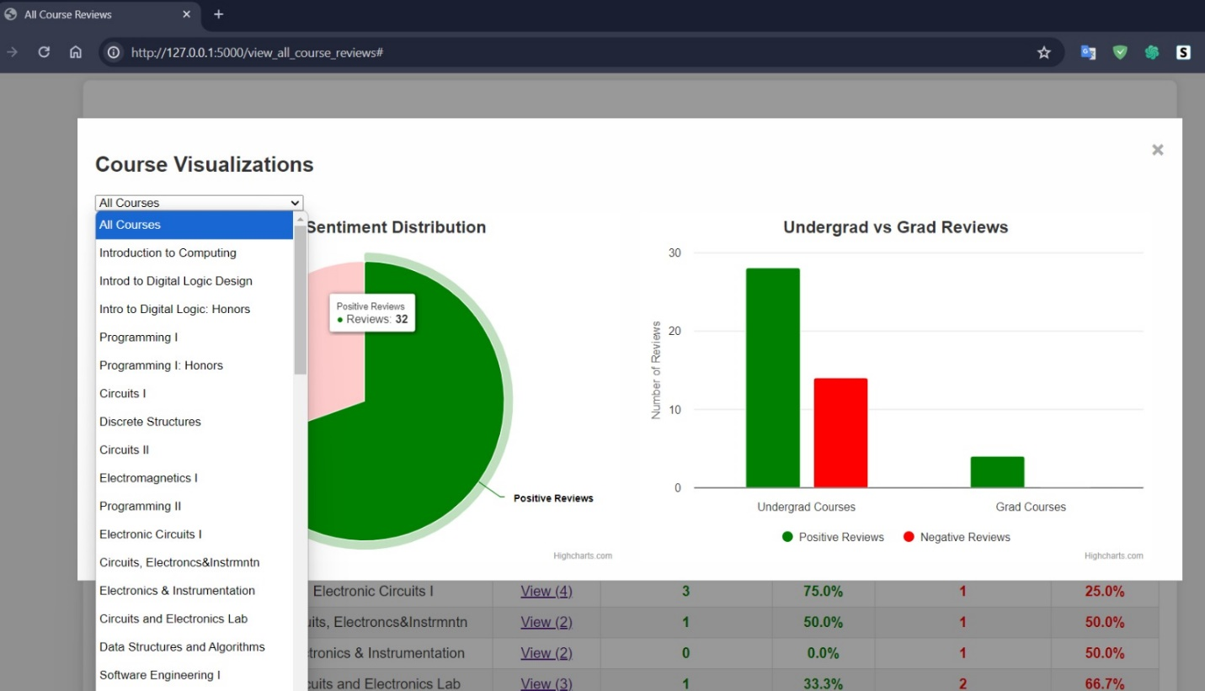
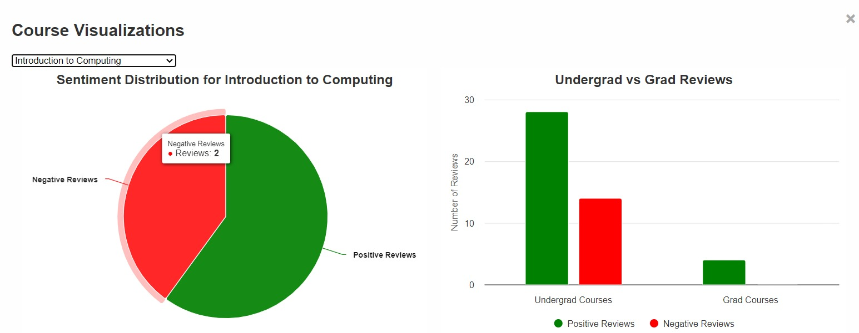
Results – Basic Visualizations (Dept. only)
Visualizations page automatically displays the chart for all courses
When selected a course from drop down, the pie chart gets updated
The bar graph displays the Undergrad and Grad course review comparisons

Slide 19
Challenges & Solutions
Challenges | Solutions
High Computational Requirements: Fine-tuning BERT with a 100k+ dataset required significant GPU resources | Utilized Google Colab Pro with A100 GPUs to reduce training time from hours to ~30 minutes
Overfitting: Longer training caused overfitting | Limited training to 3 epochs
Model Integration: Deploying a computationally heavy model in a lightweight Flask backend | Optimized inference using batching and device management (CUDA/CPU fallback)
Real-time Validations: Preventing invalid or meaningless reviews from being submitted | Added input validation at both frontend and backend

Slide 20
Future Work
Authentication
Replace passcode-based admin access with secure login (e.g., OAuth)
Advanced Visualizations
Add trend-based charts (e.g., reviews over time) and more interactive dashboards
Multilingual Support
Extend sentiment analysis to handle non-English reviews
Deployment
Host the system on cloud platforms (e.g., AWS or Heroku)

Slide 21
Conclusion
Key Achievements
Automated sentiment analysis for course feedback using BERT, achieving ~82% accuracy
Seamlessly integrated model predictions into a user-friendly web application
Takeaways
Advanced NLP models like BERT outperform traditional methods in handling complex textual data
Lays a solid foundation for future enhancements and scalability

Slide 22
Thank you!

