Slide 1
Importing notebooks by accessing this github resource and import data on Watson Studio

Slide 2
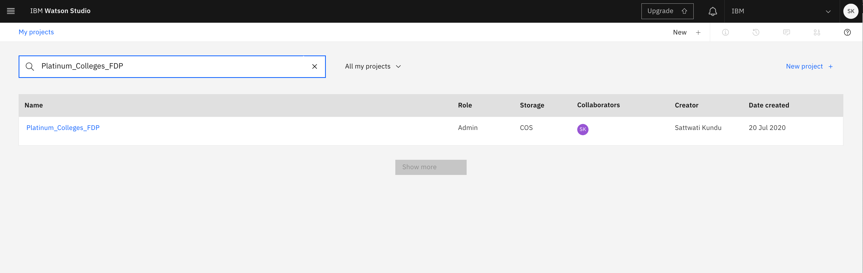
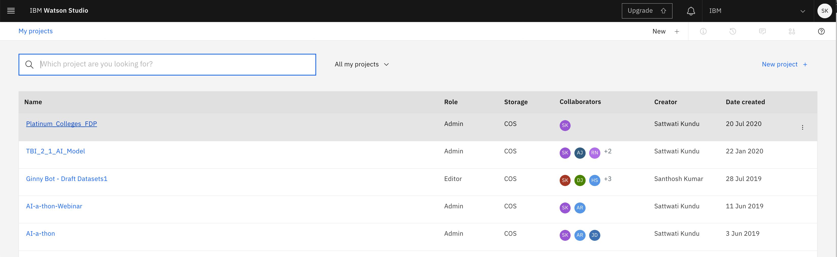
Under “My projects” either search for the project or directly select from the list
Steps to create a notebook
Step1 : go to the project

Slide 3
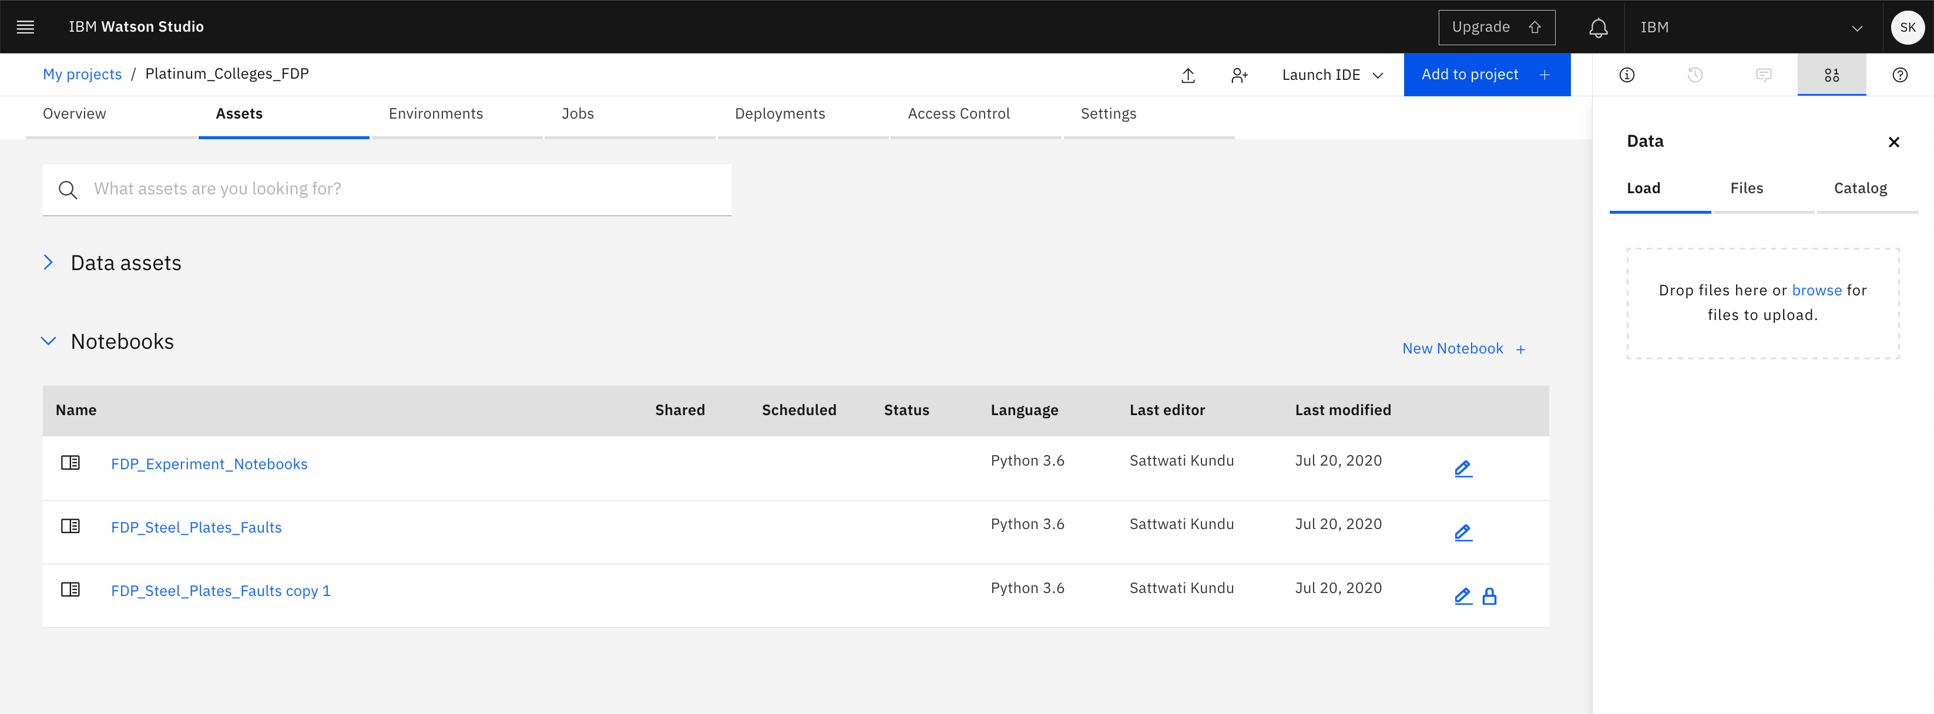
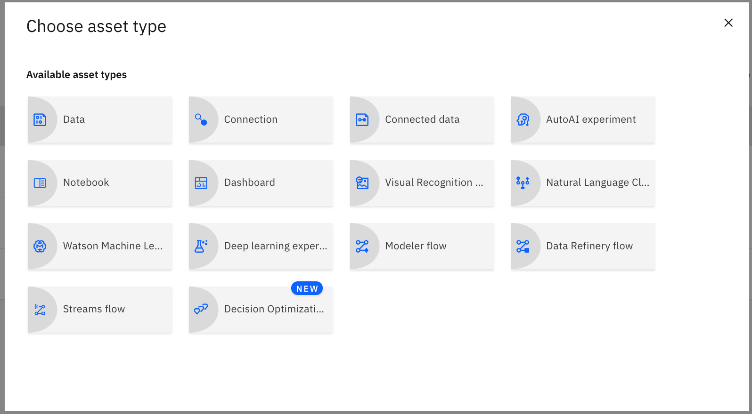
step2
Click on “Add to project” to add a notebook
Select “Notebook”
step3

Slide 4
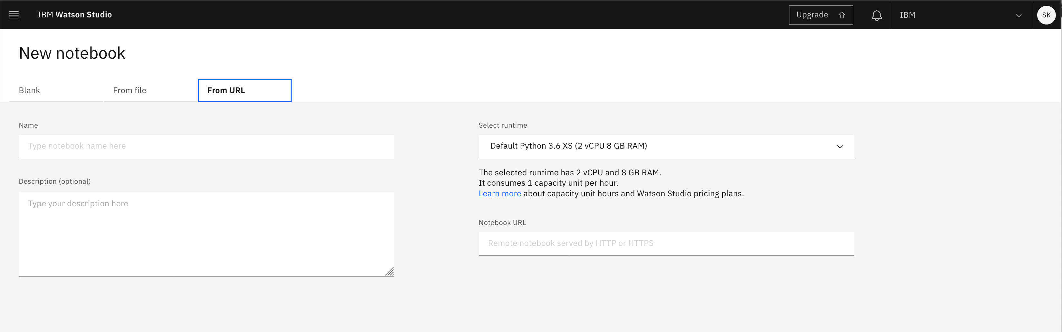
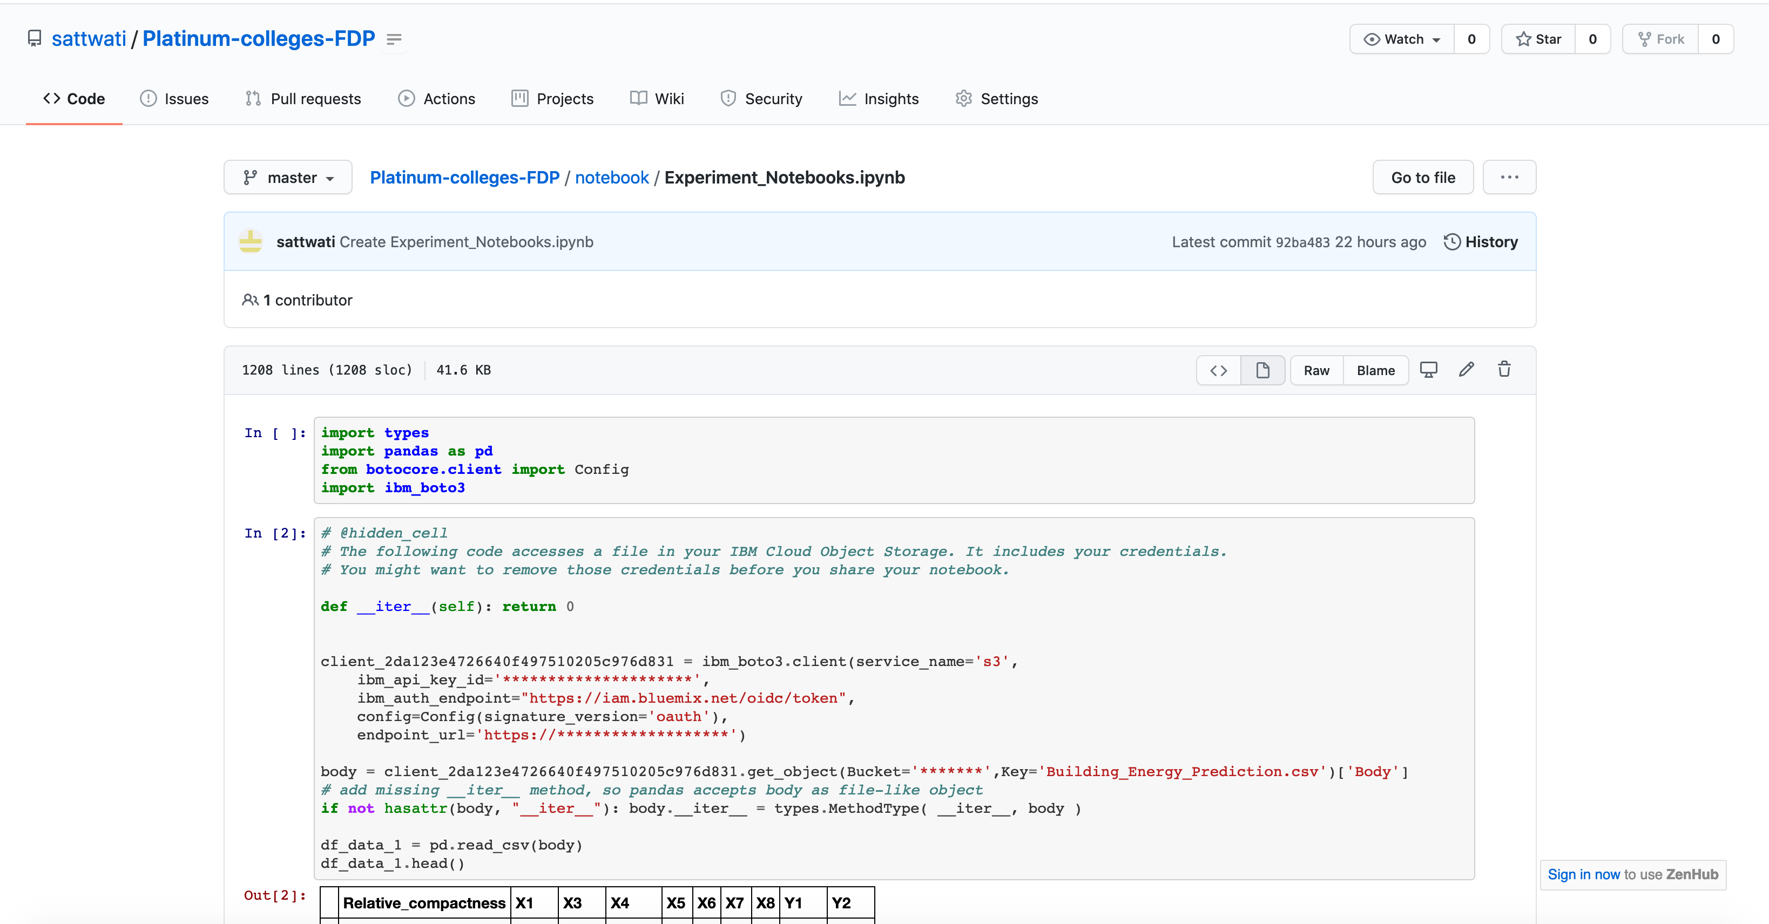
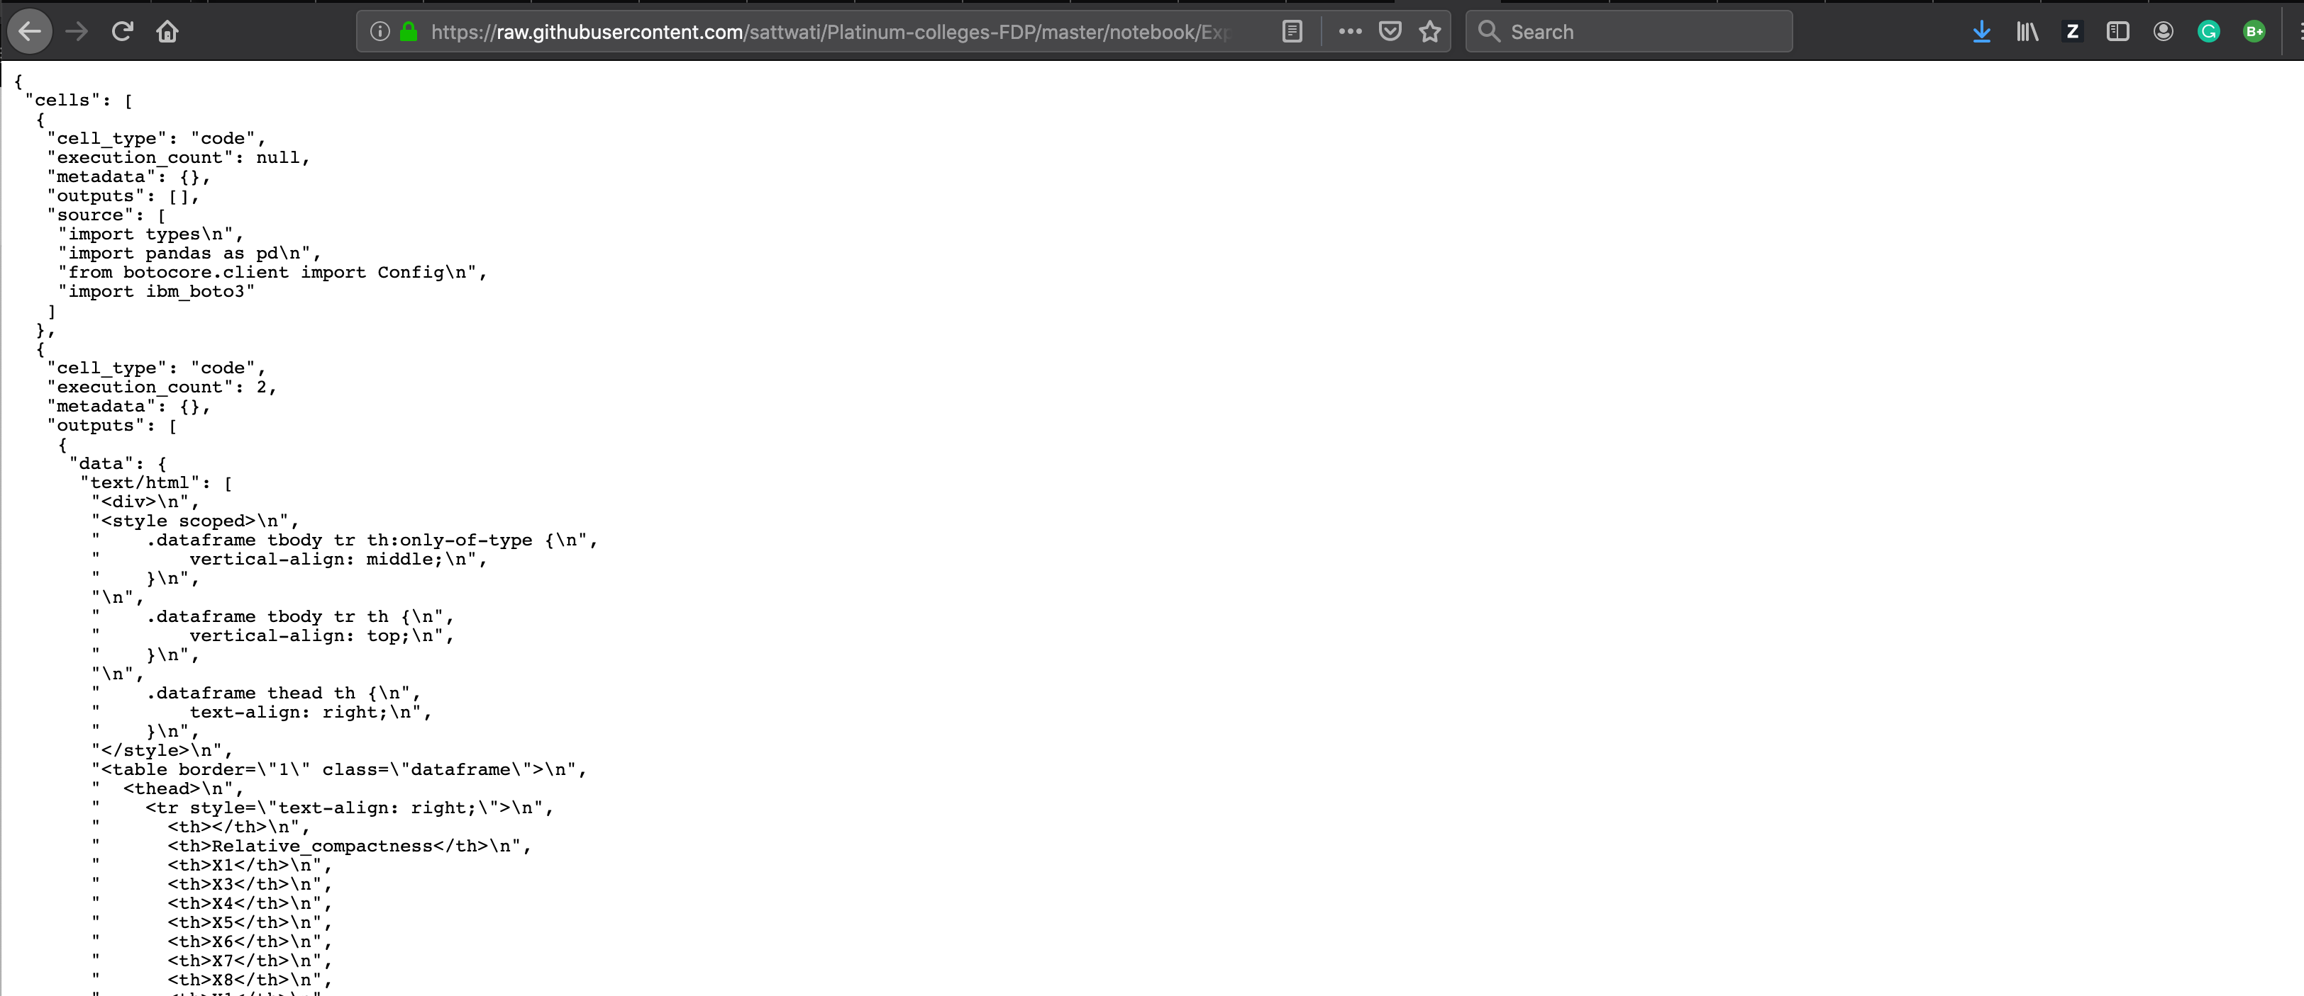
Click on “From URL” to add the notebook from github
Select the default runtime
step4
Paste the URL from github here
step7
Copy this URL and paste
step5
Raw looks like this
Click on “Raw”
step6

Slide 5
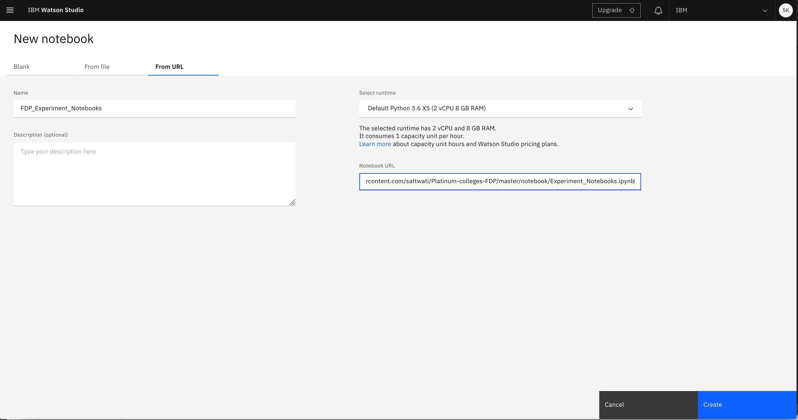
After giving the name and URL, the “Create” gets activated.
Click on “Create” to create the notebook in WS
step8

Slide 6
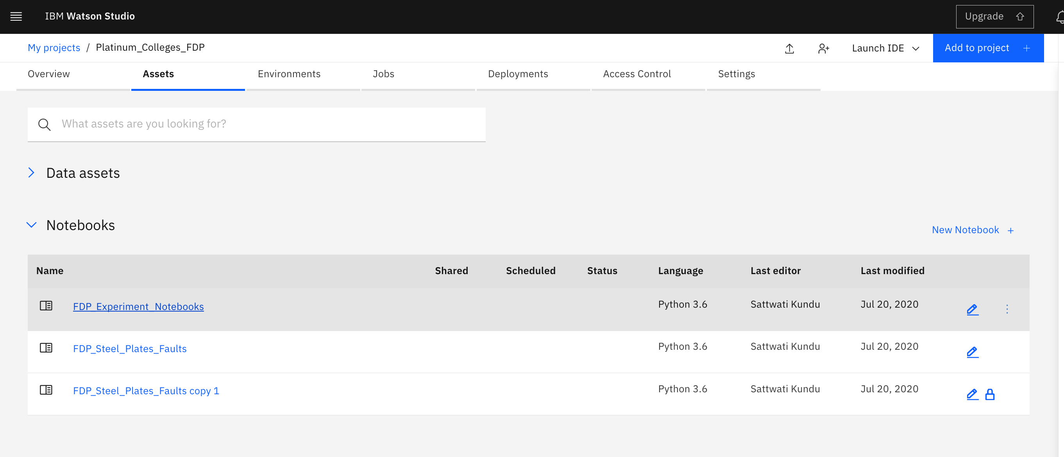
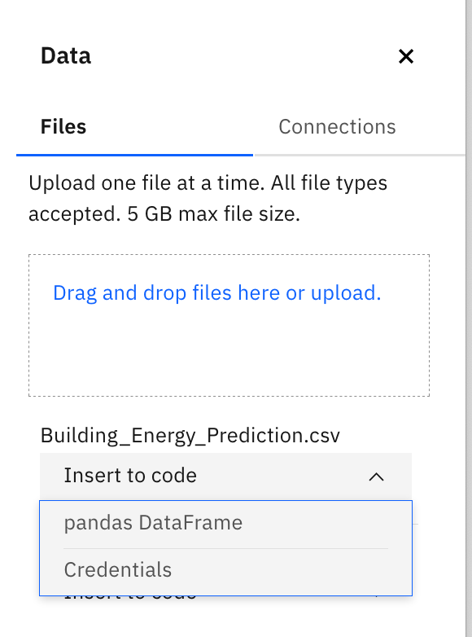
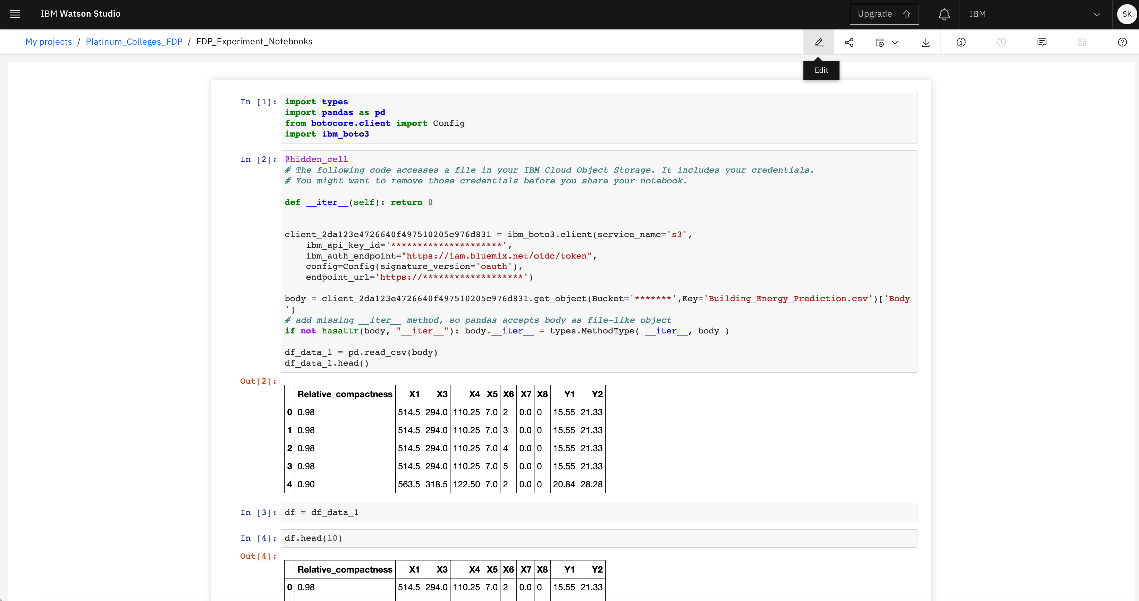
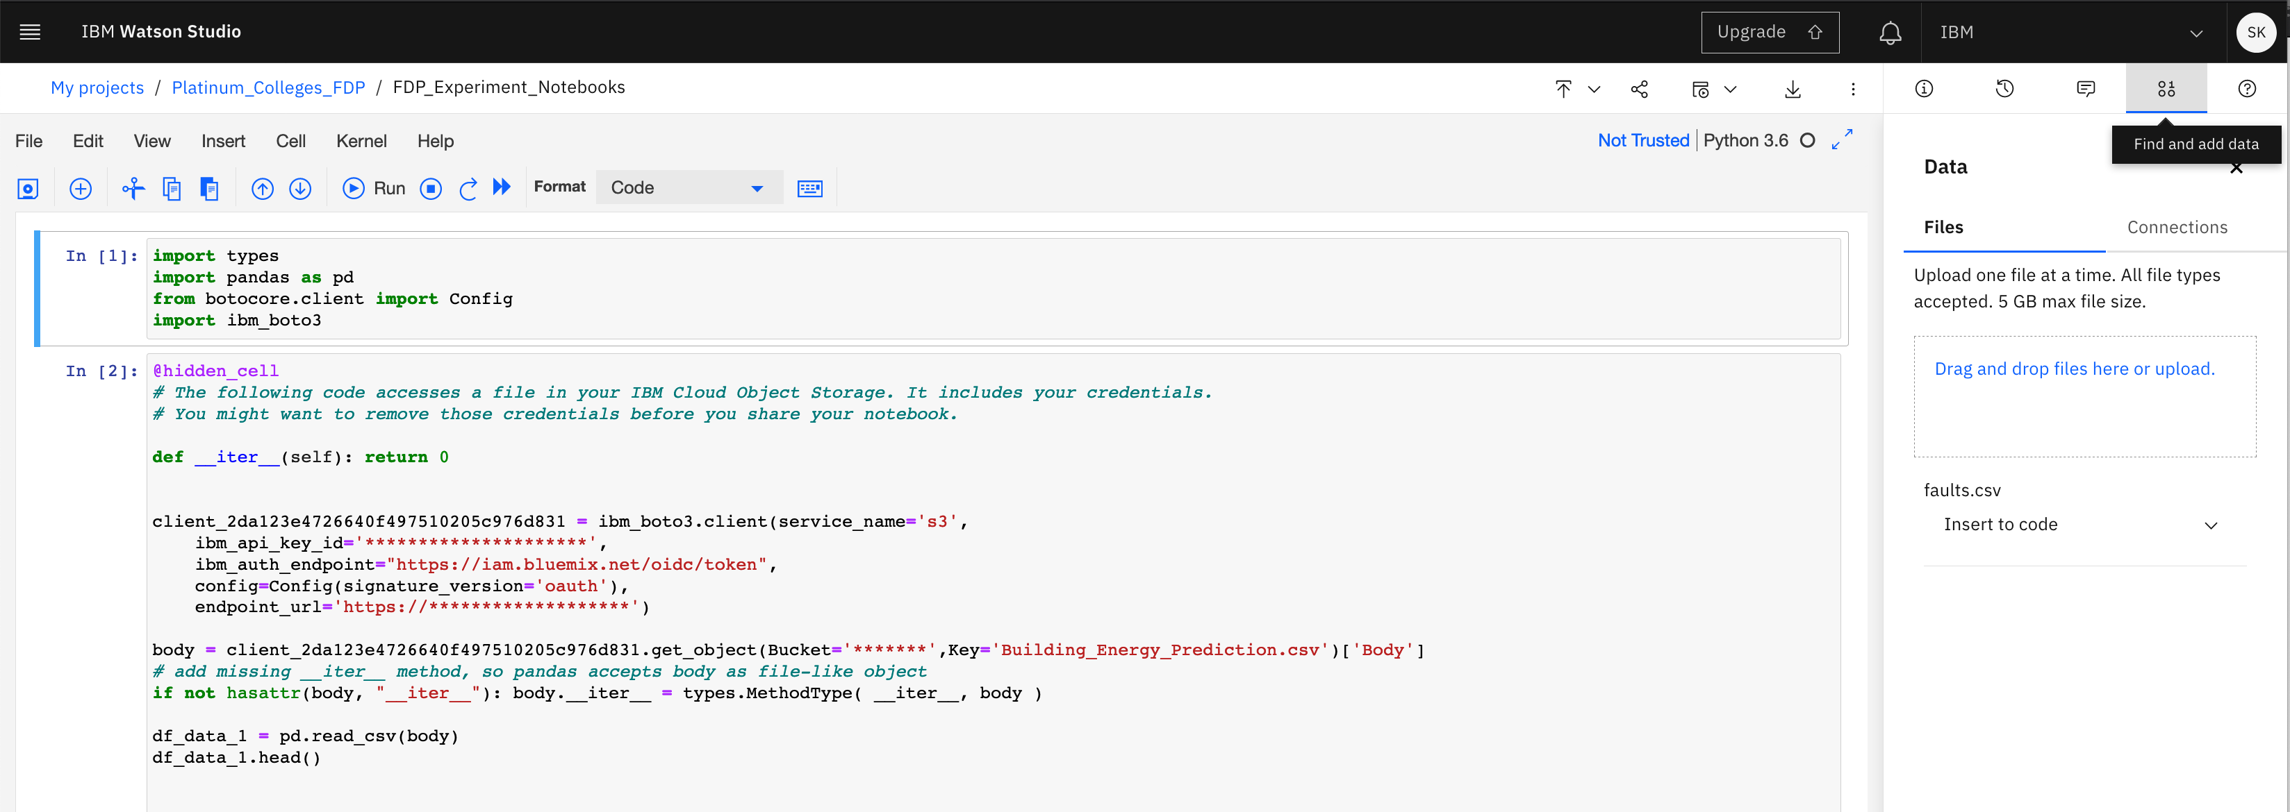
Steps to edit a notebook and import data
step1
step4
Click on the created notebook
Click on “Insert to code”
Pandas DataFrame
Click on the “Fill and add data” icon to add data
Click on the “Edit” icon to edit the notebook
step2
step3
Drag and drop the csv from local

Slide 7
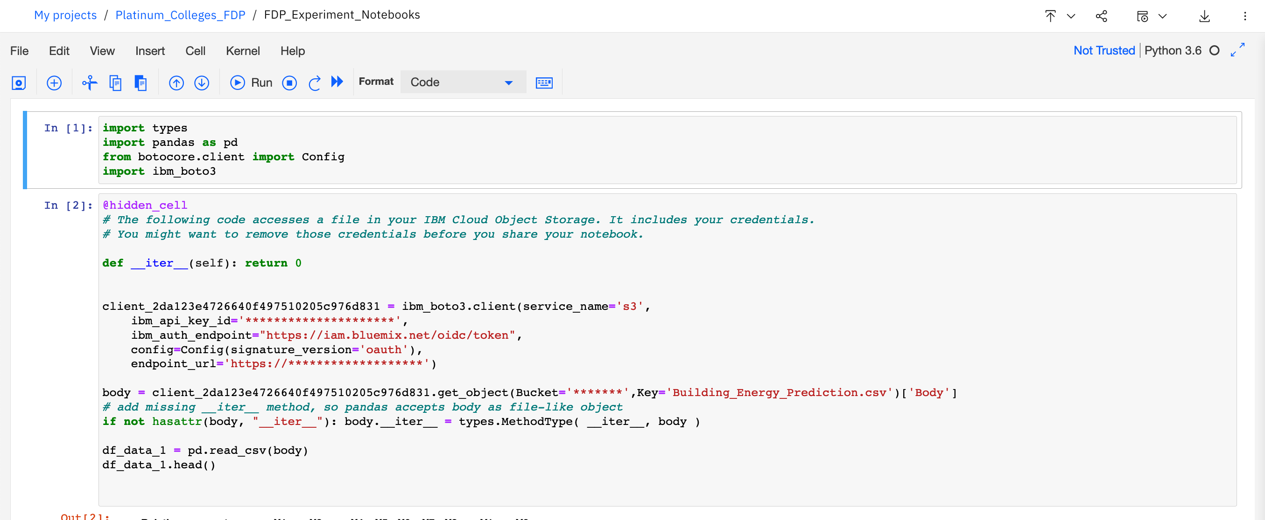
Once you generated the pandas Dataframe from previous step, you should have created the code as you see in these 2 cells with your own IBM Cloud Object Storage credemtials and hence you don’t need the existing 2 (these were placeholders), delete these.

