Slide 1
● PITCH DECK • LAUNCH-READINESS
VibeSift
The Pre-Launch Safety Net for AI-Built Websites
< 60s
Automated Quality Gate
Audit security headers, secret leaks, mobile speed & SEO in under one minute before public launch.
0–100
Launch-Readiness Score
A weighted, evidence-backed score telling founders whether their website is truly safe to ship.
1-Click
AI Code Remediations
Generates exact copy-paste code snippets for Next.js, Vite, Tailwind & Nginx to fix issues immediately.
⚡ Live SaaS Production Deployment: vibesift.pixir.in • Presented by Pixir

Slide 2
THE MODERN TREND
Slide 2 of 10
Nowadays, Anyone Can Build An App in Hours with AI
10X BUILD SPEED
1 Day
Generative Coding Tools
• Cursor, v0, Bolt, Lovable & Claude let founders ship apps in a single weekend.
• No more waiting months for an engineering agency.
• Ideas become interactive software almost instantly.
NEW DEMOGRAPHIC
Millions
A New Wave of Builders
• Solo founders, designers & marketers write code without DevOps teams.
• Fast prototyping replaces slow corporate development cycles.
• The focus is entirely on product speed and fast validation.
INSTANT PRODUCTION
1-Click
Zero-Barrier Cloud Hosting
• Platforms like Vercel & Netlify deploy apps to the world in seconds.
• Live URLs are shared on Twitter, LinkedIn & Product Hunt immediately.
• The friction between idea and production has completely vanished.
The Reality: Building software is faster than ever—but who is checking if the code is actually safe to launch?

Slide 3
THE BIG PROBLEM
Slide 3 of 10
AI Code Looks Good on Outside, But Ships Broken Inside
ACCIDENTAL LEAKS
60%+
Secret & Asset Exposure
• AI tools frequently leak .env variables & API keys into client bundles.
• Unbundled source maps (.map) expose your complete backend logic.
• Unauthenticated debug routes are left exposed online.
SECURITY RISKS
78%
Missing Security Headers
• No Content-Security-Policy (CSP) exposes users to XSS attacks.
• Missing HSTS allows traffic downgrades on public WiFi.
• Session cookies lack Secure and SameSite protection flags.
USER BOUNCE
< 52
Poor Mobile Speed & SEO
• Bloated packages cause agonizingly slow mobile load times.
• Unoptimized fonts cause massive layout shifts (CLS).
• Missing meta descriptions destroy launch day Google ranking.
The Consequence: Founders launch on Product Hunt or social media, only to get hacked or lose customers on day one.

Slide 4
THE SOLUTION
Slide 4 of 10
Meet VibeSift: The Automated Launch-Readiness Auditor
1. INSTANT AUDIT
Comprehensive 60s Scan
Paste your URL. VibeSift immediately checks HTTP security headers, TLS ciphers, Core Web Vitals, leaking secrets & SEO.
✔ Zero authorization barrier for public scans
✔ Non-destructive, safe automated inspection
✔ Instant verdict before announcing to the world
2. QUANTIFIED CONFIDENCE
Launch Score (0–100)
A single weighted score telling you immediately whether your website is safe and ready for public launch.
✔ Deducts points based on real severity risks
✔ Clear visual breakdown across Security, Speed & SEO
✔ Live score increases as you resolve issues
3. NO GUESSWORK
AI Code Remediations
We don't just dump raw error logs. VibeSift uses AI to give you exact before-and-after copy-paste code snippets.
✔ Tailored for Next.js, Vite, Tailwind & Nginx
✔ Fixes issues in minutes, not days
✔ Built for AI developers and solo builders
Think Grammarly for Website Launches: We catch critical security, speed & SEO mistakes before your users do.

Slide 5
SIMPLE WORKFLOW
Slide 5 of 10
How It Works: 3 Simple Steps for Any Builder
STEP 1
Paste Your URL
Zero installation needed
✔ Enter any staging, preview, or production link.
✔ Choose an instant Public Scan or verify ownership for deep containerized checks.
✔ Automated SSRF validation protects against malformed links.
STEP 2
Watch Live Audit
Real-time automated telemetry
✔ Multi-engine workers evaluate TLS, security headers, mobile CWV & secrets in parallel.
✔ Deduplicates overlapping findings across engines.
✔ Generates your Launch Score (0–100) in under 60 seconds.
STEP 3
Apply AI Code Fixes
Ship with complete confidence
✔ Review clear before-and-after code diffs generated by Amazon Bedrock Claude 3 Haiku.
✔ Copy and paste fixes directly into your codebase.
✔ Re-scan in 1 click and watch your score hit 100%.
⚡ Zero Friction: No complex configs or agent installs. Get your pre-launch verdict in seconds.

Slide 6
DEVELOPER EXPERIENCE
Slide 6 of 10
Evidence-Backed Reports & AI Copy-Paste Fixes
QUANTIFIABLE READINESS
The 0–100 Launch Scorecard
✔ Risk-Weighted Grading: Severe risks (exposed .env, open source maps) deduct high points; minor issues deduct less.
✔ Categorized Breakdown: Clear ratings across Security, Performance, SEO, and Accessibility.
✔ Verifiable Evidence: Inspect exact HTTP headers, DOM nodes, and leaking assets.
✔ Live Score Update: Watch your readiness score increase in real time as you resolve items.
AMAZON BEDROCK ENGINE
One-Click Code Remediations
✔ Framework Context: Generates exact fixes for Next.js, Vite, Tailwind CSS, or Nginx.
✔ Before/After Diffs: Clean copy-paste code snippets so you don't have to read security documentation.
✔ Sub-2s Streaming: High-speed streaming fixes via Amazon Bedrock Claude 3 Haiku.
✔ 100% Reliability: Built-in deterministic rule engine ensures fixes work even if offline.

Slide 7
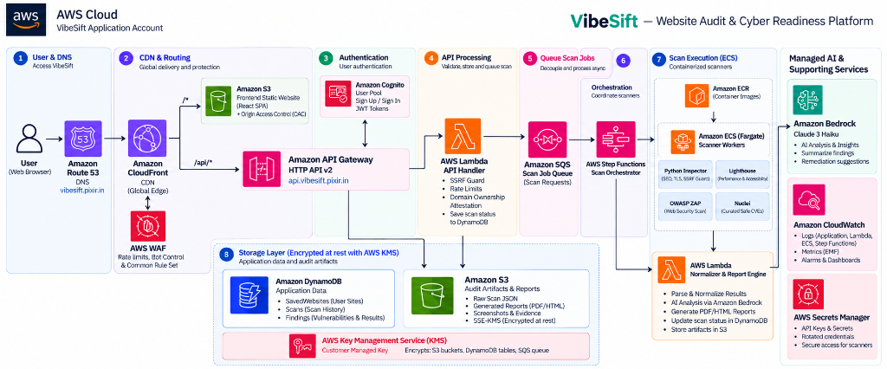
UNDER THE HOOD
Slide 7 of 10
Enterprise AWS Cloud Architecture (Serverless + Isolated Containers)

Slide 8
MARKET ADVANTAGE
Slide 8 of 10
Why Traditional Security & Audit Tools Fall Short
LEGACY ENTERPRISE
Enterprise Scanners
Qualys, Nessus, Rapid7
❌ Extremely expensive ($5k–$20k+/yr), locking out startups and solo builders.
❌ Complex multi-hour scans that produce 100-page noisy PDF reports.
❌ Zero code fixes: tells you what broke, but not how to fix it in code.
FREE DEV TOOLS
Basic Lighthouse
Chrome DevTools, PageSpeed
⚠️ Great for basic performance, but completely blind to security vulnerabilities.
⚠️ Completely misses secret leaks (.env, source maps) and missing HTTP headers.
⚠️ Zero active DAST or vulnerability fuzzing capabilities.
THE WINNER
VibeSift
Built for the AI Era
🏆 < 60s instantaneous audits covering Security, CWV, SEO & Secret Leaks.
🏆 Quantified 0–100 Launch Score built for developer clarity.
🏆 Amazon Bedrock AI generates exact copy-paste code diffs for your framework.
Our Value Prop: Fast, affordable, and actionable. We bridge speed with production-grade quality.

Slide 9
STRATEGIC VISION
Slide 9 of 10
From Pre-Launch Auditor to Everyday Quality Gate
PHASE 1 • Q1 2027
GitHub Action CI/CD Gate
Automate audits on every pull request. Automatically block merging if security score drops below threshold.
✔ Pre-merge pull request comment bot
✔ Fails build if new secrets are leaked
✔ Integrates directly into existing GitHub workflows
PHASE 2 • Q2 2027
Team Workspaces & RBAC
Shared audit dashboards for development agencies, venture studios, and engineering organizations.
✔ Multi-site portfolio monitoring
✔ Organization-wide compliance standards
✔ Role-based access & automated client reports
PHASE 3 • Q3 2027
Cursor & Vercel Plugins
1-click pre-launch audits directly integrated inside AI code editors and hosting deployment platforms.
✔ Instant audit inside Cursor & Claude Code
✔ 1-click Vercel & Netlify deploy verification
✔ Continuous weekly secret drift detection
Our Goal: To become the universal quality and security gate every AI application passes before launching.

Slide 10
● WRAP-UP • LIVE DEMO • Q&A
Thank You!
Let's Explore the Live Demo & Open for Questions
LIVE APPLICATION
Try VibeSift Live
✔ Production SaaS: vibesift.pixir.in
✔ 1-click developer demo login
✔ Run a live URL audit in < 60 seconds
✔ Inspect evidence & generated code diffs
CODEBASE & SPECS
Production Engineering
✔ Full AWS CDK infrastructure definitions
✔ React 19 + Vite 6 + Tailwind CSS design
✔ 25 passing Vitest unit & integration tests
✔ Zero-trust containerized worker isolation
DISCUSSION
Q&A & Next Steps
✔ Architecture, safety & elasticity deep dive
✔ Integration with developer workflows
✔ Partnership & early adopter pilot programs
✔ Open floor for feedback & questions
⚡ VibeSift by Pixir • "Ship fast. Ship safe. Never launch blind." • vibesift.pixir.in

