Slide 1
Predicting Student Success and Foiling Dropout
-Lakshmi Chirumamilla

Slide 2
Abstract
The increasing concern regarding student dropout rates in educational institutions prompts the exploration of predictive analytics to identify students at risk and facilitate timely interventions. This project presents a novel predictive framework using machine learning (ML) techniques to distinguish students likely to succeed academically from those at risk of dropping out. Leveraging a comprehensive dataset obtained from the Polytechnic Institute of Portalegre (IPP), Portugal, encompassing student demographics, academic performance, behavioral patterns, and socioeconomic factors. The results show that the Random forest performs better than XGBoost, Logistic regression , SVM, Decision Tree, Naive Bayes. Used SHAP analysis for finding best parameters and Fine-tune the models accordingly.

Slide 3
Research Question
What strategies and techniques can be effectively employed to achieve precise predictions regarding students at risk of dropout and those on track for academic success?

Slide 4
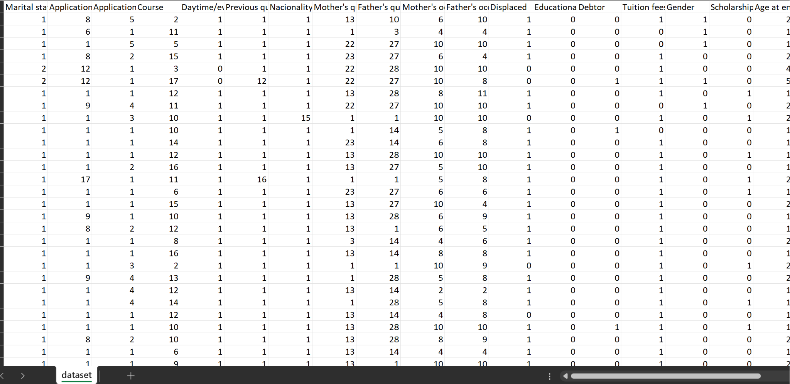
Dataset
https://archive.ics.uci.edu/dataset/697/predict+students+dropout+and+academic+success
A dataset created from a higher education institution related to students enrolled in different undergraduate degrees, such as agronomy, design, education, nursing, journalism, management, social service, and technologies. The dataset includes information known at the time of student enrollment (academic path, demographics, and social-economic factors) and the students' academic performance at the end of the first and second semesters.
Size- #instances 4424, #Features 36
Parameters - Marital status; Application mode; Application order; Course; Previous qualification; Nationality; Mother's qualification; Father's qualification; Mother's occupation; Father's occupation; Admission grade; Debtor; Tuition fees up to date; Gender; Scholarship holder; Age at enrollment; Curricular units 1st sem (grade); Curricular units 2nd sem (grade);

Slide 5
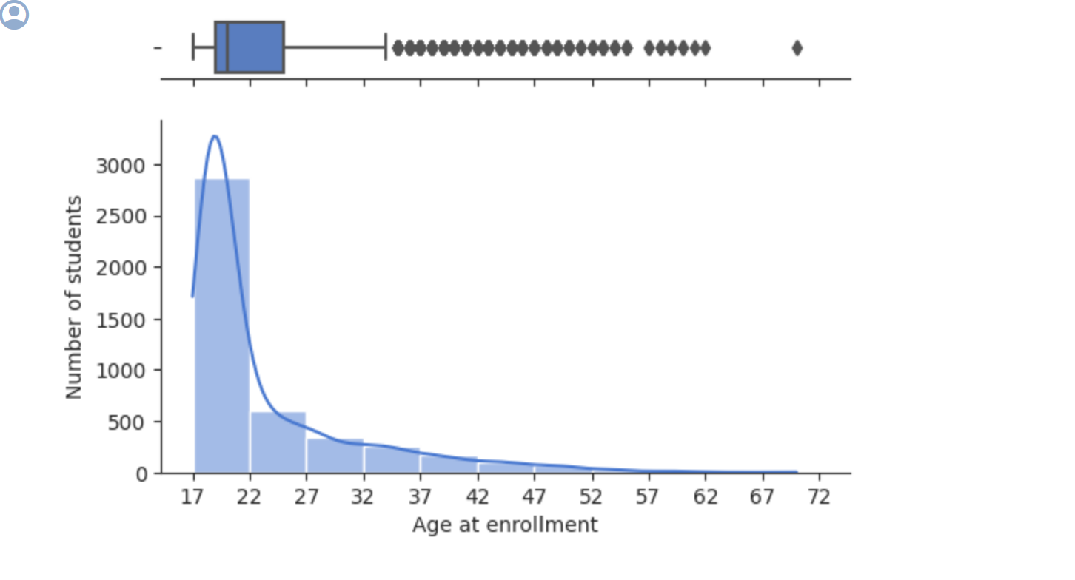
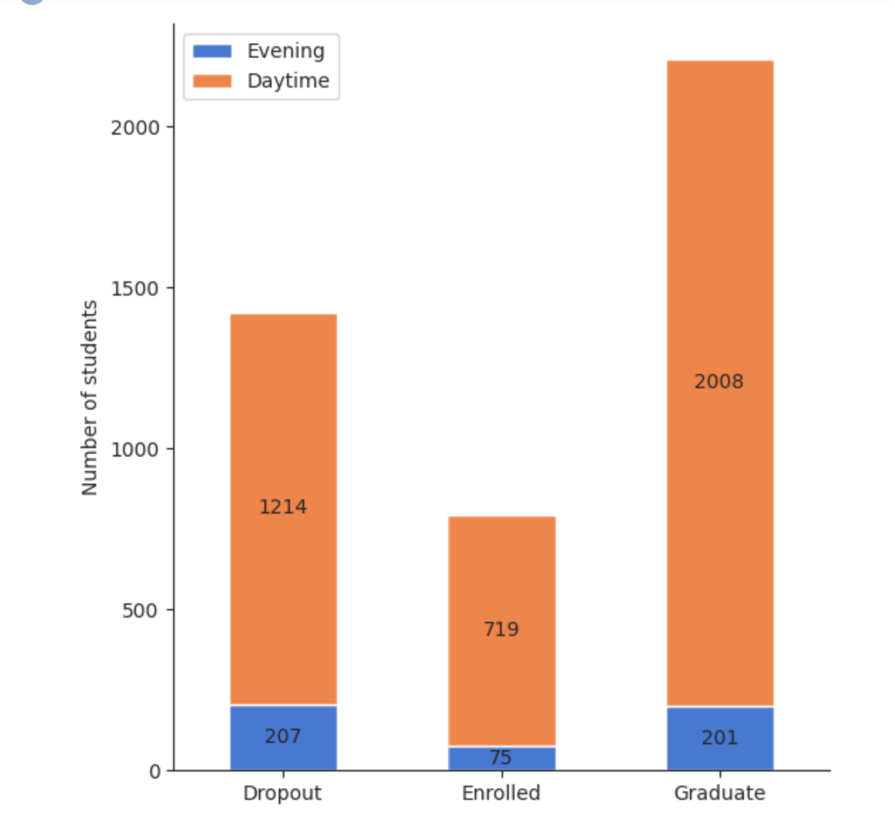
EDA
The vast majority of students are 17-22 years old.
The number of students decreases as the students age increases.
The graduation rate of daytime students is higher than the graduation rate of evening students, it is 62% against 49%. The difference is not significant.

Slide 6
Methodology
Data Balancing:
Address class imbalances using techniques like SMOTE, SMOTEENN, or ADASYN to create a more balanced dataset.
Experiment with different balancing methods to evaluate their impact on model performance.
Model Selection and Training:
Implement a variety of machine learning algorithms, including Random Forest, Gradient Boosting, Logistic Regression, and Neural Networks.
Split the dataset into training, validation, and test sets for model training and evaluation.
Apply hyperparameter tuning techniques like grid search or Bayesian optimization to optimize model performance.
Evaluation Metrics and Interpretability:
Utilize a range of evaluation metrics such as accuracy, precision, recall, F1-score, and area under the ROC curve (AUC-ROC) to assess model performance.
Conduct SHAP (SHapley Additive exPlanations) analysis to interpret the model predictions and understand the impact of individual features on outcomes.
Use confusion matrices to understand prediction errors and identify areas of improvement.

Slide 7
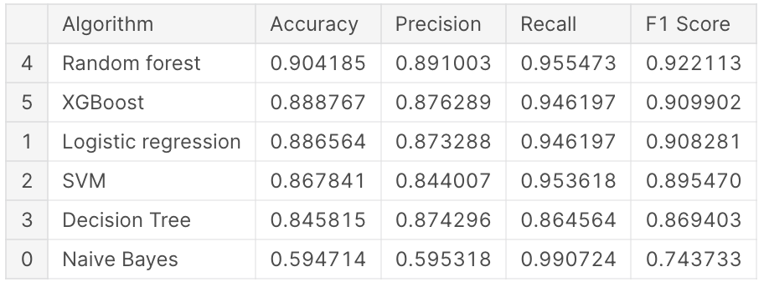
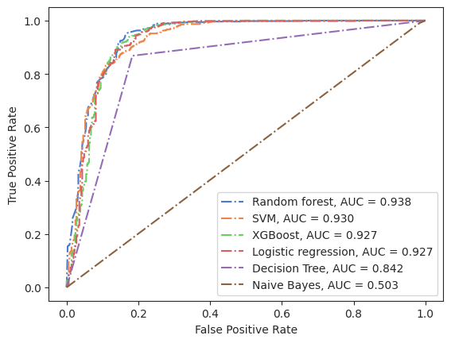

Slide 8
Next Steps
Model Fine-Tuning:
Fine-tune the selected models based on SHAP analysis and other evaluation results.
Experiment with ensemble techniques to combine the strengths of multiple models for more robust predictions.
Visualization and Real-time Integration:
Develop visualizations based on SHAP values to present the interpretability of the model predictions to stakeholders.
Explore the integration of the predictive model into existing academic support systems for real-time intervention strategies.
Develop a user-friendly interface for stakeholders to interpret model predictions and take proactive measures.

Slide 9
Results
The performance of six machine learning algorithms—Logistic Regression, SVM, Decision Tree, Naive Bayes, Random Forest, and XGBoost-was assessed for a classification task. Initial evaluation without hyperparameter tuning revealed varied performance metrics. Notably, Random Forest outperformed others with an accuracy of 90.42%, precision of 89.10%, recall of 95.55%, and F1 score of 92.21%. Subsequently, hyperparameter tuning using GridSearchCV for the Random Forest model. This refinement resulted in a marginal improvement, maintaining the accuracy at 90.42% while enhancing precision, recall, and F1 scores to 89.10%, 95.55%, and 92.21%, respectively. These findings highlight the initial strength of Random Forest and the limited impact of hyperparameter tuning on its performance in this specific classification task. Using SHAPley, the Circular units of 1st and 2nd semester have the most impact on the ML model.

Slide 10
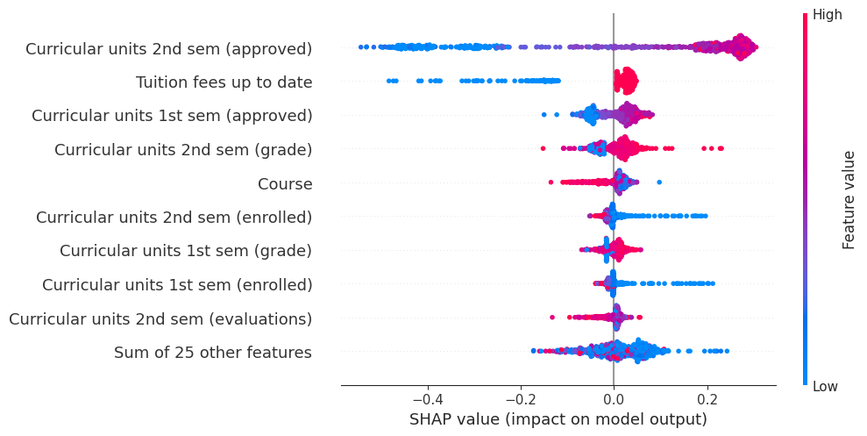

Slide 11
Conclusion
The study investigated the use of machine learning (ML) tools to predict the academic performance of first-year computer science (CS) students and identify key factors affecting their success. It found that Random Forest classifiers were effective in this prediction task. While previous work centered on GPA-based performance prediction, focusing on academic probation status allows for aiding struggling students beyond just those with low grades.
Future steps proposed involve leveraging Natural Language Processing (NLP) to analyze text materials from college applications.

Slide 12
References
M.V.Martins, D. Tolledo, J. Machado, L. M.T. Baptista, V.Realinho. (2021) Trends and Applications in Information Systems and Technologies, vol.1, in Advances in Intelligent Systems and Computing series. Springer. DOI: 10.1007/978-3-030-72657-7_16
B. M. Neda, M. Wang, A. Singh, S. Gago-Masague and J. Wong-Ma, "Staying Ahead of the Curve: Early Prediction of Academic Probation among First-Year CS Students," 2023 3rd International Conference on Applied Artificial Intelligence (ICAPAI), Halden, Norway, 2023, pp. 1-7, doi: 10.1109/ICAPAI58366.2023.10194020.
Llauró A, Fonseca D, Romero S, Aláez M, Lucas JT, Felipe MM. Identification and comparison of the main variables affecting early university dropout rates according to knowledge area and institution. Heliyon. 2023 Jun 17;9(6):e17435. doi: 10.1016/j.heliyon.2023.e17435.
E. Alhazmi and A. Sheneamer, "Early Predicting of Students Performance in Higher Education," in IEEE Access, vol. 11, pp. 27579-27589, 2023, doi: 10.1109/ACCESS.2023.3250702
Martins, M.V.; Baptista, L.; Machado, J.; Realinho, V. Multi-Class Phased Prediction of Academic Performance and Dropout in Higher Education. Appl. Sci. 2023, 13, 4702. doi: 10.3390/app13084702
Mduma, N. “Data Balancing Techniques for Predicting Student Dropout Using Machine Learning.” 2023, 8, 49. doi:10.3390/data8030049
Tang, Z., Chen, L., & Jain, A. (2023). Exploring Individual Feature Importance in Student Persistence Prediction. Journal of Higher Education Theory and Practice, 23(6). doi:10.33423/jhetp.v23i6.5957
Realinho, V.; Machado, J.; Baptista, L.; Martins, M.V. Predicting Student Dropout and Academic Success. Data 2022, 7, 146. doi: 10.3390/data7110146

