Slide 1



Data Spark Illuminating Insights for Global Electronics
View in Power BI
Last data refresh:
10/2/2024 8:27:08 PM UTC
Downloaded at:
10/2/2024 8:30:39 PM UTC

Slide 2
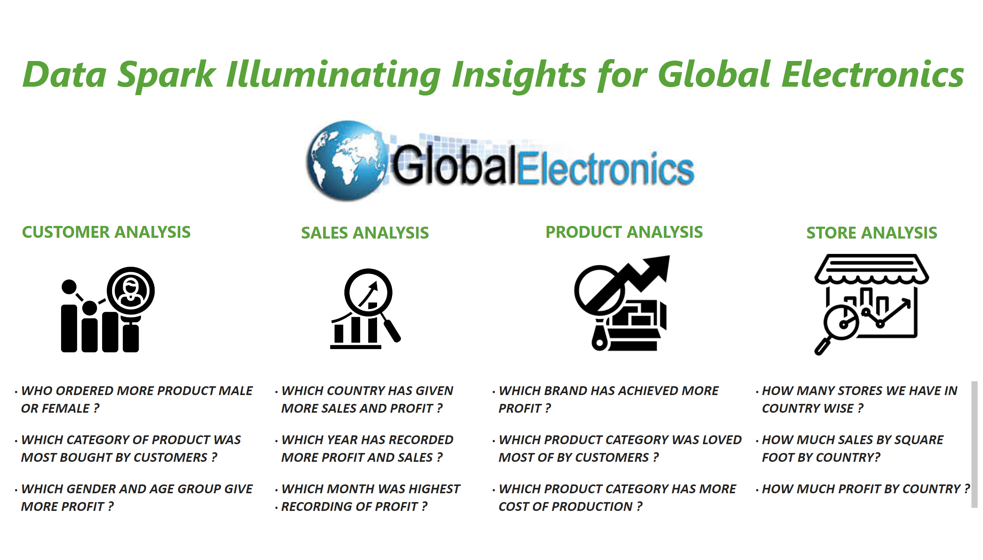
HOME
Notes:
image
No alt text provided
textbox
No alt text provided
image
No alt text provided
textbox
No alt text provided
image
No alt text provided
textbox
No alt text provided
image
No alt text provided
textbox
No alt text provided
textbox
No alt text provided
image
No alt text provided
textbox
No alt text provided
textbox
No alt text provided
textbox
No alt text provided
textbox
No alt text provided

Slide 3
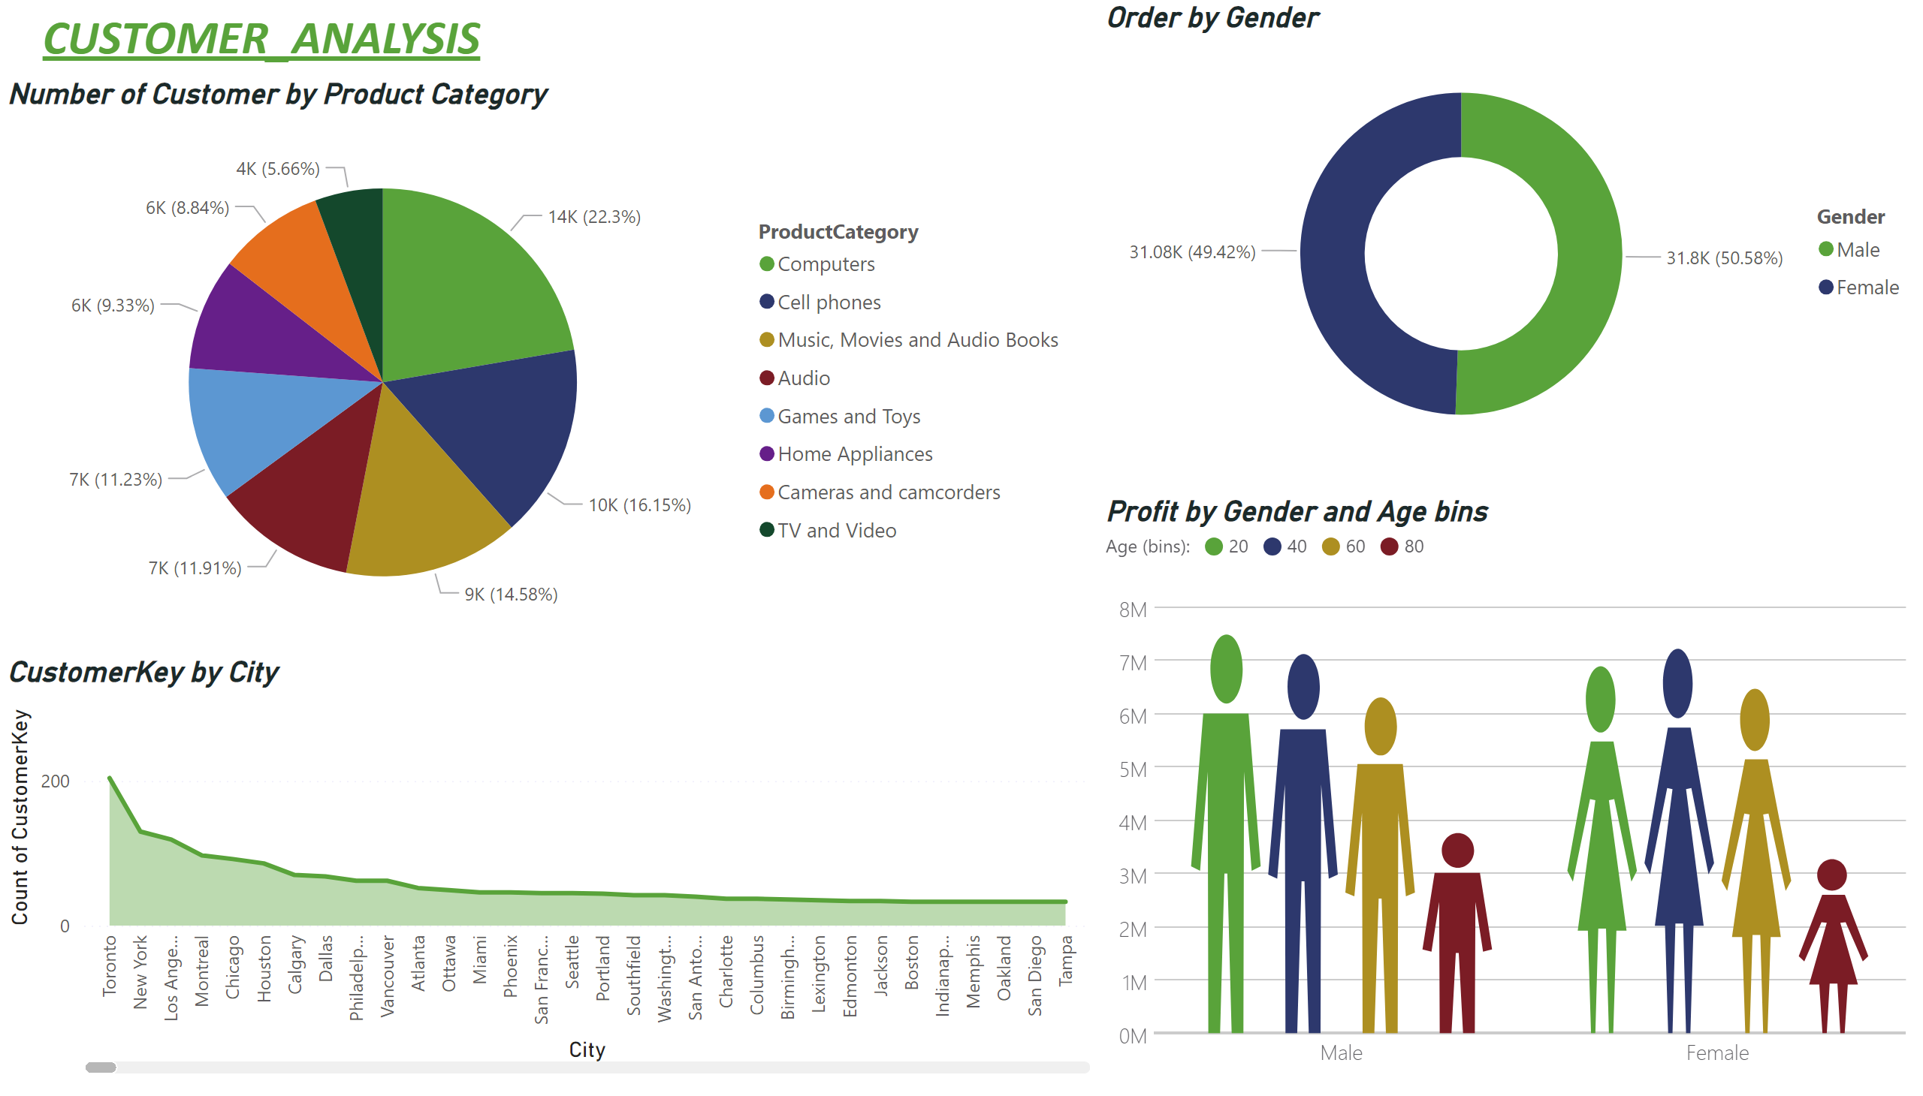
Customer_Analysis
Notes:
Number of Customer by Product Category
No alt text provided
CustomerKey by City
No alt text provided
Order by Gender
No alt text provided
Profit by Gender and Age bins
No alt text provided
textbox
No alt text provided

Slide 4
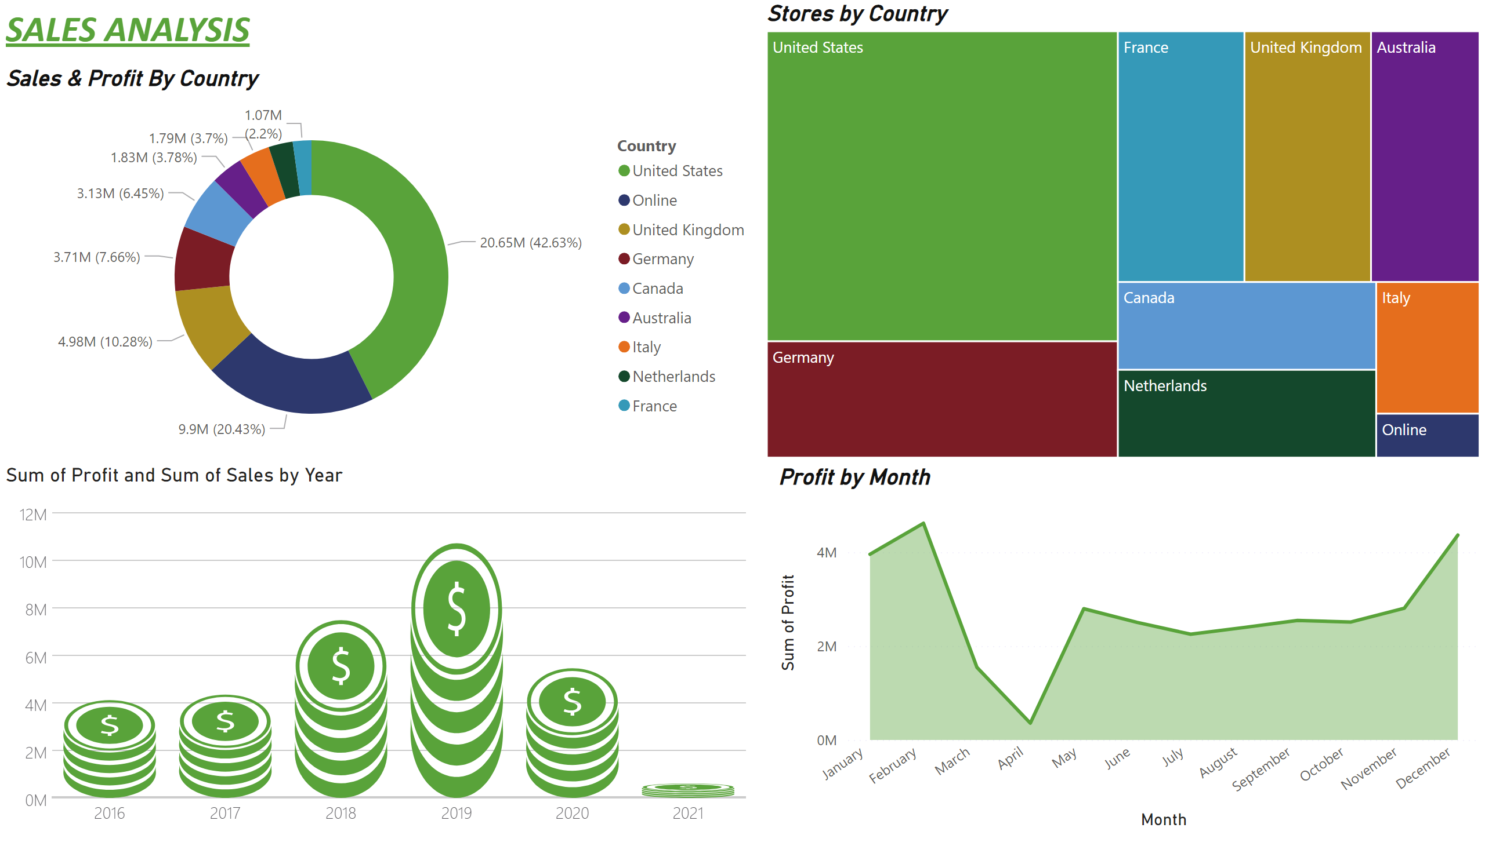
Sales Analysis
Notes:
Sales & Profit By Country
No alt text provided
Profit by Month
No alt text provided
Stores by Country
No alt text provided
textbox
No alt text provided
PBI_CV_73744D90_4DC9_4F18_8BA5_EE8FA5C98035
No alt text provided

Slide 5
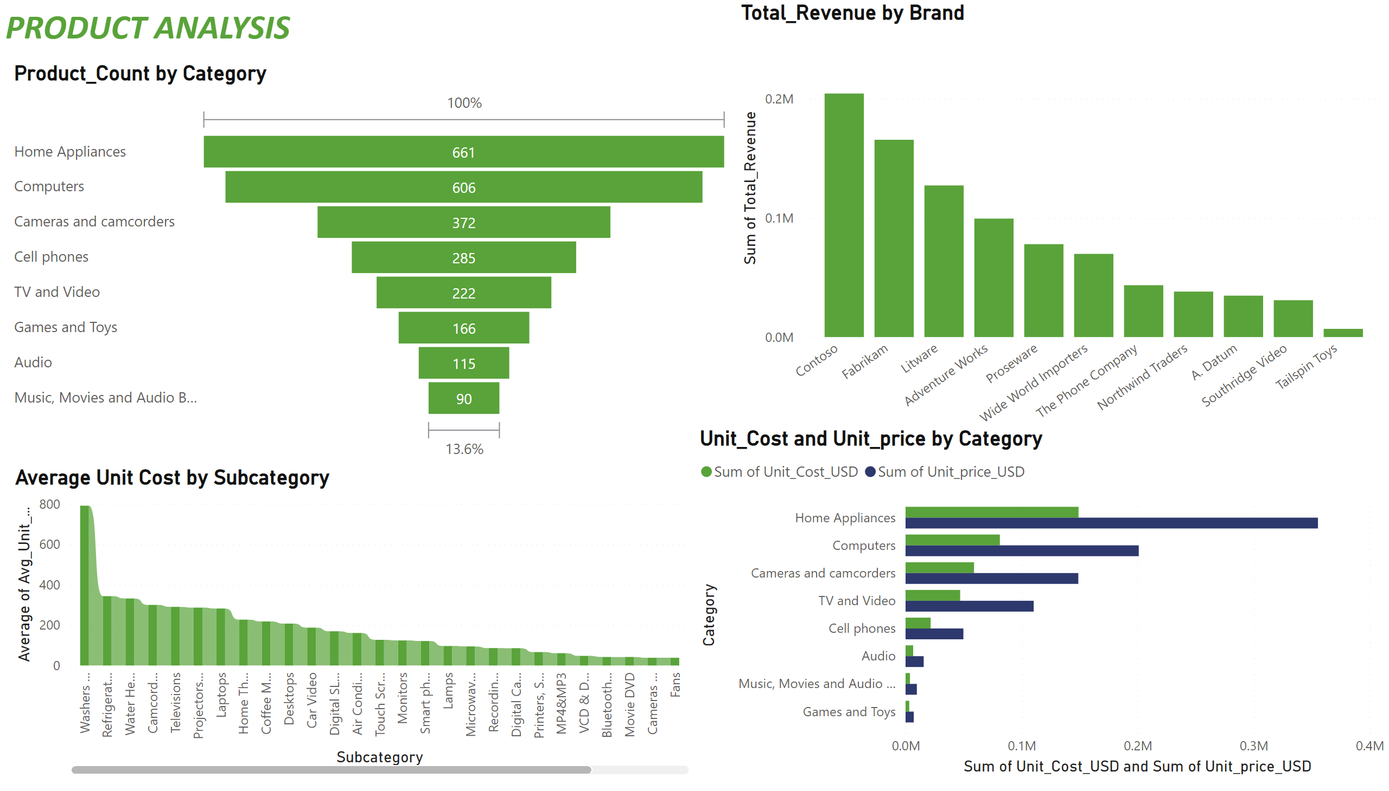
Product Analysis
Notes:
Product_Count by Category
No alt text provided
Average Unit Cost by Subcategory
No alt text provided
Total_Revenue by Brand
No alt text provided
Unit_Cost and Unit_price by Category
No alt text provided
textbox
No alt text provided

Slide 6
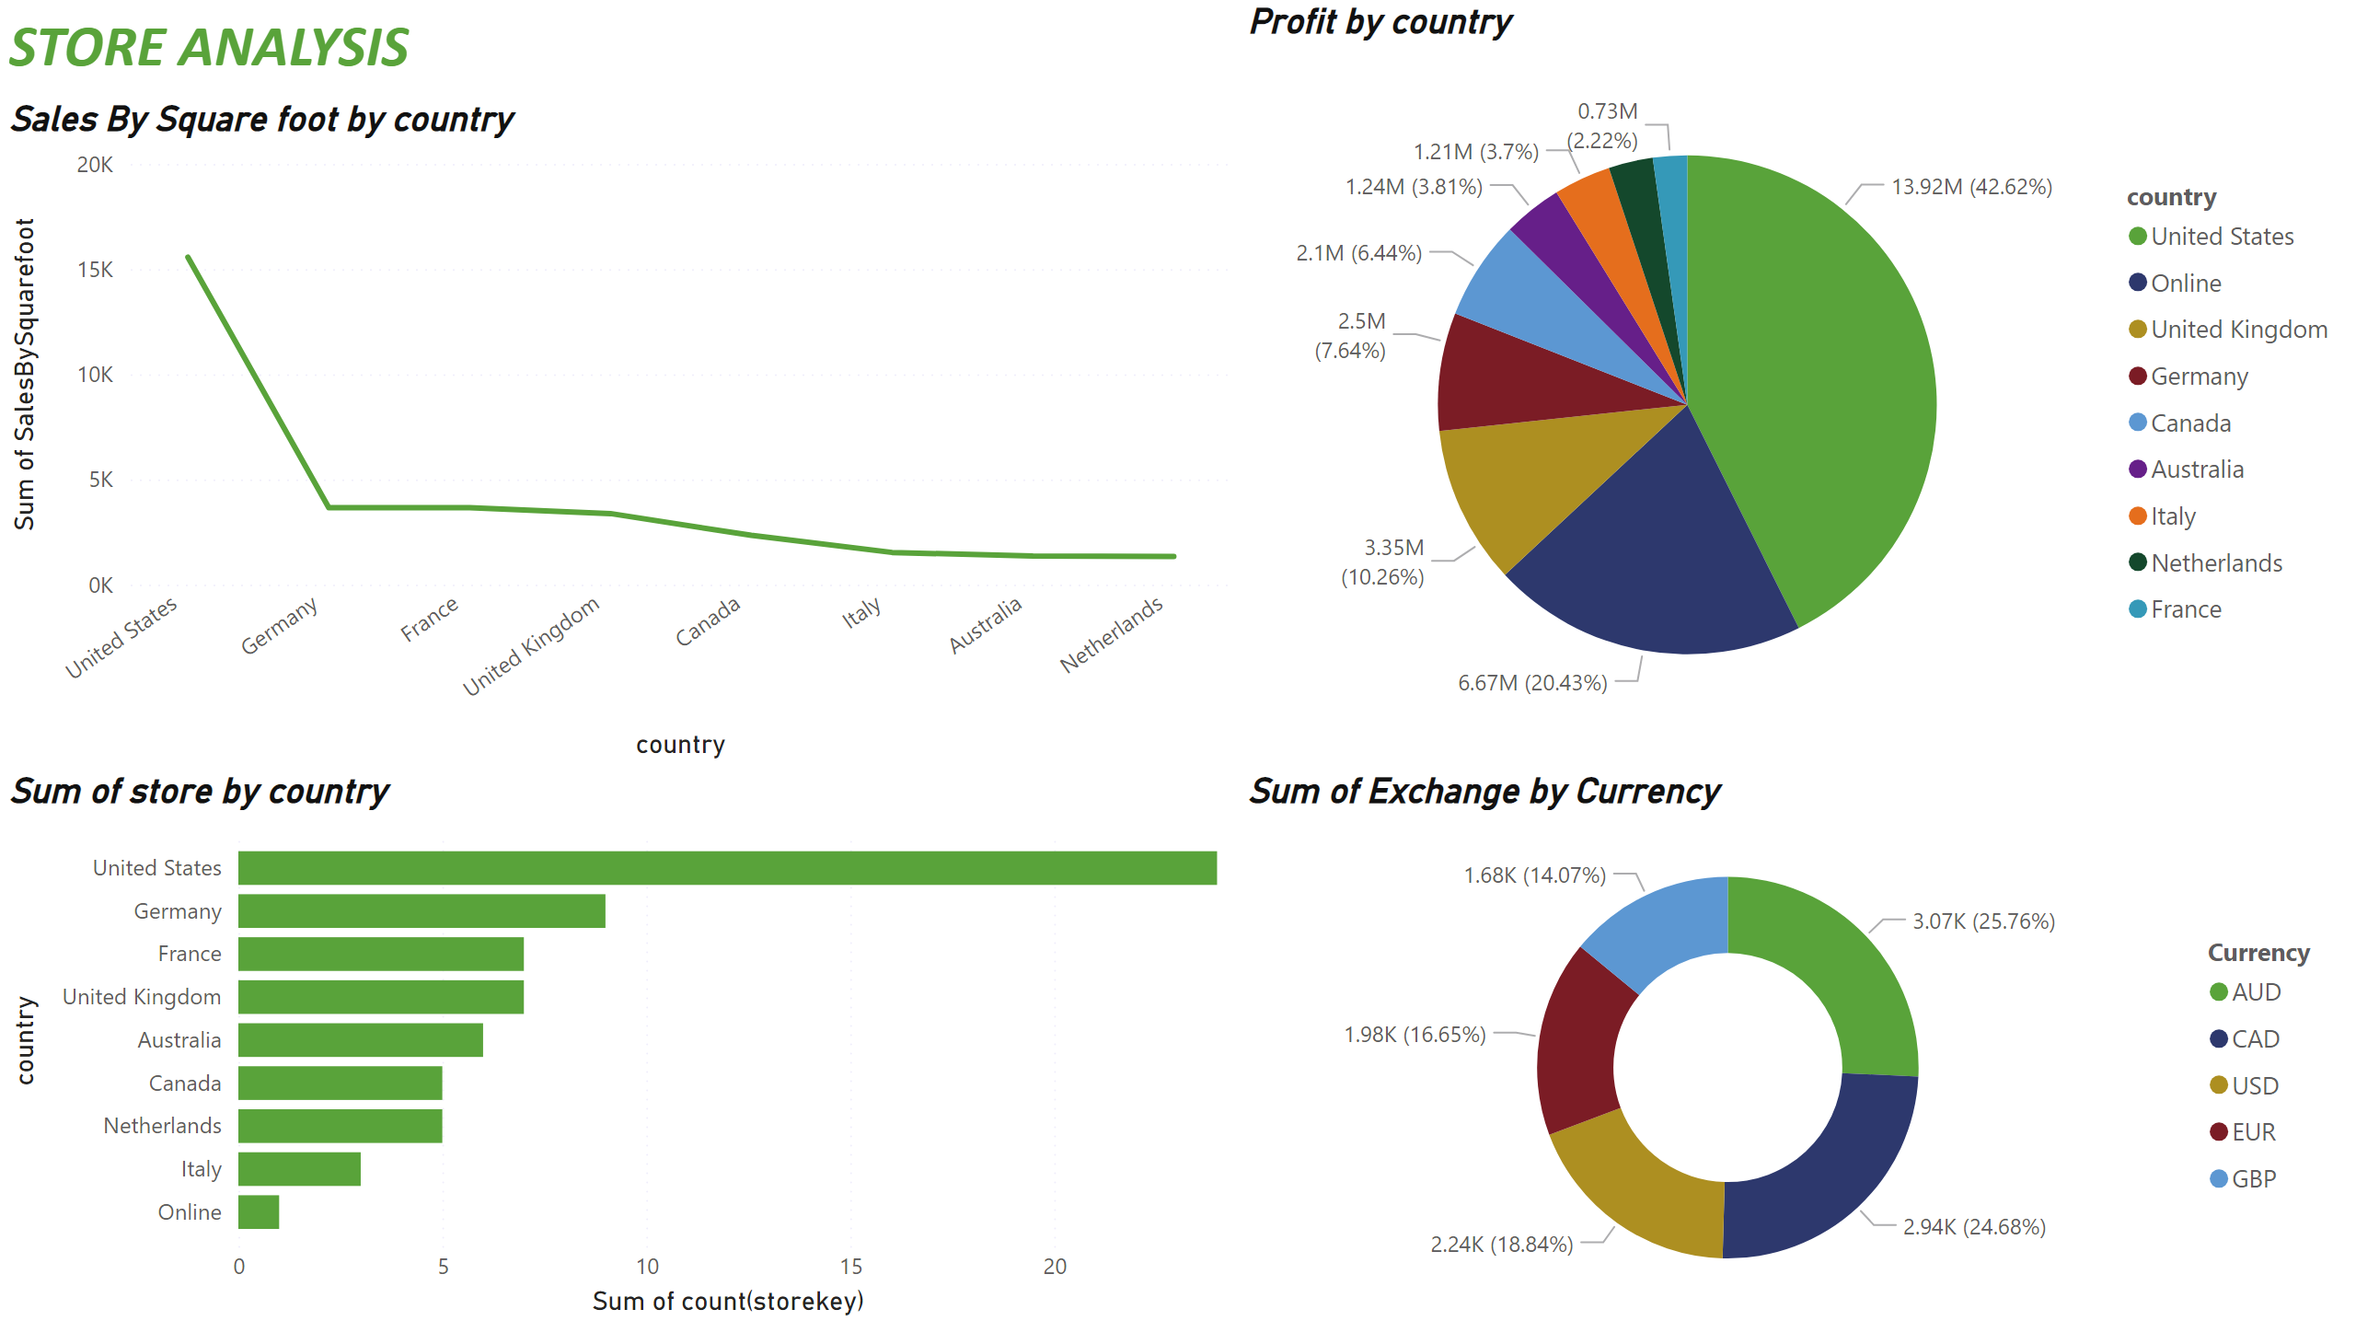
Store Analysis
Notes:
Sales By Square foot by country
No alt text provided
Sum of store by country
No alt text provided
Profit by country
No alt text provided
donutChart
No alt text provided
textbox
No alt text provided

