Slide 1
SOIL QUALITY CLASSIFICATION
Using Random Forest & Decision Tree Algorithms
Machine Learning Project
B.Tech CSE, KLH University Team: Sudha 2520030455
Keerthi 2520030416

Slide 2
Problem Statement & Objectives
Why Soil Quality Matters
Project Objectives
Soil quality directly determines crop yield, sustainability, and land-use decisions.
Manual soil testing is slow, expensive, and requires expert lab analysis.
Machine learning can predict soil quality instantly from measurable chemical & physical properties.
Explore and understand the soil quality dataset through EDA
Build Decision Tree and Random Forest classifiers to predict Soil Quality
Compare model performance and identify the most influential soil features
Recommend the best model for practical soil quality prediction
Soil Quality Classification
2

Slide 3
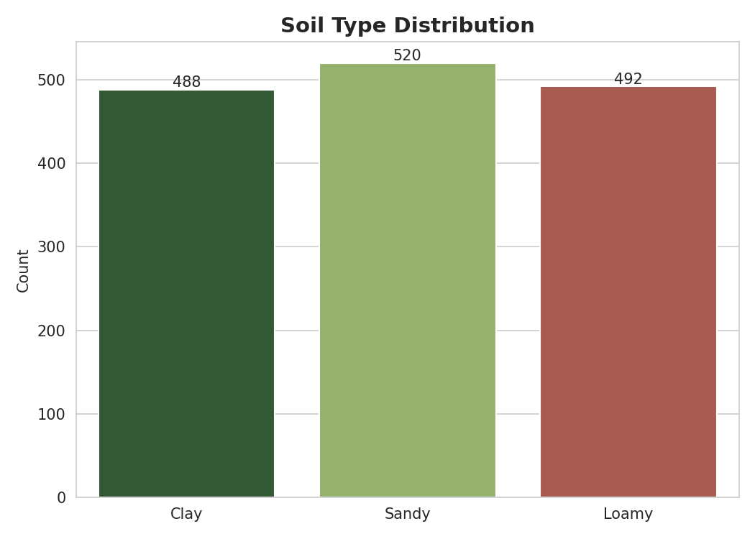
Dataset Overview
1,500
10
3
4
Total Records
Features
Soil Types
Quality Classes
Features Used
Soil_Type, pH, EC (Electrical Conductivity), Organic_Carbon, Nitrogen, Phosphorus, Potassium, Moisture, Temperature
Target Variable
Soil_Quality — Poor / Moderate / Good / Excellent
No missing values found in any of the 10 columns — the dataset required no imputation.
Soil Quality Classification
3

Slide 4
Data Quality Checks
0
0
0
Missing Values
Duplicate Rows
IQR Outliers
across all 10 columns
verified with .duplicated()
across all 8 numeric features
Why this matters
IQR outlier detection (Q1 − 1.5×IQR to Q3 + 1.5×IQR) found zero flagged points in every feature — every value lies within its expected statistical range.
A perfectly clean dataset (no missing values, no duplicates, no outliers) meant no imputation, deduplication, or outlier-capping was needed before modeling.
Soil Quality Classification
4

Slide 5
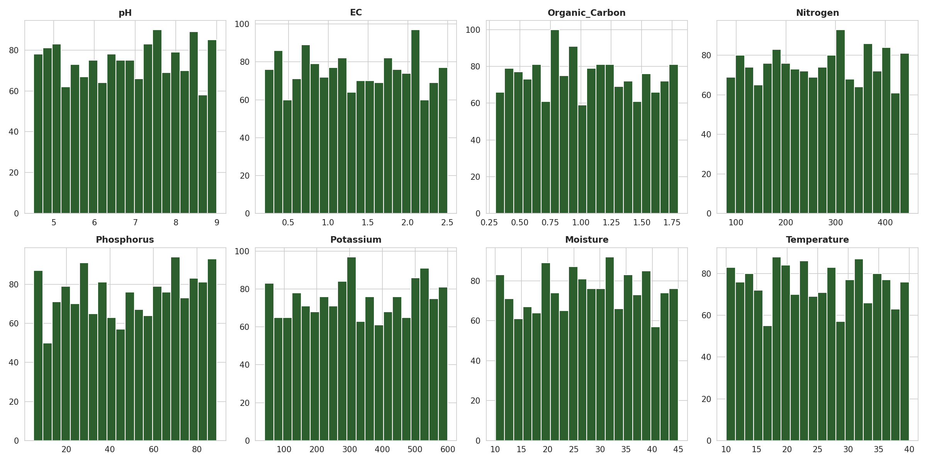
Exploratory Data Analysis — Feature Distributions
Soil Quality Classification
5

Slide 6
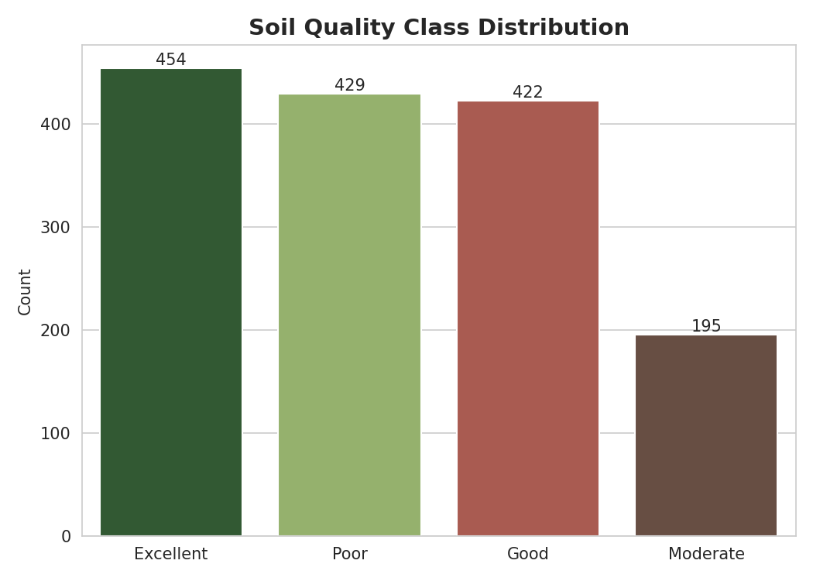
Exploratory Data Analysis — Target Distribution
Key Observations
Excellent (454) and Poor (429) are the largest classes.
Good follows closely with 422 records.
Moderate is under-represented at 195 records — a mild class imbalance to be aware of during evaluation.
Soil Quality Classification
6

Slide 7
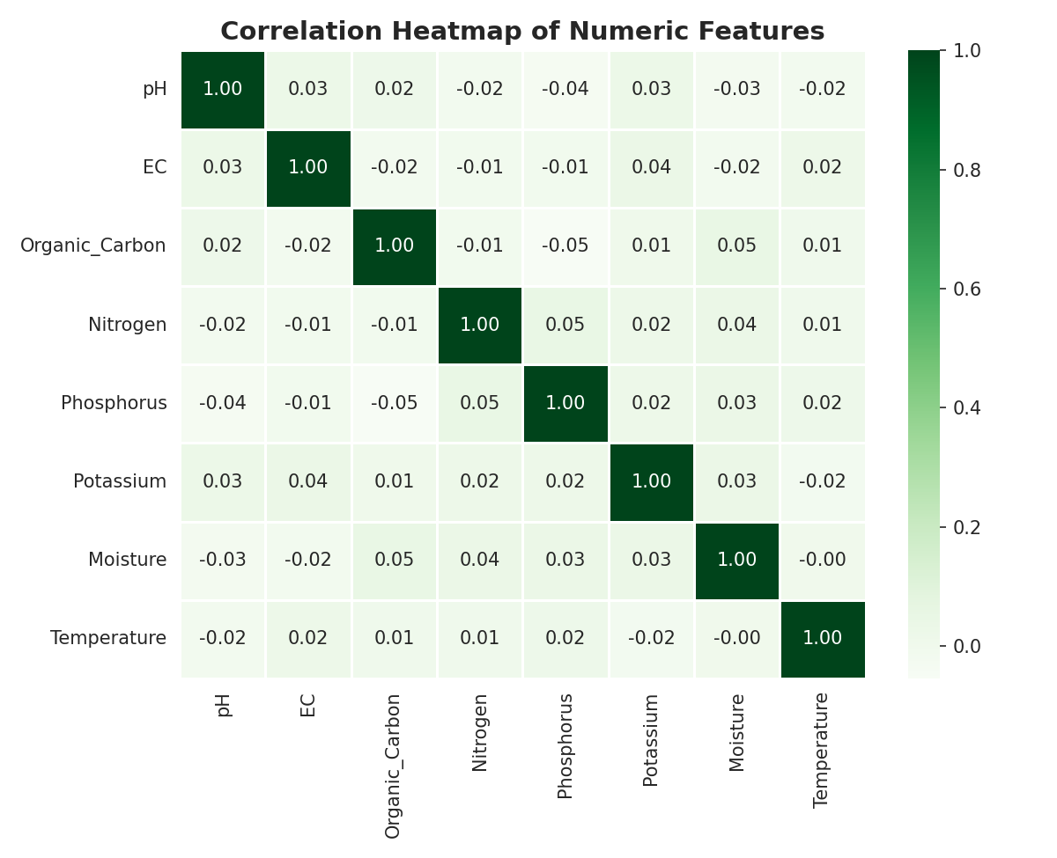
Exploratory Data Analysis — Feature Correlation
Key Observations
Most numeric features are weakly correlated with each other — little redundancy.
The strongest pairwise correlation (Organic_Carbon–Nitrogen) is still only 0.05 — essentially no multicollinearity.
This means tree-based models can use each feature independently, without redundant information skewing the split decisions.
Soil Quality Classification
7

Slide 8
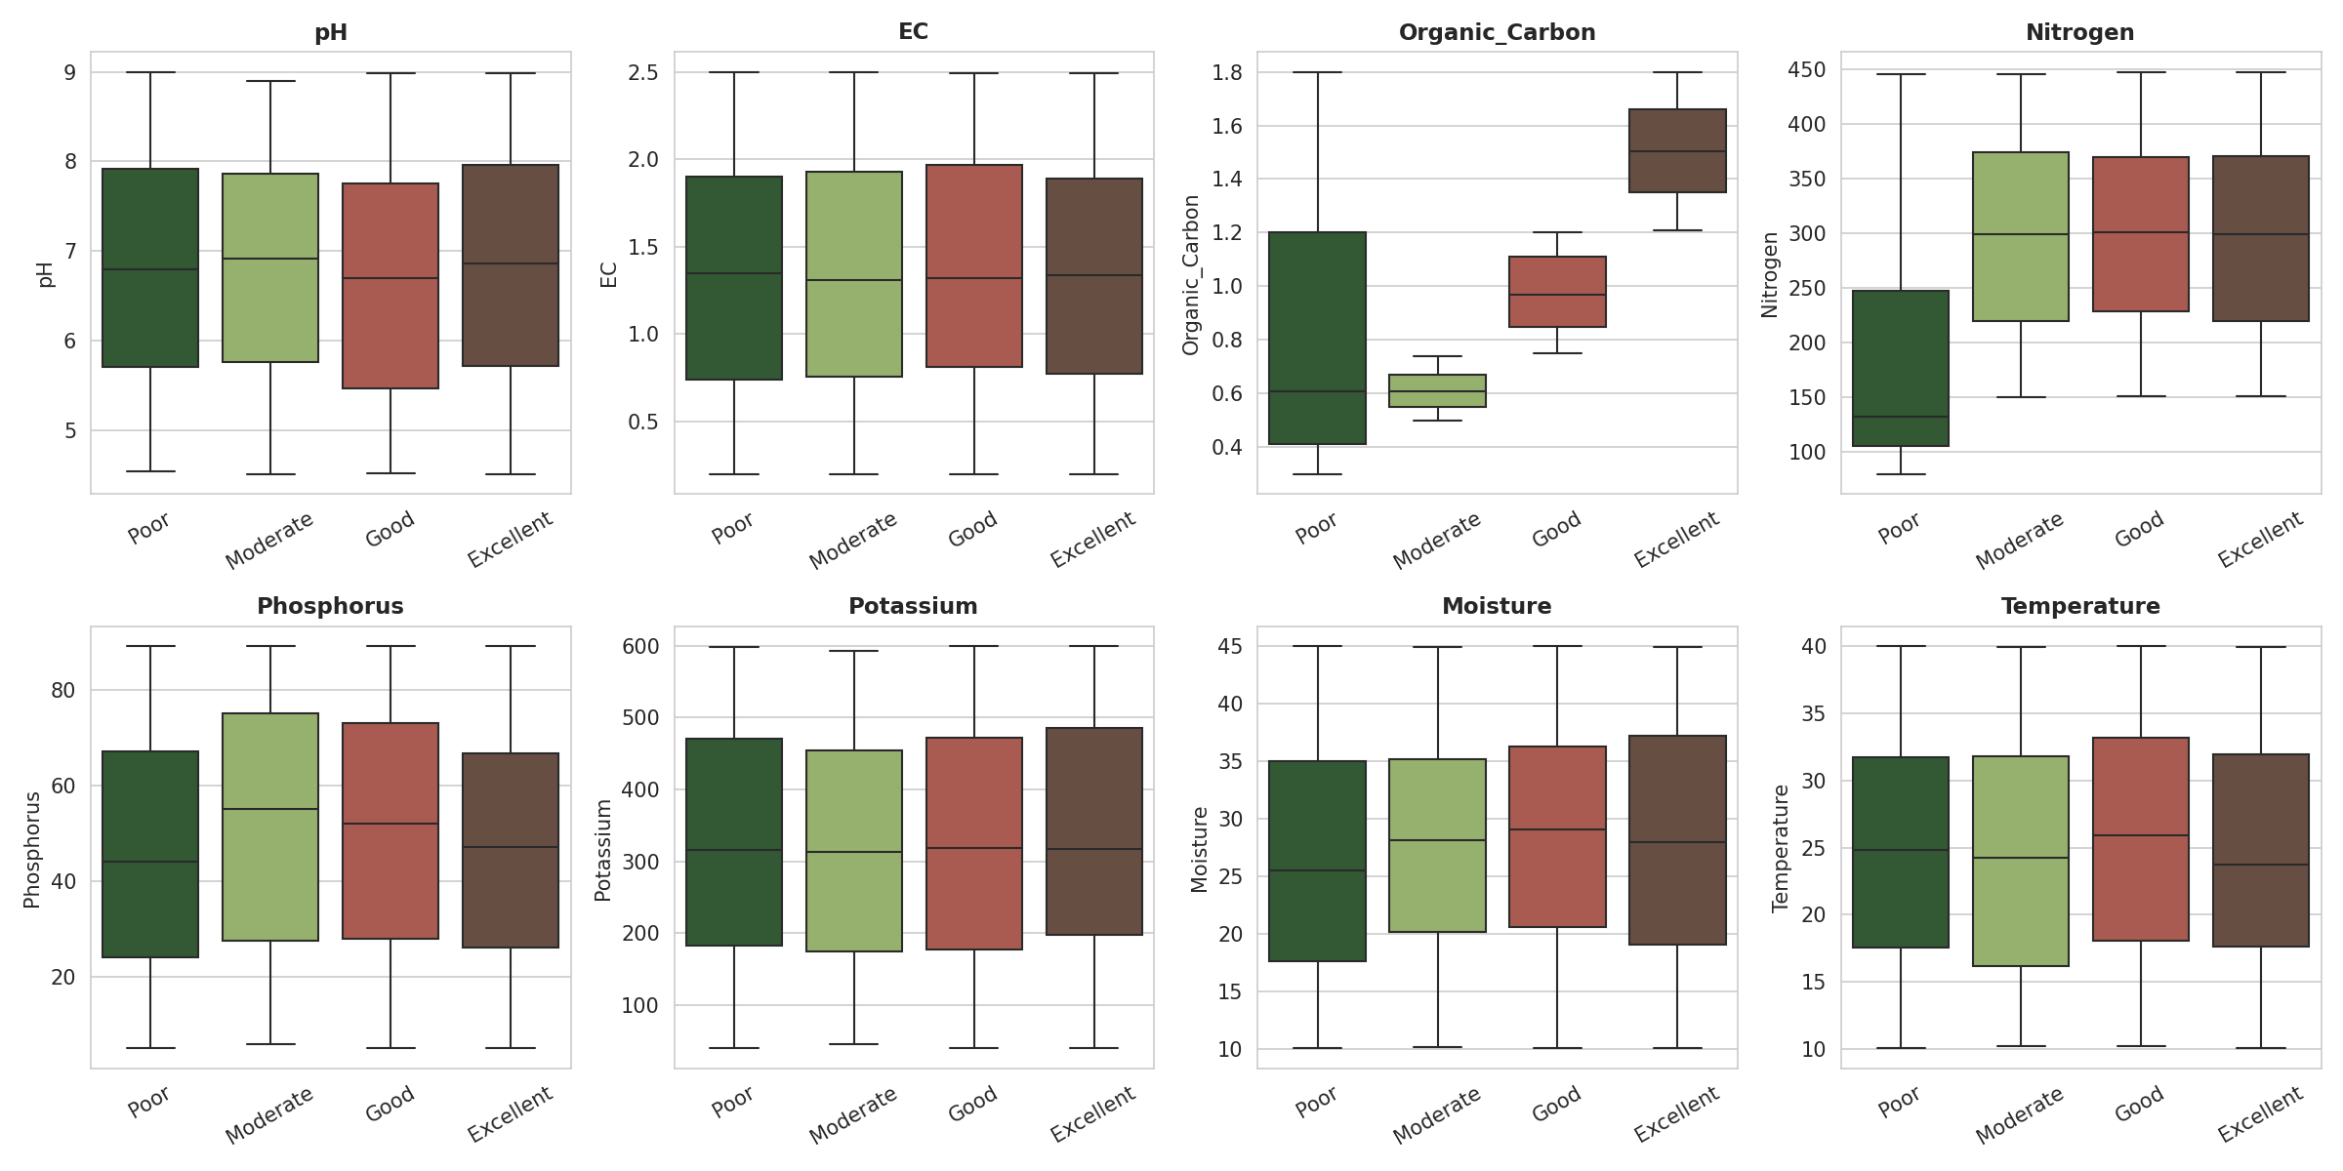
Exploratory Data Analysis — Feature Spread by Quality Class
Soil Quality Classification
8

Slide 9
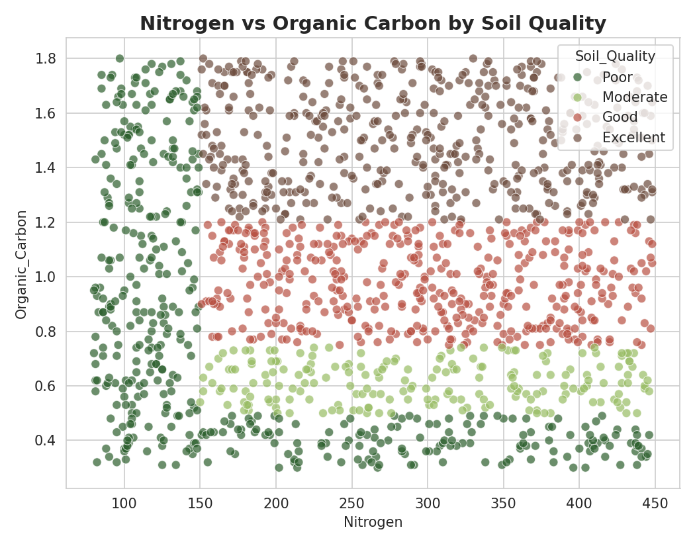
Exploratory Data Analysis — Class Separation
Key Observations
Organic Carbon shows the clearest separation across classes — Excellent soils cluster distinctly higher.
Nitrogen levels also rise steadily from Poor to Excellent soil.
Together, these two features are the strongest visual predictors of soil quality — confirmed later by feature importance.
Soil Quality Classification
9

Slide 10
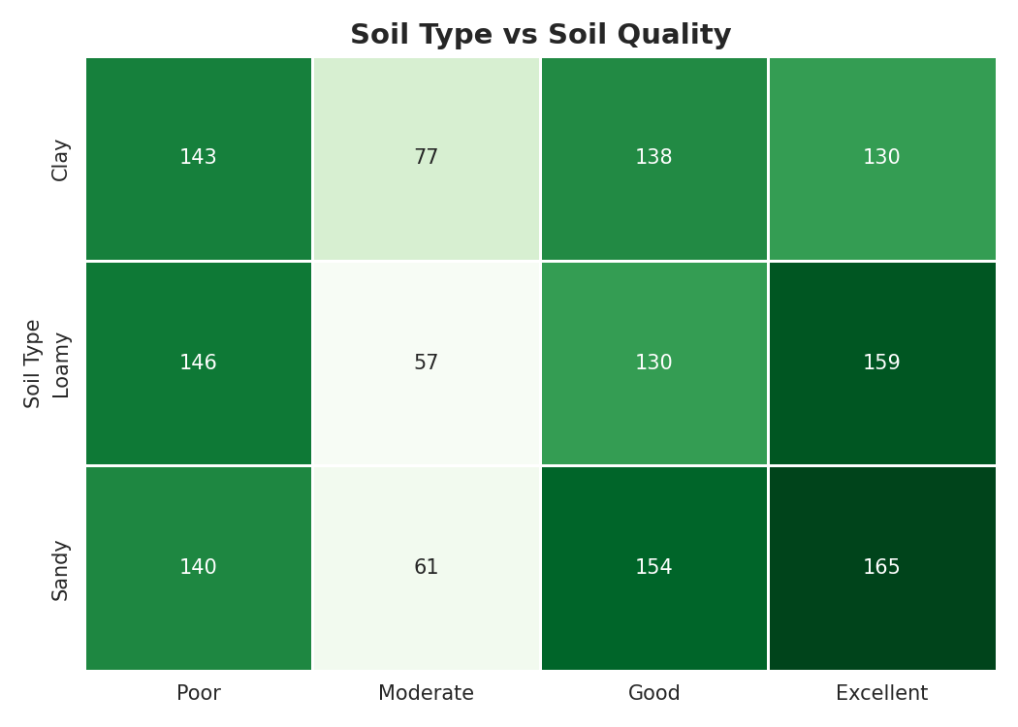
Exploratory Data Analysis — Soil Type vs Soil Quality
Key Observations
Quality classes are spread fairly evenly across Clay, Loamy, and Sandy soils — no single soil type dominates any one quality band.
This lines up with the feature-importance results: Soil_Type contributes under 1% to the Random Forest's predictions.
Soil quality here is driven almost entirely by chemical composition (Organic Carbon, Nitrogen) rather than which soil type it is.
Soil Quality Classification
10

Slide 11
Methodology
1
2
3
4
Preprocessing
Train/Test Split
Model Training
Evaluation
Label-encoded Soil_Type; verified no missing values.
80/20 stratified split — 1,200 train, 300 test records.
Trained a Decision Tree and a Random Forest classifier.
Compared using accuracy, F1-score, and confusion matrices.
Decision Tree (max_depth=6) → interpretable baseline Random Forest (200 trees, max_depth=10) → ensemble of trees for stronger generalization
Soil Quality Classification
11

Slide 12
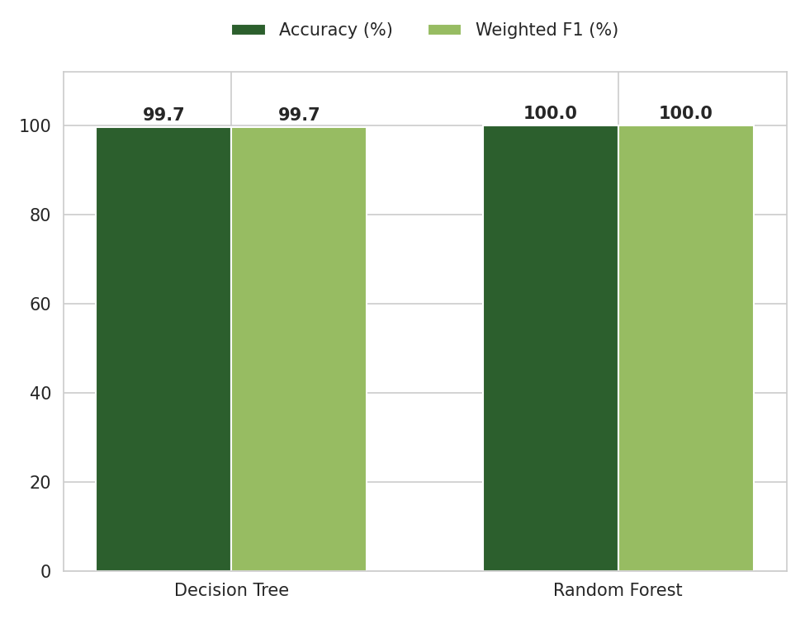
Model Performance Comparison
Decision Tree
Accuracy: 99.67% Weighted F1: 99.67%
Simple, interpretable, but slightly more sensitive to individual misclassifications at class boundaries.
Random Forest
Accuracy: 100.00% Weighted F1: 100.00%
Ensemble of 200 trees eliminates the remaining boundary errors — best overall performer on this dataset.
Soil Quality Classification
12

Slide 13
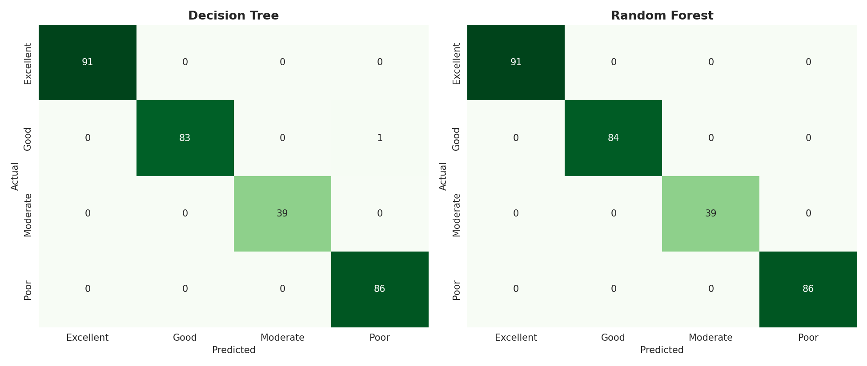
Confusion Matrices — Test Set (300 samples)
Random Forest shows a perfectly diagonal matrix — zero misclassifications. The Decision Tree misclassifies just 1 sample between the adjacent Good/Poor boundary classes.
Soil Quality Classification
13

Slide 14
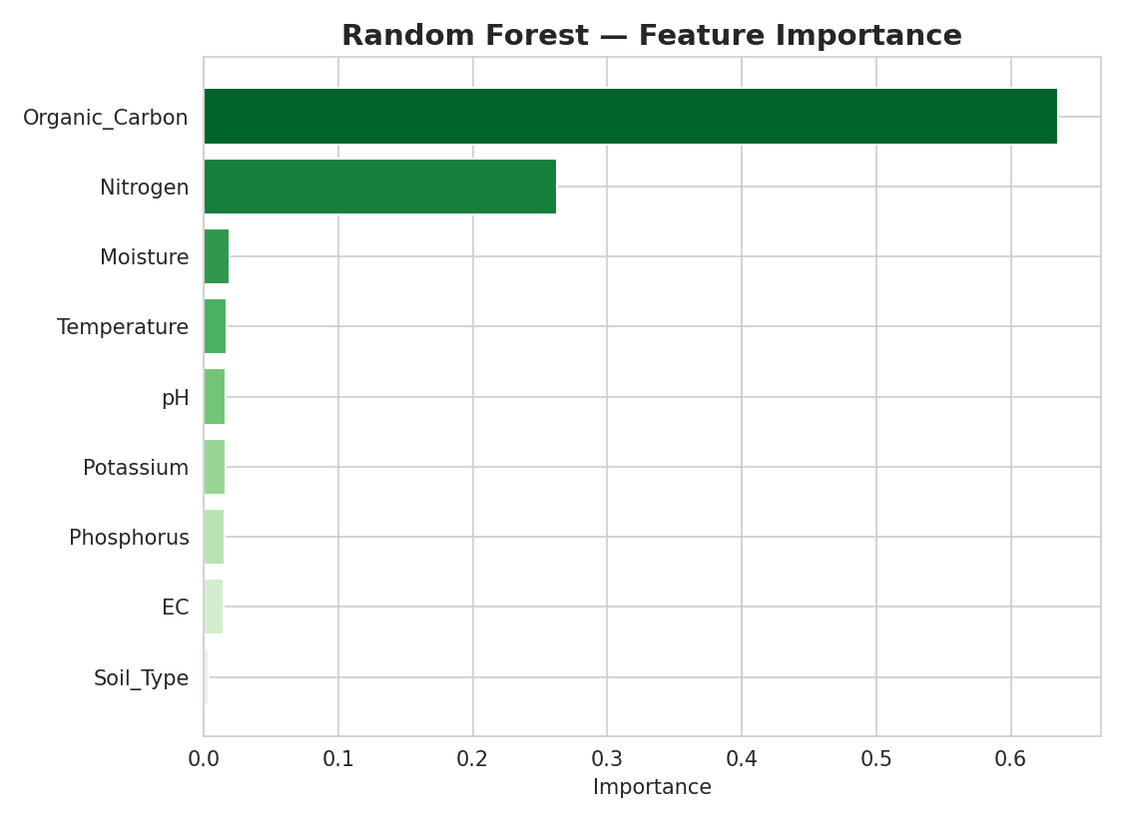
Random Forest — Feature Importance
Key Observations
Organic_Carbon dominates with ~64% importance — by far the strongest predictor.
Nitrogen contributes ~26% — together these two features explain ~90% of the model's decisions.
pH, EC, Moisture, Temperature, Phosphorus, Potassium and Soil_Type each contribute marginally (<2% each).
Soil Quality Classification
14

Slide 15
Conclusion
Random Forest achieved 100% test accuracy, outperforming the standalone Decision Tree (99.67%), by correcting the few boundary errors made near overlapping class ranges.
Organic Carbon and Nitrogen are the dominant drivers of soil quality classification — together accounting for roughly 90% of predictive importance.
Ensemble methods generalize better than a single tree, making Random Forest the recommended model for real-world soil quality prediction.
Future work: test on field-collected (non-synthetic) soil samples and explore additional agronomic features such as micronutrients and rainfall history.
Thank You

