Slide 1


Infrastructure & Development

Slide 2
INFRASTRUCTURE DIVISION
Purchase of land for office buildings and residential quarters;
Construction of office buildings and residential quarters;
Purchase of ready built accommodation (RBA) for office buildings and residential quarters;
Repair and Maintenance;
Hiring of office accommodation on Lease/Rental basis.

Slide 3

CBIC Infrastructure-At a Glance
Construction
Construction projects sanctioned/revalidated during F.Y. 2020-21
Office – 21 (Project Cost Rs. 971.28 Cr. approx)
Residence – 12 (Project Cost Rs.1279.91 Cr. approx)
An amount of Rs. 240.19 Cr. released.
Construction projects sanctioned/revalidated during F.Y. 2021-22 (till date)
Office – 21 (Project Cost Rs.1020.23 Cr. approx)
Residence – 09 (Project Cost Rs.1239.86 Cr. approx)
An amount of Rs. 250.11 Cr. released.
RBA
01 Ready built office accommodation at a project cost of Rs. 87.00 Cr. (approx) has been acquired.

Slide 4
CBIC Infrastructure-At a Glance
Repair and Maintenance
165 R&M proposals sanctioned/revalidated in the FY 2020-21 involving an amount of Rs. 84.73 Cr.
82 R&M proposals sanctioned/revalidated in the FY 2021-22 (till date) involving an amount of Rs. 44.81 Cr.
Hiring
23 proposals for Hiring of office buildings involving annual rent of Rs. 50.30 Cr were sanctioned in FY. 2020-21.
22 proposals for Hiring of office buildings involving annual rent of Rs. 26.63 Cr have been sanctioned in FY. 2021-22 (till date).
Land
In recent years, 14 projects worth Rs.199.82 Cr of acquisition of Land for construction of office building have been sanctioned.

Slide 5
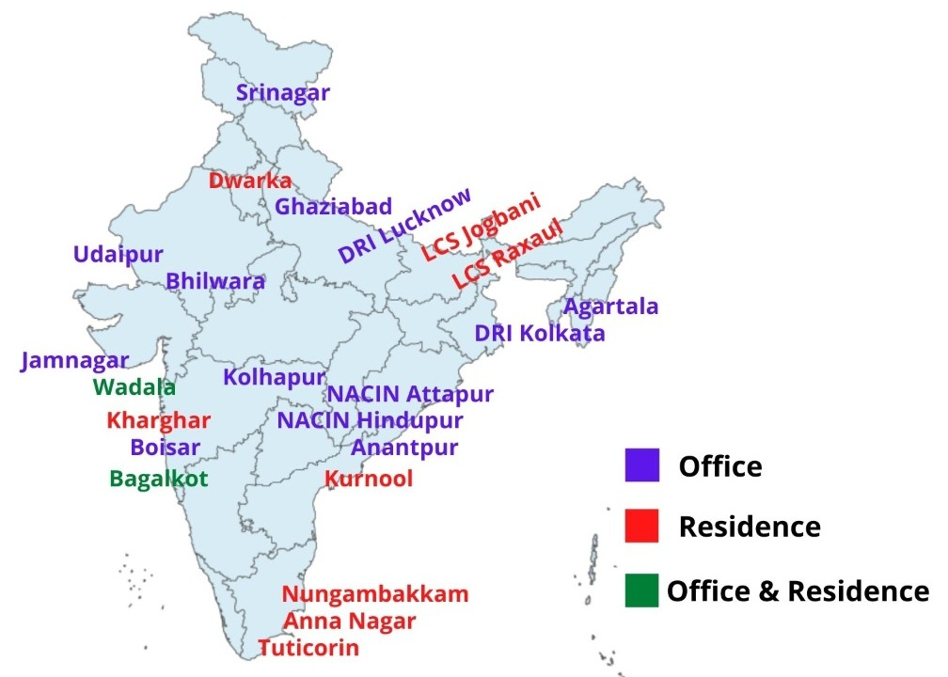
Ongoing Construction projects

Slide 6
Major Construction Projects
S.No. | Project Location | Office/Residential | Type Wise Quarters/ Office space | Project Cost
1 | Wadala, Mumbai | Office & Residential | Total– 769 Type II to VII – Office Area – 30,000 Sq.Mtrs. | Rs. 975.41 Cr.
2 | New NACIN Complex, Hindupur, A.P | Academy (500 Acres) | 500 Acres | Rs. 763.04 Cr.
3 | Annanagar, Chennai | Residential | Total– 726 Type II to IV | Rs. 348.77 Cr.
4 | Dwarka, Delhi | Residential | Total– 256 Type IV to VI | Rs. 227 Cr.
5 | Ghaziabad, U.P | Office | 8658.01 Sq. Mtrs | Rs. 116.42 Cr.

Slide 7
Major Construction Projects
S.No. | Project Location | Office/Residential | Type Wise Quarters/ Office space | Project Cost
6 | Kharghar, Mumbai | Residential | Total– 187 Type II to VI | Rs. 110.11 Cr.
7 | Nungambakkam, Chennai | Residential | Total– 36 Type V & VI | Rs. 65.42 Cr.
8 | DRI, Kolkata | Office | 2134.17 Sq Mtrs. | Rs. 64.50 Cr.
9 | NACIN, Attapur | Training Complex | 11940 Sq. Mts. | Rs. 46.71 Cr.
10 | Jamnagar, Gujrat | Office | 4431.34 Sq. Mts. | Rs. 43.67 Cr.
11 | Kolhapur, Maharashtra | Office | 9244.1 Sq. Mtrs. | Rs. 42.44 Cr.
12 | Udaipur, Rajasthan | Office | 3315 Sq. Mtrs | Rs. 42.07 Cr.
13 | Boisar, Mumbai | Office | 4305 Sq. Mtrs | Rs. 33.25 Cr.
14 | Agartala, Tripura | Office | 3256 Sq. Mts. | Rs. 28.04 Cr.

Slide 8
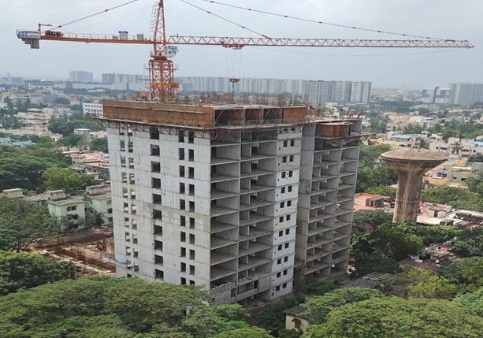
Onsite photographs of Anna nagar, Chennai project

Slide 9
NACIN Hindupur project
Land measuring 500.34 acres was purchased from Govt. of Andhra Pradesh at a cost of Rs. 10.13 Cr in March, 2015 and June, 2016. Registration of land was done in August, 2016.
Approvals so far:-
Sub Soil Exploration & Investigation at cost of Rs. 13.94 lakh (Sanctioned in July, 2018). Work completed.
Boundary wall and gate complexes at cost of Rs. 15.14 Cr. (Sanctioned in November, 2018). Work under progress.
Appointment of Master Planning and Architectural Concept Planning Consultant at cost of Rs. 2.00 Cr. (Sanctioned in January, 2021). M/s Muralage was appointed as the Master planner for the project.

Slide 10
NACIN Hindupur project
Main construction proposal:-
Total cost – Rs. 763.04 Cr.
Space requirement – 98,187 sqm.
In Phase-I, Construction of Academy, Administrative Block, Residential Buildings & other facilities essential to commence the operations have been planned.
In Phase-II which will be taken up later, facilities like Customs University, Research Center, Shooting Range, K-9 Training Center etc., will be added to enhance the Training capabilities and making it a full-fledged Academy.
Proposal has been put up to DoR for approval.

Slide 11
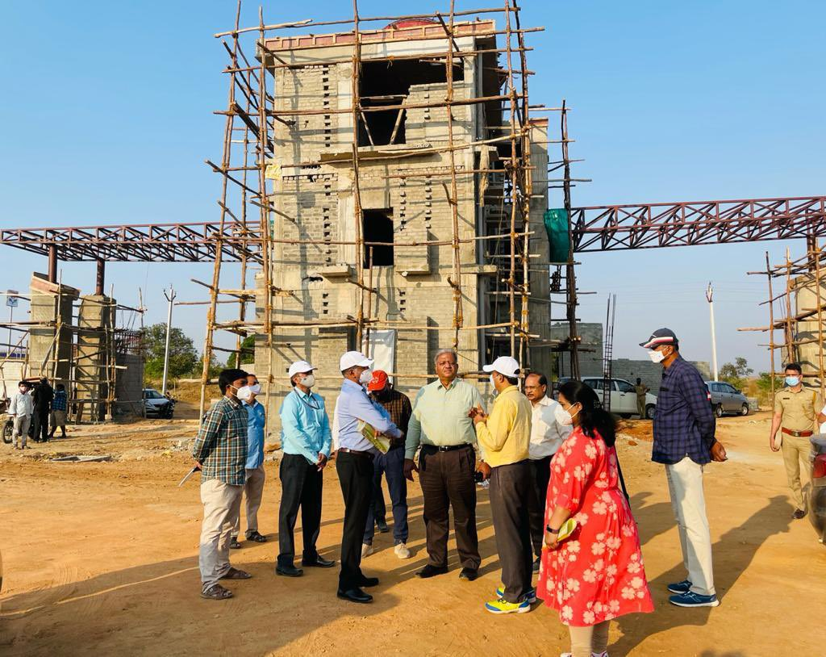
Onsite photographs of Hindupur, NACIN project

Slide 12
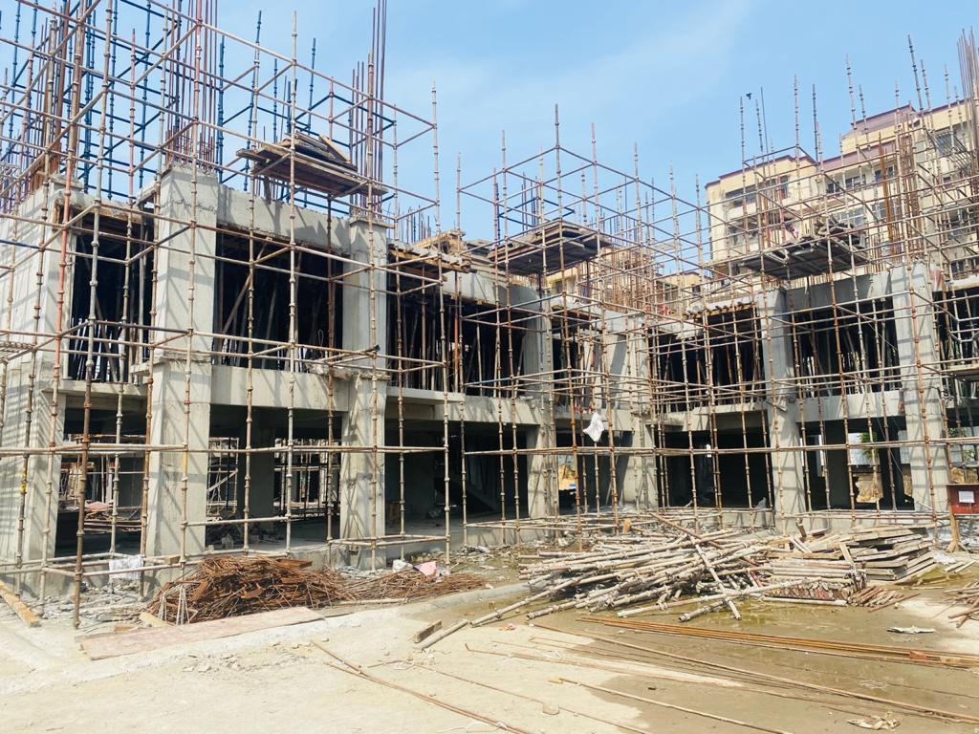
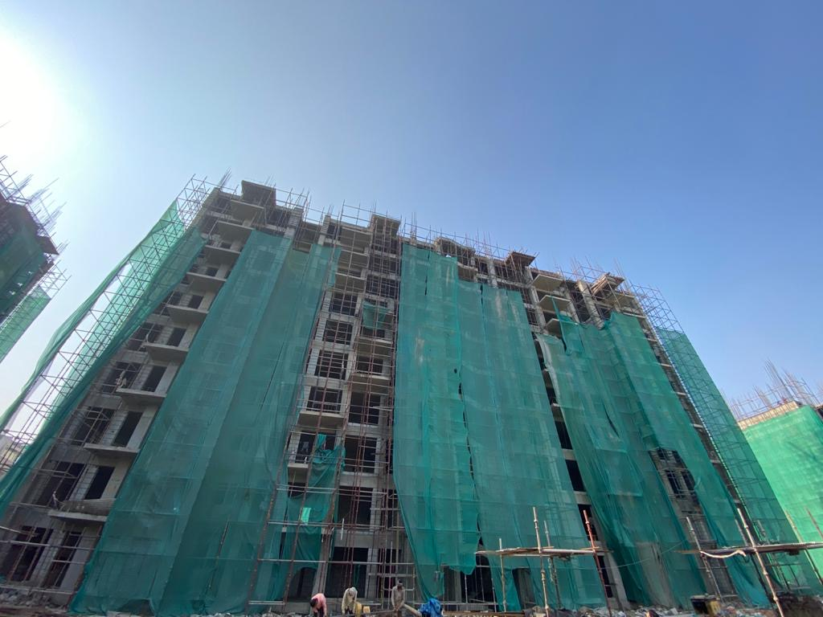
Onsite photographs of Dwarka project

Slide 13
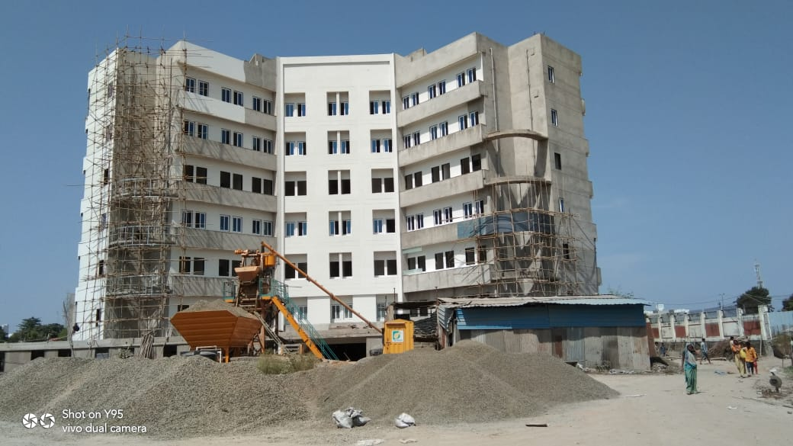
Onsite photographs of Jamnagar project

Slide 14
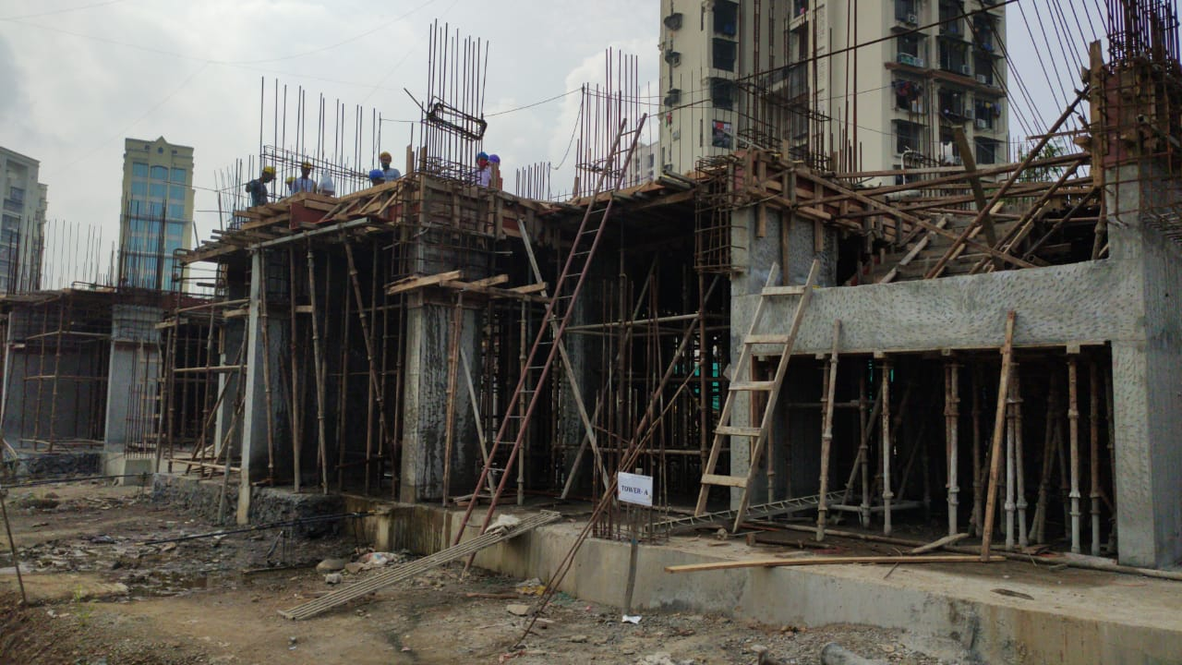
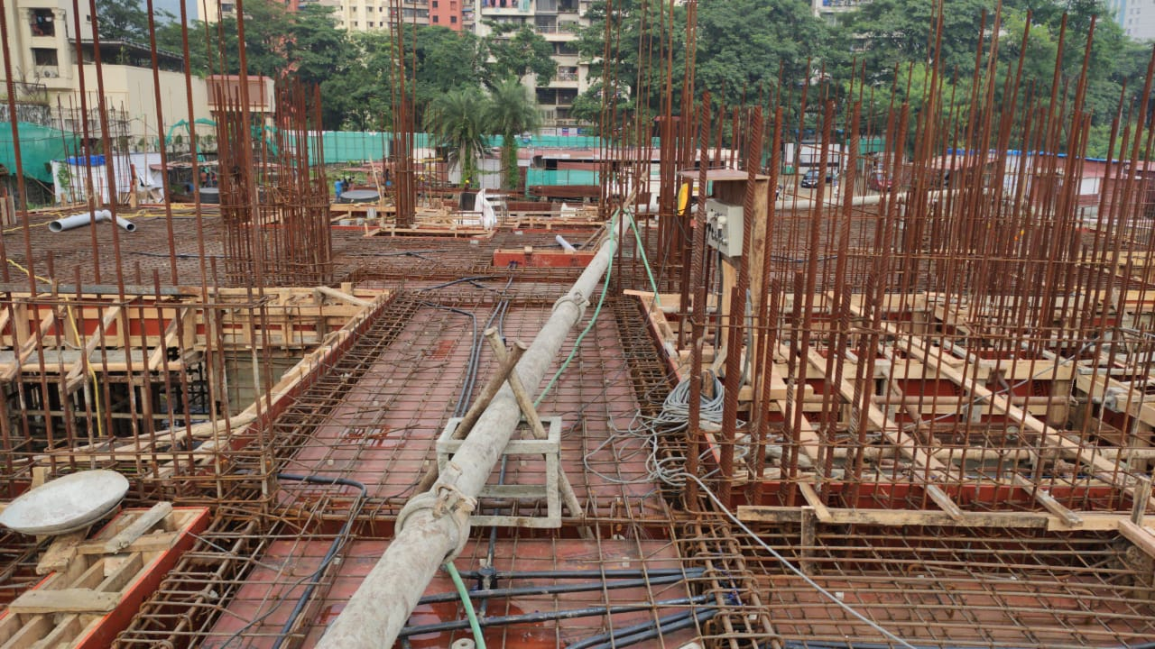
Onsite photographs of Kharghar project

Slide 15
PURCHASE OF LAND

Slide 16
PURCHASE OF LAND
Chapter-2 of the Manual of Infrastructure;
Most crucial aspect is the calculation of the space requirement for office and residential quarters to be done as per the norms prescribed in the Infrastructure Manual;
Space requirement for special components should be calculated as per category of building. In case of any additional requirements, proper justification must be provided.

Slide 17
SPACE REQUIREMENT CALCULATION
S.No | Special Components | Carpet Area (Sq. Mtrs.) for category |  |  |  | Remarks
 |  | I | II | III | IV
1 | Entrance Hall with Reception Waiting etc. | 33 | 66 | 88 | 110
2. | Public | - | - | - | - | As per requirement
3. | Conference Relations Unit |  | 22 | 44 | 44
4. | Strong Room | - | 22 | 33 | 33
5. | Record Room | * | * | * | * | * 25% of the area for current records & 30 % of the area for old records (for gazetted & non-gazetted staff)
6. | Telecommunication Centre Telephone Exchange Wireless control | - - | 22 55 | 22 66 | 22 66

Slide 18
PURCHASE OF LAND
Preference should be given to purchase/acquisition of land from Central Government agencies such as MoUD, the Directorate of Estates/ Central Public Works Department (CPWD) and thereafter to State Government/Local authorities/Development authorities/Public Sector Undertaking (PSUs) etc.
In case, land is not available with CPWD then non availability certificate from CPWD should be taken.

Slide 19
PURCHASE OF LAND – Documents to be submitted
Certificate of non-availability of Central Government land/Building issued by Estates/CPWD.
Minimum requirement of land Certificate from CPWD.
Suitability of land Certificate from CPWD.
Non-Encumbrance Certificate from State Government.
Reasonableness of price certificate from MOUD/CPWD/State Government.
Undertaking from seller that the price is final and there shall be no enhancement in price either retrospectively or prospectively.
Letter of offer with terms and conditions from land owning agencies.
Layout plan of land certified by CPWD.

Slide 20
PURCHASE OF LAND
A comprehensive proposal giving detailed justification for purchase of land in Part A & C (Annexure 2.11).
Details/documents required as per check-list (Annexure 2.12(a))
If required, Delegated Investment Board Memorandum – proposal over involving expenditure over Rs.100 Crore and upto 500 Crore Memorandum as applicable.
Public Investment Board Memorandum - proposal over involving expenditure beyond Rs. 500 Crore (Annexure 2.14)

Slide 21
PURCHASE OF LAND
Detailed justification for proposal.
Sanctioned strength and working strength post-wise and as per eligibility for different types of quarters.
Calculation of office space as per prescribed norms and staff strength.
Number and type of quarters already available.
Details of Demand Survey conducted among staff to ascertain the demand for residential quarters along with abstract for type-wise demand ascertained.
Calculation of type-wise requirement of residential quarters as per Annexure-XI.
Built up office accommodation available both owned and hired.
Monthly rent being paid for rented premises.

Slide 22
PURCHASE OF LAND
Land already available and lying vacant/unutilized.
Mode of acquisition such as outright purchase or on lease basis etc. In case of lease, details of lease tenure, ground rent/lease rent and terms and conditions of lease may be furnished.
Cost of acquisition of land including registration charges, stamp duty, ground rent etc.
Details of recurring cost, if any.
Total amount for which a/a, e/s is being sought.
Availability of Budget and major/minor head under which sanction required.
Revenue targets and collections for last five years and potential for next 10-20 years.
Immovable assets (Land/Buildings) of the Dept. at the station- both owned and hired.
Cost Benefit analysis.
Zonal Pr CC/CC Approval.

Slide 23
DEFICIENCIES IN PROPOSALS RECEIVED
Authentic translation of documents in local language.
Uniform units of measurement.
Incomplete Check- List.
Signature of each staff member and officers must be taken on Demand Survey.
Validity of offer must be clearly mentioned.
Terms and Conditions of offer must be clearly mentioned.
If the land is on lease basis, its terms/period along with the rate of lease premium payable should be incorporative in the offer letter / sale/lease deed.
Payments schedule should be mentioned clearly in the offer letter/agreement.
Where the funds are to be provided from CBIC grants, the fund requirement should be projected well in advance so that necessary provision can be made in the DDG of the concerned financial year.

Slide 24
POST ACQUISITION OF LAND
(I) Transfer of title on purchase of land: Department should get a clear legal title. The conveyance deed should be legally vetted by the Branch Secretariat of the Ministry of Law before execution.
(II) Safety/Security of the property: On acquisition of land, immediate necessary action should be initiated for securing the land by way of construction of boundary wall etc./putting up Notice Boards etc. to avoid the risk of encroachment thereon.
(III) Proposal for Construction: The proposal for construction of office building/residential quarters should be initiated on priority by the Commissionerate after acquisition of land.

Slide 25
CONSTRUCTION OF OFFICE BUILDINGS & RESIDENTIAL QUARTERS

Slide 26
STEPS FOR PREPARATION OF PROPOSAL BY FIELD FORMATIONS
CONSTRUCTION PROJECTS
1. Determination of space requirements - As per the norms prescribed in the Infrastructure Manual, 2015.
2. Submission of the space requirements to the Construction Agency.
3. Obtaining P.E., Drawings and layouts with other relevant documents for the proposed building from the Agency.
4. Preparation of a comprehensive proposal along with necessary information as per Manual on Infrastructure 2015 and forwarding to I&W Wing of DGHRD.
5. Sending reply to observations made by DGHRD or IFU/Ministry.
6. Monitoring the Construction process after receiving A/a and E/s (constituting a Works Committee).

Slide 27
OTHER NECESSARY INFORMATION
Information as per Part A and Part C of the instructions issued by the Ministry (Annex 2.11 of Infrastructure Manual).
General Information as per the Infrastructure Manual.
Information related to Guest house.
Information pertaining to construction of boundary wall.

Slide 28
Check List for Infrastructure Proposal prescribed by IFU
S. No. | Subject | Remarks
1 | Available area (Land in sq.mtrs.)
2 | Encumbrances if any (Enclose certificate from concerned District/Local Authority)
3 | Date of Administrative Approval /expenditure sanction for the cost of the land ( copy of Ministry’s letter to be enclosed )
4 | Date of possession of the land
5 | Sanctioned strength at the station (category –wise as on date )
6 | Working strength at the station (category –wise as on date )
7 | Requirement of quarter (worksheet as per the Table to be attached (Annexure –2.8)
8 | Requirement of office space to be worked out on the basis of the sanctioned strength and as per the prescribed norms(work sheet to be enclosed )
9 | Deviation if any from the norms /reasons thereof
10 | Lease rent /Ground rent and other one time (Non-Recurring) /Recurring payment to local authority.
11 | Particulars of administrative approval of construction (copy of Ministry’s letter to be enclosed )
12 | Non construction fee and other charges payable for delay of construction.
13 | Cost of construction (Preliminary estimate prepared by CPWD to be enclosed).
14 | Plan of building (drawing/layout plan of the building to be attached in duplicate).
15 | Date of completion as per estimate.

Slide 29
Check List for Infrastructure Proposal prescribed by IFU
16 | Budget availability and phasing of expenditure year-wise.
17 | Ongoing works at the place/ station.
18 | Commitment of any other work by CPWD.
19 | In case the proposed accommodation is residential accommodation, whether willingness of the officers/staff has been obtained. (Report of demand survey duly signed by eligible officer showing their willingness/ non-willingness are to be enclosed).
20 | Revenue collection (last five Financial Year wise).
21 | Anti-smuggling/ Anti evasion formations-Value of seized goods, confiscated goods, sale proceeds etc. during last five years are to be provided.
22 | Statement of all immovable assets (Land and Building of CBEC, both owned and hired, to establish the necessity of fresh requirement is to be furnished).
23 | Reason for gap, if any, between taking possession of land and initiating the proposal for construction.
24 | Reasonableness of the cost of the land already purchased may be confirmed
25 | Cost economics of hire vs construction may be worked out in detail.
26 | It may be confirmed whether economic cost analysis of building vs hire supports the proposal.
27 | Total saving in the form of HRA from staff/ officers once the proposed quarters are constructed.
28 | The validity and date of the CPWD estimates be clarified.
29 | Agency responsible for day to day/annual maintenance of the building after its construction?.
30 | What is the expenditure likely to be incurred on day to day /annual maintenance of the building?
31 | Information in SFC memorandum or CNE Memorandum may also be furnished. Format of SFC memorandum as per (Annexure 2.14(a)) and CNE Memorandum as per (Annexure 2.14(b)).

Slide 30
Check List for Infrastructure Proposal prescribed by IFU
32 | Whether the proposed office building is IT (Infrastructure Technology) friendly i.e. whether requirements for Consolidation project for Computerization have been accounted for and whether the Directorate of Systems consulted for any specific requirements.
33 | Budget Head under which expenditure should be accounted (Information to be obtained from CPWD).
34 | Cost of construction per sq. ft. of super area/carpet area/plinth area/ covered area to be mentioned
35 | Permissible FAR/FSI available on the plot to be mentioned
36 | Certificate from the appointed agency regarding the GRIHA norms to be obtained
37 | Measures regarding Disaster Management to be mentioned in the proposal

Slide 31
ESSENTIAL COMPONENTS
Proposed building with at least 3 star GRIHA (Green Rating for Integrated Habitat Assessment) rating.
Provisions for rainwater harvesting, LEDs, fly ash bricks and PVC windows.
Proposal of office/ residential building with boundary wall.
Focus on building a state of the art building.
IT and senior citizens/specially abled friendly.
Provision of Centralized Air Conditioning.

Slide 32
Financial Powers/Approval Authorities OM No.24(35)/PF-II/2012 dated 5th August 2016
Scheme/Project Appraisal |  | Scheme/Project Approval
Cost (Rs. Cr.) | Appraisal by | Cost (Rs. Cr.) | Approval by
Upto 100 | The Financial Advisor | Upto 100 | Secretary of the Administrative Department
> 100 & upto 500 | SFC/DIB Chaired by Secretary of the Admn. Department | > 100 & upto 500 | Minister- in-charge of the Administrative Department
> 500 | EFC/PIB Chaired by the Expenditure Secretary, except departments/schemes/projects for which special dispensation has been notified by the Competent Authority | > 500 & upto 1000 | Minister-in-charge of the Admn. Dept. And Finance Minister, except where special powers have been delegated by the Finance Ministry.
 |  | > 1000 | Cabinet/Committee of the Cabinet concerned with the subject.

Slide 33
Common deficiencies in proposals
Incomplete Proposals without the checklist as prescribed by IFU/Ministry.
The proposed area of construction is not in conformity with the prescribed norms.
Availability of sufficient funds in the budget for the proposed expenditure
on construction not informed.
Copy of Ministry’s Sanction letter is not enclosed.
Where there is a time gap between taking possession of the land and initiating the proposal for construction, then a full justification for such a delay has to be furnished.
The correct Budget Head under which the expenditure has to be debited is not mentioned/or is incorrectly mentioned.
The requirement of space is not worked out as per the applicable norms.

Slide 34
COMMON OBSERVATIONS RAISED BY IFU
Whether the budget is available and how is the expenditure on construction proposed to be met.
Cost-benefit analysis of Hire v/s Construction.
Reasons for delay in initiating the proposal.
Is there any financial implication in demolition (in case of demolition of old/dilapidated buildings) Whether the same can be met by disposing off the materials salvaged after demolition.
Whether feasibility of PPP model has been explored.
Cost comparisons with similar projects in the vicinity.

Slide 35
KEY TERMS
Carpet Area
Plinth Area
Super Built up Area
FSI
Ground Coverage
Budget Head
GRIHA

Slide 36
Flow Chart-Residential & Office Building Construction
Ensure that the land is free from encumbrances. Non-encumbrance Certificate from the concerned District Authority to be enclosed.
Work out the requirement of quarters (type-wise) and office space including space for special components as per applicable norms
Conduct demand survey for residential quarters among the eligible persons which should be signed by the eligible persons showing their willingness/non-willingness. Construction of residential quarters will be restricted either to requirement as per the applicable norms or to the actual demand whichever is lower. A worksheet of the demand survey is to be prepared. |  |  | Prepare a detailed worksheet for requirement of space for office and special components keeping in view the austerity cut and a fixed allowance for future expansion on the basis of applicable norms.

Slide 37
Submit the requirement to CPWD and get the drawings and preliminary estimate (P.E.) prepared
Submit a self contained proposal along with preliminary estimate (P.E.), drawings and checklist to the office of the DGHRD for processing and necessary action.
Proposal is examined and processed in the I&W Wing of the office of the DGHRD. Deficiency, if any noticed, is communicated to the concerned office for clarification /rectification.
Proposal found complete in all respects is sent to the Ministry for administrative approval and expenditure sanction.
Proposal approved by the Ministry and sanction accorded if found complete in all respects. Where any observations are made by the Ministry, it is communicated to the concerned office for necessary clarification/rectification.
On receipt of approval, an approval letter is sent by the Ministry to the concerned office, under intimation to the Chief Engineer, CPWD.

Slide 38
REPAIR AND MAINTENANCE

Slide 39
Classification of works
Original Works shall mean:
(i) all new constructions;
(ii) all types of additions, alterations and/or major repairs to newly acquired assets, abandoned or damaged assets that are required to make them workable;
(iii) major replacements or remodelling of a portion of an existing structure or installation or other works, which results in a genuine increase in the Capital Value of the property.
Expenditure under Major Head ‘4059/4216’

Slide 40
Minor Repair Works
(i) Annual repairs: Routine and yearly operation and maintenance works.
(ii) Special repairs: Renovation or remodelling of a portion of an existing structure or installation or other works due to major breakdown, or deterioration, or periodic renewal, which do not result in a genuine increase in the value of the property but are necessary to make them workable.
Expenditure incurred under MH 2038/2037/2216

Slide 41
Rule 84 of GenerAL FINANCIAL RULES, 2017
Capital Expenditure (Major Head 4059/4216)
Enhances the capital value of the asset
Expenditure in significant in amount
Revenue Expenditure (Major Head 2037/2038/2216)
Necessary for repair and up-keep of the asset.
Yearly maintenance and repair
Special repair/One Time repair.

Slide 42
Original works (Capital Expenditure) Major Head : 4059/4216 | Special Repairs/Renovation/Minor Works (Revenue Expenditure) Major Head : 2038/2037/2216
Construction of additional floors/conference rooms in office building. Replacement/Up-gradation of lifts. Installation/Replacement of DG Sets. Installation of Deep Tube Wells or Water Reservoirs in Residential Buildings. Major up-gradation work in residential/office buildings in which the expenditure in significant. | Electrical Rewiring of office/residential building. Civil up-gradation of office/residential building. Annual civil repair and maintenance work in office/residential building.

Slide 43
 | Office building | Residential building
Revenue Expenditure | 2038 (GST) | 2216 (GST & Customs)
 | 2037 (Customs)
Capital Expenditure | 4059 (GST & Customs) | 4216 (GST & Customs)

Slide 44
Power to Sanction Works
As per Rule 133 of GFR, 2017:
‘Works’ upto ₹ 30 lakhs - Rule 133(1)
‘Works’ more than ₹ 30 lakhs - Rule 133 (2)
Work may be assigned to:
Any Public Works Organisation e.g., CPWD, State PWD.
Central Government organizations authorized to carry out civil or electrical works such as Military Engineering Service (MES), Border Roads Organisation (BRO) etc., or Ministry/Department’s construction wings of Ministries of and Departments of Posts, and Space, etc.

Slide 45
Power to Sanction Works
Rule 133 (3) - As an alternative to 133(2), works may be awarded to :
(i) any Public Sector Undertaking set up by the Central or State Government to carry out civil or electrical works or,
(ii) any other Central/State Government organization/PSU which may be notified by the Ministry of Urban Development (MoUD) for such purpose after evaluating their financial strength and technical competence.
For the award of work under this sub-rule, the Ministry/Department shall normally ensure competition among such PSUs/organizations. This competition shall be essentially on the lump sum service charges to be claimed for the execution of work.

Slide 46
Power to Sanction Works
Rule 194 - In exceptional cases, for award of work under (i) and (ii) above, on nomination basis, the conditions contained in Rule 194 would apply. The work in these cases shall be awarded only on the basis of lumpsum service charge.
e.g., INTACH /ASI for restoration/renovation work in ‘Heritage Buildings’ under the department.

Slide 47
Major Head(s)
As per Nature of Work
Grant/Demand No.35-Indirect Taxes:-
Item of expenditure | Object Head | Major Head
Repairs/maintenance (including special repairs) of Departmental Office Building of Customs. | Minor Works | 2037
Repairs/maintenance (including special repairs) of Departmental Office Building of Central GST. | Minor Works | 2038
Repairs/maintenance (including special repairs) of Departmental Residential Building of Customs and Central GST. | Minor Works | 2216

Slide 48
Grant /Demand No.35 Indirect Taxes (Lumpsum)
Item of expenditure | Major Head
Original works of Departmental Office building of Customs. | 4059
Original works of Departmental Office Building of Central GST. | 4059
Original works of Departmental Residential Building of Customs and Central GST. | 4216
Grant/Demand No.95-Public Works (in F.Y. 2018-19)
Item of expenditure | Major Head
Original Works of Office Building for Customs and Central GST. | 4059 (Lumpsum)
Original Works of Residential Building for Customs and Central GST. | 4216 (Lumpsum)

Slide 49
DELEGATION OF FINANCIAL POWERS TO THE HoDs
As per Ministry of Finance O.M. Dated 15.09.2011-The Financial Power(s) of HOD is ₹ 30 lakh per annum which is inclusive of repair works in Office (MH 2037/2038) and Residential (MH 2216)
S.No. | Item of Expenditure/Subject (Nature of Work) | Budget Head | Power delegated to
1 | Repairs/Maintenance of Departmental Office Building of Customs. (Minor Works) through CBIC. | 2037 | Pr. Commissioner/ Commissioner
2 | Repairs/Maintenance of Departmental Office Building of Central GST. (Minor Works) through CBIC. | 2038 | Pr. Commissioner/ Commissioner
3 | Repairs/Maintenance of Departmental Residential Building of Customs and Central GST (Minor Works) through CBIC. | 2216 | Pr. Commissioner/ Commissioner

Slide 50
Funds provided by MoUD/CPWD
S.No | Item of Expenditure/Subject (Nature of Work) | Budget Head | Power delegated to | Financial Power
1 | Original Works in office | 4059 | Pr. Chief Commissioner/ Chief Commissioner | ₹ 1 cr
2 | Original Works in office | 4059 | Pr. Commissioner/ Commissioner | ₹10 lakh
3 | Original Works in residential. | 4216 | Pr. Commissioner/ Commissioner | ₹10 lakh

Slide 51
Sanction under HoD Financial Powers
IFU/Ministry OM dated 15.09.11 refers.
Expenditure of Rs. 30 Lakhs or below.
HoD may:
Accord a/a and e/s to the proposal under the Financial Power delegated to HoD(s)
(ii) Simultaneously approach EMC wing of DGHRD through budgetary authority (CC office) for provision of funds for the proposal.

Slide 52
Check-List
Chapter 7 (7.10) of Manual of Infrastructure.
It should be signed by HoD.
Object/Major Head should be mentioned correctly.
S.No. | Subject | Remarks
1 | Date of acquisition or completion of construction of the building and (b)Total cost of acquisition or construction of the building,
2 | The agency which constructed the office/residential building or the agency from which the ready built office/residential building had been purchased.

Slide 53
Check-List
S.No. | Subject | Remarks
3 | (a) The status of utilization i.e. whether this building is fully used for office or residential purpose. (b) In case of office building whether the entire building is being used. If not, the reasons thereof. (c) In case of residential quarters/flats, details of types of flats and the number of flats under occupation. (d) If not occupied fully, the reasons thereof and the plan of the Department to utilize the unoccupied quarters or to dispose of these unutilized quarters/buildings to prevent wastage in maintenance expenditure.
4 | Whether the repair and maintenance estimates are of regular nature or one time special repair nature or both
5 | Whether the Delegated Financial Powers of HOD viz. ₹ 30 lakhs have been exhausted in the current F.Y. If yes, a certificate to the effect is to be produced.

Slide 54
Check-List
S.No. | Subject | Remarks
6 | (a) If the repair and maintenance estimates are of regular nature then the previous financial year’s estimates and approval for the same items may be indicated. (b) If the repair and maintenance estimates are of special nature then the details of last such special repair and maintenance work undertaken and approval may be indicated. (c) the number of such special repair and maintenance works undertaken after taking possession of the building/on completion of construction or after purchase, may be indicated.
7 | (a) The certification from the CPWD that only those items of repair and maintenance (whether one time repairs of special nature or regular/annual repair) have been included in the estimates which are permissible in general pool office or residential accommodation of similar types. (b) If the agency is other than the CPWD, whether GFR provision has been followed in its engagement and the certification as required in item 6(a) above has been provided.
8 | Whether the items of regular or one time special repair fall within the liability of the agency which constructed the building or from which the building had been purchased. If yes, whether that agency has been contacted for this repair work/expenditure. The details thereof.

Slide 55
Check-List
S.No. | Subject | Remarks
9 | The availability of budget along with the Demand Number, Major Heads, Object Head, etc. from which this expenditure will be booked.
10 | Date of the estimates and the total amount involved.
11 | The time to be taken by the repair and maintenance agency for completion of this work for which the estimates has been sent.
12 | Whether the HOD/Commissioner and the users of this building are satisfied with the quality of repair/maintenance work of the agency undertaken by it in the past.
13 | All annual repair and maintenance proposals are to be received in the first quarter of the financial year and it received late, the reasons there for.
14 | Whether the proposal has been routed through the CCO of concerned zone.

Slide 56
Flow chart for proposal for R&M
Identification of Requirement, its justification and Scope of work
Obtaining detailed designs and estimate from CPWD/Executing agency
Provisioning for expenditure under the correct Budget Head
Completion of Check-list to be signed by the HoD
Submission of detailed note on necessity of the work, scope, financial provisioning by the Commissioner to the Pr Chief Commissioner/Chief Commissioner
Scrutiny, justification , approval and recommendation by the Pr Chief Commissioner/Chief Commissioner

Slide 57
Submission of the proposal to the I&W Wing of DGHRD
Examination and processing by the I&W Wing of DGHRD
Provision/Commitment of Funds sought from EMC Wing of DGHRD
Submission of the proposal to the Ministry/Board
Administrative Approval & Expenditure Sanction by the Ministry
Approval directly conveyed by the Ministry to the concerned Commissionerate
Funds released by EMC wing of DGHRD to the concerned formation

Slide 58
BOOKING OF EXPENDITURE

Slide 59
Booking of Expenditure
HoD should write to PAO for getting Letter of Authorization (LoA) issued by the Pr. CCA, New Delhi. A copy of the letter may also be marked to Pr. CCA, New Delhi and Joint Director (I&W) DGHRD, New Delhi.
PAO should make an online request to the Office of Pr. CCA for issuance of LETTER OF AUTHORIZATION (LoA).
Once the office of the Pr. CCA, Delhi issues a Letter of Authorization (LoA) for transfer of funds in favour of the zonal CPWD account, funds should be transferred by concerned PAO via PFMS to the zonal PAO, MoUD/Executing agency.

Slide 60
Booking of Expenditure
The amount released by MoUD/CPWD/Executing agency to be successful bidders/contractors for execution of the project should be booked online.
The physical execution of work should be regularly monitored by field formation(s) by forming Works Committee.
A report regarding the physical and financial progress of the project(s) should be forwarded to the office of DGHRD on monthly basis for regular monitoring of expenditure.

Slide 61
Common Shortcomings/Deficiencies Observed in Proposals of R&M
An incomplete checklist which is not signed by the Commissioner (HOD) is submitted by the field formations.
The object head under which the expenditure would be incurred is incorrectly mentioned.
A detailed justification of the proposal is not furnished by the formations. The justification should be self-contained and submitted after proper scrutiny.
In case of renovation of departmental quarters, Demand Survey for the quarters is not submitted by the field formations.
The Preliminary Estimate submitted by the field formation is more than 02 years old.
* Only Proposals in which preliminary estimate is less than 02 years old are considered valid. In case the preliminary estimate is more than 02 years old, the field formations have to approach CPWD for submission of fresh estimates.

Slide 62
BUDGETING OF EXPENDITURE

Slide 63
Budgeting of Expenditure
The work concerning allocation of Budget comes under the Expenditure Management Cell (EMC) of DGHRD. A Budget Estimate covering all repair and maintenance proposal(s) is forwarded to EMC for provisioning/commitment of funds.
After the Budget is passed, EMC informs Infrastructure Wing of DGHRD the funds received for repair/renovation work in respective Major Heads (2038/2037/2216/4059/4216).
3. If either owing to (i) non inclusion of proposal in initial Budget Estimate, or (ii) under-estimation of expenditure or insufficient allowance for factors leading to the increase in expenditure or excess expenditure on a particular item, allotment of additional funds by way of supplementary grant or Revised Budget Estimates (RBE) is requested.

Slide 64
POWER OF HoD FOR PURCHASE OF DG SETS
Rs. 15 lakhs
Expenditure incurred under Major Head 4059
Only essential load will be taken into account while arriving at the required capacity of the DG set for any particular office.
The purchase, installation and maintenance of the DG sets will be done by following the provisions of GFRs, 2017.

Slide 65
PURCHASE OF DG SETS
Check List for proposal for installation/maintenance of D.G. Set
Location/Premises for which the proposal for provision/maintenance etc. relates to;
Grounds on which the provisioning of the DG set is considered essential;
Age and repair worthiness of the existing DG set;
Specifications of the new DG Set;
Capacity of the DG Set;
Whether DG Set required for Communication Room;

Slide 66
PURCHASE OF DG SETS
Whether the DG Set is installed/ to be installed as a back up to main power source during periods of power cuts for only the following essential loads:-
Only one AC installed in the rooms of officers who are entitled to the same.
50% of the ACs installed in the Conference Room to be connected.
All Lifts, booster pumps and submarine pumps.
All computers, 20% of the printers and 50% of the Photostat Machines/Fax Machines.
All Lights, Ceiling fans, exhaust fans and Water Coolers.

Slide 67
PURCHASE OF DG SETS
(5) Whether the Delegated Financial Powers of HOD viz. ₹ 15 lakhs has been exhausted in the current F.Y. If yes, a certificate to the effect is to be produced.
Details of Preliminary Cost estimates of the proposed DG Set at each site/station framed by CPWD.
Whether a certificate has been obtained from CPWD to the effect that estimates have been prepared keeping in view the guidelines for installation, maintenance etc. of DG Sets.
The availability of funds in the Budget along with the Demand Number, Major Heads, Object Head, etc from which the expenditure will be booked.
Date of preparation of the estimate and the total amount involved.
(10) Whether the HoD/Commissioner is satisfied about the essentiality of the requirement of the DG Set at the station.

Slide 68
Common Shortcomings/Deficiencies Observed in Proposals for Providing & Installation of DG Sets
Non-submission of the prescribed Check-list for DG Sets;
The field formations wrongly furnish checklist for Repair & Maintenance or furnish an incomplete checklist which is not signed by the Commissioner (HOD).
A detailed justification of the proposal is not furnished by the formations. The justification should be self-contained and submitted after proper scrutiny.

Slide 69
HIRING OF ACCOMODATION ON LEASE/RENTAL BASIS

Slide 70

FLOW CHART
Proposal for hiring of office accommodation
Non Availability Certificate (NAC) from CPWD
Tendering through CPP Portal
Obtaining RRC from CPWD for selected premises
Negotiation of rent with landlord and fixation of rent
Signing of DSLA as prescribed by MoUD
Submission of the proposal by the jurisdictional Chief Commissioner to the I&W Wing of DGHRD

Slide 71
COMPETENCY DELEGATION OF FINANCIAL POWERS TO HoDs
13 Major Cities (A/A1) | Rs. 3 lakh per month
Other than A/A1 Cities | Rs. 1.50 lakhs per month
Beyond the financial powers of HoDs, the approval from the Ministry/IFU is mandatory.

Slide 72
A/A1 CITY
Hyderabad
Delhi
Bengaluru
Mumbai
Chennai
Kolkata
Ahmedabad
Surat
Nagpur
Pune
Jaipur
Lucknow
Kanpur

Slide 73
ACQUISITION OF ACCOMODATION ON LEASE/RENTAL BASIS
CVC guidelines & GFRs 2017 to be followed essentially for Tendering process.
A). Advertise in Print Media
Local and National Newspaper
Departmental Website
21 days’ time mandatory for Notice Inviting Tender (NIT).
B). Salient Features
Area of Accomodation Required
Approximate Location
Other Terms & Conditions

Slide 74
ADVERTISEMENT AND TENDER
Tender shall be invited in a two-bid system viz., Technical and Financial bids separately on CPP Portal.
Note: No advertisement and tender is necessary in case of transactions between PSU and Govt. Buildings. Preference should be given to buildings owned by PSUs/Govt. Organizations.

Slide 75
RENT REASONABLE CERTIFICATE
Details of short listed premises sent to CPWD for obtaining RRC/FRC.
FRC/RRC issued by CPWD with specified Carpet area is mandatory.
FRC/RRC not mandatory for PSUs or Government (Central/ State).

Slide 76
RENT NEGOTIATION WITH LANLORD & FIXATION OF RENT
Minutes of the Rent Negotiation Committee to be recorded.
Rent Negotiation Committee to negotiate the rent, if possible below the range of rent given in the RRC.
Rent escalation not more than 8% P.A. in SLA.

Slide 77
STANDARD LEASE AGREEMENT
SLA should be in MoUD prescribed format.
Duly filled and signed by both the parties for at least period of three years mandatorily.
All taxes/levies e.g., Municipal Tax, GST, Cess, Education Cess or any other statutory Govt. Levies, as applicable may specifically be factored into the terms of the lease agreement.

Slide 78
APPROVAL OF MINISTRY/IFU REQUIRED FOR HIRING OF OFFICE PREMISES
Proposal beyond the power of HoD requires approval of Min./IFU and is sent to DGHRD with check-list & documents prescribed in the “Infrastructure Manual”.
Budget provision to be ensured in the FY by EMC, DGHRD.

Slide 79
e-Procurement through CPP Portal
Rule 159 of GFR- “Mandatory for all Ministries/ departments of the Central Government, their attached and subordinate offices and Autonomous/ Statutory bodies to publish their tender enquiries, corrigenda thereon and details of bid awards on the Central Public Procurement Portal (CPPP).”
Rule 160 of GFR – “mandatory for Ministries/ Departments to receive all bids through e-procurement portals in respect of all procurements."

Slide 80
SHORTCOMINGS OBSERVED IN HIRING PROPOSAL
Check-list: The prescribed check-list is often not submitted or submitted containing inadequate information.
Space calculation: Space requirement is not calculated as per the prescribed norms. Worksheet showing actual space entitlement as per norms issued by MOUD for hiring should be annexed.
SLA: SLA in prescribed by MOUD is not often enclosed. SLA is not signed by tenant and owner.
RRC: Issued by CPWD not for relevant period.

Slide 81
HIRING PROPOSAL RECEIVED AND SANCTIONED DULY FINANCIAL YEAR 2020-21
S.No. | Details of work done | No. of cases | Amount involved
1 | Hiring proposals of fresh /revision of rent processed and sent to Ministry for seeking a/a & e/s | 53 | Rs. 108.25 Cr.
2 | Out of 53 proposals number of proposals sanctioned by the Ministry | 23 | Rs. 50.30 Cr.

Slide 82
HIRING PROPOSAL RECEIVED AND SANCTIONED DULY FINANCIAL YEAR 2021-22 (till date)
S.No. | Details of work done | No. of cases | Amounting involved
1 | Hiring proposals of fresh /revision of rent processed and sent to Ministry for seeking a/a & e/s | 47 | Rs. 82.38 Cr.
2 | Out of these proposals, number of proposals sanctioned by the Ministry | 22 | Rs. 26.63 Cr.

Slide 83
DGHRD RECOMMENDATIONS

Slide 84
ISSUES FACED
Proposals are received late in the Financial Year.
After sanction, delay in booking of expenditure.
Lack of communication between field formations and CPWD/Executive Agency.
Lapse of funds.
Revalidation sought which takes a major chunk of funds reserved for repair/maintenance works.

Slide 85
Do’s
Proposals should be submitted well in advance so that funds can be provisioned accordingly.
Better communication between the field formation and CPWD/Executing agency for proper booking of expenditure.
Works Committee be constituted with Civil Engineer, CPWD for monitoring of work.
Monthly meetings between the Works Committee and CPWD to ensure that the work is completed on time.
It should be made sure that the funds do not lapse.

Slide 86
THANK YOU

