Slide 1
THESIS MEETING
WEEK 6

Slide 2
PREDICTED TEARDROP GAUSSIAN DATASETS
WITH 150 NEURONS
MEAN AND STD TRAINED COMBINEDLY
WITH 150 NEURONS
MEAN AND STD TRAINED WITH DIFFERENT MODELS
VARIABLE | PSNR
MEAN | 53.45023233608507
STD | 54.520331886650396
AVERAGE | 53.98528211136774
RMSE | 0.004012450504575702
VARIABLE | PSNR
MEAN | 72.7810994165529
MEAN_RMSE | 0.0004591716062941985
STD | 61.882343845798715
RMSE | 0.001610322285992644

Slide 3
PREDICTED TEARDROP GAUSSIAN DATASETS
WITH 100 NEURONS
MEAN AND STD TRAINED WITH DIFFERENT MODELS
WITH 75 NEURONS
MEAN AND STD TRAINED WITH DIFFERENT MODELS
VARIABLE | PSNR
MEAN | 70.99600435898026
MEAN_RMSE | 0.0005639359456849854
STD | 45.96877506273633
RMSE_std | 0.01005984391767345
VARIABLE | PSNR
MEAN | 68.81945277856768
MEAN_RMSE | 0.0007245316417552435
STD | 39.4419941231431
RMSE_std | 0.02132702556322328

Slide 4
PREDICTED TEARDROP GAUSSIAN DATASETS
WITH 50 NEURONS
MEAN AND STD TRAINED WITH DIFFERENT MODELS
VARIABLE | PSNR
MEAN | 60.64286791037465
MEAN_RMSE | 0.0018573194218674783
STD | 34.0030166844129
RMSE_std | 0.03989138926950883

Slide 5
Model size with different set of neurons .
Model has 6 blocks.each block has 2 layers.
Neurons | Model size | std+mean 2 models size
50 | 130 KB | 260KB
75 | 278KB | 556KB
100 | 485KB | 970KB
150 | 1074KB | 2148KB
The teardrop dataset size is 2.4MB

Slide 6
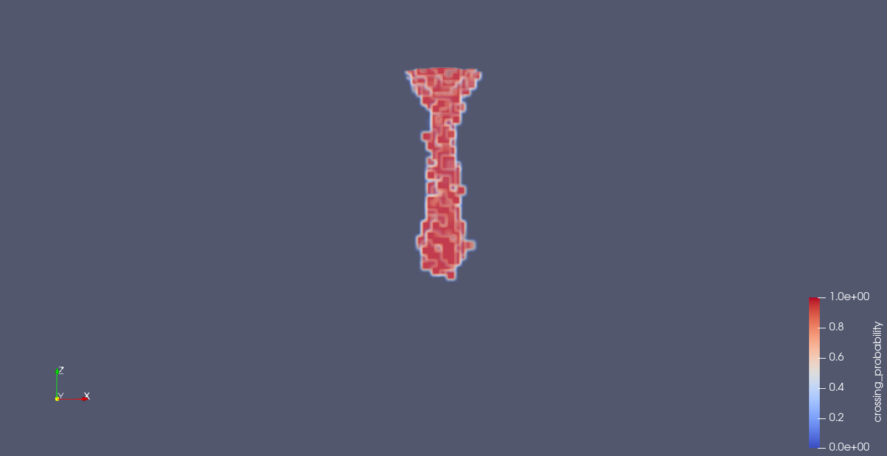
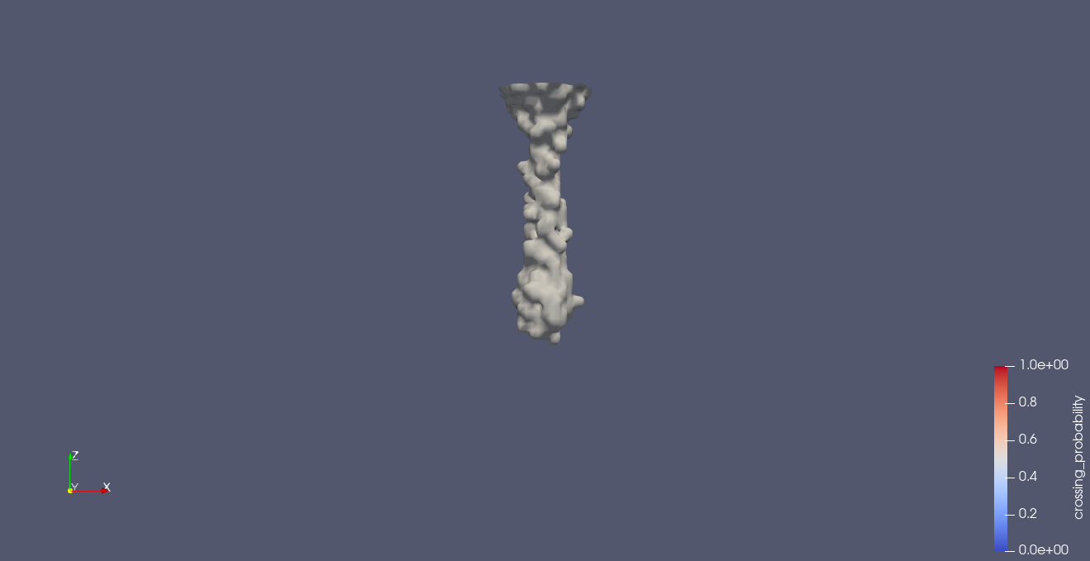
WITH 150 NEURONS
MEAN AND STD TRAINED COMBINEDLY

Slide 7
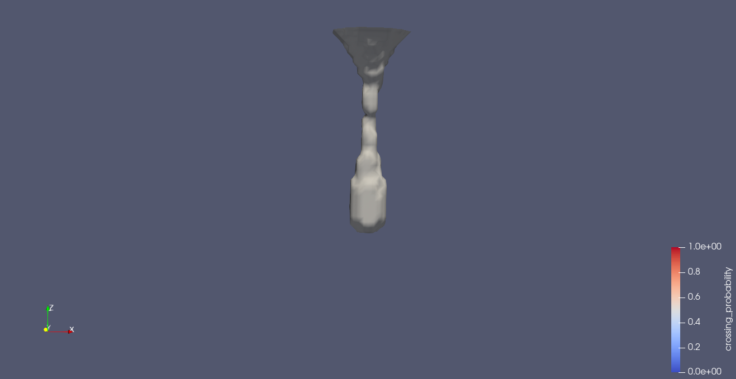
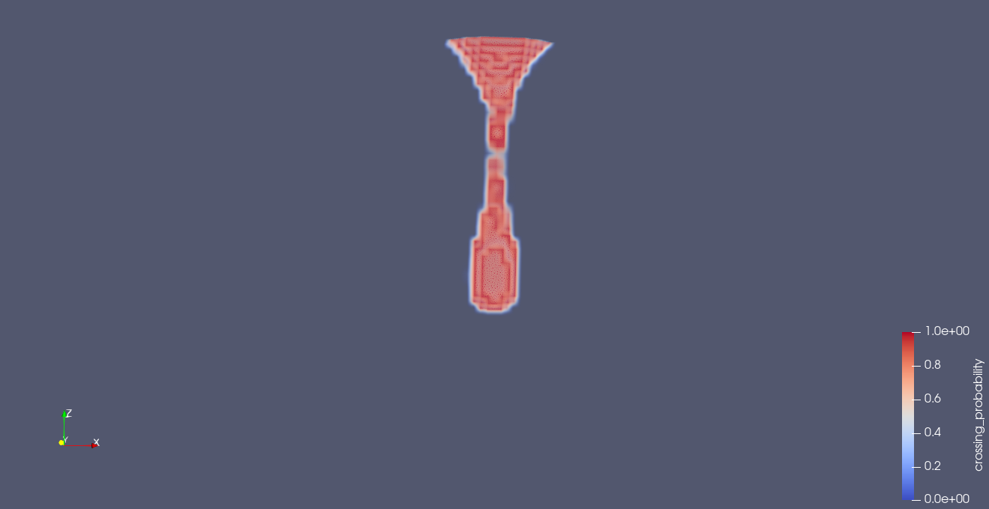
WITH 150 NEURONS
MEAN AND STD TRAINED WITH DIFFERENT MODELS

Slide 8
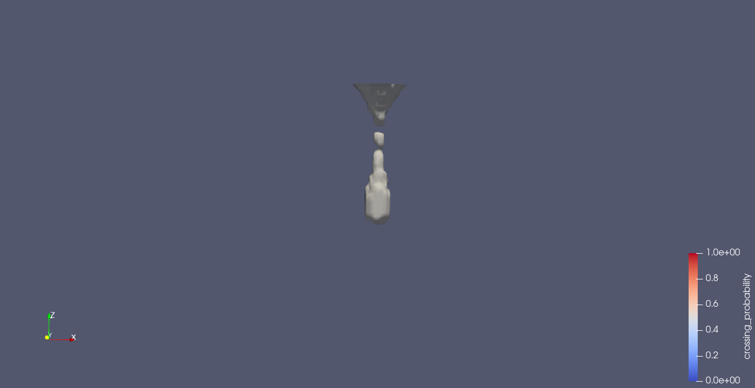
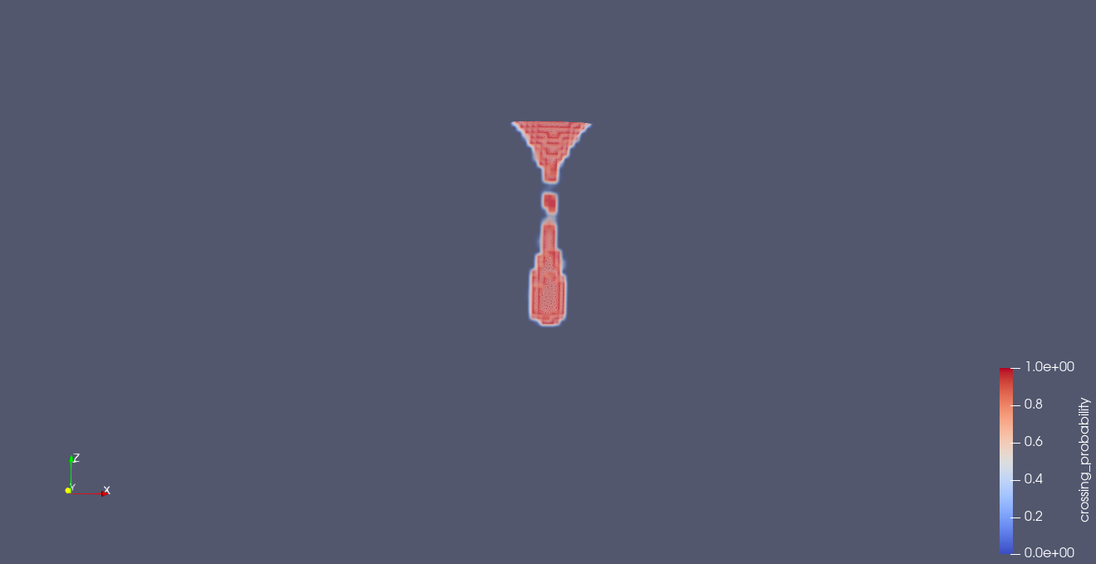
WITH 100 NEURONS
MEAN AND STD TRAINED WITH DIFFERENT MODELS

Slide 9
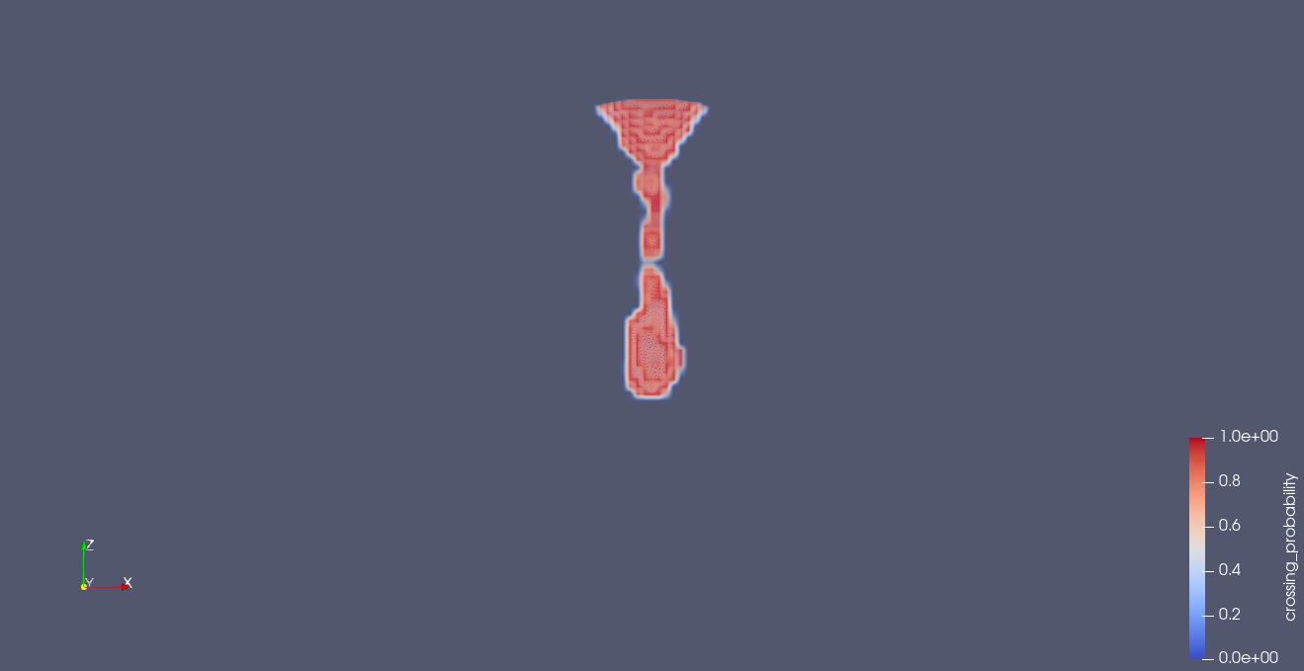
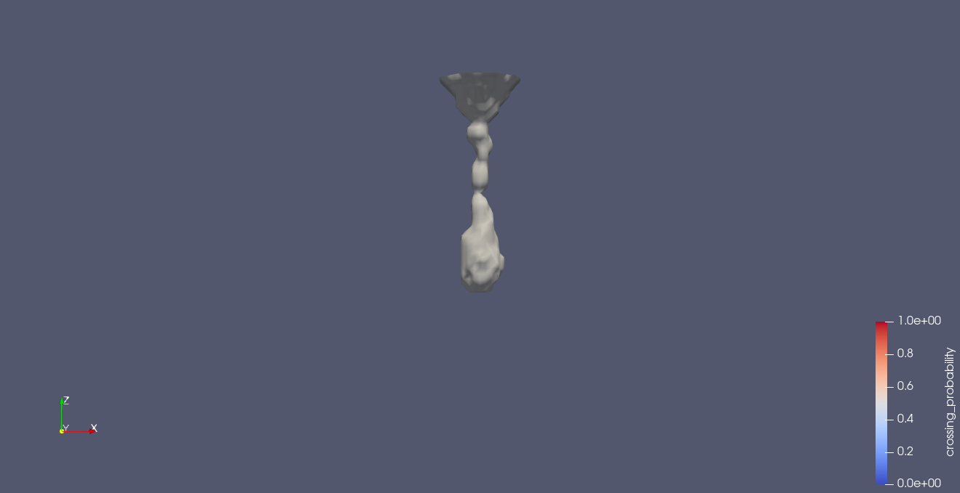
WITH 75 NEURONS
MEAN AND STD TRAINED WITH DIFFERENT MODELS

Slide 10
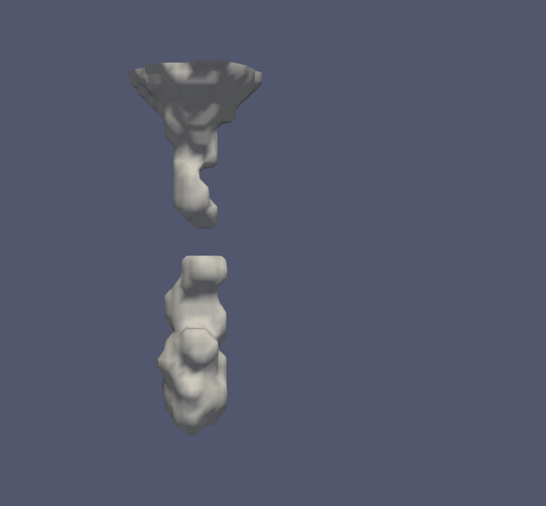

WITH 50 NEURONS
MEAN AND STD TRAINED WITH DIFFERENT MODELS

Slide 11
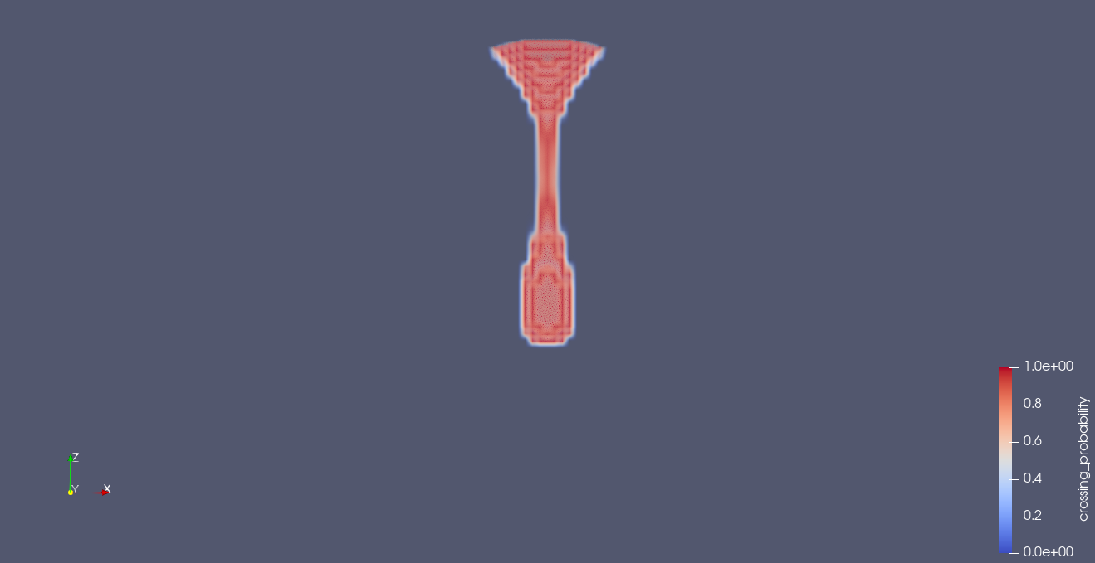
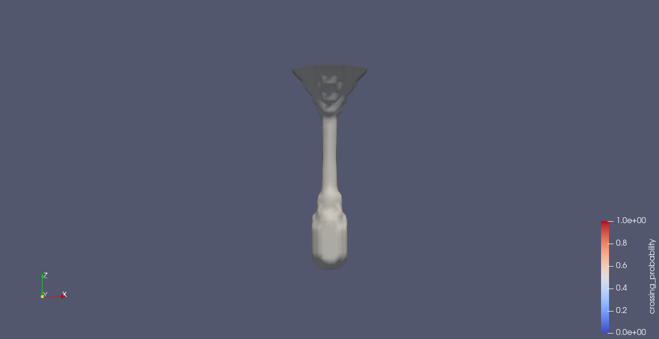
ORIGINAL TEARDROP GAUSSIAN DATASET WITH ISO VALUE 159.9798

Slide 12
Generation of gaussian and gmm datasets using isabel
I used 24 neighbours to calculate standard deviation
After the generation of gaussian I did not std as zero for any point.
So I generated gmm dataset with 3 –components
I plotted the loss during training when training using siren

Slide 13
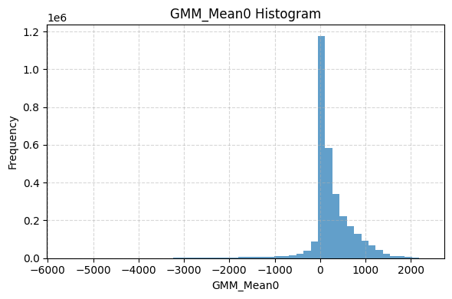
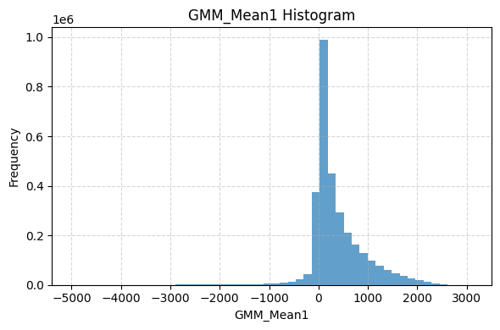
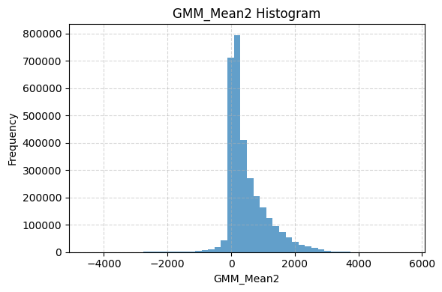
Histogram Distribution of GMM Mean Components in gmm dataset

Slide 14
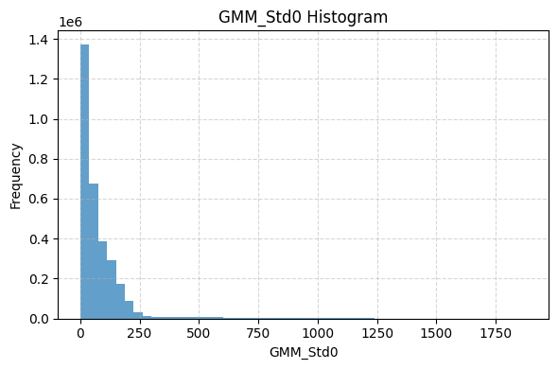

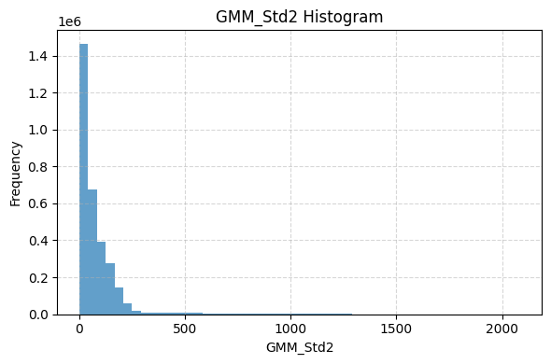
Histogram Distribution of GMM STD Components in gmm dataset

Slide 15
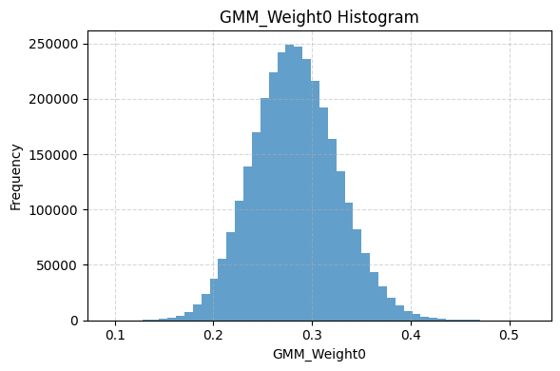
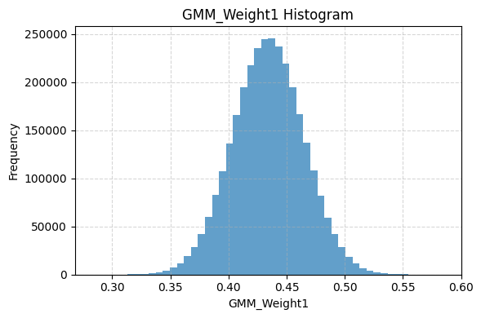
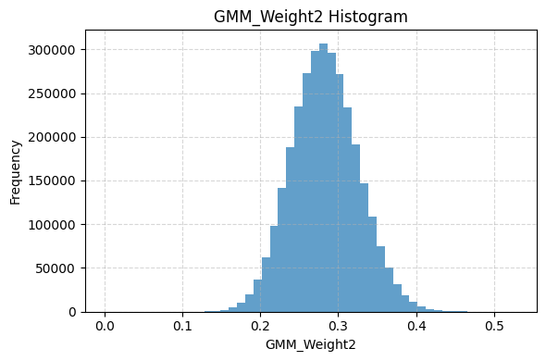
Histogram Distribution of GMM weights Components in gmm dataset

Slide 16
When I trained with 150 neurons the gmm dataset predicted psnr values are
variable | Psnr value
GMM_Mean0 | 44.84974623443168
GMM_Mean1 | 45.45198826500048
GMM_Mean2 | 46.56783828958738
GMM_Std0 | 41.91337560106874
GMM_Std1 | 43.01154597556938
GMM_Std2 | 42.76765444001239
GMM_Weigh0 | 21.043050301696443
GMM_Weight1 | 20.380498552489893
GMM_Weight2 | 22.53042956245537
Average psnr | 36.501791913590196
RMSE | 0.10079844284908461

Slide 17
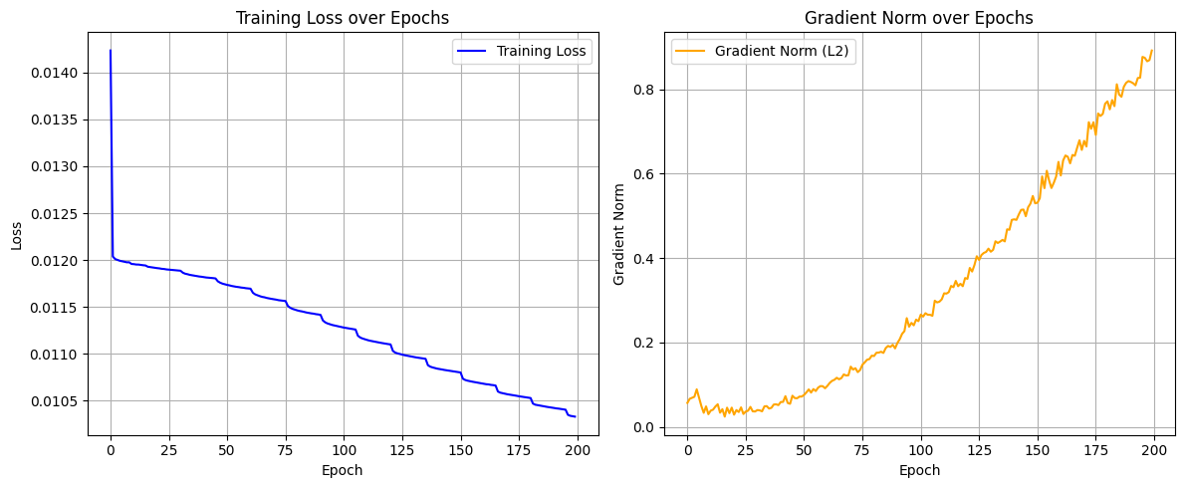
For 150 neurons

Slide 18
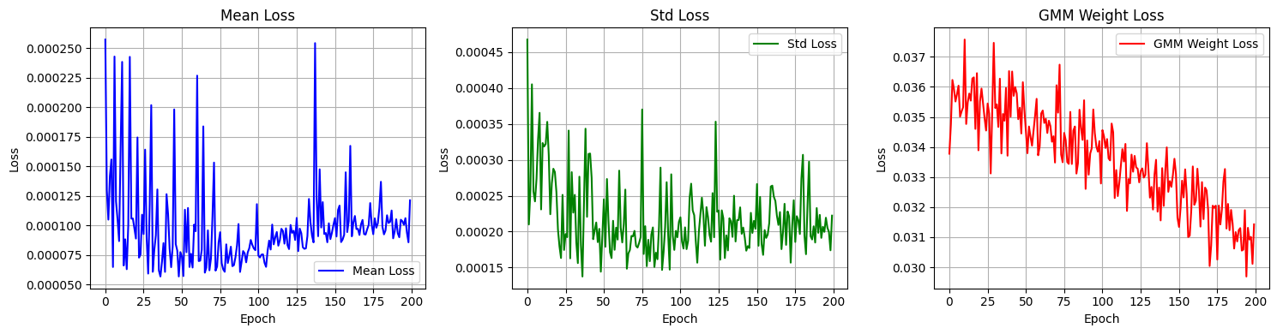
With 150 neurons and the plots show how the each stastical property loss decreasing across epochs

Slide 19
OBSERVATIONS FROM PLOTS:
Mean loss vs epochs plot
There fluctuations in the graph
means componnets are learned quickly by the network
initial loss after first epoch is approx. 0.0001
STD loss vs epochs plot
There fluctuations in the graph
std componets are learned quickly by the network
initial loss after first epoch is approx. 0.00025.
Mean and std components are learned quickly by the network, with the loss reaching its minimum in fewer epochs compared to other components.Despite the rapid convergence of the mean and std components, the training continues for 200 epochs due to the slower convergence of the GMM weight component.
As a result, the mean and std losses show minor fluctuations (increasing and decreasing trends) even after reaching near-optimal values early in training.
Weights loss vs epochs plot
The initial loss after the first epoch is approximately 0.036, which is significantly higher than the losses for mean and std components.
The weights loss scale is about 100× larger than that of the mean and std losses, indicating a different magnitude of optimization.The loss is decreasing.
I think this is the weights ae not learning very quickly
Although the loss gradually decreases, the decline is relatively slow and less stable.

Slide 20
RESULTS OF PREDICTED GMM DATASET WITH 320 NEURONS
With 150 neurons
variable | Psnr value
GMM_Mean0 | 43.89544969987719
GMM_Mean1 | 44.6762679584089
GMM_Mean2 | 41.600959277978305
GMM_Std0 | 41.91337560106874
GMM_Std1 | 42.52544751480539
GMM_Std2 | 42.34507206125229
GMM_Weigh0 | 24.637314528247153
GMM_Weight1 | 22.674514038258096
GMM_Weight2 | 25.33990923591391
Average psnr | 37.061069139565305
RMSE | 0.07317564190826542
variable | Psnr value
GMM_Mean0 | 44.84974623443168
GMM_Mean1 | 45.45198826500048
GMM_Mean2 | 46.56783828958738
GMM_Std0 | 41.91337560106874
GMM_Std1 | 43.01154597556938
GMM_Std2 | 42.76765444001239
GMM_Weigh0 | 21.043050301696443
GMM_Weight1 | 20.380498552489893
GMM_Weight2 | 22.53042956245537
Average psnr | 36.501791913590196
RMSE | 0.10079844284908461

Slide 21
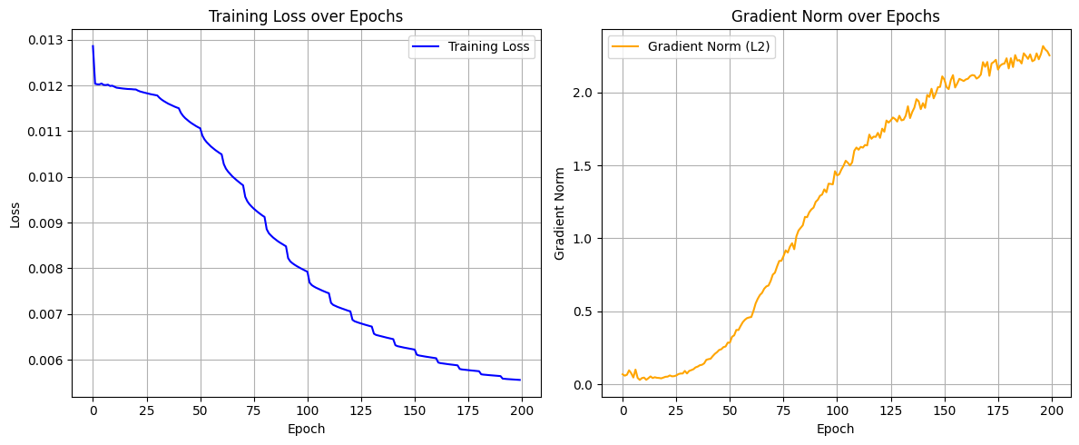
FOR 150 NEURONS

Slide 22
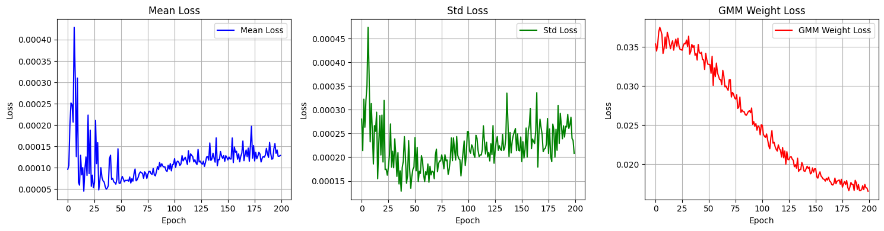
With 320 neurons and the plots show how the each statstical property loss decreasing across epochs

Slide 23
Observations This Week:
When I used separate models to predict the mean and standard deviation, the resulting predicted dataset produced a better isocontour compared to using a single model for both.
A good PSNR for the mean often results in a better isocontour.
The gradient norm field of the weights is very low, indicating that the weights are not changing as quickly as the mean and std components with (x,y,z).
There is no match sptial information for weights to learn I think this is the reason why they are not getting good psnr values.
I think,Applying weighting to the loss (e.g., increasing weight loss importance) improves weights PSNR, but reduces the PSNR of mean and std.
The GMM weight values in the dataset exhibit low variance.
The loss values for mean, std, and weights are not on the same scale. I think,Using a loss function like: total_loss = loss_mean + loss_std + 0.01 * loss_weights helps bring weights loss closer to the scale of mean loss. However, in this case, the weights may not improve significantly.like we decrease the importance of weight loss.
Increasing model capacity — for example, from 320 to 400 or 500 neurons per layer or from 6 to 8 blocks — might help improve weight learning.because the gradient norm is increasing and loss of weights is still decreasing for 320 neurons.

Slide 24
Week 7

Slide 25
I increased the no of neurons in the models
[300 neurons]
[350 neurons]
Variable | PSNR
GMM_Mean0 | 50.68538852454506
GMM_Mean1 | 51.82190518609326
GMM_Mean2 | 52.159960141684046
GMM_Std0 | 46.284891093468204
GMM_Std1 | 48.10045509375277
GMM_Std2 | 46.911142360946094
GMM_Weight0 | 20.6634182481077
GMM_Weight1 | 20.20132361253499
GMM_Weight2 | 22.495532353945332
Average psnr | 39.9248907350086
RMSE | 0.021932
Variable | PSNR
GMM_Mean0 | 50.18182835662976
GMM_Mean1 | 51.316061552124495
GMM_Mean2 | 51.54530339478251
GMM_Std0 | 45.86846982773601
GMM_Std1 | 47.933022707695805
GMM_Std2 | 46.55642596354995
GMM_Weight0 | 22.834263973621717
GMM_Weight1 | 20.341310328221454
GMM_Weight2 | 24.713002653208953
Average psnr | 40.14329875084118
RMSE | 0.018522

Slide 26
[400 neurons]
[450 neurons]
Variable | PSNR
GMM_Mean0 | 50.205253978668324
GMM_Mean1 | 51.60168410875397
GMM_Mean2 | 51.6871439135054
GMM_Std0 | 45.714349648117974
GMM_Std1 | 47.965080551043215
GMM_Std2 | 46.5437480175122
GMM_Weight0 | 24.813084174172406
GMM_Weight1 | 20.99176636993146
GMM_Weight2 | 26.547743285444895
Average psnr | 40.67442822746109
RMSE | 0.015980
Variable | PSNR
GMM_Mean0 | 50.674759015589586
GMM_Mean1 | 51.9603004719618
GMM_Mean2 | 51.85521297777086
GMM_Std0 | 46.42110397847088
GMM_Std1 | 48.159167736384745
GMM_Std2 | 47.08193165596305
GMM_Weight0 | 25.809918019121845
GMM_Weight1 | 21.402980606080003
GMM_Weight2 | 28.001577832950627
Average psnr | 41.262994699365926
RMSE | 0.014520

Slide 27
500 neurons
Variable | PSNR
GMM_Mean0 | 50.69643759920173
GMM_Mean1 | 51.917958727938576
GMM_Mean2 | 51.978975362959694
GMM_Std0 | 45.60617146725501
GMM_Std1 | 48.26964658825009
GMM_Std2 | 46.41242325976934
GMM_Weight0 | 28.29385234728999
GMM_Weight1 | 23.59420425482977
GMM_Weight2 | 30.26184005562364
Average psnr | 41.89238996256864
RMSE | 0.011914
=== Summary: Avg PSNR by Neuron Count ===
300 neurons: Avg PSNR = 39.9249
350 neurons: Avg PSNR = 40.1433
400 neurons: Avg PSNR = 40.6744
450 neurons: Avg PSNR = 41.2630
500 neurons: Avg PSNR = 41.8924

Slide 28
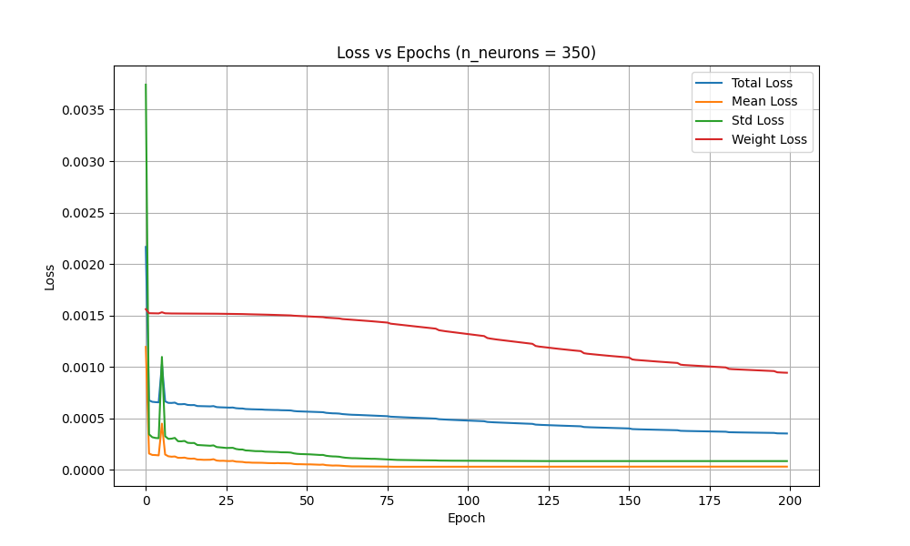
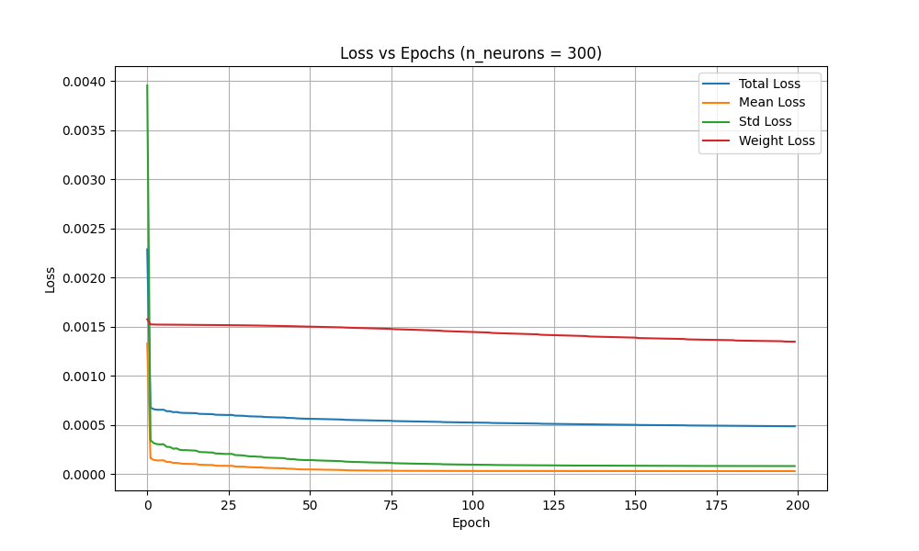

Slide 29
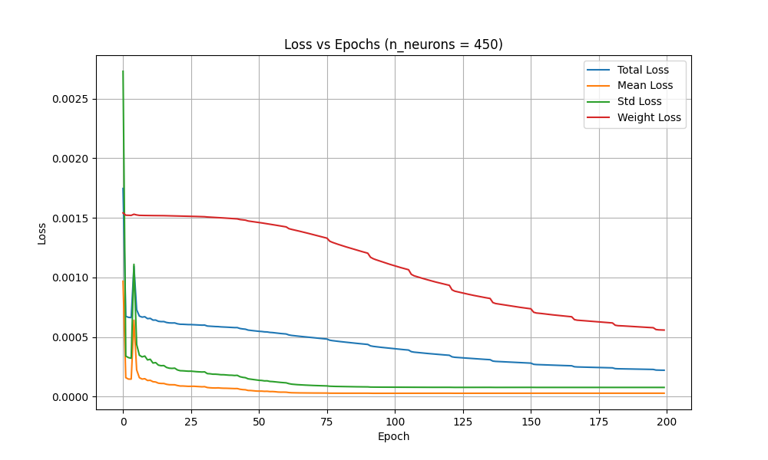
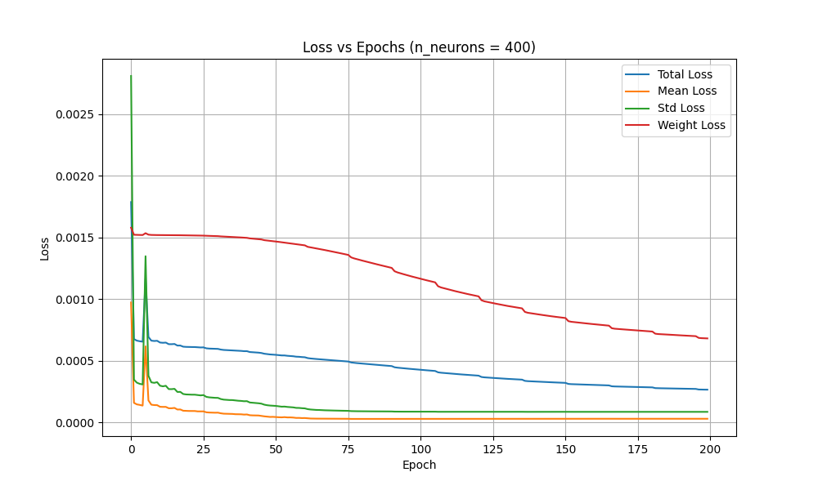

Slide 30
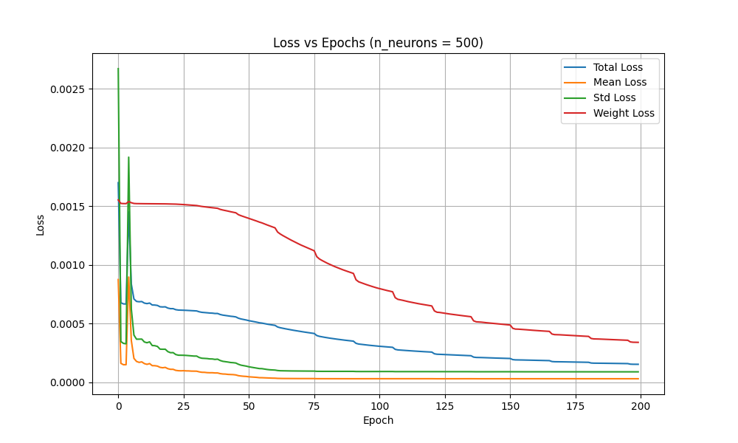

Slide 31
[150 neurons | alpha = 5]
[150 neurons | alpha = 10]
Variable | PSNR
GMM_Mean0 | 48.13619267068614
GMM_Mean1 | 48.905095830682015
GMM_Mean2 | 50.11823974273967
GMM_Std0 | 43.33768306505051
GMM_Std1 | 44.99806440779931
GMM_Std2 | 44.16635435697887
GMM_Weight0 | 20.11484719927527
GMM_Weight1 | 19.971321139067694
GMM_Weight2 | 21.93092912498912
Average psnr | 37.964303
RMSE | 0.023805
Variable | PSNR
GMM_Mean0 | 45.349276750941186
GMM_Mean1 | 45.79528187641489
GMM_Mean2 | 46.687280523483274
GMM_Std0 | 42.486488209758974
GMM_Std1 | 43.77896335062971
GMM_Std2 | 43.30042041418854
GMM_Weight0 | 20.60450170227691
GMM_Weight1 | 20.025649047849544
GMM_Weight2 | 36.7188011281659
Average psnr | 36.718801
RMSE | 0.023504

Slide 32
=== Summary: Avg PSNR by Alpha ===
alpha = 5: Avg PSNR = 37.9643
alpha = 10: Avg PSNR = 36.7188
alpha = 20: Avg PSNR = 35.7200
alpha = 30: Avg PSNR = 35.1181
alpha = 40: Avg PSNR = 35.0714
alpha = 50: Avg PSNR = 34.2428
alpha = 60: Avg PSNR = 34.0522
alpha = 70: Avg PSNR = 33.9629
alpha = 80: Avg PSNR = 33.5362
alpha = 90: Avg PSNR = 33.5027
alpha = 100: Avg PSNR = 33.5391
alpha = 0.1: Avg PSNR = 38.5815
alpha = 0.01: Avg PSNR = 37.9175
alpha = 0.05: Avg PSNR = 38.1682
alpha = 0.5: Avg PSNR = 37.9563
alpha = 0.001: Avg PSNR = 38.0186
alpha = 0.005: Avg PSNR = 37.8184

Slide 33
=== Average Gradient Magnitude per Field ===
GMM_Mean0: 49.891052
GMM_Mean1: 48.417450
GMM_Mean2: 53.302048
GMM_Std0: 13.526381
GMM_Std1: 9.703481
GMM_Std2: 13.540495
GMM_Weight0: 0.049081
GMM_Weight1: 0.035096
GMM_Weight2: 0.049043
Observations:
The weights has small variance compared to mean and std.
Very low variation — the weights are nearly flat across space. These values hardly change spatially.
Moderate variation — these standard deviation fields are smoother than the means. They change, but not as sharply.
These mean fields have strong spatial variation — the values change a lot across space. They likely contain detailed structures or features.
So when x,y,z are changing there is no changing in weight values so train with x,y,z as input it is very difficult to good psnr for weight componnents.

