Slide 1
Thesis meeting
Week 8

Slide 2
Instant Neural Graphics Primitives with a Multiresolution Hash Encoding
Paper discuss about how to capture the finer details when we reconstruct the data
Inspired from transformers and attention
As there are feature representation in the nlp for words. We have feature representation for each grid point
First they create a level of grids let say grids of 16x16x16,32x32x32,……..512x512x512.
Then the data in this grids is learned during training.
To store efficiently and access every grid point we use hash table of size n for each level.
We have encoder part i.e the hash table store feature representations.
We have small mlp which is decoder.
The results in the paper are good so I tried this approach.
Model size is 65 MB. I used 16 layers and hash table for each grid of size 2^19

Slide 3
variable | psnr
GMM_Mean0 | 34.834049224853516
GMM_Mean1 | 35.100341796875
GMM_Mean2 | 35.085365295410156
GMM_Std0 | 31.520713806152344
GMM_Std1 | 31.542598724365234
GMM_Std2 | 32.40241241455078
GMM_Weight0 | 34.59486389160156
GMM_Weight1 | 34.31684112548828
GMM_Weight2 | 36.342994689941406

Slide 4
Uncertainty-based Multi-Task Loss for Deep Learning Regression
total_loss = (
(1 / (2 * torch.exp(log_sigma_means) ** 2)) * loss_means + log_sigma_means +
(1 / (2 * torch.exp(log_sigma_stds) ** 2)) * loss_stds + log_sigma_stds +
(1 / (2 * torch.exp(log_sigma_weights) ** 2)) * loss_weights + log_sigma_weights
)
where log_sigma_means,log_sigma_stds,log_sigma_weights are uncertianies associated with their componnents

Slide 5
With 150 neurons
variable | psnr
GMM_Mean0 | 50.13675768151905
GMM_Mean1 | 51.12603007005838
GMM_Mean2 | 51.959698635795505
GMM_Std0 | 44.88317925206796
GMM_Std1 | 45.629468617454954
GMM_Std2 | 20.102607026557703
GMM_Weight0 | 19.935151223201782
GMM_Weight1 | 19.935151223201782
GMM_Weight2 | 21.920187961608267
Average psnr | 39.19652692438011
RMSE | 0.023364
THERE IS IMPROVEMENT IN MEANS AND STDS BUT NO IMPROVEMENT IN WEIGHTS

Slide 6
EMA_TRAINING
# Compute gradient norms
g_mean = compute_grad_norm(loss_mean)
g_std = compute_grad_norm(loss_std)
# EMA tracking
grad_ema["mean"] = ema_decay * grad_ema["mean"] + (1 - ema_decay) * g_mean
grad_ema["std"] = ema_decay * grad_ema["std"] + (1 - ema_decay) * g_std
# Compute adaptive weights
total_ema = grad_ema["mean"] + grad_ema["std"]
w_mean = total_ema / grad_ema["mean"]
w_std = total_ema / grad_ema["std"]
# Final loss (weighted)
final_loss = w_mean * loss_mean + w_std * loss_std

Slide 7
Since we are using different for each component mean and std I tired use them in single model.
I tired different combinations of neuorns and weights the result of psnr are best but iso surface better than previous(combined model) but no that good
100 neuorns -> 2blocks
100 neuorns -> 2blocks_ema
150 neuorns -> 2blocks_ema
Mean_psnr | 47.7
Std_psnr | 36.3
Avg_psnr | 42.005
Model_size | 160kb
Mean_psnr | 54.2
Std_psnr | 35.5
Avg_psnr | 44.908
Model_size | 160kb
Mean_psnr | 56.14
Std_psnr | 40.38
Avg_psnr | 48
Model_size | 362kb

Slide 8
180 neuorns -> 2blocks_ema
320 neuorns -> 3blocks_ema
320 neuorns -> 1blocks_ema
Mean_psnr | 56.266045
Std_psnr | 44.12411
Avg_psnr | 50.19
Model_size | 518kb
Mean_psnr | 66.587299
Std_psnr | 77.00
Avg_psnr | 71
Model_size | 2.36mb
Mean_psnr | 67
Std_psnr | 44
Avg_psnr | 56
Model_size | 813kb

Slide 9
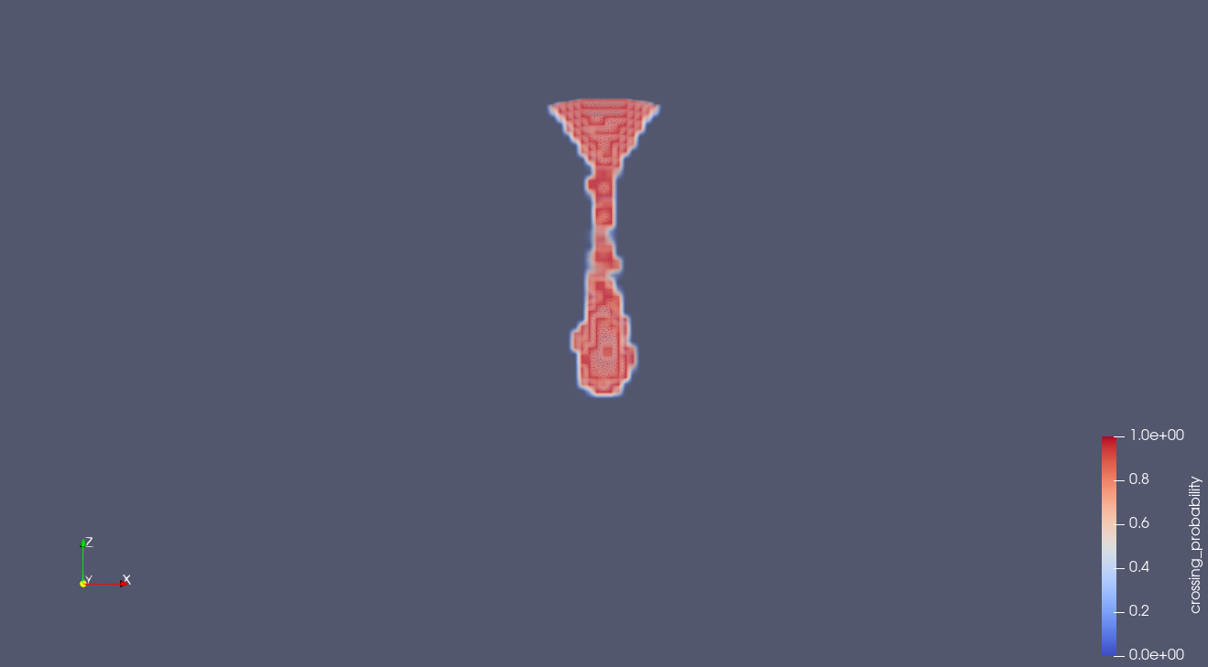
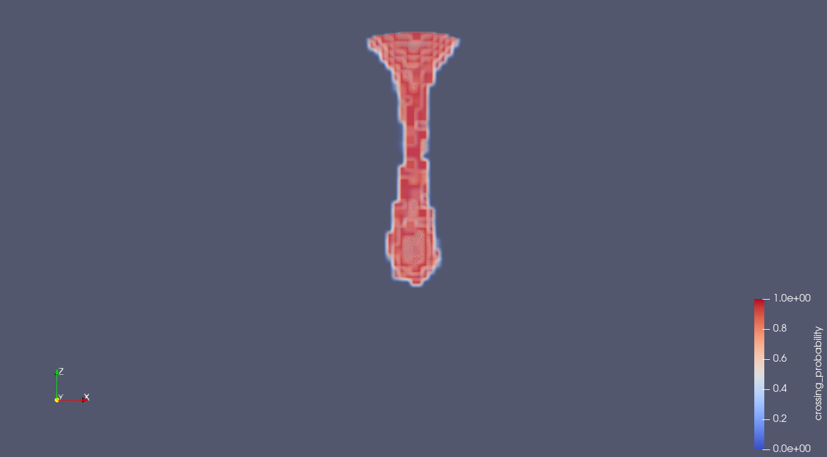

320_1_layer
320_3_layers
320_2_layers

Slide 10
I tired quantization method to prune the model it reduced to 269 kb but psnr drops to 72 to 44.
I am thinking of adding patterns to the field then after prediction subract that pattern.

