Slide 1
Thesis Meeting
Week 13

Slide 2
Variable_name | psnr
mean | 81.05476284932116
Mean_rmse | 0.00017712989011017433
std | 85.15517594744747
Std_rmse | 0.00011047682849939942
variable | psnr
GMM_Mean0 | 52.85720206271286
GMM_Mean1 | 53.05718976799278
GMM_Mean2 | 52.275178479143925
GMM_Std0 | 34.96048935725756
GMM_Std1 | 36.929754264515815
GMM_Std2 | 35.5661347586169
GMM_Weight0 | 21.266653435614128
GMM_Weight1 | 21.200009165903083
GMM_Weight2 | 21.00507326270257
Average psnr | 36.56863161716218
RMSE | 0.102860264

Slide 3
The problems faced this week
The probablisitic marching cubes not worked on rectangular grid. There is some inconsistence in saving vti file.it has taken lot of time to figure out it.
The std in predicted datasets we are getting negatives in gaussian as well as in gmm datasets.
At first I have seen in gmm so I fixed for gmm by two methods
The first adding tanh at the end so the output scales to[-1,1].
The second one is log transformation of std
eps = 1e-8
val[:, std_idx] = np.log(val[:, std_idx] + eps)
for i in std_idx:
min_data = np.min(val[:, i])
max_data = np.max(val[:, i])
val[:, i] = 2.0 * ((val[:, i] - min_data) / (max_data - min_data) - 0.5)

Slide 4
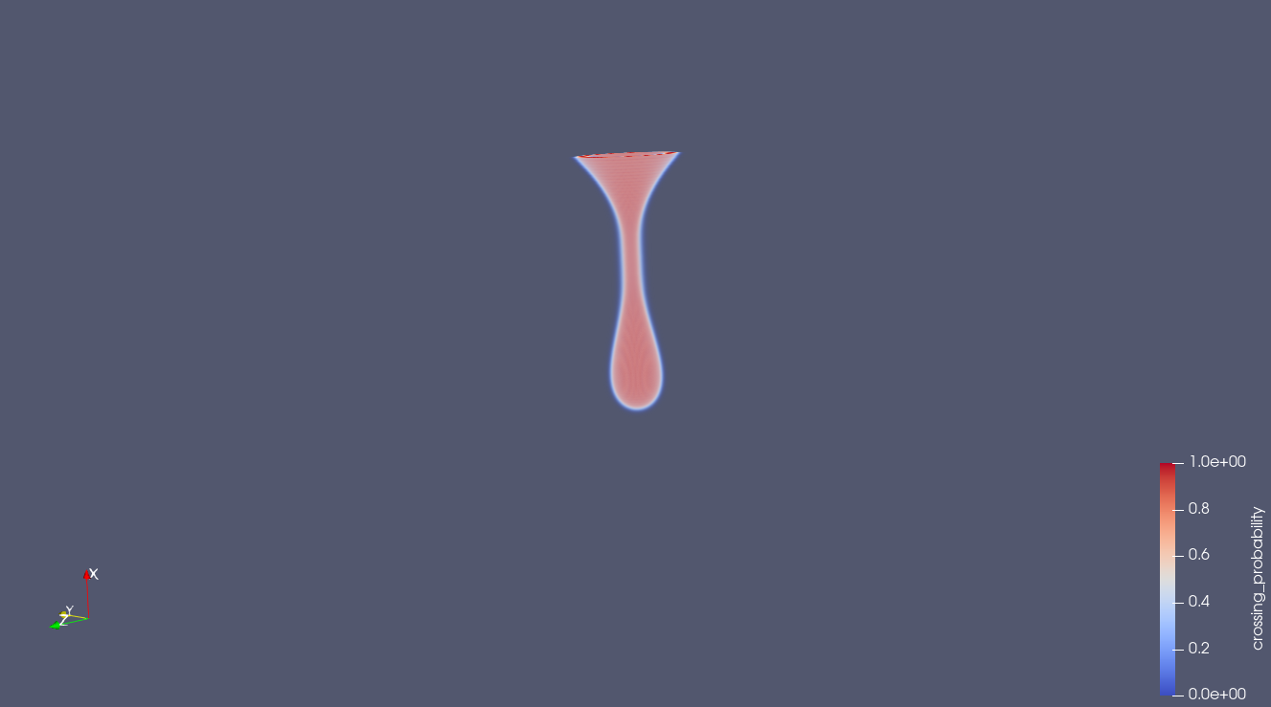
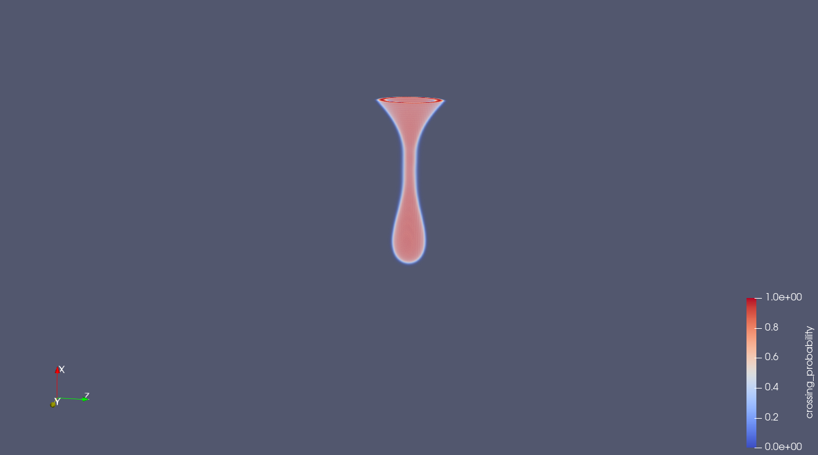
On teardrop_128*128*128_gaussian.vti file
Variable_name | psnr
mean | 81.82765183350214
std | 87.11274761378158
Average_psnr | 84.47019972364185
Rmse | 0.00013045406103250512
Original_gaussian_isosurface
Predicted_gaussian_isosurface

Slide 5
On teardrop_128*128*128_gmm.vti file
used 180 neurons and std log transormation
variable | psnr
GMM_Mean0 | 55.52934336636599
GMM_Mean1 | 55.549143179763504
GMM_Mean2 | 54.942701807859706
GMM_Std0 | 39.307978560967804
GMM_Std1 | 41.747658114466084
GMM_Std2 | 39.252505440933476
GMM_Weight0 | 19.82989184523482
GMM_Weight1 | 20.452309865394053
GMM_Weight2 | 19.937945074089406
Average psnr | 38.5054974727861
RMSE | 0.11521189594282878

Slide 6
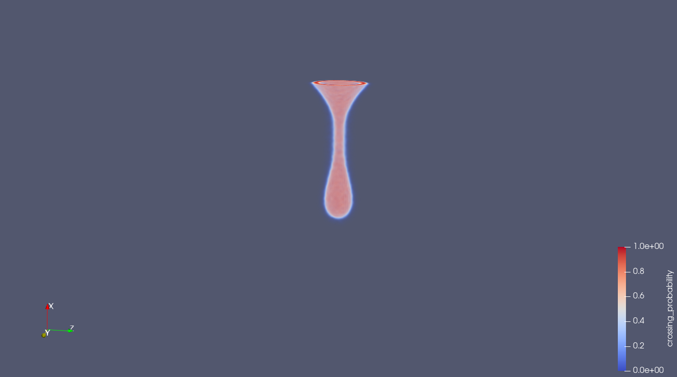

On original_gmm_teardrop
On predicted_gmm_teardrop

Slide 7
On teardrop_128*128*128_gmm.vti file
used 150 neurons and tanh transormation
variable | psnr
GMM_Mean0 | 55.36601648991801
GMM_Mean1 | 55.40222340964735
GMM_Mean2 | 54.72859222756558
GMM_Std0 | 35.15823217663269
GMM_Std1 | 36.834695527144966
GMM_Std2 | 34.73371881657913
GMM_Weight0 | 21.66070427848239
GMM_Weight1 | 20.247727198597936
GMM_Weight2 | 21.666695450882226
Average psnr | 37.31095617505003
RMSE | 0.10314664079296022

Slide 8
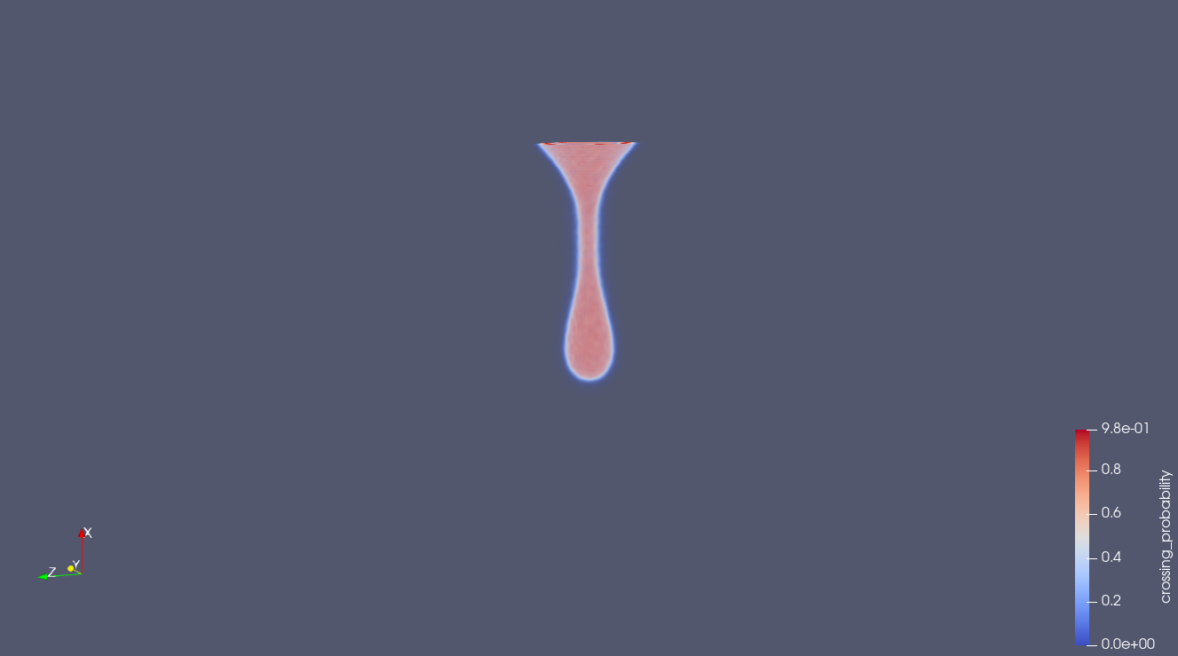
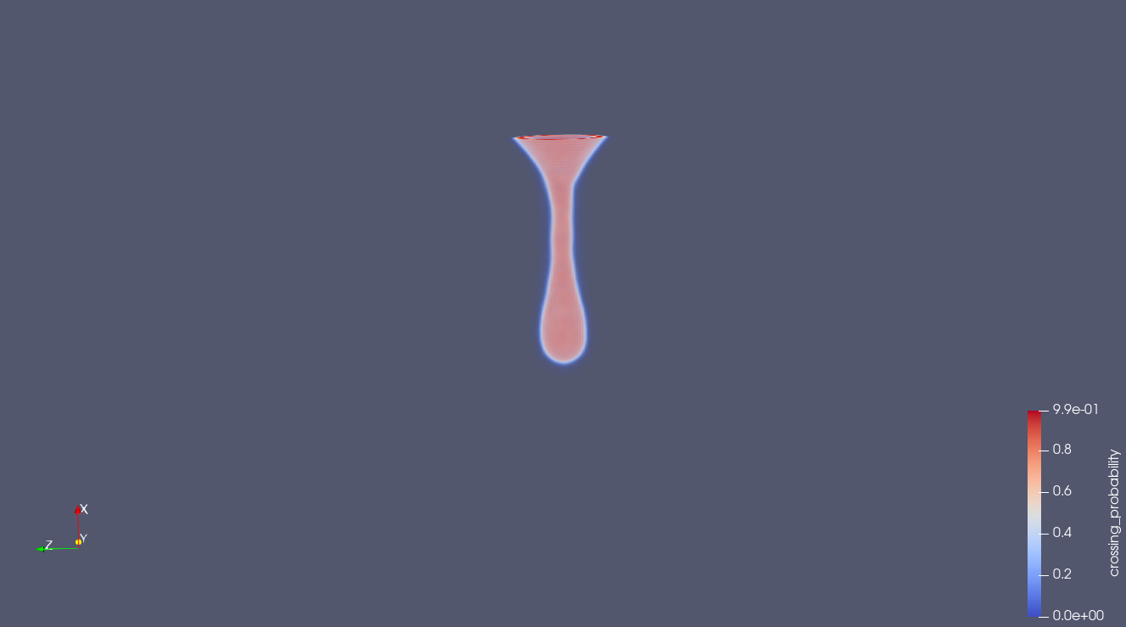
On original_gmm_teardrop
On predicted_gmm_teardrop

Slide 9
On isabel_gmm.vti file
used 150 neurons and tanh transormation
variable | psnr
GMM_Mean0 | 52.81208396496978
GMM_Mean1 | 54.040416864909425
GMM_Mean2 | 54.89906310699559
GMM_Std0 | 49.218597682836986
GMM_Std1 | 50.739830433156015
GMM_Std2 | 49.06157711294832
GMM_Weight0 | 21.356897232247935
GMM_Weight1 | 20.085474913061447
GMM_Weight2 | 21.0875694240108
Average psnr | 41.47794563723736
RMSE | 0.10530733748501203

Slide 10
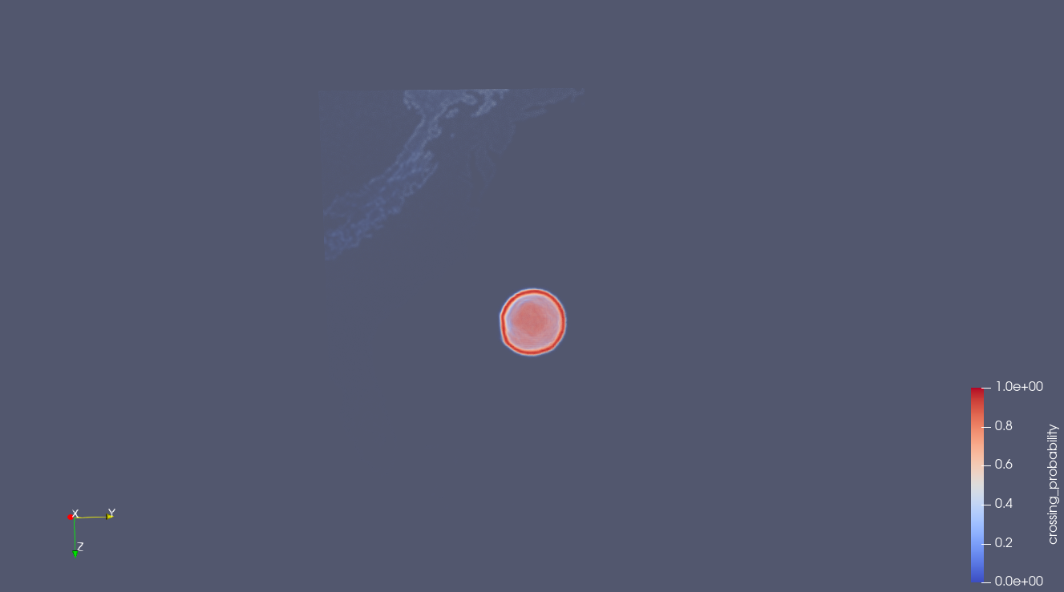

On original_isabel_gmm
On predicted_isabel_gmm

Slide 11
On isabel_gmm.vti file
used 180 neurons and tanh transormation
variable | psnr
GMM_Mean0 | 53.45328095856853
GMM_Mean1 | 54.63576720505762
GMM_Mean2 | 55.4329464253225
GMM_Std0 | 50.550457899088315
GMM_Std1 | 51.81091081759572
GMM_Std2 | 50.87805311527766
GMM_Weight0 | 22.168342227806367
GMM_Weight1 | 20.878452999783114
GMM_Weight2 | 23.356191447768445
Average psnr | 42.573822566252026
RMSE | 0.09162731638658178

Slide 12
On predicted_isabel_gmm
On original_isabel_gmm

Slide 13
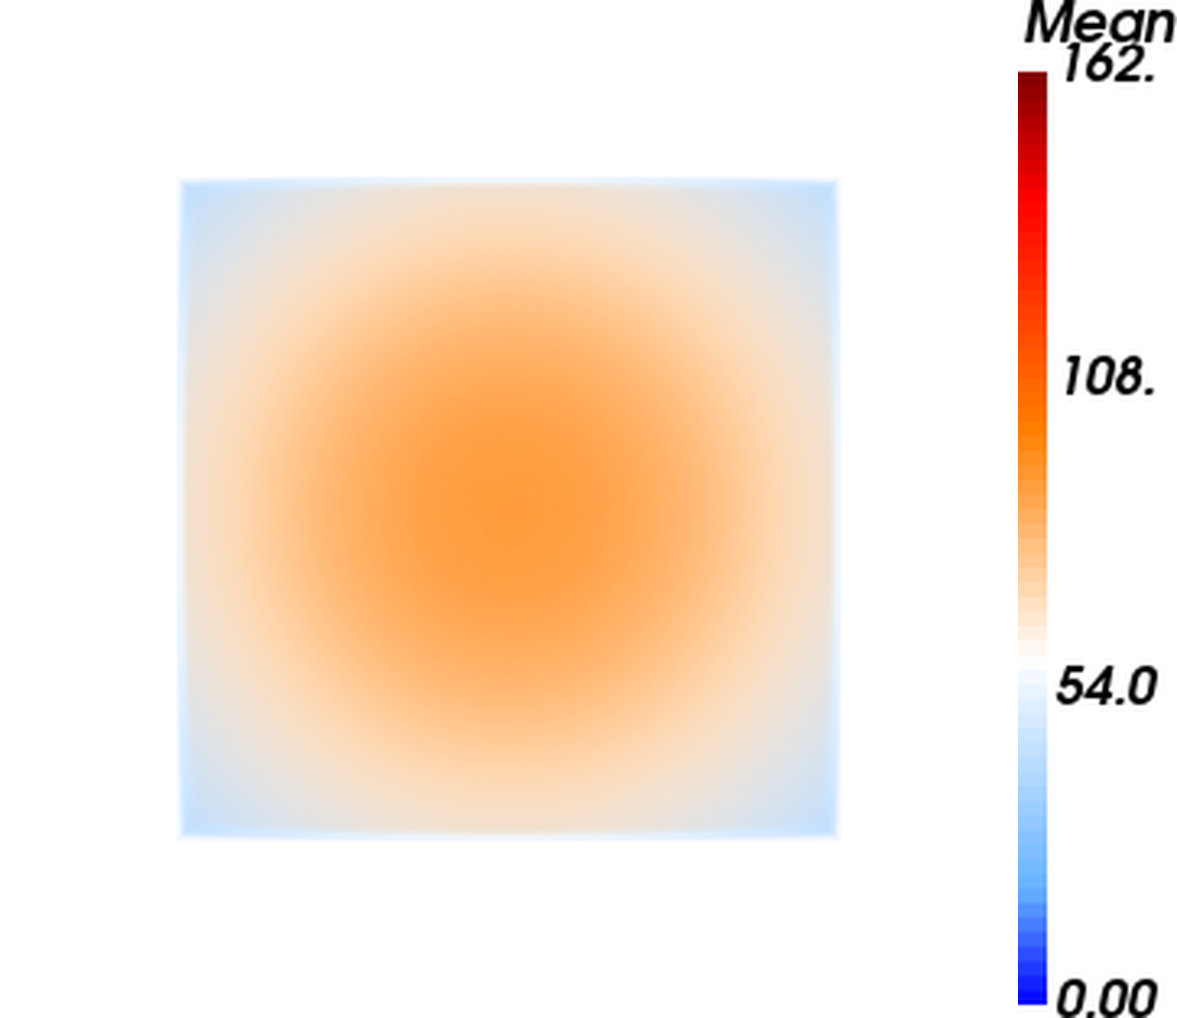

Volume rendering on teardrop_gmm
Mean_original_front
Mean_predicted_front

Slide 14
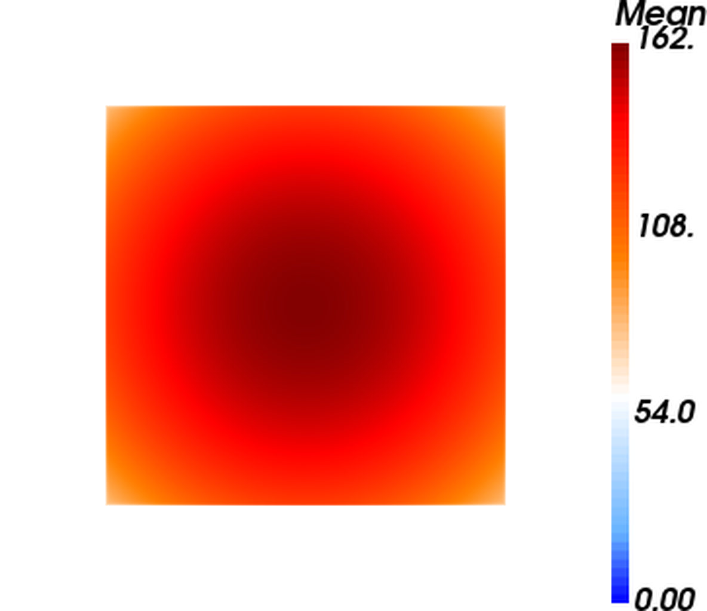

Mean_original_back
Mean_predicted_back

