Slide 1
THESIS MEETING
WEEK 5

Slide 2
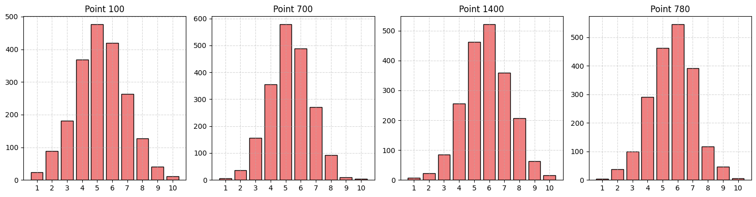
HISTOGRAM DATASET :ISABEL

Slide 3
Three heads approach and 150 neurons
variable | PNSR VALUE
GMM_Mean0 | 45.834816004019
GMM_Mean1 | 47.00352263106169
GMM_Mean2 | 47.90792950877452
GMM_Std0 | 46.01488435172483
GMM_Std1 | 47.15446023311529
GMM_Std2 | 46.4477757102207
GMM_Weight0 | 27.45882988363473
GMM_Weight1 | 24.32572532377982
GMM_Weight2 | 22.553957168079265
Average psnr | 39.41098918613458
RMSE: | 0.023770873

Slide 4
Three different models each with 150 neurons on Isabel dataset
variable | PNSR VALUE
GMM_Mean0 | 69.86358692062308
GMM_Mean1 | 69.47344938637569
GMM_Mean2 | 69.36991253847741
GMM_Std0 | 42.86743236562045
GMM_Std1 | 42.85970858249337
GMM_Std2 | 42.95604818176638
GMM_Weight0 | 33.37286158508181
GMM_Weight1 | 32.73838162732251
GMM_Weight2 | 34.073979662689915
Average psnr | 48.61948453893896
RMSE: | 0.01048636

Slide 5
Teardrop_hist.vti with 320 neruons and 250 epochs
variable | PNSR VALUE
Bin_1 | 32.28083583683942
Bin_2 | 30.82116863683565
Bin_3 | 32.42848972345543
Bin_4 | 32.97757422850286
Bin_5 | 31.719955055789658
Bin_6 | 31.704007667188463
Bin_7 | 32.87418971828012
Bin_8 | 32.753359977968884
Bin_9 | 32.22169796633131
Bin_10 | 34.47119678784613
Average psnr | 48.61948453893896
RMSE: | 0.01048636

Slide 6
ON ISABEL DATASET WITH 320 NERUONS 250 EPOCHS
variable | PNSR VALUE
GMM_Mean0 | 38.017699728803
GMM_Mean1 | 38.39557146564917
GMM_Mean2 | 40.19041128921137
GMM_Std0 | 42.07880809737389
GMM_Std1 | 42.11922546630849
GMM_Std2 | 42.536426666247664
GMM_Weight0 | 26.140022052845854
GMM_Weight1 | 24.280421033162764
GMM_Weight2 | 21.039232126397987
Average psnr | 34.97753532511113
RMSE: | 0.0805909842891456

Slide 7
ISABEL_HIST WITH 320 NEURONS AND WITH 250 EPOCHS
variable | PNSR VALUE
Bin_1 | 21.064372683904335
Bin_2 | 20.258117278434923
Bin_3 | 20.01717876989965
Bin_4 | 19.81988902749301
Bin_5 | 23.627333150806965
Bin_6 | 30.92362894914003
Bin_7 | 20.03524121066662
Bin_8 | 20.434236499205557
Bin_9 | 21.699231173875255
Bin_10 | 21.04578837797224
Average psnr | 21.892501712139858
RMSE: | 0.17477897649485186

Slide 8
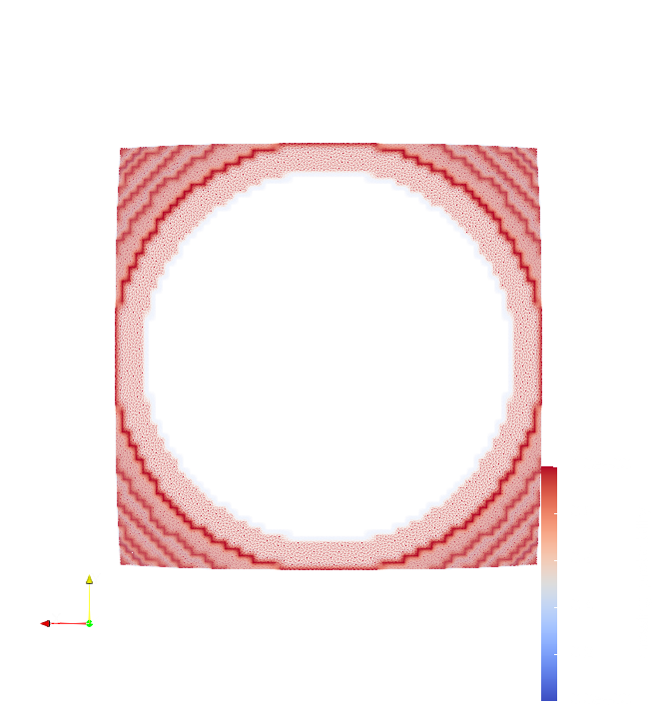
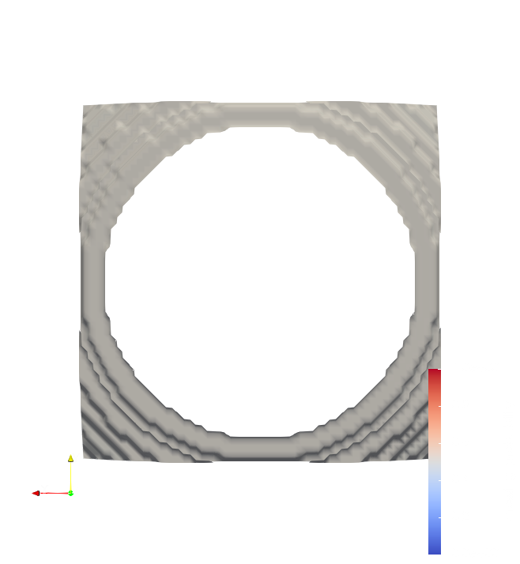
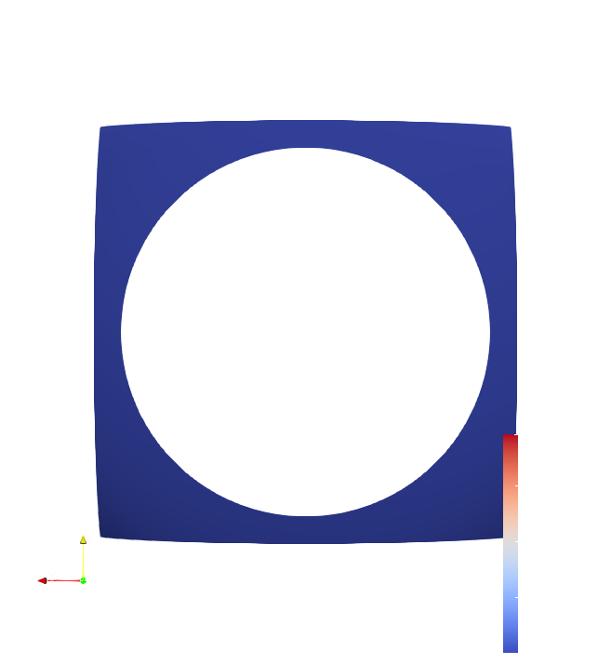
PROBABLISTIC MARCHING CUBES
TEARDROP_GAUSSIAN.VTI
ISO_VALUE=50
CROSSING_PROB=0.5
ORIGINAL ISOSURFACE
GENERATED BY PMC

Slide 9

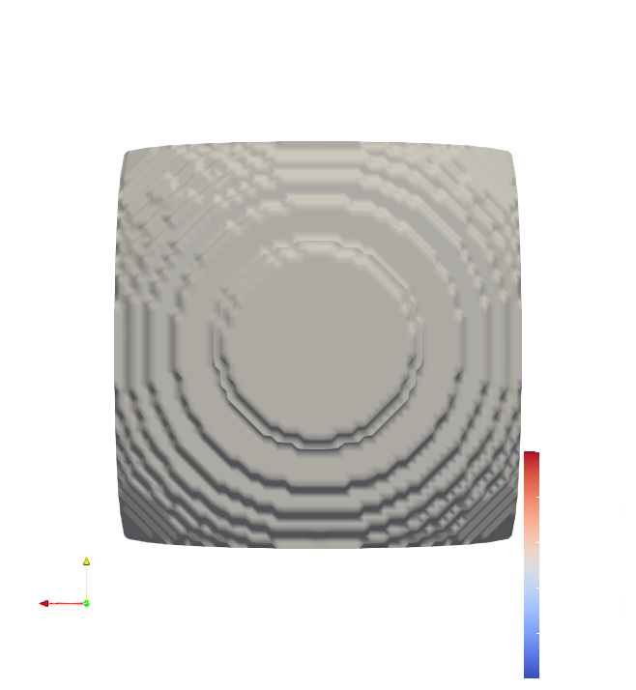
ISO VALUE=81

Slide 10
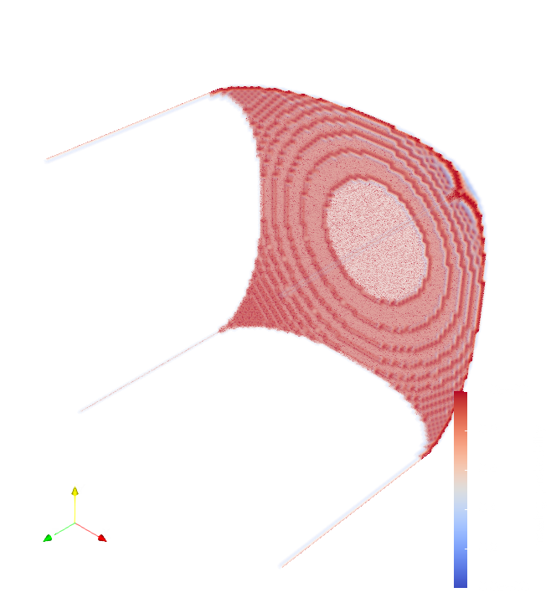


Slide 11
THE OBSERVATION MADE BY ME THIS WEEK
As neruons increases there is no improvement inc ase datasets generated from Isabel .vti
In case of teardrop_gmm.vti there is improvement
So in the zip file they give directly gaussian file.
So they might be problem while generating gaussian dataset
I have detailed on observation of datasets
I noticed some std in case of Isabel_gaussian there are zeros. I think that is the problem.
So I am currently generating Isabel_gaussian.vti with more neighbours and constraint with std not equal to zero.
If in this it doesnot work then there might problem as data is large the model capacity should also increase

