Slide 1
Thesis meeting
Week 10

Slide 2
On teardrop_128*128*128_gmm.vti file
variable | psnr
GMM_Mean0 | 52.85720206271286
GMM_Mean1 | 53.05718976799278
GMM_Mean2 | 52.275178479143925
GMM_Std0 | 34.96048935725756
GMM_Std1 | 36.929754264515815
GMM_Std2 | 35.5661347586169
GMM_Weight0 | 21.266653435614128
GMM_Weight1 | 21.200009165903083
GMM_Weight2 | 21.00507326270257
Average psnr | 36.56863161716218
RMSE | 0.102860264

Slide 3
On teardrop_128*128*128_gaussian.vti file
Variable_name | psnr
mean | 81.05476284932116
Mean_rmse | 0.00017712989011017433
std | 85.15517594744747
Std_rmse | 0.00011047682849939942

Slide 4
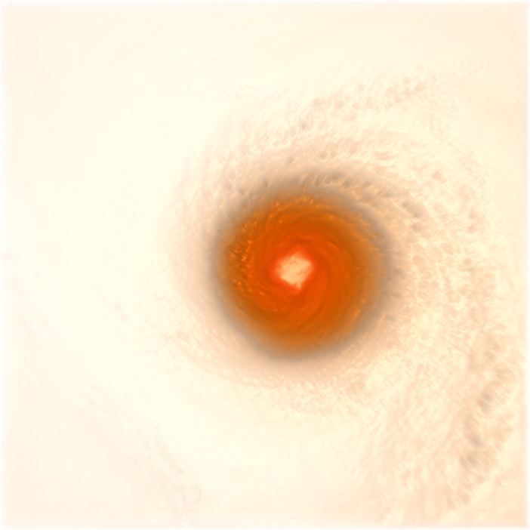
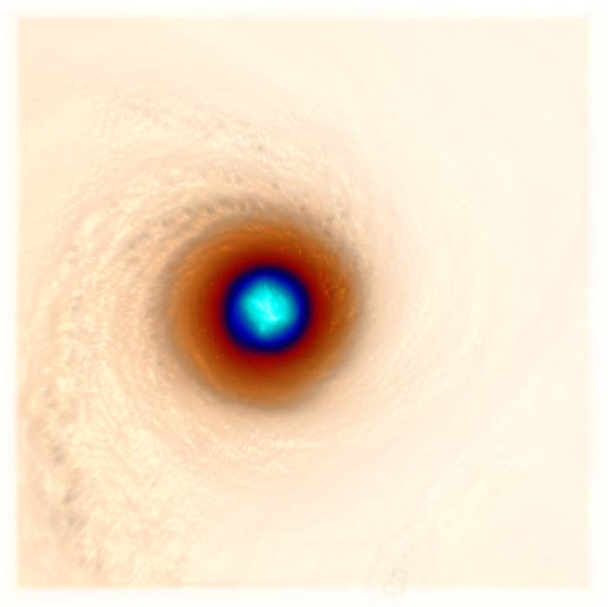
Volume_rendering of Isabel_dataset using smartvolumer mapper inspired form first assignment with phong shade on and I have take values for colot and opacity from assignment 1
front
back

Slide 5
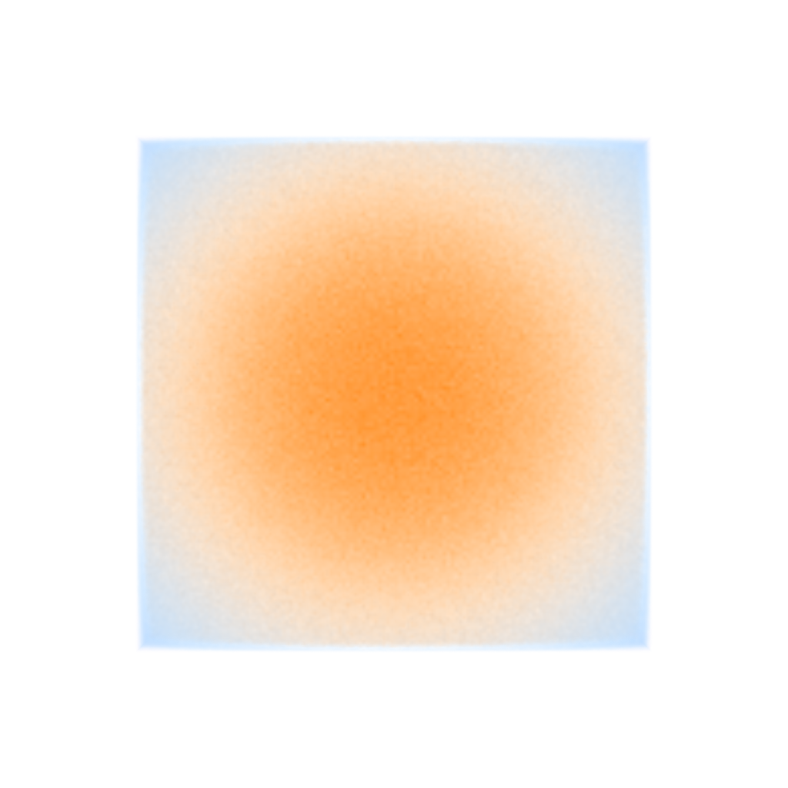
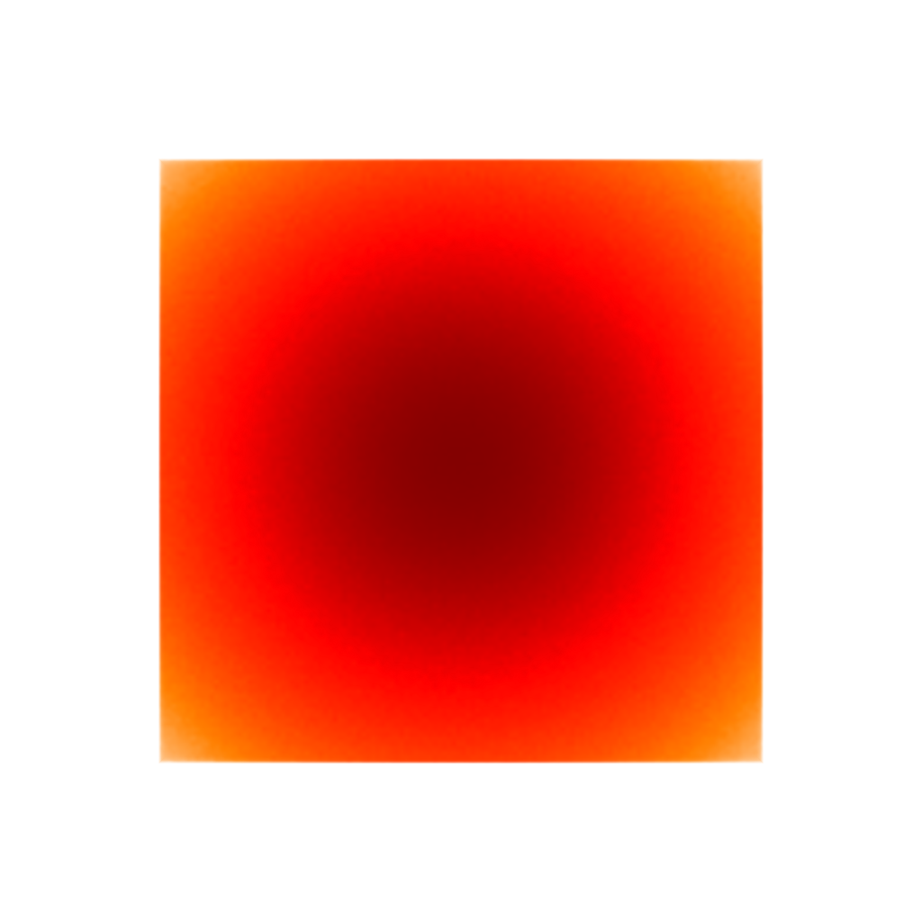
On teardrop_128*128*128.vti file one sample

Slide 6
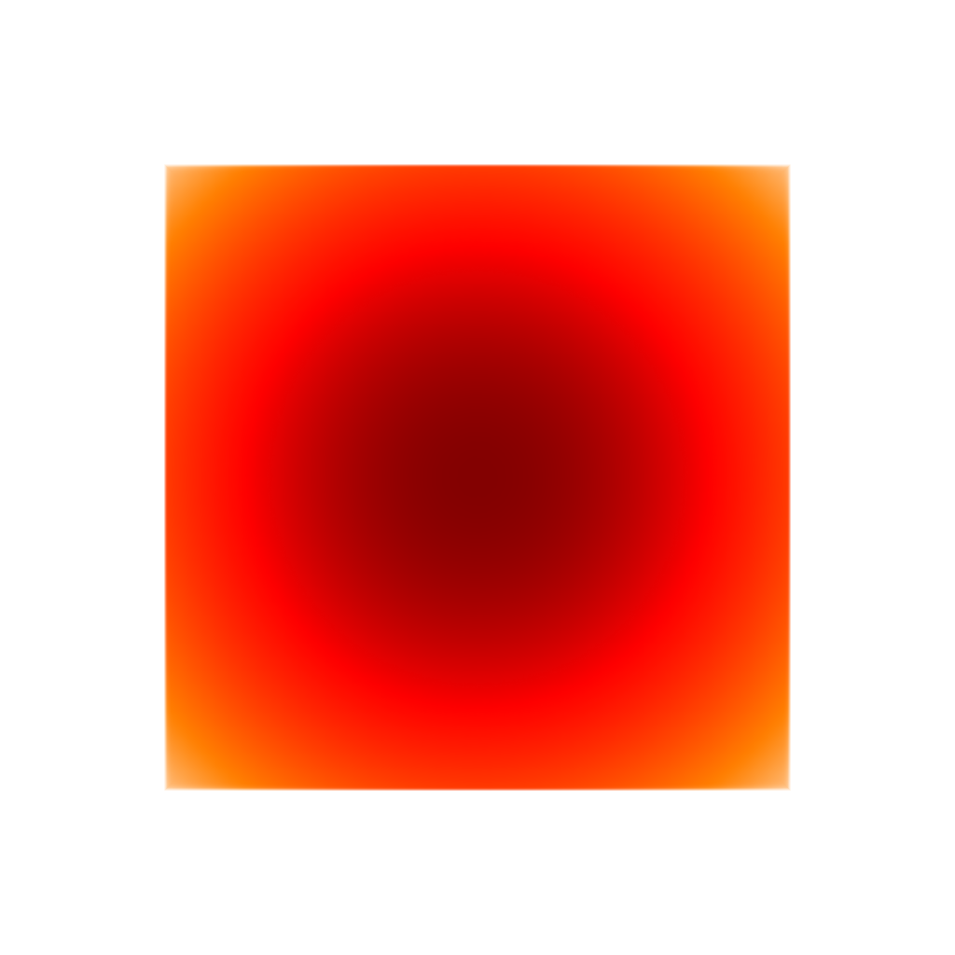

I have taken hundred samples from gaussian files and there are images of average_pixel_image of hundred samples

