Slide 1
Thesis Meeting
Week 14

Slide 2
Isabel_Gaussian
Variabe | Psnr
Mean | 60.0315568201194
Std | 56.34812321739823
Average Psnr | 58.189840018758844
RMSE | 0.0025733854845772885

Slide 3
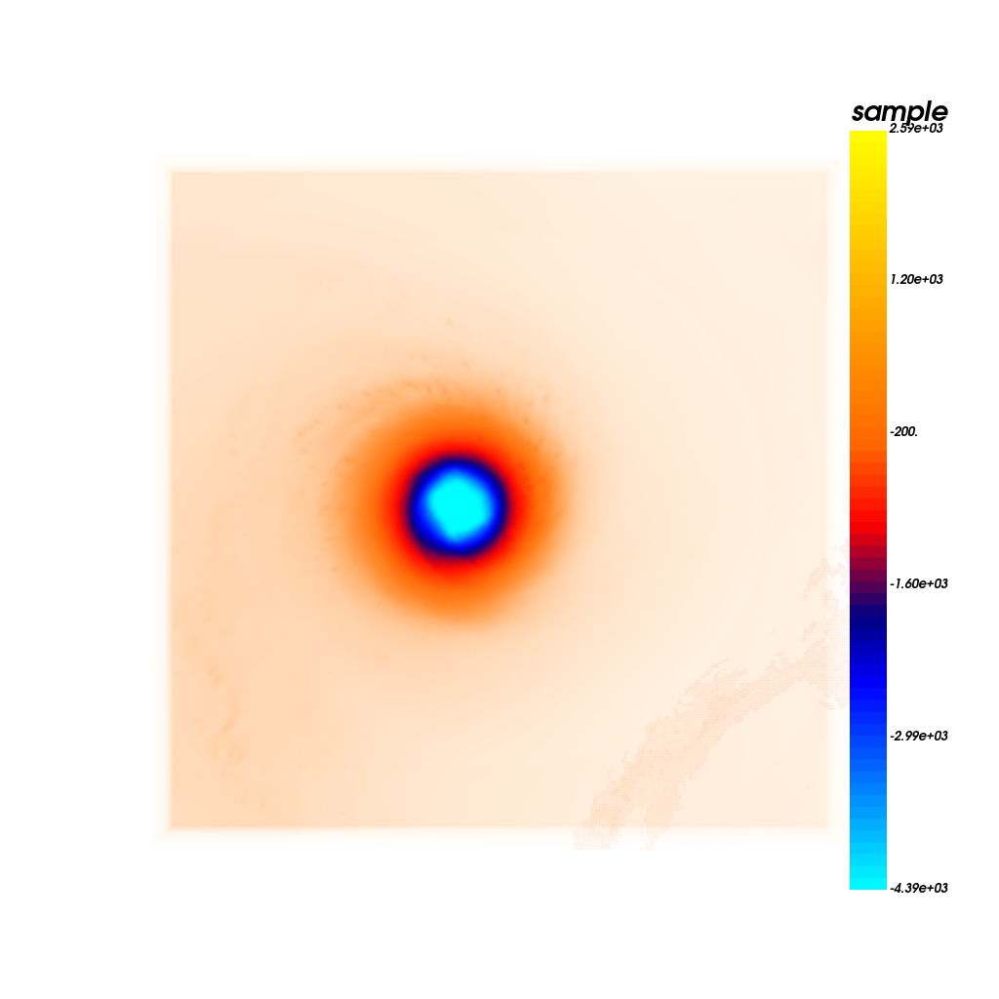

VOLUME RENDERING
Mean_back_original
Mean_back_predicted

Slide 4
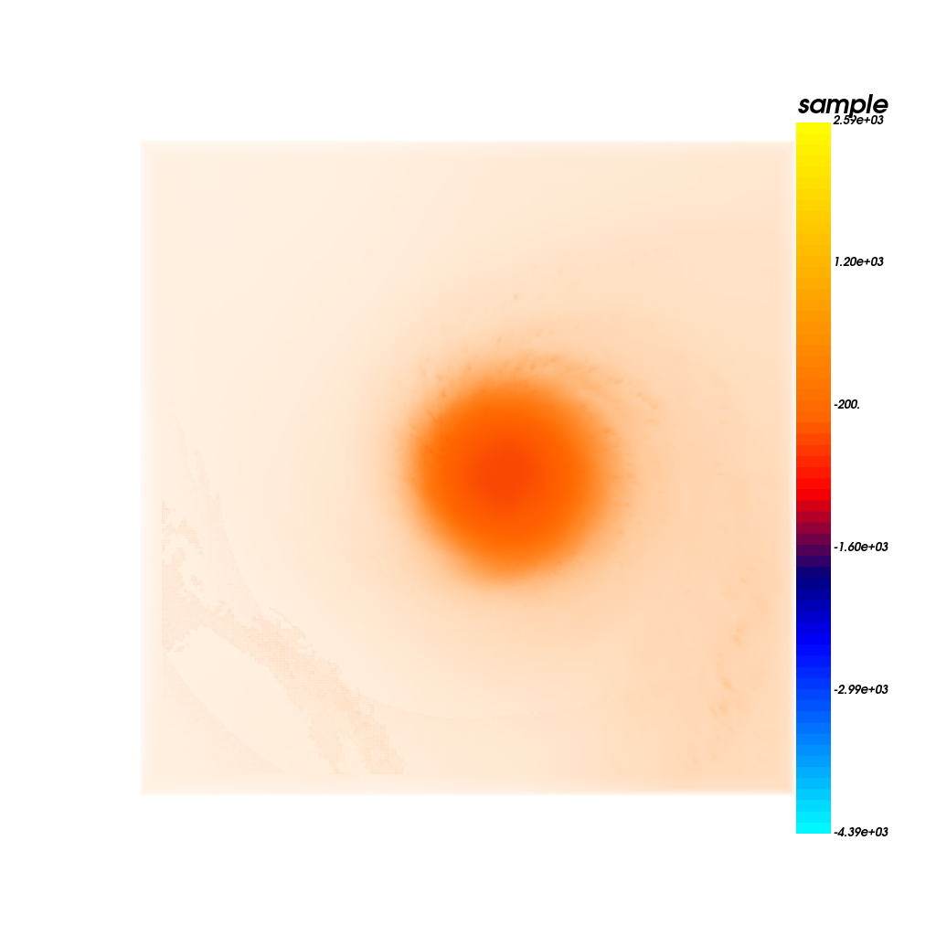
Mean_front_original
Mean_front_predicted

Slide 5
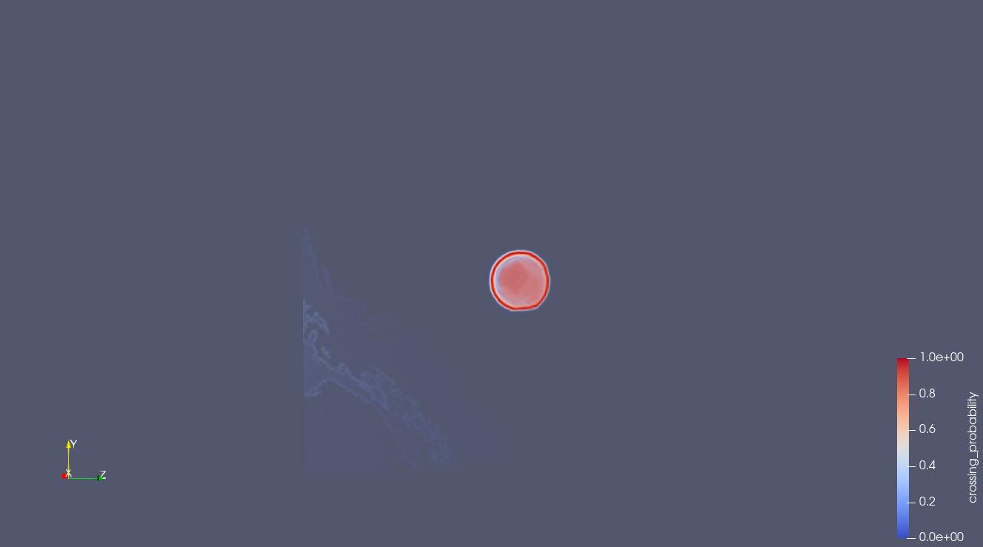

Original_Gaussian_isosurface
Predicted_Gaussian_isosurface

Slide 6
Isabel_Gaussian_before_distillation
Isabel_Gaussian_after_distillation_into_single_model
Variabe | Psnr
Mean | 60.0315568201194
Std | 56.34812321739823
Average Psnr | 58.189840018758844
RMSE | 0.0025733854845772885
Variabe | Psnr
Mean | 54.1177
Std | 53.2743

Slide 7

Original_gaussian_isosurfaces_isabel
KD_gaussian_isosurfaces_Isabel

Slide 8
Teardrop_Gaussian_before_distillation
KD_gaussian_isosurfaces_teardrop
Variabe | Psnr
Mean | 81.4074113092276
Std | 85.71168114121399
Average Psnr | 83.5595462252208
RMSE | 0.00014082835423453324
Variabe | Psnr
Mean | 55.0834
Std | 54.1784

Slide 9
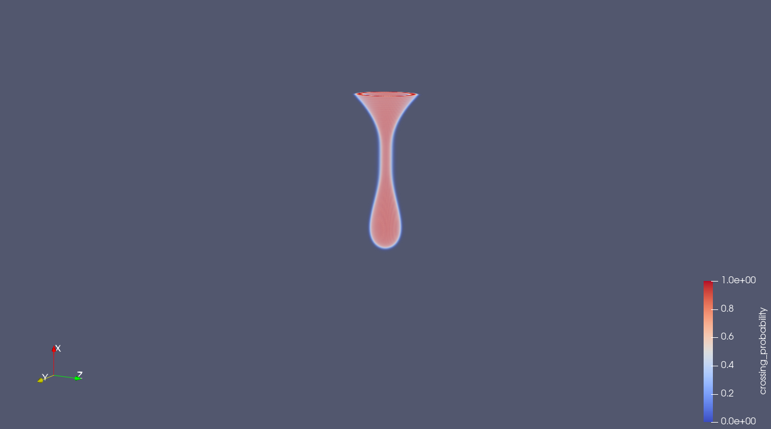
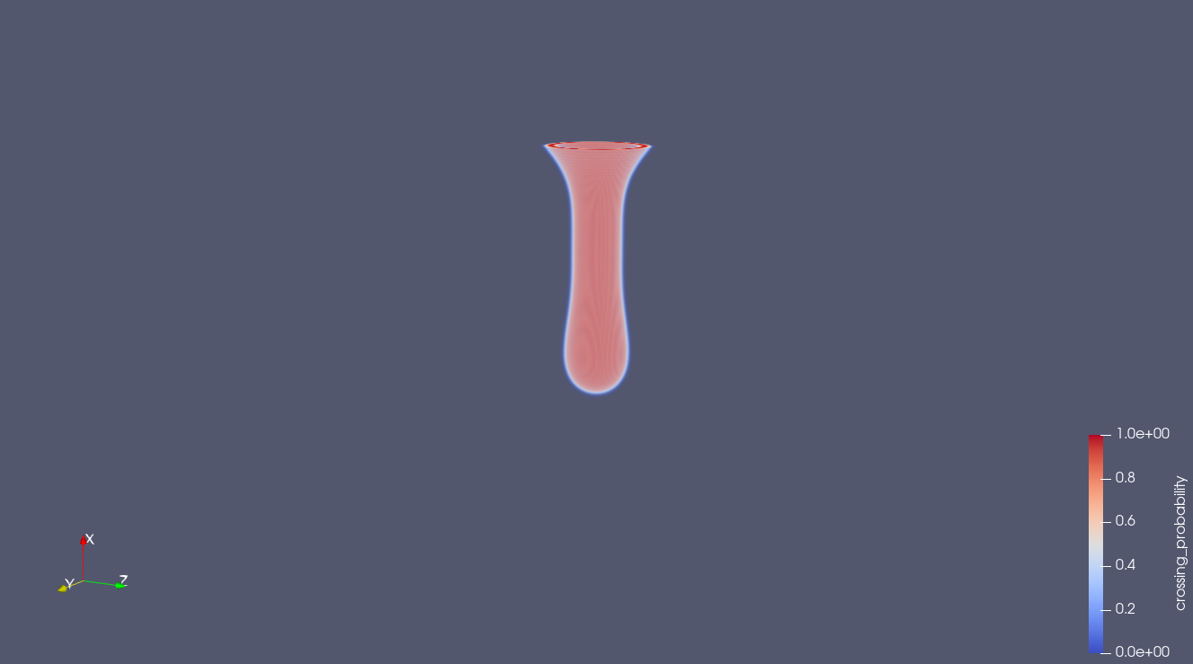
Original_gaussian_isosurfaces_teardrop
KD_gaussian_isosurfaces_Teardrop

Slide 10
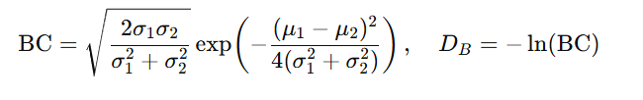


Bhattacharyya distance
Small value->more similar
Wasserstein distance
Small value->more similar
SSIM
Close to 1->more similar

Slide 11
Some of the metrics I used For distribution comparison and image
For volume rendering images of isabel;
Comparision Of predicted and original_isabel_gaussian
Image_name | SSIM (RGB):
Front | 0.9999445619042752
Back | 0.9999377399613824
Metric | Value
Average Bhattacharyya distance: | 0.022372097728995545
Average Wasserstein distance: | 4.234690682219564
Comparision Of predicted and original_teardrop_gaussian
Metric | Value
Average Bhattacharyya distance: | 4.1679593919214995e-05
Average Wasserstein distance: | 0.008539204284860461

