Slide 1
Presentation On
GRUB

Slide 2
GRUB: Grand Unified Boot Loader
GRUB is a boot-loader (can also be spelled boot loader) capable of loading a variety of free and proprietary operating systems. GRUB will work well with Linux, DOS, Windows, or BSD. GRUB stands for Grand Unified Boot-loader.
GRUB is dynamically configurable. This means that the user can make changes during the boot time, which include altering existing boot entries, adding new, custom entries, selecting different kernels, or modifying init-rd. GRUB also supports Logical Block Address mode. This means that if your computer has a fairly modern BIOS that can access more than 8GB (first 1024 cylinders) of hard disk space, GRUB will automatically be able to access all of it.
GRUB can be run from or be installed to any device (floppy disk, hard disk, CD-ROM, USB drive, network drive) and can load operating systems from just as many locations, including network drives. It can also decompress operating system images before booting them. You can learn much, much more from the official GRUB Manual 0.97.

Slide 3
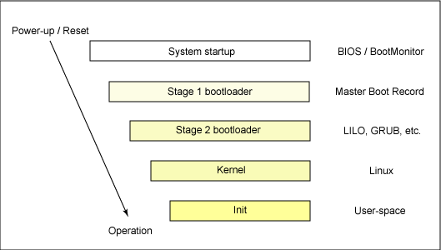
How Linux boot?

Slide 4
Resetting The Root Password Using:-
Single User Mode.
2.Rescue Mode.

Slide 5
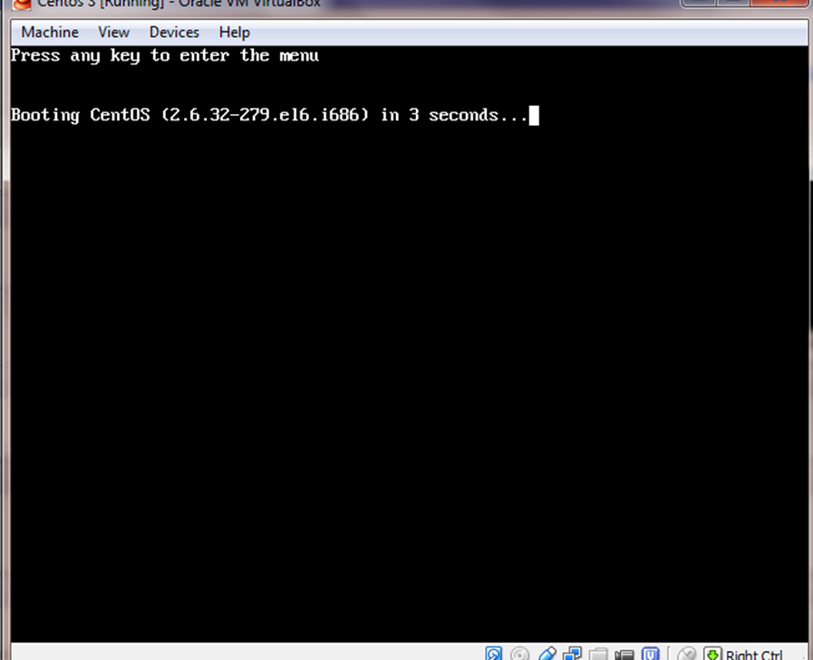
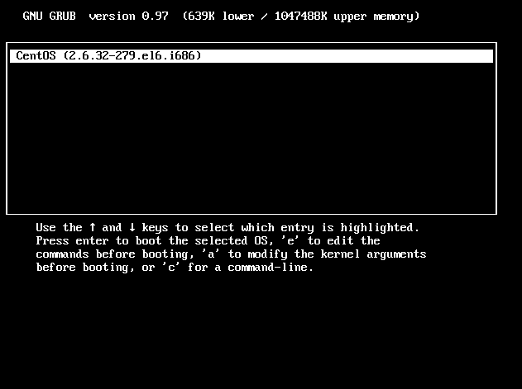
How We Use GRUB (By Single User Mode Method)
Power On The System.
When Power On Self Test Is Going On Press Any Key.
You Are In The BIOS Setup.
Now You Can Perform The GRUB RESET Password Operation.

Slide 6
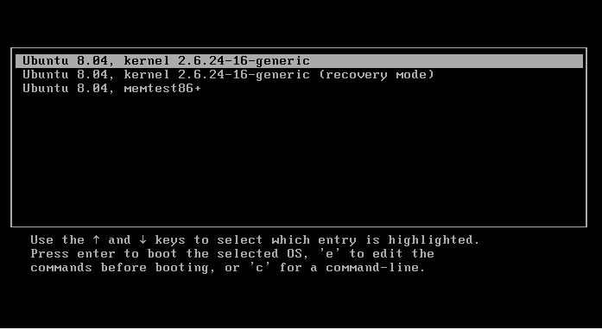
Edit Grub Boot Menu Options
1. First you need to get into grub menu options. This menu is displayed right at the beginning of the boot. If you cannot see your grub menu options press "ESC' key.
You should get something similar to this:

Slide 7
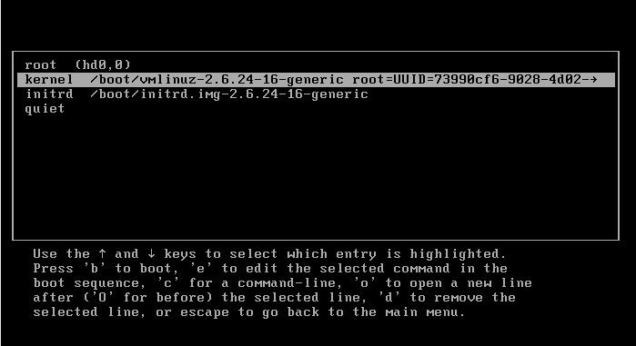
Edit Grub Boot Menu Options
2. Now we attempt to edit grub's boot option. Press "e" to edit the first grub menu option and navigate to kernel line:
Press "e" key again to edit and remove:

Slide 8

Edit Grub Boot Menu Options
-> And Add:
“init=/bin/bash” OR Simply Type “1”
3. You may have some different boot options but the main part you need to change/add is init=/bin/bash. You will get something similar to this:

Slide 9

Edit Grub Boot Menu Options
Press enter:
4. At this point, we have edited grub boot menu, and we are ready to boot. Press "b" key to boot.

Slide 10
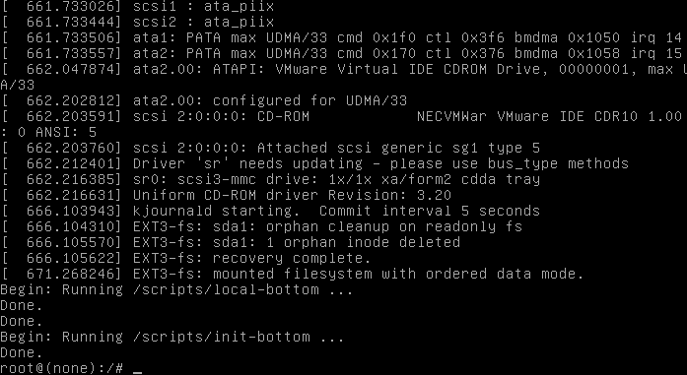
Edit Grub Boot Menu Options
5. After successfully boot you will be presented with bash command prompt:

Slide 11
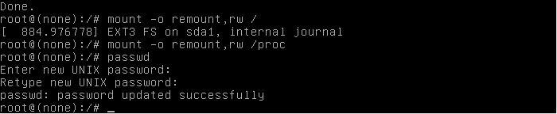
Edit Grub Boot Menu Options
6. To reset a actual root password is now simple as typing :
“passwd”
7. Finally Now Reboot.

Slide 12
Advantages:-
It is very Useful, When User forgot the Linux System Password.
It is Easy to do.
Less Commands Require To Perform Reset Operation.

Slide 13
Dis-Advantages:-
Hackers Can Easily Break The Password. If Server Room Is Not Under Security.
Anonymous User Also Reset It.

Slide 14


