Slide 1


K.RAMAKRISHNAN COLLEGE OF TECHNOLOGY (AUTONOMOUS), TRICHY
Detecting Basic Anomalies in Bank Transactions
GUDIED BY
MRS.MURUGAVALLI
PRESENTED BY
SUDHAKARAN M - 2303811724321111

Slide 2
PRESENTATION OVERVIEW
Problem Identification
Objective
Proposed system
Block diagram of proposed system
R Data Structure Used
List Of Modules
Module Description
Screen Shot
Conclusion

Slide 3
PROBLEM IDENTIFICATION
Financial institutions process thousands of transactions every day, making it difficult to manually monitor and detect fraudulent or abnormal activities. Without proper analysis tools, suspicious transactions can easily go unnoticed, leading to potential financial losses and security risks. Traditional detection methods often lack flexibility and interactivity, limiting their effectiveness for real-time monitoring. Therefore, there is a clear need for an automated, user-friendly system that can efficiently identify and visualize transaction anomalies to help prevent fraud and improve security.

Slide 4
OBJECTIVE
To develop an interactive R Shiny application that can identify anomalous bank transactions using statistical methods (Z-score and IQR), visualize patterns, and provide a user-friendly interface for analysis.

Slide 5
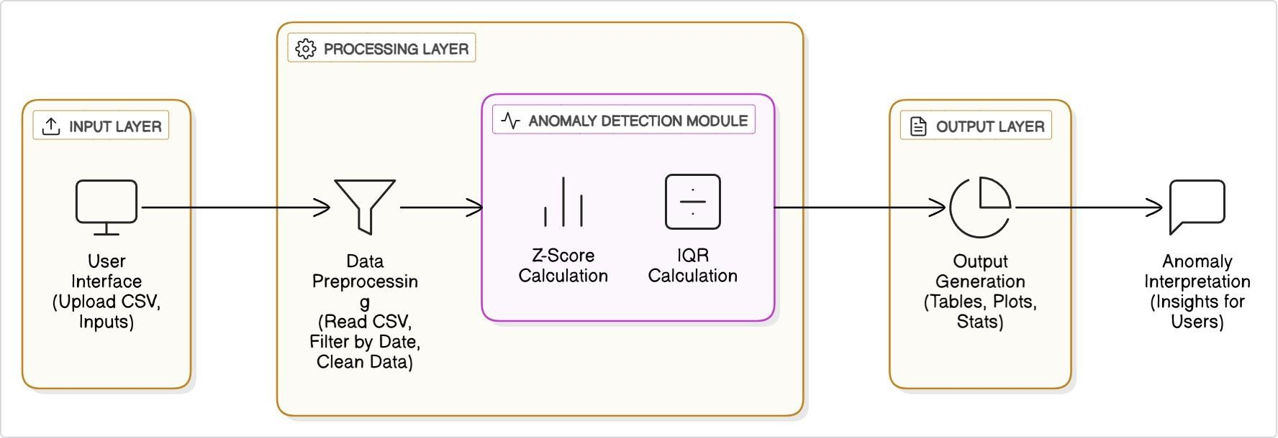
PROPOSED SYSTEM
BLOCK DIAGRAM

Slide 6
R DATA STRUCTURES USED
Z-score based detection (for standard deviation-based anomalies)
IQR-based detection (for detecting outliers in skewed distributions)
Isolation Forest (unsupervised anomaly detection)
One-Class SVM (for detecting novel or anomalous data)
Autoencoders (neural networks for anomaly detection)

Slide 7
LIST OF MODULES
Data Upload Module
Preprocessing & Cleaning Module
Z-score Anomaly Detection Module
IQR Outlier Detection Module
Visualization Module
Summary & Reporting Module

Slide 8
MODULE DESCRIPTION
Data Upload Module Enables users to upload transaction datasets in CSV format for processing.
Data Cleaning and Filtering Module Processes the raw data by converting date formats, removing missing values, and filtering transactions by user-defined date ranges.
Anomaly Detection Module Detects suspicious transactions using Z-score and Interquartile Range (IQR) statistical methods.
Visualization Module Creates interactive tables and plots to display transaction data and highlight anomalies.
User Interaction Module Allows users to adjust detection thresholds and filters dynamically to refine anomaly detection.
Summary and Reporting Module Generates concise summaries and exports anomaly reports for further review.

Slide 9
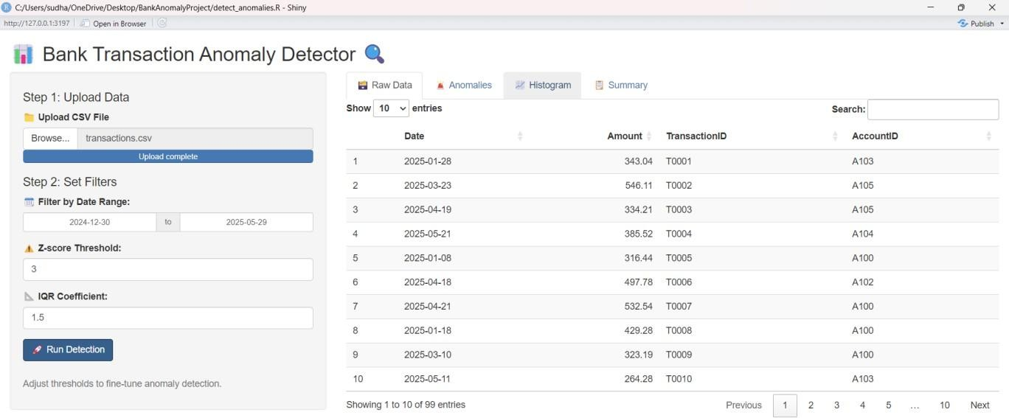
SCREEN SHOT

Slide 10
CONCLUSION AND ADVANTAGES OF PROPOSED SYSTEM
CONCLUSION
Bank Transaction Anomaly Detection system effectively identifies unusual transactions using statistical methods like Z-score and IQR. By integrating data visualization and interactive filters, the system helps users quickly spot potential fraud or errors. This automated approach enhances security, saves time, and supports better decision-making in financial monitoring.
ADVANTAGES
Improves Fraud Detection
User-Friendly Interface
Saves Time and Resources

Slide 11


