Slide 1


AlumniConnect
● OFFICIAL UNIVERSITY NETWORK
Our Distinguished
Alumni
Connecting excellence across generations — a global network of leaders, innovators, and mentors shaping the future.
Join Alumni Network →
View Directory
Developed by Sunsys Technologies · Alumni Network Portal 2026
Notes:
Title slide for the AlumniConnect alumni network portal, developed by Sunsys Technologies.

Slide 2

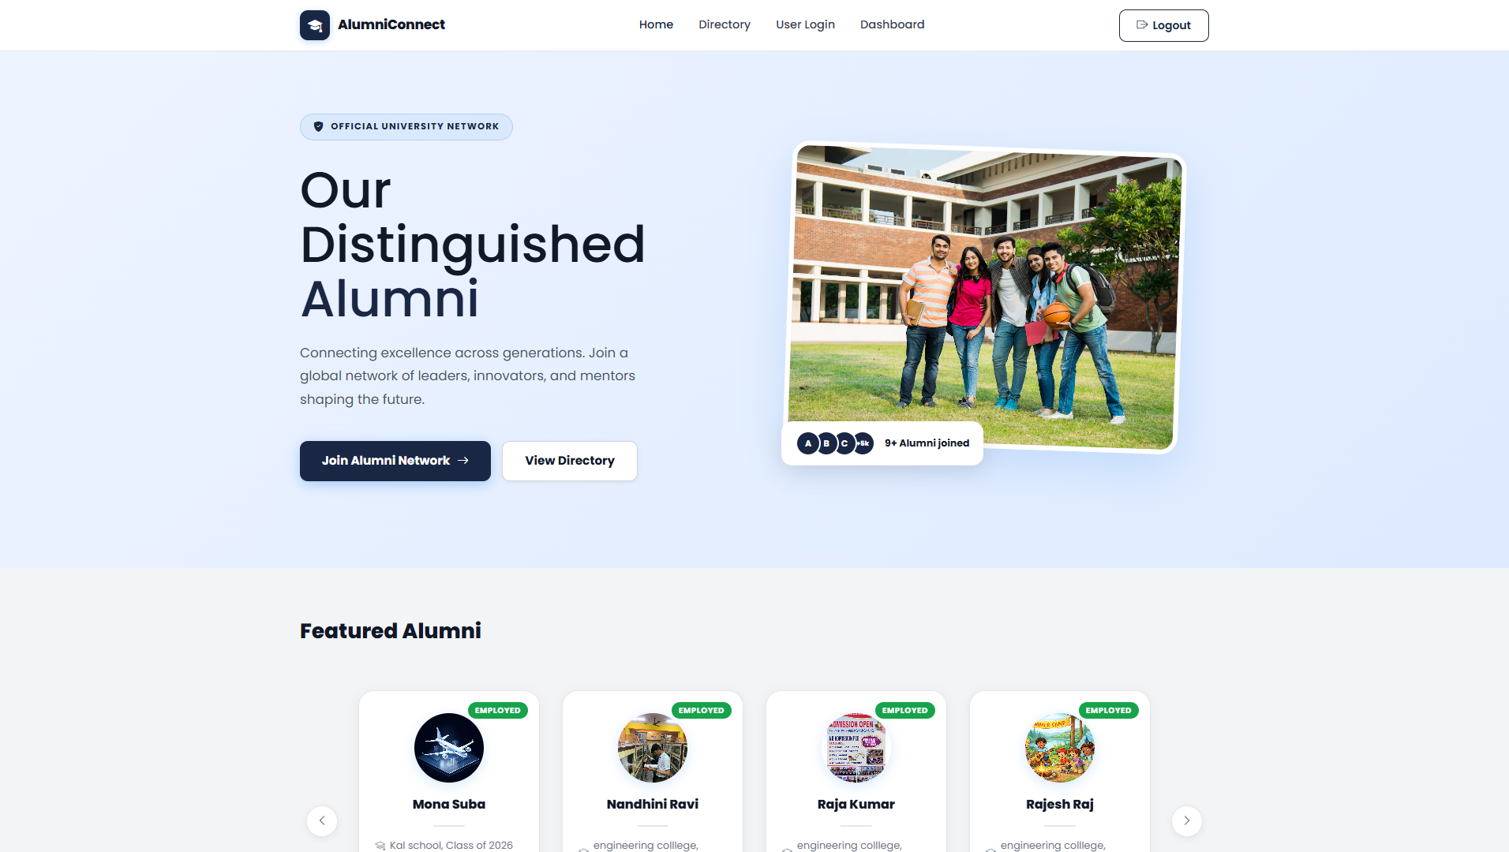
OVERVIEW
One platform. Every generation.
A single home for the whole community
Students and alumni register, connect, and stay in touch across batches and campuses.
Verified & admin-approved
Every self-registration is reviewed and approved by the admin before going live.
Careers, mentorship & events
Discover jobs, find mentors, and join reunions, webinars, and hackathons in one place.
Notes:
Overview of what AlumniConnect provides, with a live view of the homepage.

Slide 3






CAPABILITIES
Everything an alumni network needs
Alumni Directory
Career Networking
Mentorship
Search and browse a rich directory of alumni by batch, company, and location.
Reconnect with batchmates and grow a professional network across industries.
Students and juniors learn directly from experienced graduates and leaders.
Events & Meetups
Profile Management
Job Opportunities
Reunions, webinars, hackathons, and campus events — all in one calendar.
Members create and update detailed academic and professional profiles.
Explore exclusive career opportunities shared across the alumni network.
Notes:
Six core capability areas of the portal.

Slide 4




NETWORK AT A GLANCE
Impacting the world through our collective reach
14
2
3
5
Active Members
Careers Launched
Global Companies
Countries Represented
A growing community spanning multiple companies and countries — and just getting started.
Notes:
Network statistics headline the portal's reach.

Slide 5



GETTING STARTED
Register in three simple steps
1
2
3
→
→
Account Setup
Academic Info
Professional Info
Enter your name, mobile, email, and choose your role — Alumni or Student.
Add your college, batch year, and program details as per college records.
Share your current role and employment status to complete your profile.
Admin approval keeps it trusted — new registrations are reviewed by the administrator before joining the live directory.
Notes:
Three-step registration flow, gated by admin approval.

Slide 6





ADMIN CONTROL
A dashboard that runs the network
Alumni by status
Add Alumni
10
8
Create alumni profiles manually
Total Alumni
Employed
Manage Alumni
View, edit, and delete records
2
0
Self-Employed
Studying
Pending Approvals
Review self-registrations
1
Events
Publish reunions & webinars
Pending
Broadcast
Send announcements to all members
Notes:
Admin dashboard: live counts, status breakdown, and management tools.

Slide 7




COMMUNITY
Events that bring everyone back
Reunions
Webinars
Hackathons
Campus Events
Silver Jubilee & annual alumni meets
Live sessions for students & alumni
Build, compete, and innovate together
Ideathons and on-campus gatherings
Aug 2026 · Vijayanagar
Jun 2026 · Online
Mar 2026 · Campus
May 2026 · Vijayanagar
Notes:
Event categories with representative upcoming events.

Slide 8
AlumniConnect
READY TO RE-CONNECT?
Re-connect with your community
Don't miss out on exclusive alumni events, job opportunities, and a growing network of graduates worldwide.
Create Account
Contact Office
© 2026 Alumni Portal · All Rights Reserved | Developed by Sunsys Technologies
Notes:
Closing call-to-action.

