Slide 1
Online Voting System
A console-Dased simulation of a secure and fair electoral process
C 0 RE JAVA 0 OP C 0 N S 0 LE A PPLI C AT ION
PR E S E N T E 0 B Y
Sudhanshu Deshmukh
Santanu Sasmal

Slide 2
Project Introduction
Stepl
System Purpose 6 Scope
Console-based Java system simulates secure, fair voting; manages candiaotes, voters, vote casting, and result calculation ’ithina controlled, educational pi oject environment.
Step2
Technology Focus & Audience
Emphasizes Cote Java and OOP principles like classes, objects, encapsulation, and inheritance, targeting students learning Java, object-oriented design, and basic software ai clnitecture.

Slide 3
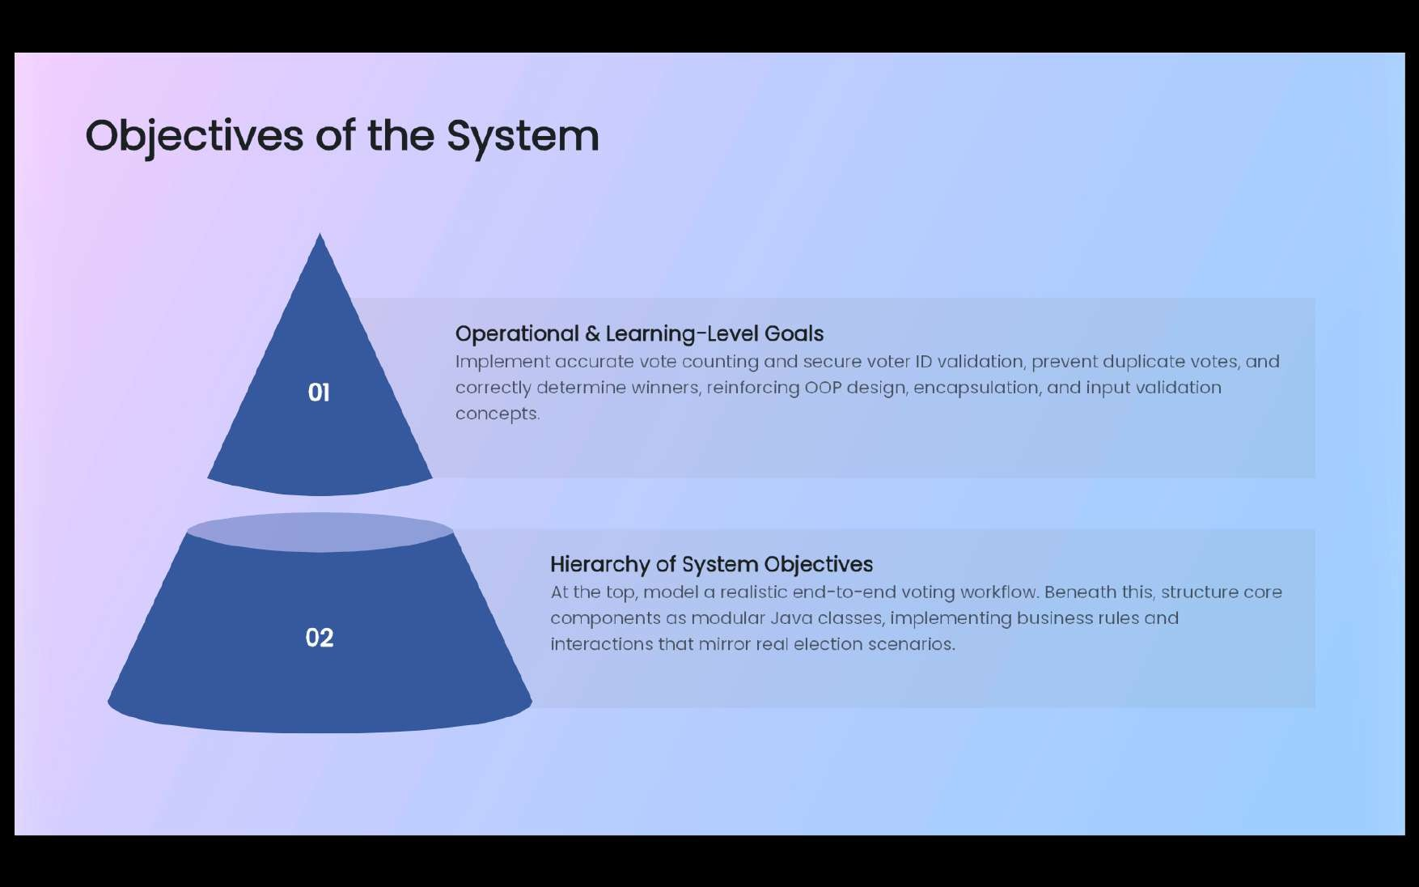

Slide 4
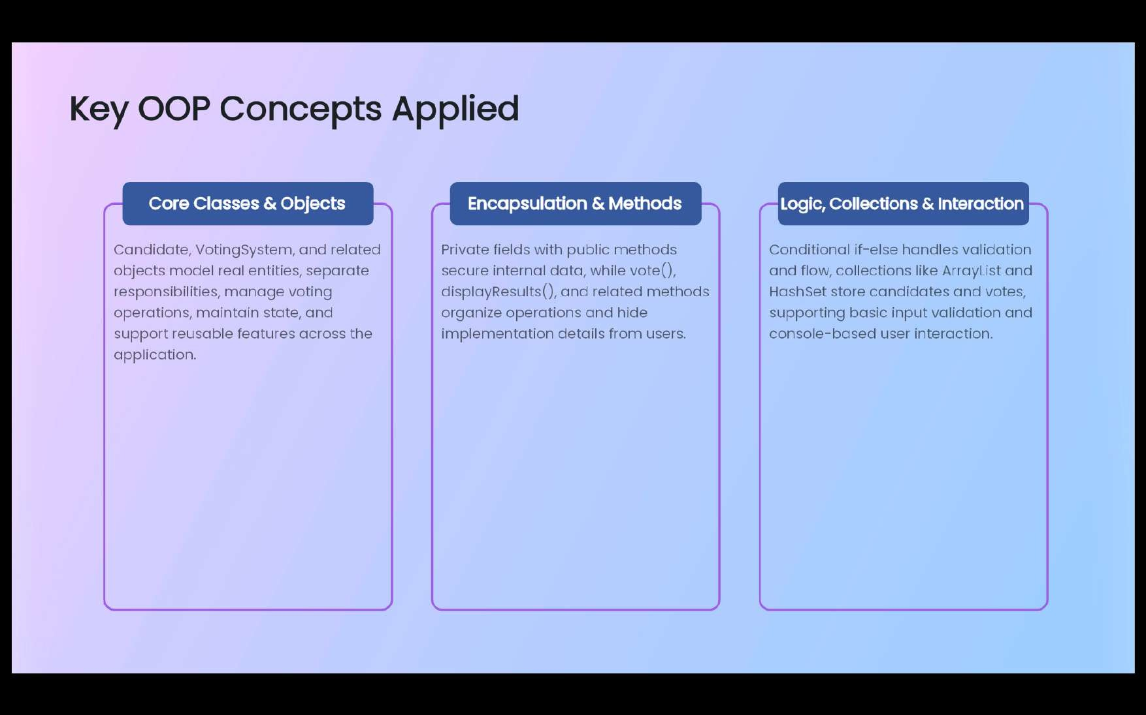

Slide 5
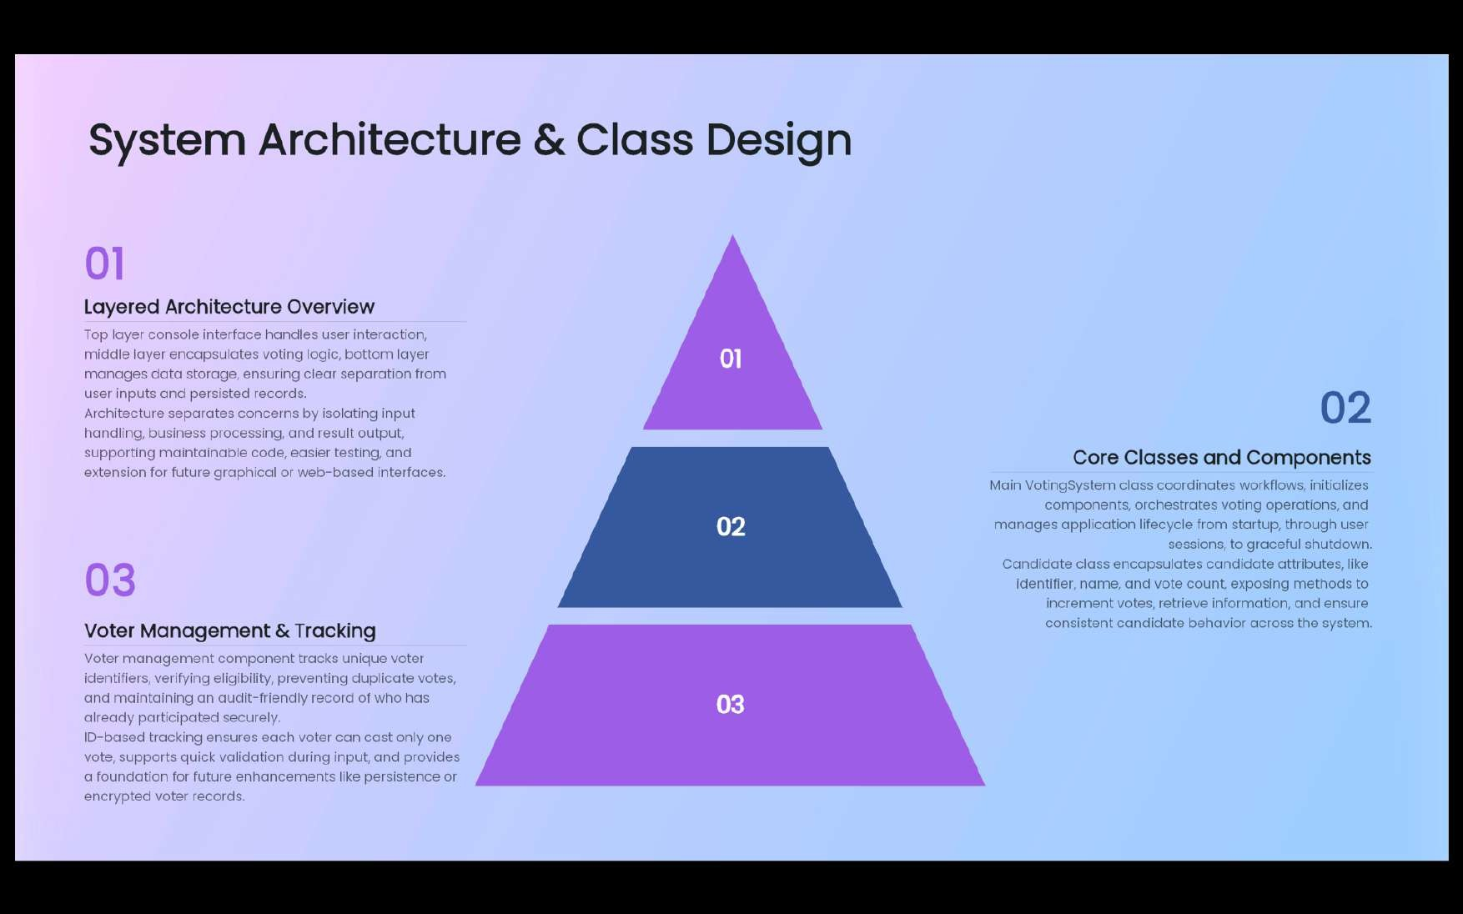

Slide 6

lmplementotion Flow & Core Logic
Voting workflow steps
Initiulize cninÓiÓotes uno cloto sti Lectures, present menu options, capture and validote uníque voter IDs, captLire and volidate condidote cnoíces, tnen invoke vote metlaod to in i”eiment selectecl candidate's count.
Result computotion and output
Persist voter IDs, look for additional operations, on demand compute total votes, determine winner based on maximum count, and display formatted voting iescilts cincl winner infornJcitiors.

Slide 7
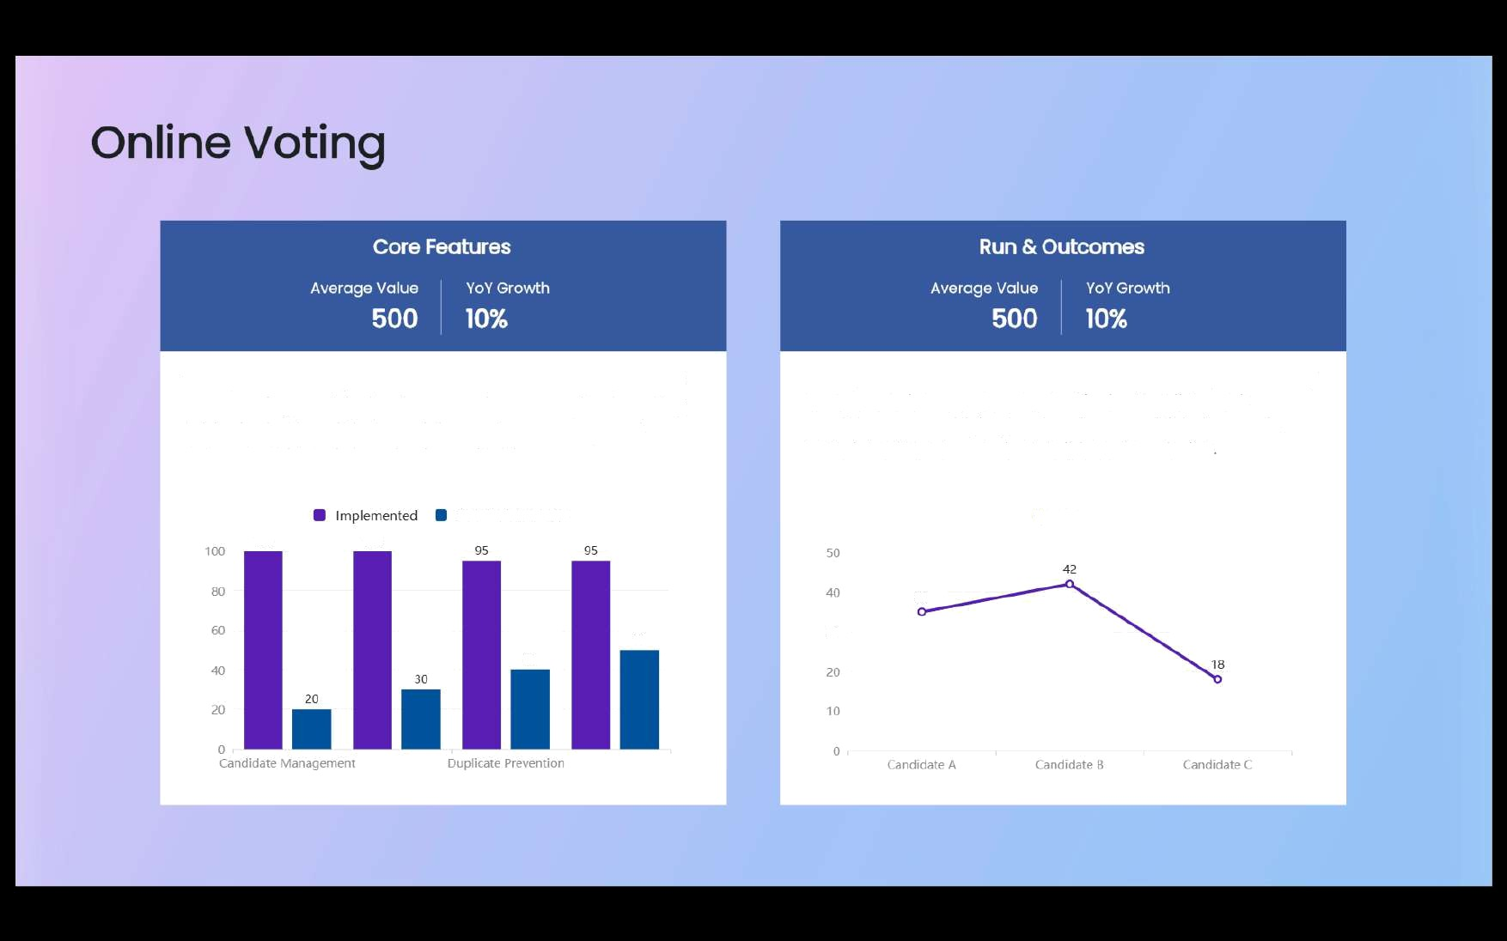
The system manages canoidates and voters using unique IDs, ensuring each Dallot is counted once. Duplicate voting is blocked with voliaotion, while results cire computed transparently and stored using collections.
A sample con sole run shows welcome text, menu options, voting prompts, and success n essciges. Final output lists ecich candidate's votes, highlights the winner, and links lessons in UOP, data structures, and extensible system design
Planned tension
O Votes
100
100
35
5O
30
40

Slide 8


