Slide 1
Project Title: FITCLUB Gym Website
From: Sudhanshu Sigh
REG N0. : 12405898
SECTION: K24CN
ROLL NO. : 45

Slide 2
Navigation Bar:
An interactive navigation bar with a logo, allowing easy access to various sections of the website.
Enhanced styling using CSS attributes like borders, padding, margins, and background colors.
Hover effects on the navigation menu for added visual appeal.

Slide 3
Hero/Home Section:
A dedicated section that outlines the gym's mission, vision, and values.
Includes quick links to start a gym membership or learn more about the gym.

Slide 4
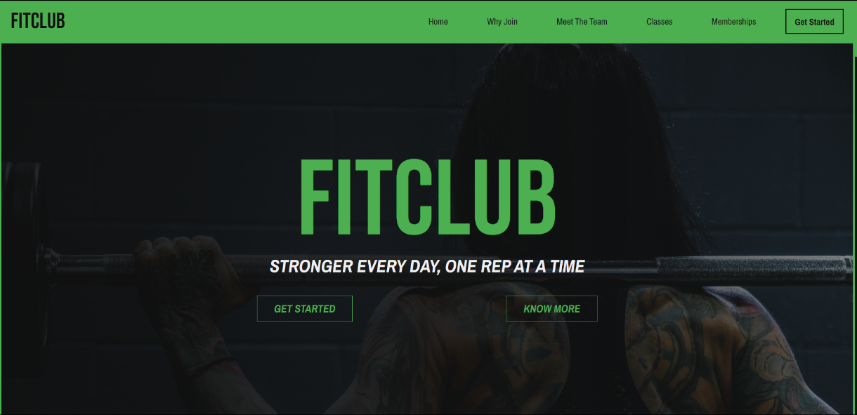
Sample:

Slide 5
Why Join? Section:
Detailed descriptions of various services, including personal training, group classes, and nutrition counselling, highlighting the gym's offerings and values.
Bold and eye-catching typography.
Styled using CSS attributes such as position, display, and box-shadow.

Slide 6
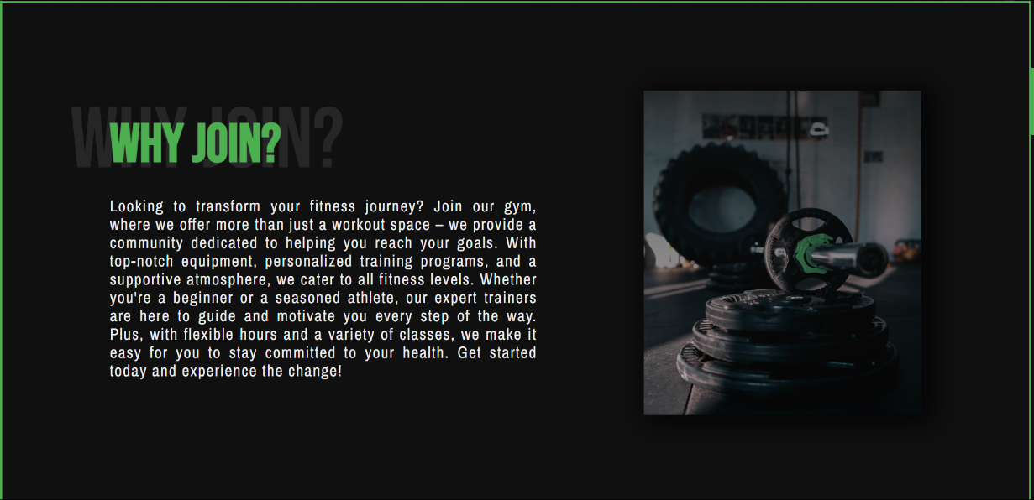
Sample

Slide 7
Meet the Members Section:
A photo gallery showcasing key members of the gym, including the owner and various coaches.
Images arranged in a grid layout for easy viewing.

Slide 8
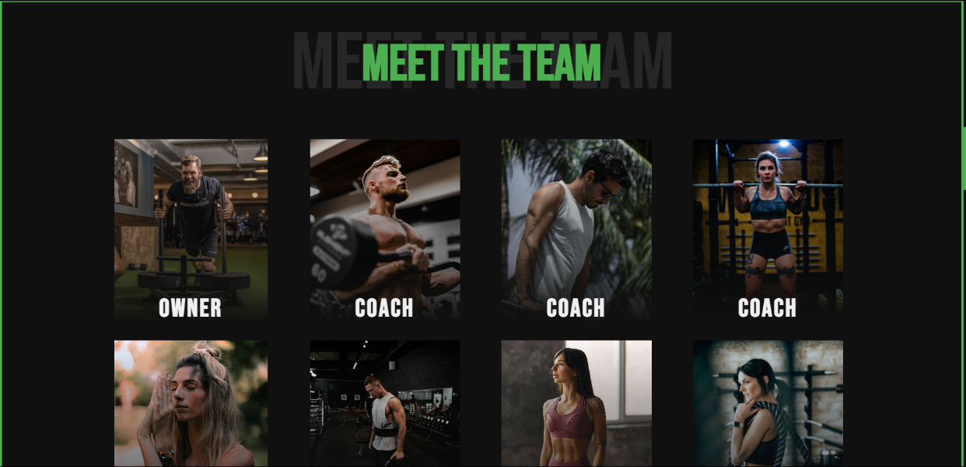
Sample

Slide 9
Memberships Section:
Classes presented in a grid layout, with a linear gradient applied to blend images with the background.
"Know More" buttons with hover effects for a vibrant display.

Slide 10
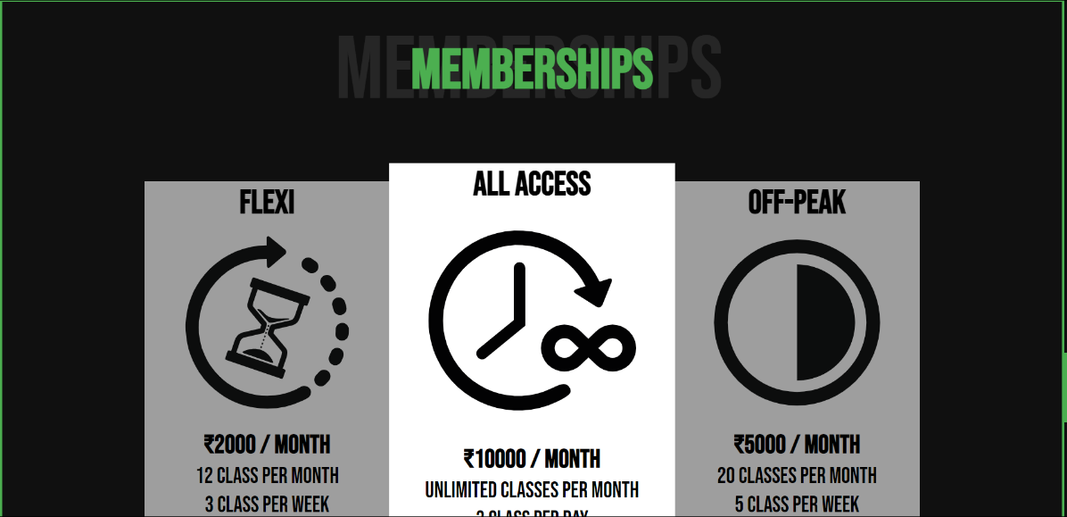
Sample

Slide 11
Join Our Community Section:
A form for users to fill out (Name, Email, Phone Number) to request a callback.
Attractive input fields, custom font styles for placeholders, and a styled submit button.

Slide 12
Contact/Social Media/Address Section:
Details for connecting with the gym through various channels

Slide 13
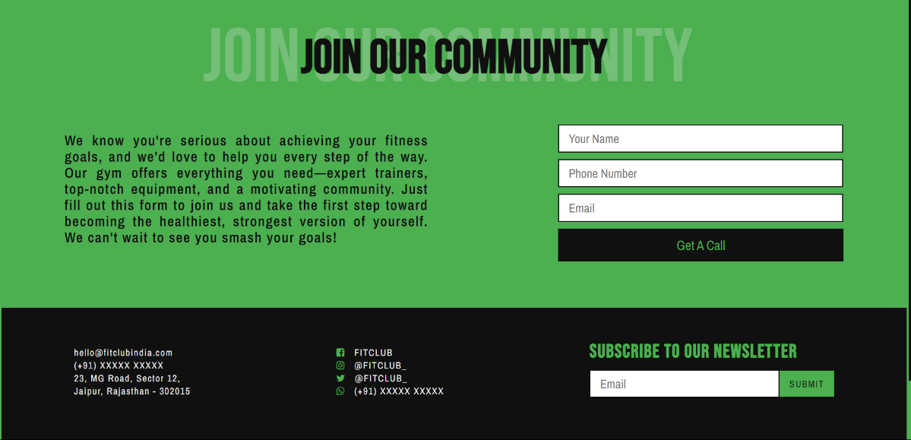
Sample

Slide 14
Additional CSS Enhancements:
Colors:
Background colors: #101010 and #4CAF50.
Paragraph color: #F0F0F0.
Fonts:
Imported Google Fonts: "Bebas Neue" for headings and "Archivo Narrow" for other text.
Styling:
Bold, well-defined fonts increase visual impact and engagement.
Shadows behind section headings make them stand out.
Each section has distinct height and background color for easy navigation.
Images are perfectly sized to fit the screen and maintain a clean UI.

Slide 15
Technologies Used:
HTML: For structuring the content and layout.
CSS: For styling the website, including layout, typography, and responsiveness.

Slide 16
Conclusion:
The FITCLUB Gym Website serves as a valuable resource for promoting the gym and engaging with potential members. Its clean design and intuitive navigation ensure that users can easily find the information they need, making it an essential tool for anyone interested in joining the gym.

