Slide 1

Note: The data and information in this document is reflective of a hypothetical situation and client. This document is to be used for KPMG Virtual Internship purposes only.
Sprocket Central Pty Ltd
Data analytics approach
Sudhanshu Gosain

Slide 2
Agenda
Introduction
Data Exploration
Model Development
Interpretation

Slide 3
Introduction
Identify and Recommend Top 1000 Customer to Target from datasets
Outline of Problem
Contents of Data Analysis
Sprocket Central is a company that specializes in high-quality bikes and cycling accessories.
Their marketing team is looking to boost business sales by analysing the provided datasets.
Using the 3 datasets provides, the aim is to analyse and recommend 1000 customers that Sprocket Central should target to drive higher value to the company.
“New” and “Old” customer age distribution
Getting Customer status by “RFM” Approach
Job – Industry distribution
Customer status by age and wealth segment
category
Profit by wealth segment and gender category
Car owners by genders
Last-3 Year purchase by Age and Gender
Data Exploration
Model Development
Interpretation
This will done in 3 phases:

Slide 4
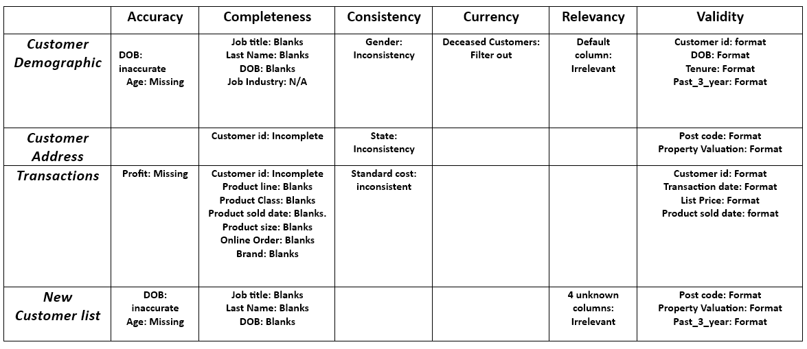
Data Exploration
Data Quality Assessment and Clean up
Summary Table
Data Quality issue
Accuracy : Correct Values
Completeness: Data Filled with Values
Consistency: Values Free from Contradiction
Currency: Values up to date
Relevancy: Data items with value Meta-data
Validity: Data Containing allowable values
Uniqueness: Records that are duplicated

Slide 5
Data Exploration
Age Distribution
Most customers are aged between 40-49 in “Old Customers” as well as in “New Customers”.
Least number of customers are 70+ in the “Old Customers” and 80+ in the “New Customer”.
“Old Customers” has majority of customers from 20-70 years.
40-69 is the most popular age group range in “New Customers”
“New Customers” sees a steep drop of customers in the 30 – 39 age group.

Slide 6
Data Exploration
Bike Related purchases over last 3 years by gender
In the last three years around 50% of the bike related purchases were made by the females in the “Old customers”
472 purchases in the “Old Customers” is done by unknown gender.
In the “New Customers” the female percentage is 51.48%, whereas the 48.52% purchases is done by males.

Slide 7
Data Exploration
Bike Related purchases over last 3 years by AGE
In “Old customers” majority of purchases is done by customers from age group 30-59.
In “Old Customers” 40-49 age group has done highest 34% purchases in the last 3 years.
In the “New Customers” highest 22% is made by the customers belonging to 40-49 age group.
80+ customers purchased only 5% bike related produced in the last 3 years from the “New Customers”

Slide 8
Data Exploration
Job Industry Distribution
In “Old customers” 48% of customers are in Manufacturing and Financial Services industry.
This become 49.03% when we analyse the customers in “New Customers”
In both the group the smallest numbers of customers are from Agriculture and Telecommunication industries.
Only 2% customers are from Telecommunication in “Old Customers” and 3.06% in the “New Customers”.

Slide 9
Data Exploration
Wealth Segment Analysis
In “Old customers” 49.96% of customers are in Mass Customer Segment.
In “New Customers” Highest 499 customers are in Mass Customer Segment.
In both the group the smallest numbers of customers are in Affluent Customers Segment

Slide 10
Data Exploration
Wealth Segment Analysis by age group
In “Old customers” highest 3293 are from Mass Customers from age group 40 – 49.
In “New Customers” Highest 108 are from Mass Customers from age group 40 – 49.
In both the group the numbers of customers are start decreasing from the age 50 onwards.
In “Old Customers only 24 customers are 70+ age.

Slide 11
Data Exploration
Car Ownership analysis
In “Old customers” 13.11% females and 12.86% males in NSW owns a car.
In “New Customers 14.04% females and 13.12% males in NSW owns a car.
In both the group the highest numbers of car owners are in New South Wales.
Victoria splits quite evenly as the male to female car ownership ratio is looking similar.
Least number of customers are from QLD and in “New Customers ” 8.04% of female do not have a car which is double as compared to the female car owner in the city.

Slide 12
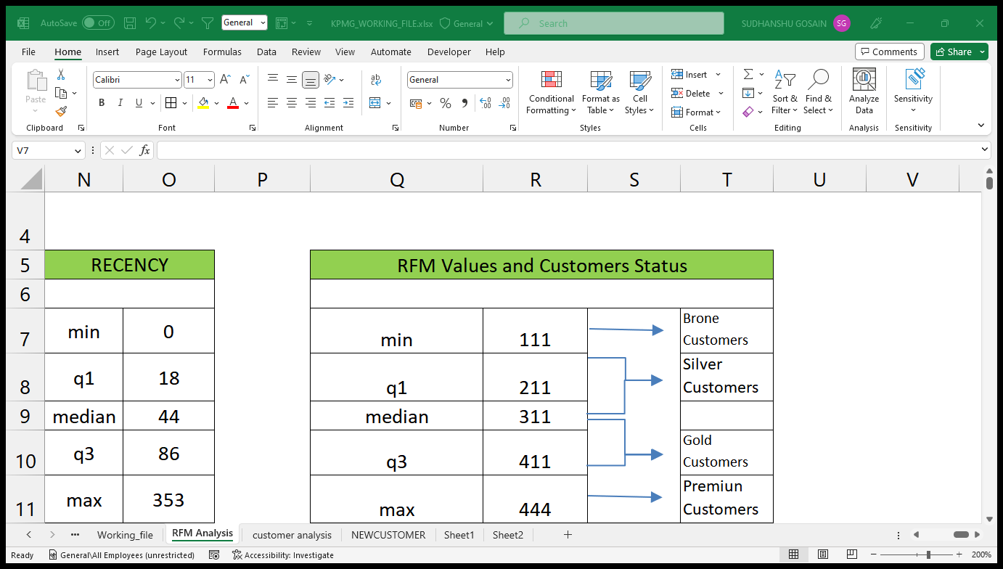
Data Exploration
RFM Analysis and Customer classification
RFM analysis is used to determine which customers a business should target to increase its revenue and values.
The RFM ( RECENCY, FREQUENCY, and MONETARY ) model shows customers that have displayed high levels of engagements in 3 categories mentioned.
We have 5322 “Premium Customers”, 5168 “Gold Customers”, 4705 “Silver Customers”, Least 4139 “ Bronze Customers”.

Slide 13
Data Exploration
RFM Analysis
Very low frequency of 0-2 correlated with high recency values. i.e. more than 250 days
Customers who visited recently (0-100) days have a higher frequencies i.e. up to 12 times and they are visiting frequently .
Higher frequency has a inverse relationship with frequency as the recent customers are the less frequent customers

Slide 14
Data Exploration
RFM Analysis
The chart shows that customers who purchased more recently have generated more revenue , than the customers who visited a while ago.
Customers who visited recently (80-150) days also show to generate a moderate amount of revenue .
Customers visited more than 200 days ago generate low revenue

Slide 15
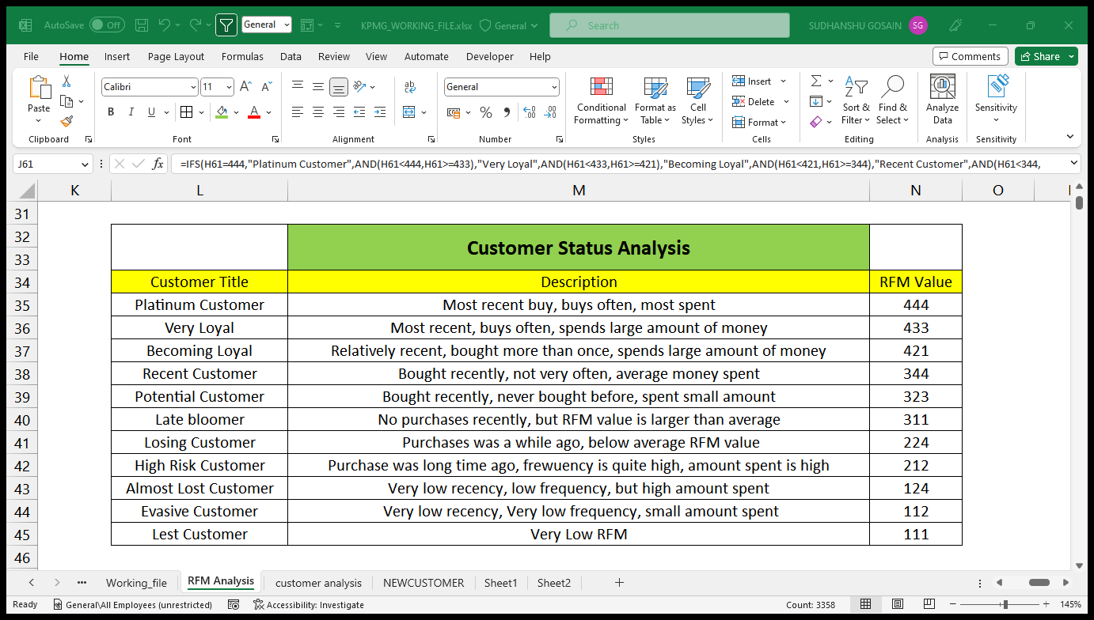
Model Development
Customer Status table with RFM values

Slide 16
Model Development

Slide 17
Model Development
Customers status state wise

Slide 18
Model Development
Age distribution of Customer status

Slide 19
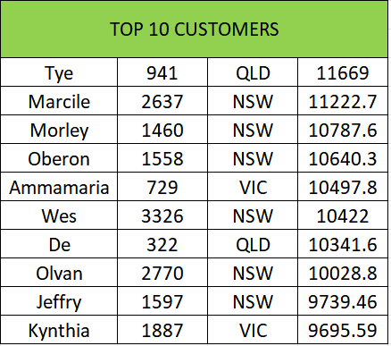
Data Exploration
These are the top 10 Customers who provides best business to the company.
6 out of 10 are from NSW , 2 customers are from QLD & VIC.
11669 is the revenue provide by “TYE” from QID which is highest .
Customers visited more than 200 days ago generate low revenue

Slide 20
For Better Understanding of RFM Model visit the following links:
https://www.optimove.com/resources/learning-center/rfm-segmentation
https://clevertap.com/blog/rfm-analysis/

Slide 21

Appendix

