Slide 1
Conventional Latch Type Sense Amplifier(Mux16 configuration)
ECE-611 (Memory Design and Test)
Abhishek Bidhan MT21151
Nikhil Pratap Singh MT21199
Sudhanshu Trivedi MT21212

Slide 2
Problem Statement
Design of Conventional latch-type sense amplifier (for MUX-16 configuration) with the following conditions:
✦ Voffset at 3-sigma = 25mV (after layout extraction) @wc, 1.08V
✦ SA-enable to Qlatch delay = 200ps @wc, 1.08V
✦ SA-enable pulse width = 100ps @wc, 1.08V
✦ Study incremental benefit of Common Centroid Layout
✦ Study incremental benefit of Structural Matching
In this, we have to design a latch-type sense amplifier circuit with a pre-charge circuit and latch circuit, where the two inputs to the sense amplifier are BL and BLB from the memory cell.We have to minimize offset voltage below 25 mv(After layout extraction).For this design, we will be using the common centroid layout in order to have a common Vt for pull-down devices in the circuit.

Slide 3
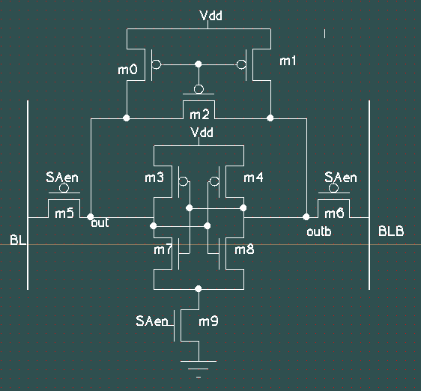
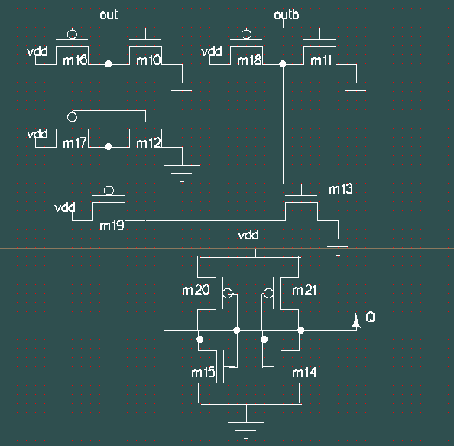
Design Schematic
w7=w8=4u ,l7=l8=.12u
w9=6u, l9=0.065u ,w5=w6=1u
w0=w1=w2=0.135 &l=0.065 l=0.065
w3=w4=w16=w17=w18=w19=0.9 ,
w10=w11=w12=0.45
w20=w21=0.270u
w15=w14=0.135

Slide 4
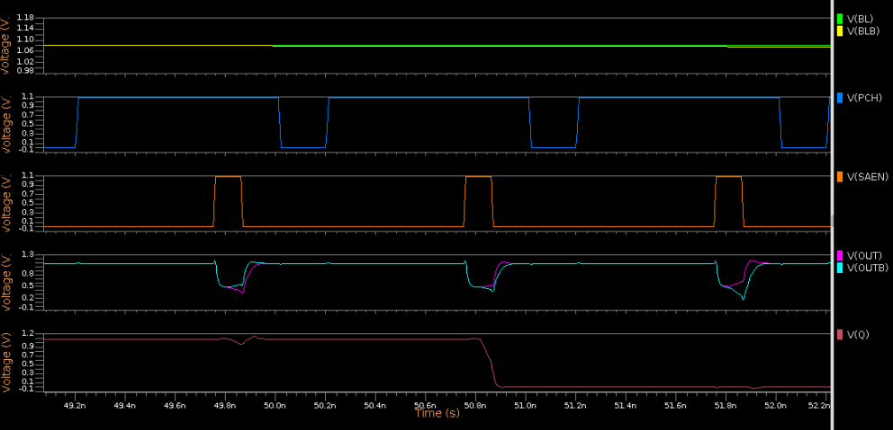
Read-0 (Functionality)

Slide 5
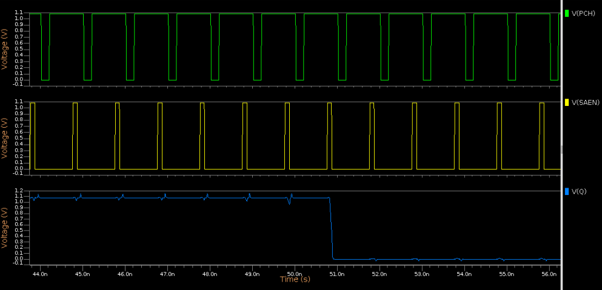
Read-0 (Delay)
CASE | PVT | DELAY
Worst Case | SS, -40 | 104.29 ps
Best Case | FF, -40 | 52.86 ps

Slide 6
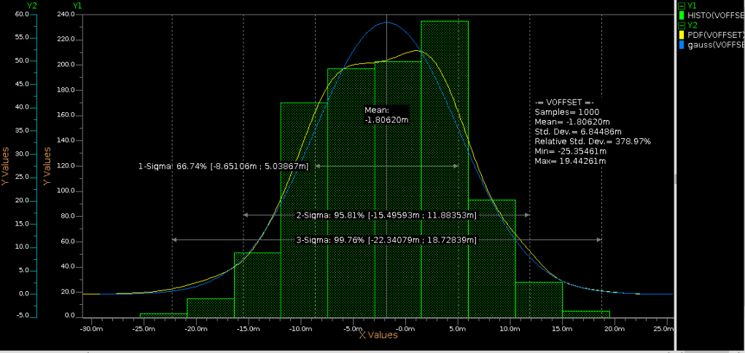
Read-0 (Offset)
Voffset = 18.72 mV (at worst PVT → FF, -40)

Slide 7
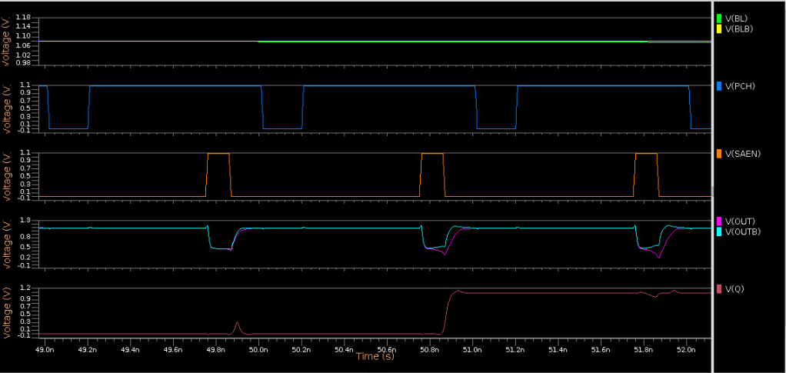
Read-1 (Functionality)

Slide 8
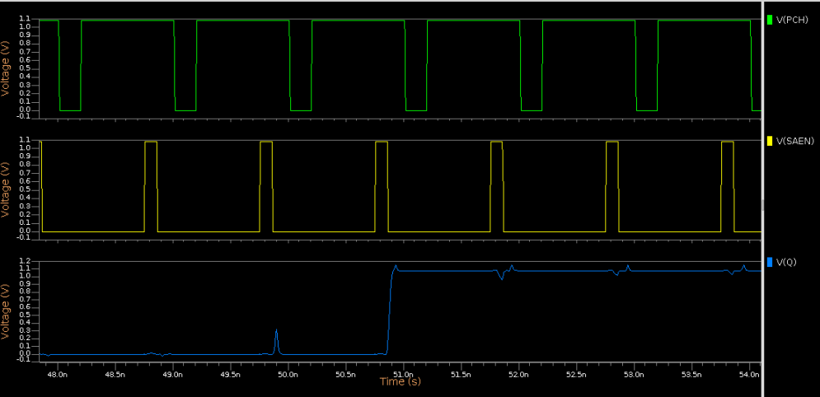
Read-1 (Delay)
CASE | PVT | DELAY
Worst Case | SS, -40 | 121.31 ps
Best Case | FF, -40 | 67.95 ps

Slide 9
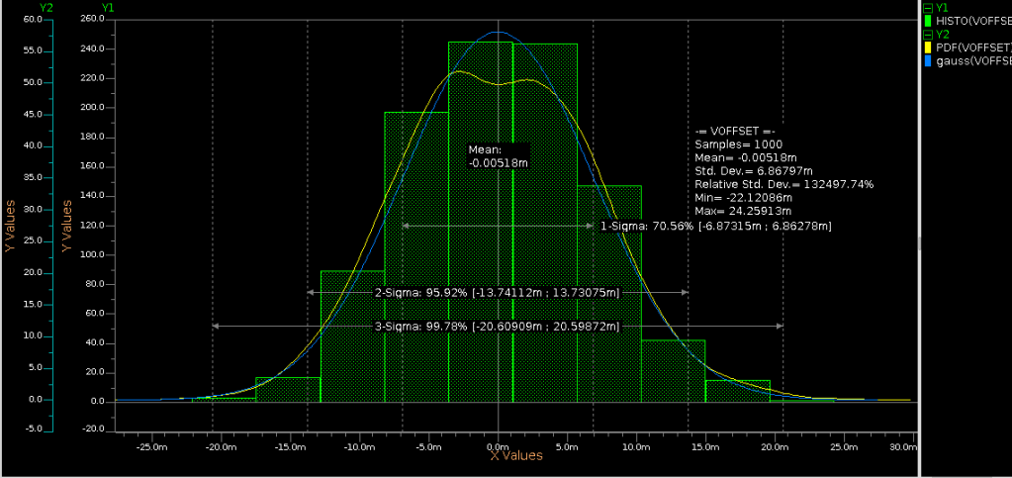
Read-1 (Offset)
Voffset = 20.59 mV (at worst PVT → FF, -40)

Slide 10
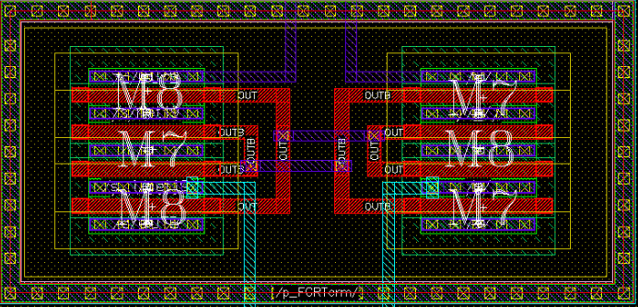
Layout (Common Centroid part)
Here we have used common centroid layout for the 2 differential pull down nMOSs (M7 and M8), as we want very least Vt variations in those 2 devices due to Process variations.)

Slide 11
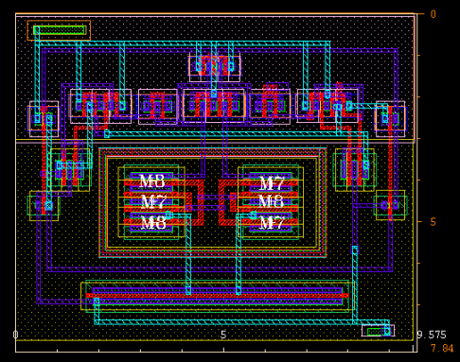
Layout (With PP - NP layers)
Width → 9.575 um, Height → 7.84 um, Total Area → 75.06 um2

Slide 12
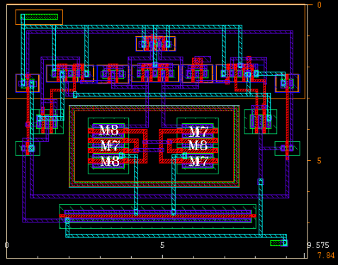
Layout (Without NP-PP layers)

Slide 13
Challenges
Challenges are there to minimize Voffset
Finding the Footer and pull down size to maintain 3sigma offset
And reducing SAen to Qlatch delay below 200 ps, with proper sizing
Proper matching of pull down devices , it was mitigated with common centroid approach in layout
Utilizing area while layout making

Slide 14
Conclusions and Future Plans
Technical Conclusions
What worked?
We have designed the layout with common centroid technique and maintained symmetricity in layout
What did not work?
Layout can be more compact with utilization of available area
Emphasise on learning from the project
Common centroid layout , collaboration with others teams and their design
Better understanding of topics
Future plans
We will also try to generate the Pre-charge signal from the clock instead of directly using it as separate signal.
We will try to extend and design complete I/O circuitary by ourself.

Slide 15
References
Some references that we have followed
A High Speed Low Voltage Latch Type Sense
Comparative analysis of Sense Amplifiers for SRAM in 65nm CMOS technology
MDT and DVD classroom lectures.

