Slide 1


IMPACT OF AI
A HUMAN-CENTRIC PERSPECTIVE
THE HUMAN SIDE OF INTELLIGENCE • 2026

Slide 2

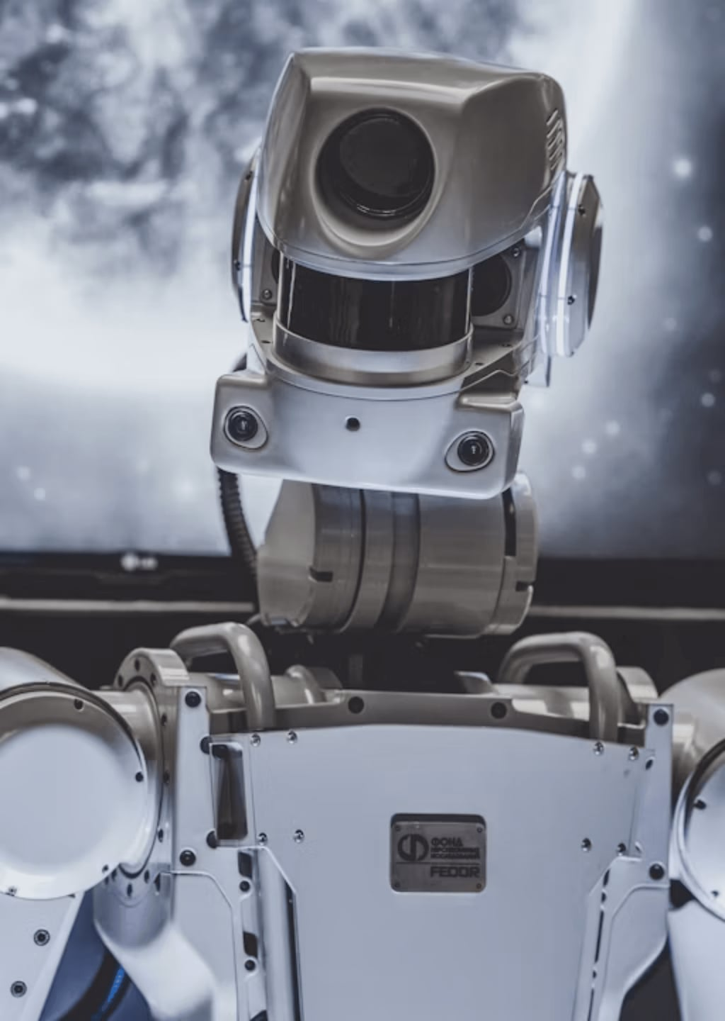
AUGMENTATION STRATEGY
Rise of Human-Centric AI
CO-PILOT VS. AUTOPILOT
AI acts as an intelligent assistant that empowers humans to make better, faster, and more informed decisions.
AUGMENTATION
Enhancing human creativity and emotional intelligence rather than seeking to replace the human element.
PURPOSE-DRIVEN
Aligning AI development with core human needs and the long-term well-being of our global society.

Slide 3

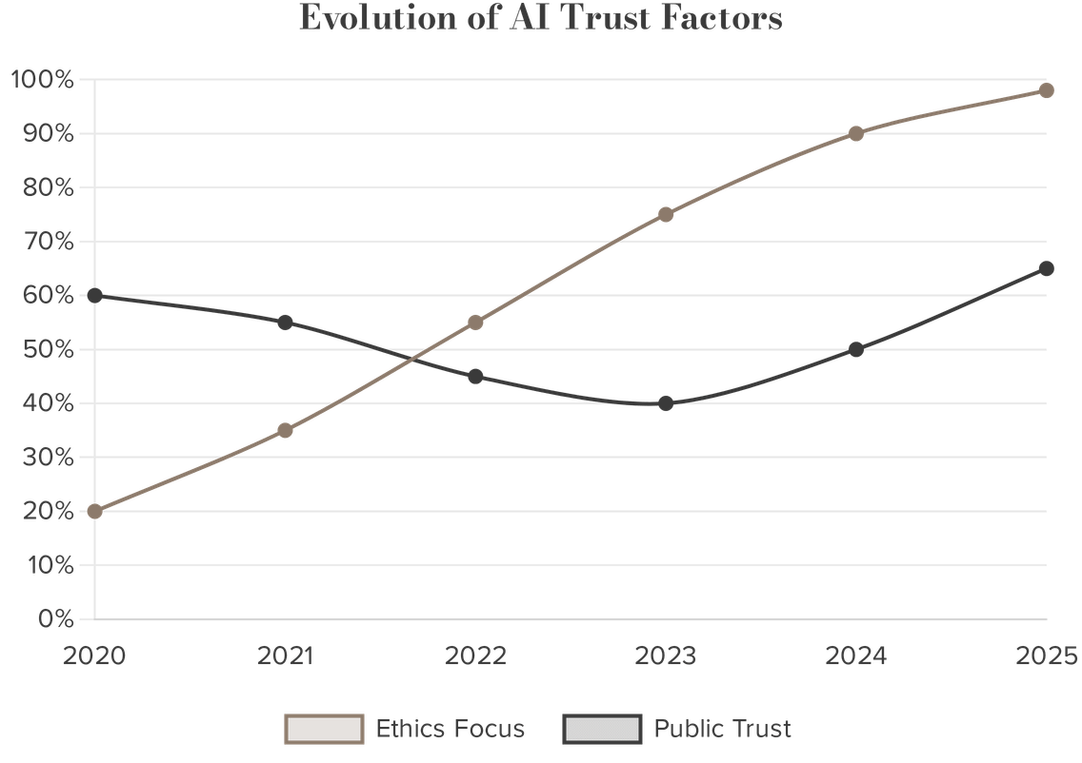
F
AI ETHICS & ACCOUNTABILITY
The Pillars of Trust
Trust is the foundation of the AI era, built on a robust ecosystem of ethical principles that ensure technology remains a force for good.
"Trust is not a feature; it is the foundation of human-AI synergy."
Transparency
Fairness
Moving away from "black box" systems to understandable logic.
Actively identifying and removing algorithmic bias.
Human Control
Privacy
Ensuring humans always have the final say in high-stakes calls.
Enforcing strict data permissions and governance layers.

Slide 4

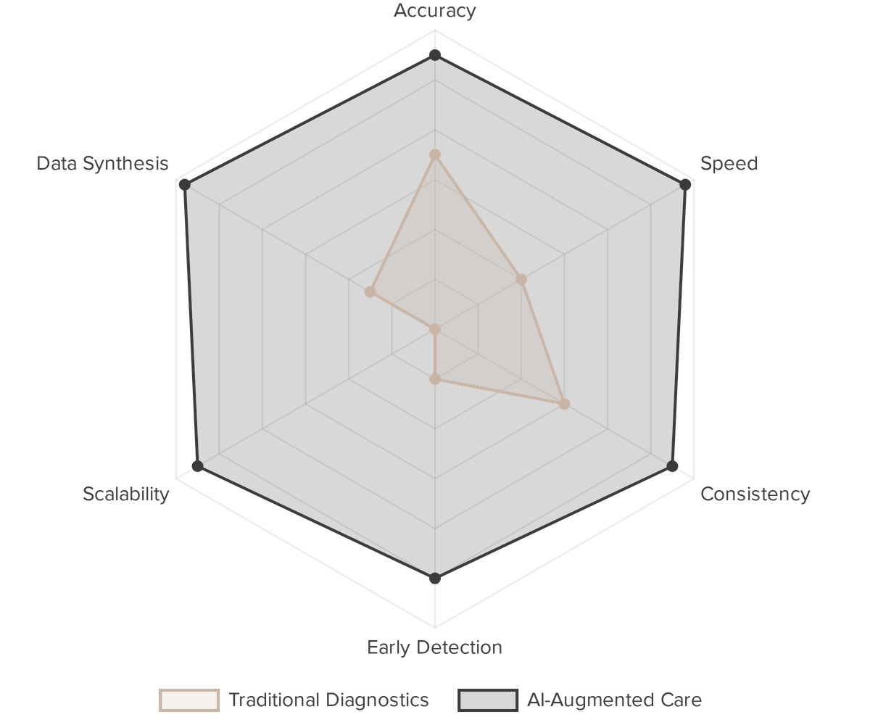
D
HEALTHCARE REVOLUTION
AI as a Digital Life-Saver
AI is bridging the global healthcare gap by augmenting clinical expertise and enabling early detection of life-threatening conditions.
"AI is the most powerful stethoscope ever invented."
Diagnostic Precision
Early Detection
Twice as accurate in interpreting brain scans
Spotting signs of 1,000+ diseases years early

Slide 5

PROFESSIONAL EMPOWERMENT
The Future of Work
AI co-pilots are redefining productivity by handling routine tasks, allowing humans to focus on high-value strategy and creative problem-solving.
GitHub Copilot
Efficiency Gains
Real-time pair programming assistance for faster software development
Automating documentation and routine coding tasks seamlessly
Skill Evolution
Human Oversight
Shifting workforce focus toward architectural and strategic thinking
Ensuring final accountability and ethical judgment remain human

Slide 6


E
HUMAN-CENTRIC SERVICE
AI in Customer Experience
Modern AI systems are learning to recognize human emotion, ensuring that technology serves with a "human touch" rather than rigid automation.
"The best customer service is if the customer
doesn't need to call you, it doesn't need to talk to
you. It just works."
— Jeff Bezos
Sentiment Awareness
Context Preservation
AI detects frustration or distress and hands off to humans when needed
Seamless transitions so customers never have to repeat themselves
Natural Interactions
Empathetic Design
Moving beyond rigid scripts to context-aware, human-like conversations
Prioritizing the customer's emotional state in every interaction

Slide 7


STRATEGIC GROWTH
Intelligent Business Strategy
AI-driven insights are helping businesses build deeper, more authentic customer relationships by providing high-context strategies grounded in real-time data.
Salesforce Einstein
Explainable Insights
Using years of CRM data to generate tailored outreach strategies
Providing the "why" behind every suggested business move for clarity
Trust Layers
Data-Driven Growth
Enforcing strict data permissions and privacy while scaling operations
Identifying new market opportunities through advanced predictive modeling

Slide 8

CHALLENGES & GUARDRAILS
Navigating the Risks
Acknowledging the limitations and failures of AI is essential for building safer, more resilient systems that respect human values and social responsibility.
Ethical Alignment
Algorithmic Bias
Controversies like Grok highlight the need for strict ethical guardrails
Unvetted data can lead to discriminatory outcomes in critical sectors
Regulatory Oversight
Social Responsibility
Political and social intervention is vital for maintaining public trust
Ensuring AI development reflects the diverse values of global society

Slide 9


E
GLOBAL IMPACT & INCLUSION
AI for Social Good
AI has the potential to democratize access to essential services and protect cultural heritage, ensuring that progress benefits the global population.
"The best way to predict the future is to create it,
and the best way to create it is together."
— Peter Drucker
Bridging the Gap
Preserving Tradition
Providing health services to 4.5 billion people lacking access
Cataloguing and protecting indigenous medical knowledge
Inclusive Innovation
Sustainable Progress
Ensuring AI reflects the diversity of the global population
Aligning technology with long-term humanitarian goals

Slide 10

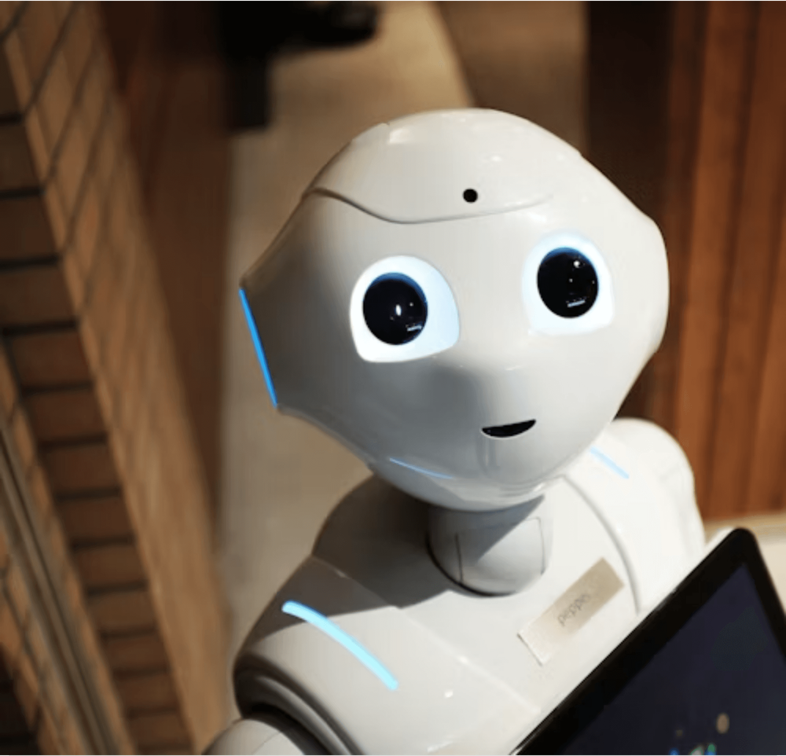
H
A COLLABORATIVE FUTURE
Embracing a Collaborative Future
The future of AI is not a race between humans and machines, but a partnership for collective progress. By combining AI's speed with human wisdom and empathy, we can create a sustainable and dignified future for all.
"The most profound technologies are those that disappear. They weave themselves into the fabric of everyday life until they are indistinguishable from it."

