Slide 1
Employee Attrition Analysis

Slide 2
Introduction
The key purpose for having this HR attrition analytics dashboard is to understand why people leave the company and how one can retain them. It helps in keeping track of important numbers such as how many, why, and what are the patterns behind them leaving.
It uses this information to pinpoint the most probable causes of employee turnover, such as job dissatisfaction, growth opportunities, or work ambiance. This gives insight into what precisely is wrong, so that the company can take proactive measures toward its retention rate as a whole, ensuring a more stable and satisfied workforce.

Slide 3
Data Overview
Dataset is downloaded from the official internship portal.
It contains columns such as:
Job Satisfaction: Measures how content employees are with their job roles and work environment.
Job Role: Indicates the specific position or job title held by the employee within the company.
Department: Specifies the division or business unit where the employee works.
Education: Represents the highest level of education attained by the employee.
Years at Company: Shows the total number of years the employee has been with the company.
Monthly Income: Displays the monthly salary or wages earned by the employee.

Slide 4
Approaching the dataset
Checked the dataset for any null values and removed them from the dataset
Looked for duplicated values and treated them accordingly if occurred
I have added one conditional column named as Attrition count, and two custom columns named as Age Group and Salary Range.
Attrition Count column shows that if attrition is ‘yes’ then it shows 1 or else 0
Age group column shows 5 to 6 range of ages such as 18 to 25, 26 to 37 till 60.
Salary range also shows the range of monthly incomes.
I created a new measure named as Attrition Rate which shows the rate of attrition in percentage.

Slide 5
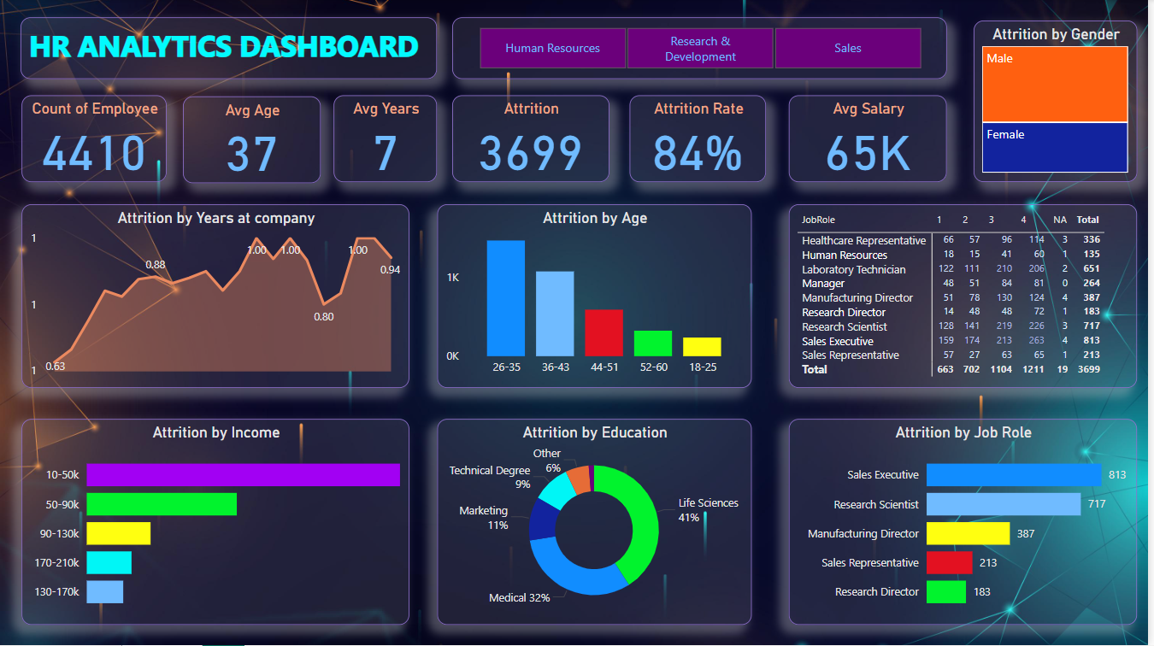
The Dashboard

Slide 6
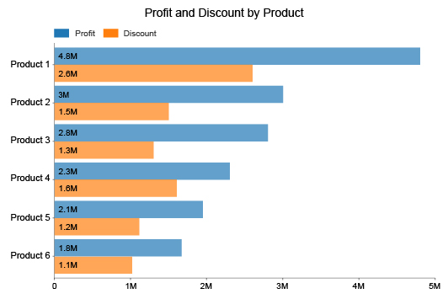
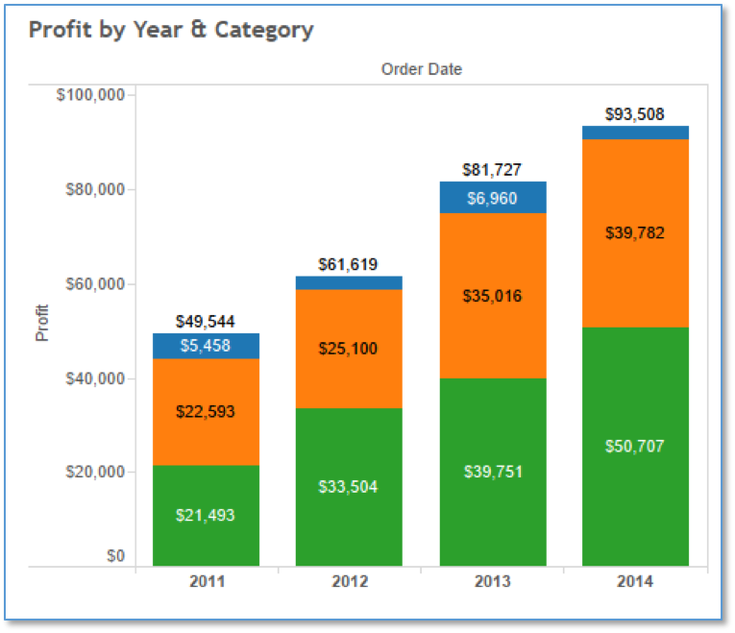
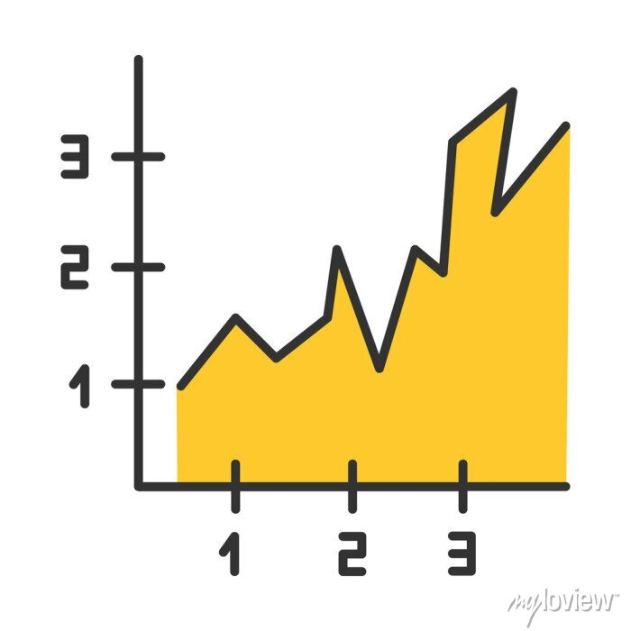
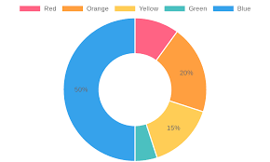
Dashboard Overview
Clustered Bar Chart
Cards/KPIs
Created 2 charts of this type one for attrition by income and another for attrition by job role
Created 6 KPIs for shwing total employee, avg age, avg years, attrition, attrition rate and avg salary
Stacked Column Chart
Matrix Table
Created this chart for showing attrition by age
Created this table for showing what ratings have employees given accroding to job role
Area Chart
Donut Chart
Created this chart by showing attrition by years at comapany
Created this chart for shwing attrition by education

Slide 7
Uses of HR Analytics Dashboard
I have created slicers in the dashboard for department so we can directly see the attrition on the basis of each department
Analyze factors like job satisfaction, role, department, education, tenure, and income to understand why employees leave.
Points the areas for improvement in job satisfaction to foster a more engaged and productive workforce.
The dashboard shows patterns and trends across different departments and demographic groups, thus helping in proactive management and early intervention in the potential problem areas.

Slide 8
Summary
The HR attrition analytics dashboard helps analyze drivers like job satisfaction, role, department, education, tenure, and income, among others, for understanding the reason for employee exit. It delivers insights to create focused initiatives for employee retention and reducing turnover rates.
It identifies the areas of improvement in terms of job satisfaction, thus fostering a more engaged and productive workforce. This dashboard offers data-driven insights for key decisions related to workforce planning, recruitment, and talent management. Furthermore, it is tracking and visualizing the important HR metrics in real time.
Thus, it keeps all the stakeholders of the company well informed about the performance in attrition, it further unveils patterns and trends across different departments and demographic groups.

Slide 9
Conclusion
The HR attrition analytics dashboard is an effective tool to better understand and address employee turnover. It provides valuable insights into job satisfaction, role, department, education, tenure, and income, helping to create focused retention strategies.
These insights not only work on enhancing employee satisfaction but also support data-driven decisions in workforce planning and talent management. Informed and empowered stakeholders are delivered through real-time monitoring and visualization of HR metrics for proactive management.
At the very end, this helps to recognize patterns and trends across departments and demographic groups, takes action on time, and thus builds a more stable and engaged workforce.

Slide 10
THANKYOU

