Slide 1

Chinook Music Store
Name: Sudhanshu Vilas Kulkarni
Guided By:
Newton School

Slide 2
Problem Statement
You are hired as a consultant data analyst at Chinook and your objective is to analyze music record sales data to gain insights and make recommendations for the company's strategy in the physical music market.

Slide 3
Introduction
This project analyzes the performance of a digital media store using the Chinook database.
The goal is to derive insights and recommend strategies to enhance sales and customer engagement.
Data is explored across attributes such as customers, invoices, tracks, and employee performance.
SQL queries provide detailed insights into sales trends, top-selling genres, and customer behavior.
Recommendations focus on improving revenue streams and optimizing operational efficiency.

Slide 4
Applications of Chinook music store
Analyses sales trends to boost revenue and increase profit
Gain insights into customer profiles and purchasing habits
Tracks employee performance by region
Identifies top selling genres, albums or tracks
Enables target product suggestions and bundling opportunities.

Slide 5
Data Overview
The Chinook database contains information on digital media sales, including tracks, albums, artists, and genres.
It includes customer details, invoice transactions, and employee records.
Tracks are categorized by genre, media type, and associated albums.
Invoice data captures sales transactions, including purchase dates and customer locations.
Employee data reflects roles and regions served, supporting insights into team performance.

Slide 6
The Chinook database comprises 11 interrelated tables covering customers, invoices, tracks, albums, artists, and employees.
Tracks are linked to albums and artists, providing a detailed view of music inventory.
Invoice data records transaction details, including purchase dates, amounts, and customer information.
Customer data captures demographic and location details, supporting regional sales analysis.
Employee data highlights roles and territories, enabling insights into team productivity and performance.

Slide 7
Steps Taken
01
02
Data Cleaning
Data Exploration
04
05
Gathering Insights
Recommendations
03
SQL Querying
Explore content and structure of the tables
Removed duplicates and irrelevant data to ensure accuracy.
Executed several queries to extract some particular insights
Analysed data to derive key insights
Provide actionable suggestions based on the analysis

Slide 8
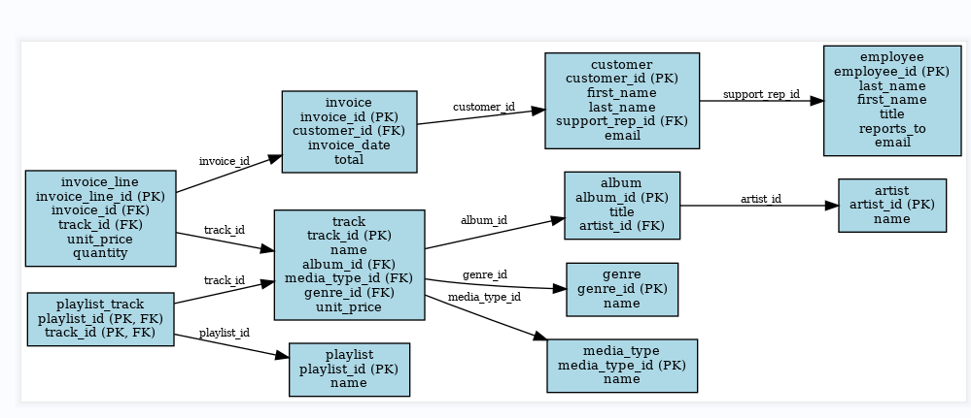
ER Diagram

Slide 9
Overview of Schema
The ER diagram represents a relational database structure for managing music-related data. It includes key entities such as album, artist, track, genre, MediaType, playlist, customer, employee, invoice, and their relationships. Each entity has primary keys (PK) for unique identification, and foreign keys (FK) establish connections between them.
The “artist” is linked to “album” through artist_id.
The “album” is connected to track via album_id, while track references genre and media_type through genre_id and media_type_id, respectively.
The “playlist” and “track” have a many-to-many relationship managed by playlist_track.
The “customer” relates to “employee” via support_rep_id, and to “invoice” through customer_id.
The “invoice” connects to invoice_line using invoice_id, which also references “track” through track_id.

Slide 10
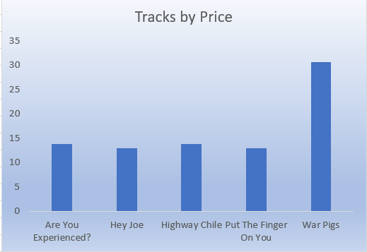
Top Selling Tracks
Given Below are the top 5 purchased tracks by customers
War Pigs
Highway Chile
Are you Experienced
Hey Joe
Put the Finger on You.

Slide 11
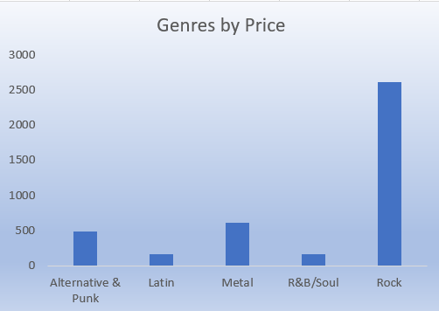
Top Selling Genres
Given below are the top 5 sold genres to the customers
Rock
Metal
Alternative & Punk
Latin
R&B/Soul

Slide 12
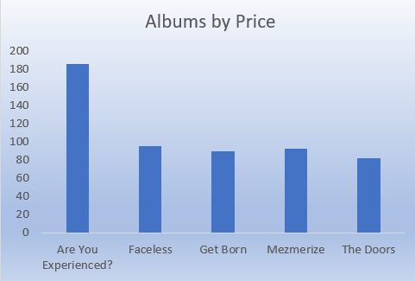
Top Selling Albums
Given below are the top 5 albums purchased by customers:
Are you Experienced
Faceless
Mezmerize
Get Born
The Doors

Slide 13
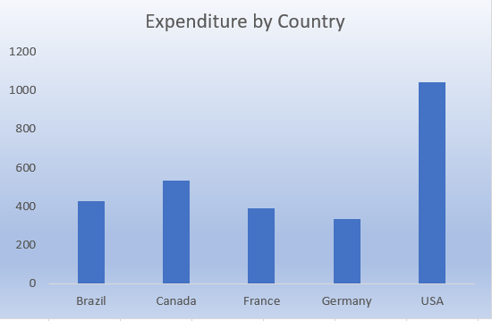
Expenditure by Country
Given below are the top countries that have the highest expenditure on tracks, albums and genres.
USA
Canada
Brazil
France
Germany

Slide 14
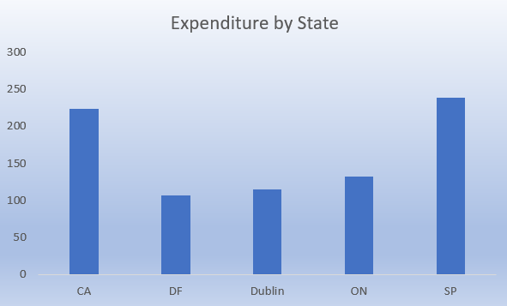
Expenditure by State
Given below are the top states that have the highest expenditure on tracks, albums and genres.
SP(Sao Paulo)
CA(California)
ON(Ontario)
Dublin
DF(Federal District)

Slide 15
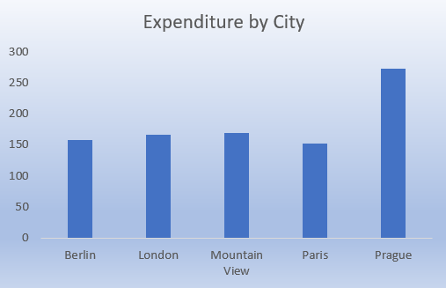
Expenditure by City
Given below are the top cities that have the highest expenditure on tracks, albums and genres.
Prague(Czechia – near Germany)
Mountain View(California)
London
Berlin
Paris

Slide 16
Recommedations
Stock more albums and tracks from top-performing genres and artists identified in the analysis.
Focus marketing efforts on customers who generate the highest revenue to improve loyalty and retention.
Based on customer payment preferences, refine the checkout process to boost conversion rates and minimize abandoned purchases.
Use demographic and purchasing behavior data to refine customer profiles and develop more effective segmentation strategies.

Slide 17
Conclusion
The analysis of the Chinook dataset provided valuable insights into customer preferences, sales trends, and regional performance.
By leveraging SQL queries and thorough data exploration, we identified top-selling genres, high-revenue customers, and key purchasing behaviors.
These findings enable the formulation of actionable strategies to enhance customer engagement, optimize inventory, and boost revenue.
With targeted recommendations and a focus on data-driven decision-making, the Chinook music store is well-positioned to improve its operational efficiency and achieve sustainable growth.

Slide 18
THANKYOU

