Slide 1



T.Krishna Koushik Padamaraj Kore Sudhanshu Pal
Online Traffic Challan Portal
Date: 8 Aug 2022

Slide 2
01
INTRODUCTION

Slide 3
A Portal for Issuing and Paying the Traffic Violation challans.
Purpose to implement Online challan is to minimize the effort and load of both the Police and Users in doing the operations.
For that we have two kind of Login for Traffic police and Vehicle owners.
Traffic police should be able to login and issue a challan to a particular vehicle on a particular timestamp at a particular traffic camera location for a particular set of violations with Image Proof.
Vehicle owners should be able to login and view pending challans on their vehicles and pay the challan and can also raise the dispute.

Slide 4
02
APPROACH

Slide 5
Analysis of the Requirements needed in Design and Data Flow.
Designed ER diagram and Database, Angular Endpoints and flow chart of Portal.
Generated Three Main Components
Welcome Page
Police Homepage
Vehicle owner page

Slide 6
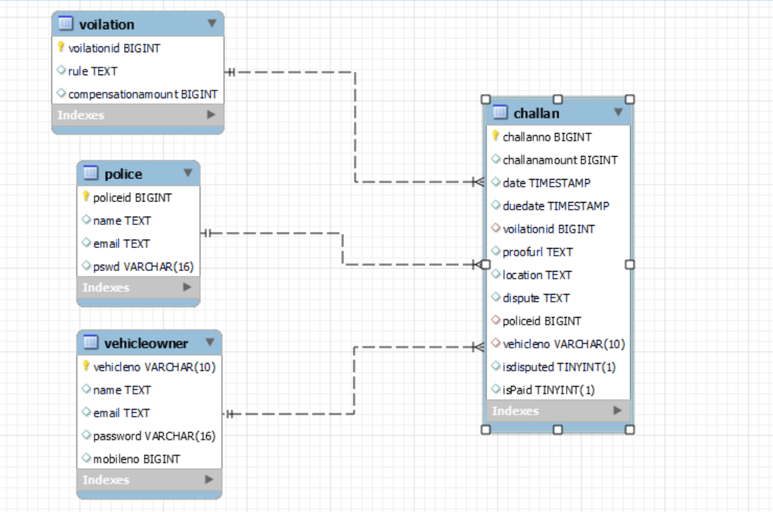

Slide 7
Welcome Component
Police log in
Vehicle owner log in
2. Police Home Page
View Issued Challan
View Disputed Challan
View Paid Challan
View Violation Report
Generate New Challan
3. Vehicle Log in
View challans
Raise a dispute
To Pay
Guidelines

Slide 8
03
LEARNINGS

Slide 9
Clear Idea About Designing A Web Portal/Application.
Understood RestApi Integration.
Understood Requirements Of Good UI Design.
Understood The Advantages Of Angular Framework.
Understood How To Connect Different Services to Each Other Like MySQL ,STS and Angular.

Slide 10
04
CHALLENGES

Slide 11
To Design The Appropriate Database.
Allow vehicle owners to pay for Assigned challans only in due time.
Maintaining data flow rate.
To provide g-map visualization on the basis of pin code.

Slide 12
05
STATISCTICS

Slide 14
06
MOCKUPS

Slide 15
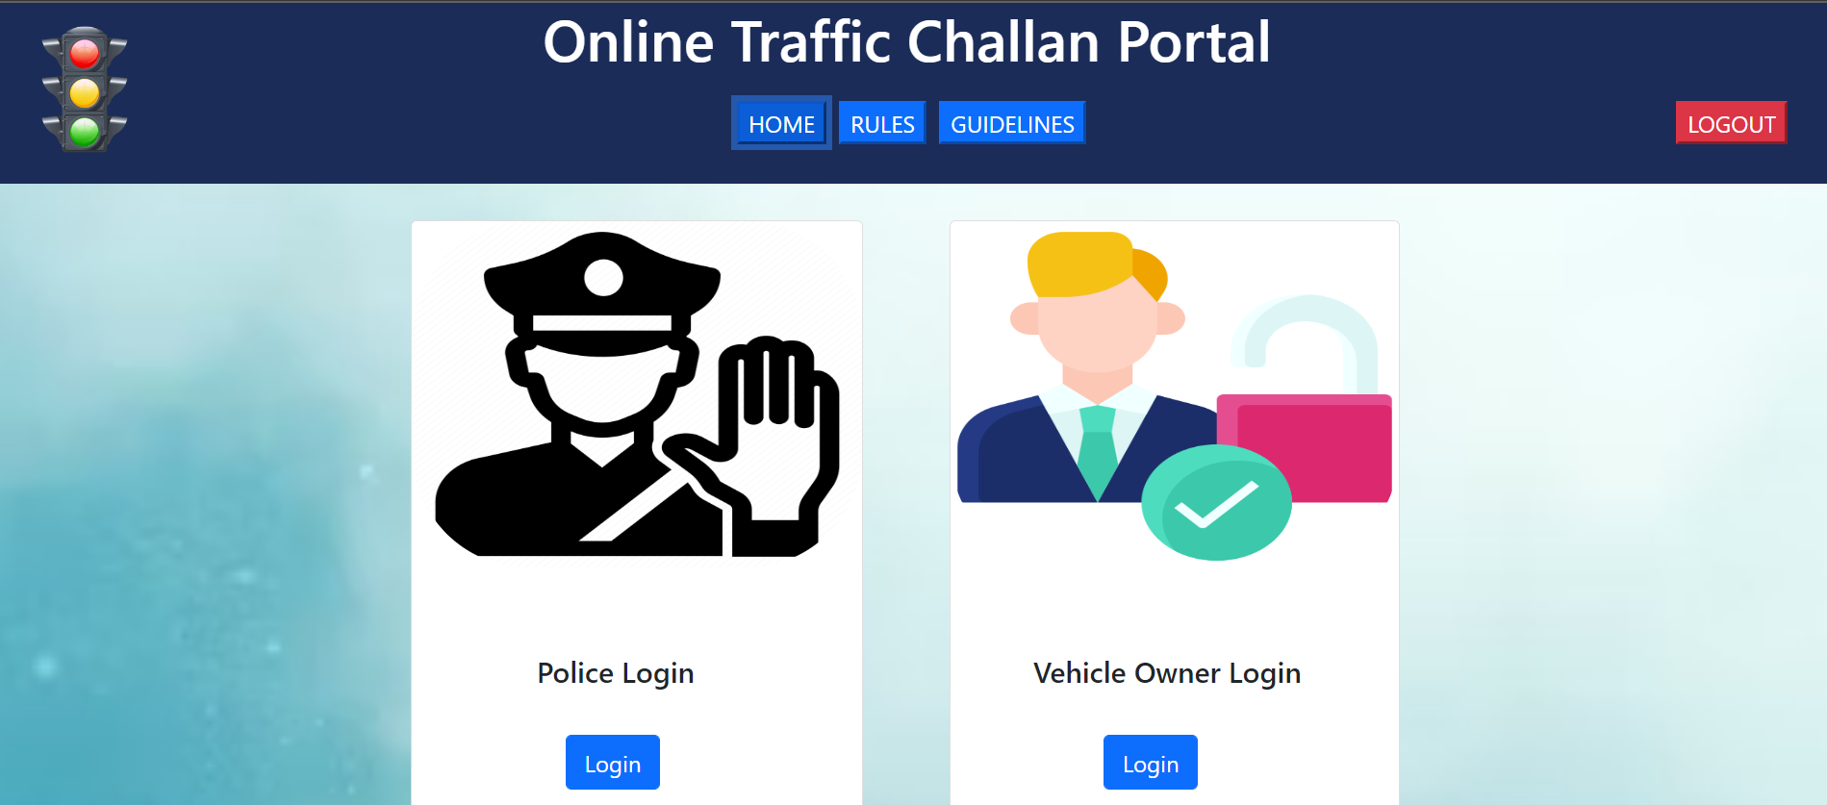
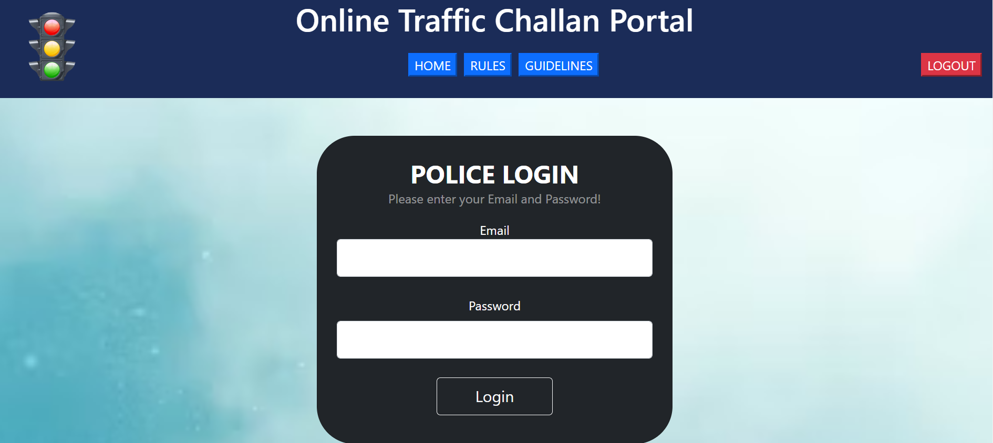

Slide 16
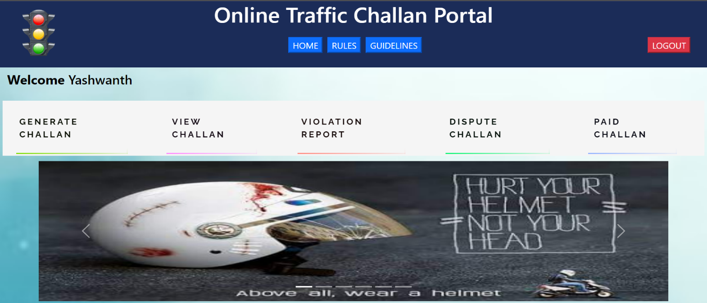
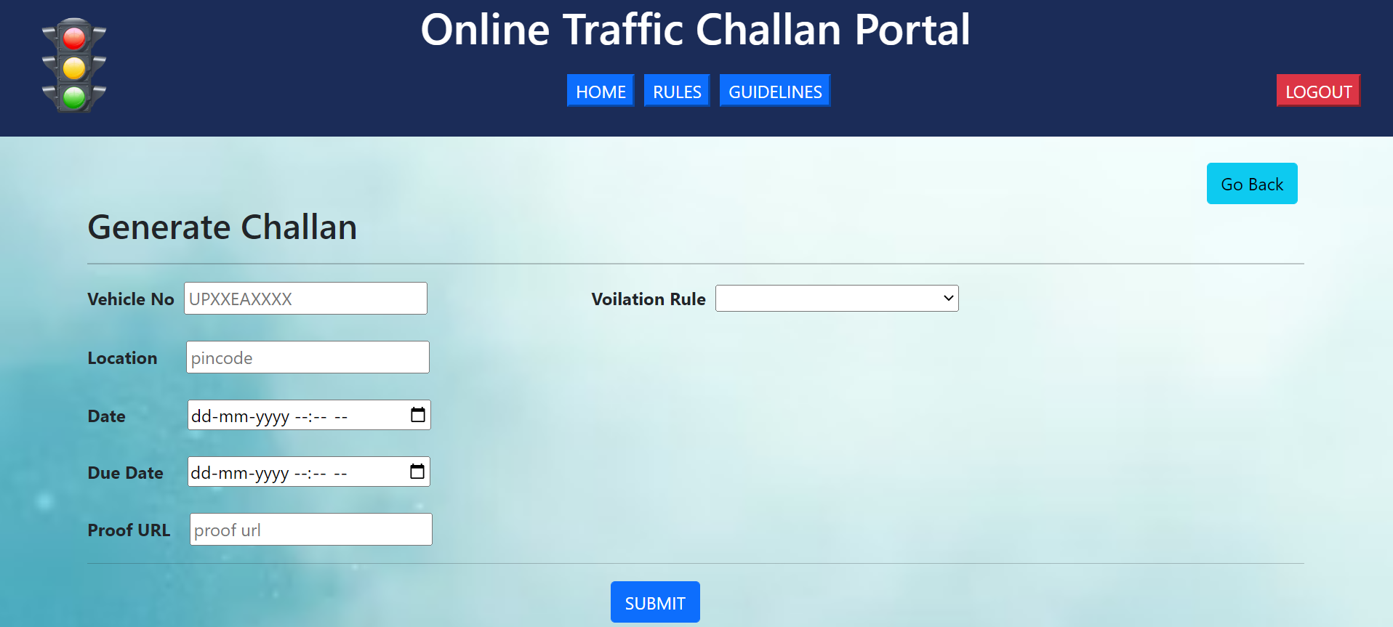

Slide 17
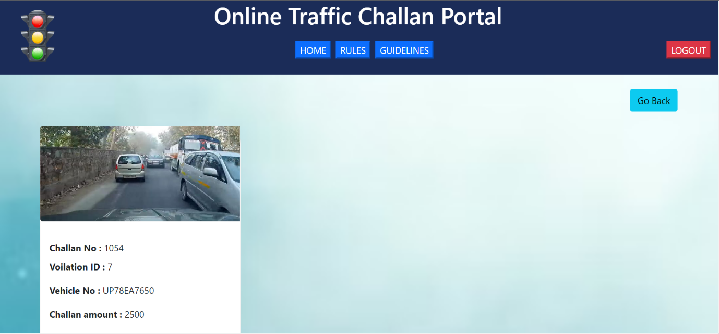
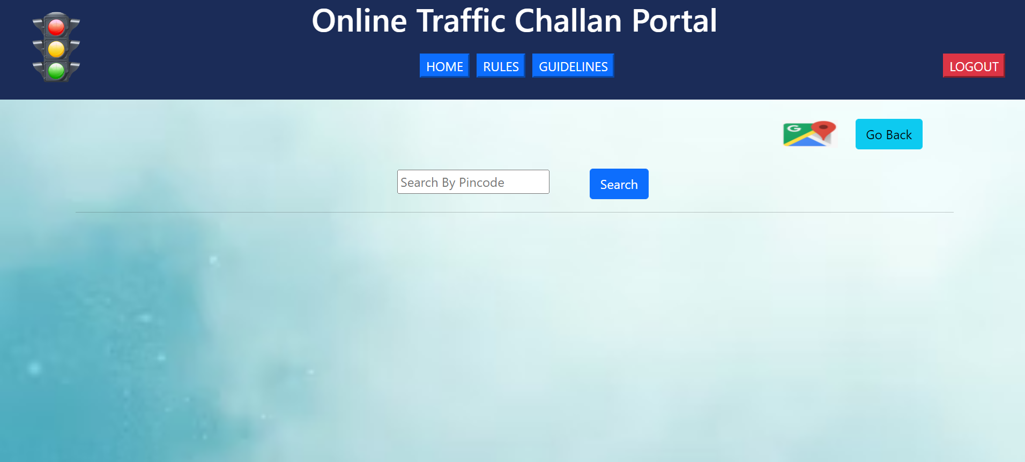

Slide 18
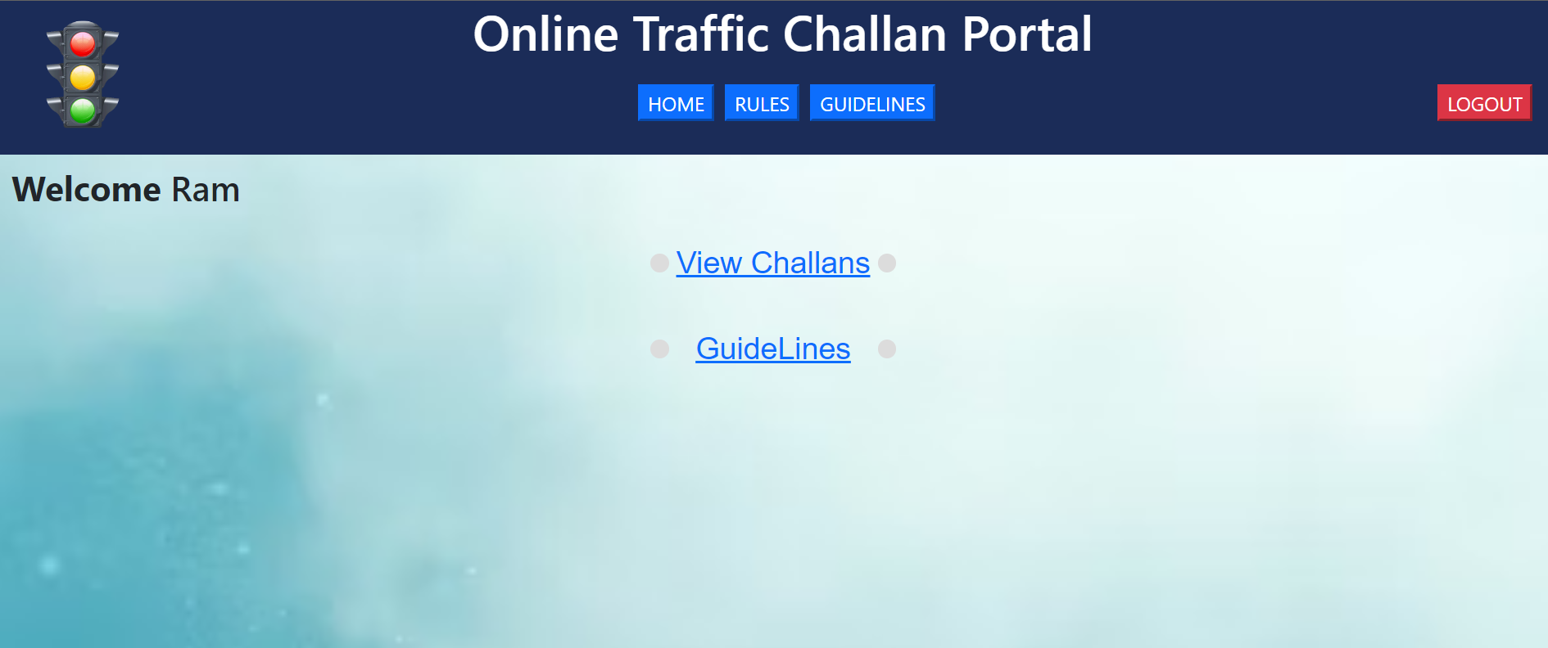
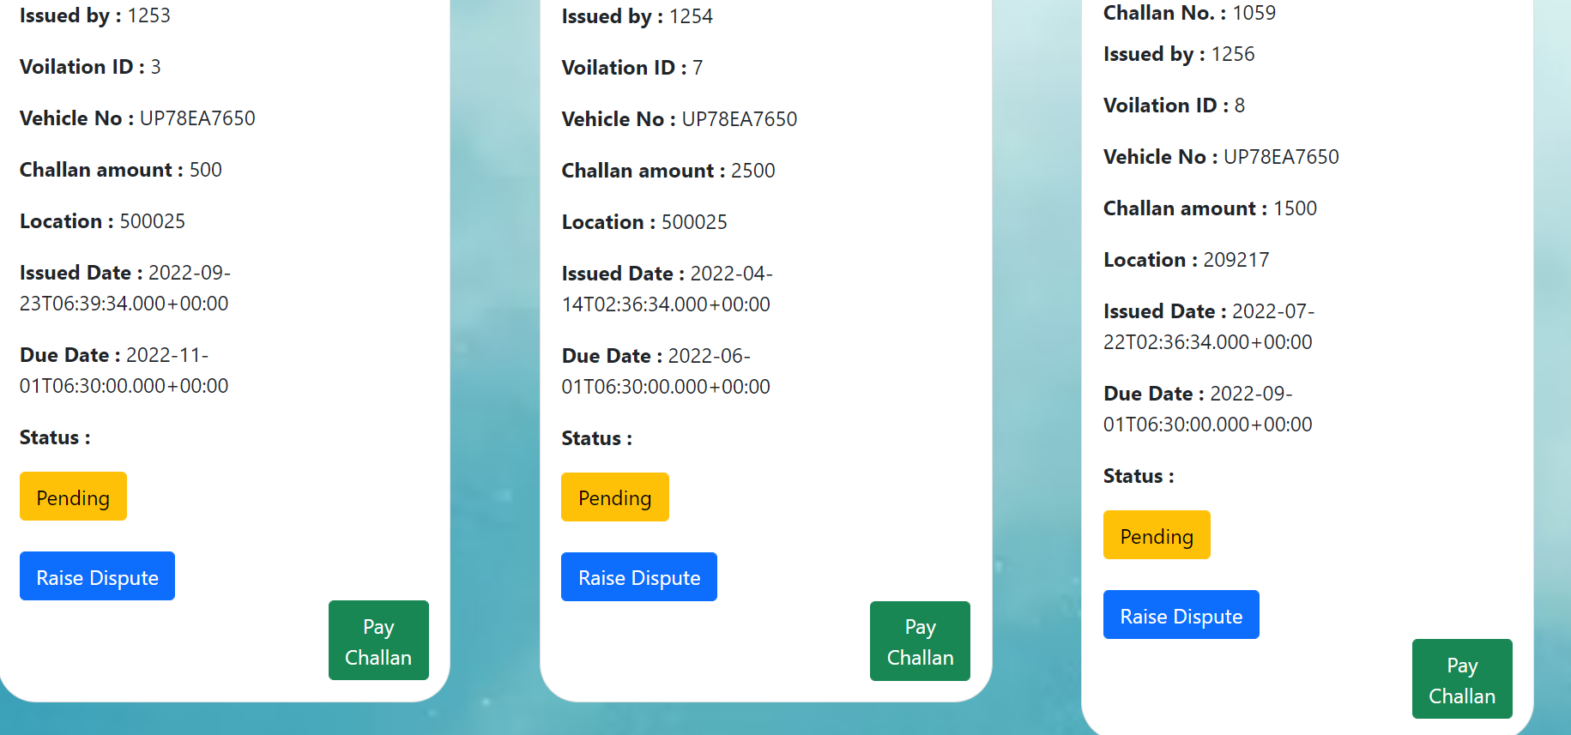

Slide 19
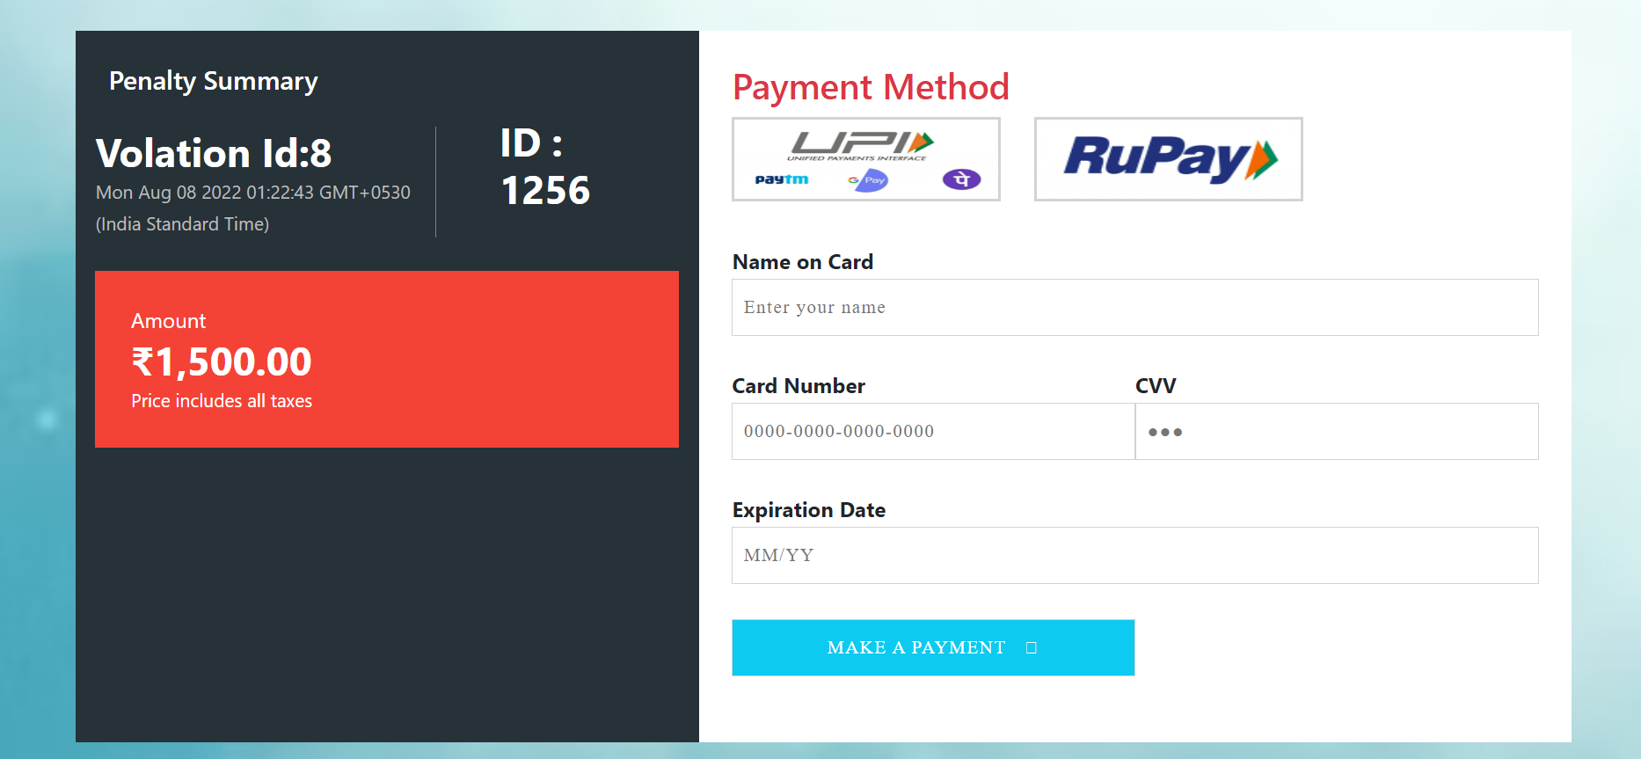
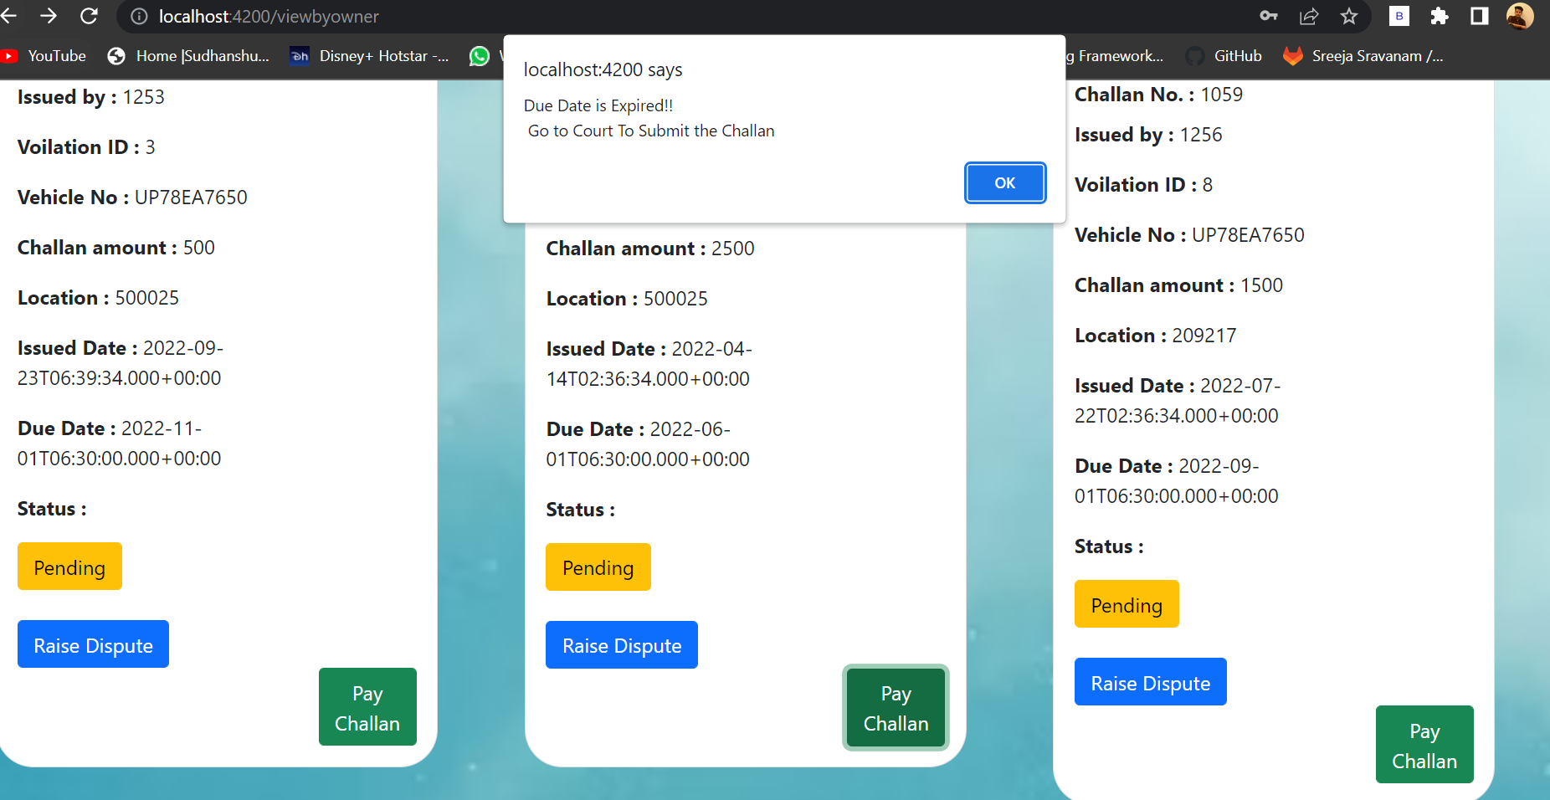

Slide 20
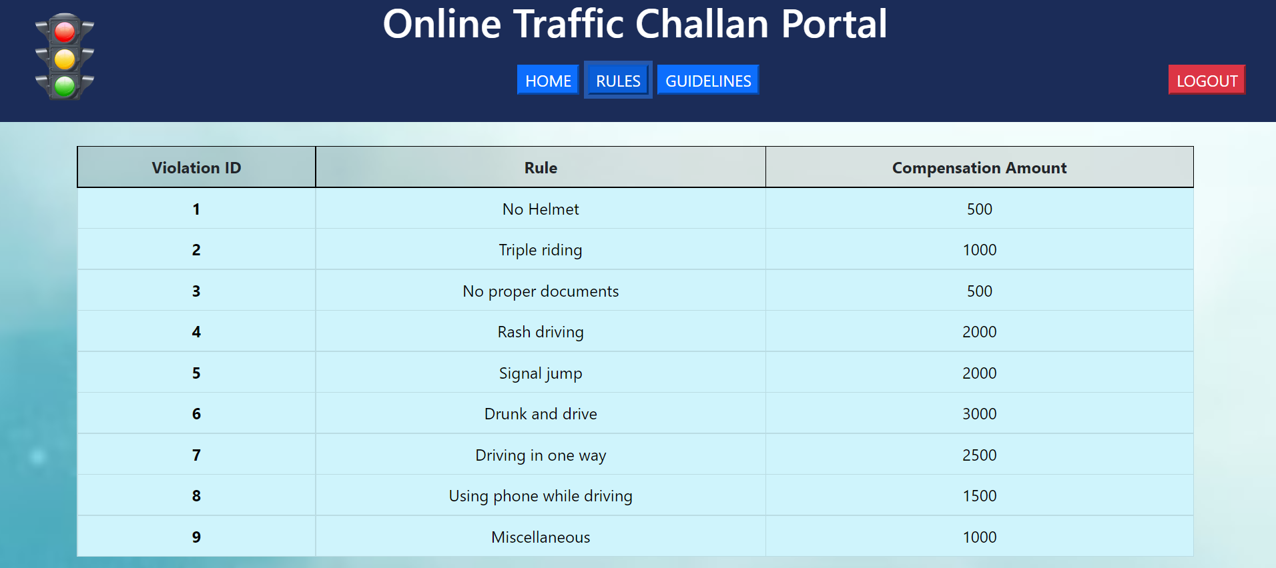
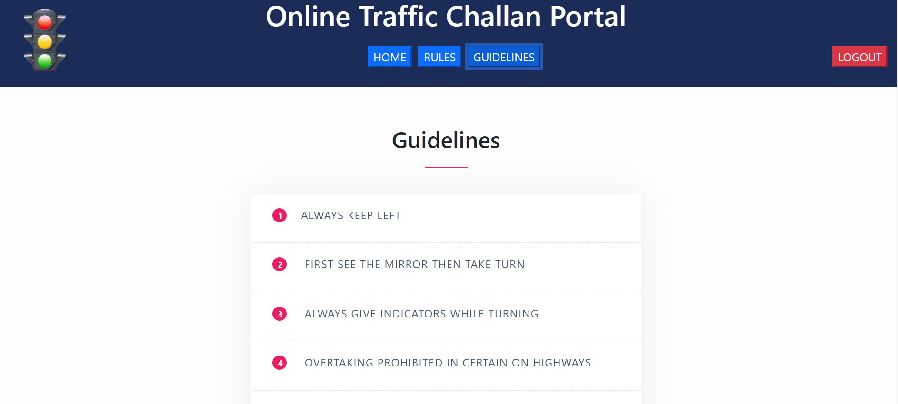

Slide 21
THANK YOU

