Slide 1
GraphX

Slide 2
GraphX
Graph processing
Data generally stored as collection of rows
Not always efficient
Graph oriented data comes handy
FB, Twitter, WWW
Graph
Vertices
Edges
Could be directed or undirected

Slide 3
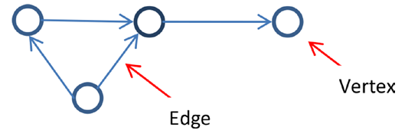
Terminology

Slide 4
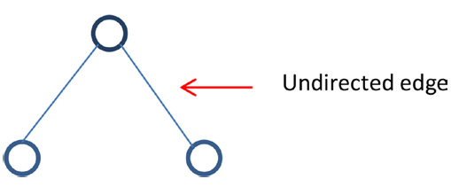
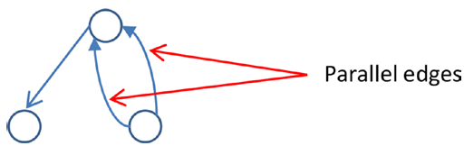
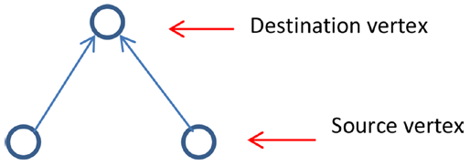

Slide 5
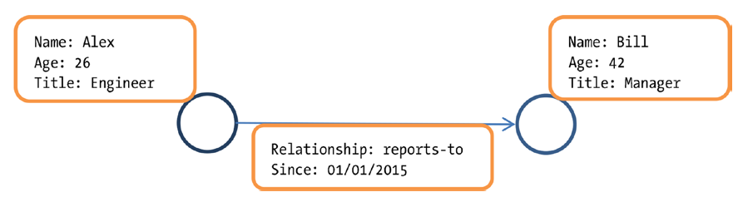
Property Graph

Slide 6
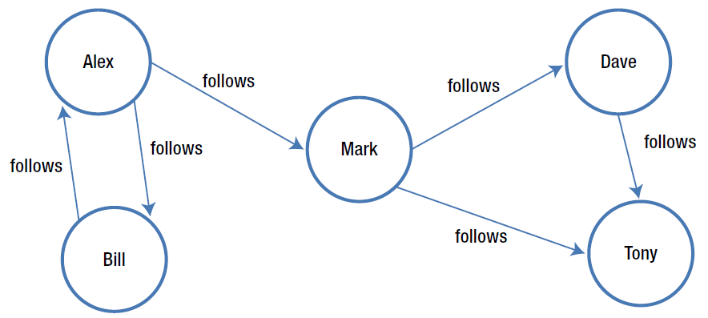

Slide 7
GraphX
Distributed Graph Analytics framework
Fundamental graph operators
Advanced Operators
Page rank
Triangle count
Integrated platform for complete graph analytics

Slide 8
Graph Analytics Pipeline
Read raw data
Preprocess
Extract vertices and edges and create property graph
Slice
Graph Algorithms
Analyze results

Slide 9
API
Data types for representing graph oriented data
Operators for graph analytics
Data abstraction
Verted RDD
Edge
EdgeRDD
EdgeTriplet
Graph

Slide 10
Data Types
Vertex RDD
Distributed collection of vertices
One entry for each vertex
Vertex represented by a key-value pair
Edge
Abstracts a directed edge
Source vertex id, destination vertex id, edge attributes
EdgeRDD
Distributed collection of edges
Graph
Abstraction for property graphs
Immutable, distributed, fault tolerant

Slide 11
Creating a Graph
Let us imitate social network graph
Vertex represents user
Directed edge represents follow relationship

Slide 12
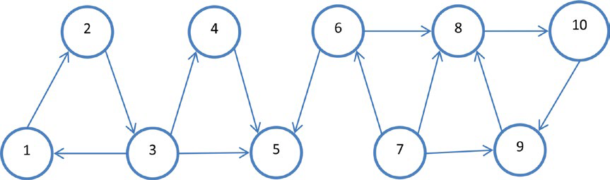

Slide 13
import org.apache.spark.graphx._
case class User(name: String, age: Int)
val users = List((1L, User("Alex", 26)), (2L, User("Bill", 42)), (3L, User("Carol", 18)),(4L, User("Dave", 16)), (5L, User("Eve", 45)), (6L, User("Farell", 30)),(7L, User("Garry", 32)), (8L, User("Harry", 36)), (9L, User("Ivan", 28)),(10L, User("Jill", 48)))
val usersRDD = sc.parallelize(users)

Slide 14
val follows = List(Edge(1L, 2L, 1), Edge(2L, 3L, 1), Edge(3L, 1L, 1), Edge(3L, 4L, 1),Edge(3L, 5L, 1), Edge(4L, 5L, 1), Edge(6L, 5L, 1), Edge(7L, 6L, 1), Edge(6L, 8L, 1), Edge(7L, 8L, 1), Edge(7L, 9L, 1), Edge(9L, 8L, 1), Edge(8L, 10L, 1), Edge(10L, 9L, 1), Edge(1L, 11L, 1))
val followsRDD = sc.parallelize(follows)
val defaultUser = User("NA", 0)
val socialGraph = Graph(usersRDD, followsRDD, defaultUser)

Slide 15
Graph Properties
val numEdges = socialGraph.numEdges
val numVertices = socialGraph.numVertices
val inDegrees = socialGraph.inDegrees
inDegrees.collect
val outDegrees = socialGraph.outDegrees
outDegrees.collect
val degrees = socialGraph.degrees
degrees.collect

Slide 16
val vertices = socialGraph.vertices
val edges = socialGraph.edges
val triplets = socialGraph.triplets
triplets.take(3)
val follows = triplets.map{ t => t.srcAttr.name + " follows " + t.dstAttr.name}
follows.take(5)

Slide 17
Graph Operators
Property Transformation
Structure Transformation
Join
Aggregation
Graph Algorithm
Graph Parallel Computation

Slide 18
Property Transformation
mapVertices
Transformation to each vertex in property graph
val updatedAges = socialGraph.mapVertices( (vertexId, user) =>User(user.name, user.age + 1 ))
socialGraph.vertices.take(5)
updatedAges.vertices.take(5)
mapTriplets
val weightedGraph = socialGraph.mapTriplets{ t =>if (t.srcAttr.age >= 30) 2 else 1}
socialGraph.edges.take(10)
weightedGraph.edges.take(10)

Slide 19
Structure Transformation
reverse
val reverseGraph = socialGraph.reverse
reverseGraph.triplets.map{ t => t.srcAttr.name + " follows " + t.dstAttr.name}.take(10)
subgraph
val subgraph = weightedGraph.subgraph( edgeTriplet => edgeTriplet.attr > 1,(vertexId, vertexProperty) => true)
subgraph.edges.take(10)

Slide 20
Join
joinVertices
val correctAges = sc.parallelize(List((3L, 28), (4L, 26)))
val correctedGraph = socialGraph.joinVertices(correctAges)((id, user, correctAge) =>User(user.name, correctAge))
correctedGraph.vertices.collect
outerJoin Vertices
case class UserWithCity(name: String, age: Int, city: String)
val userCities = sc.parallelize(List((1L, "Boston"), (3L, "New York"), (5L, "London"),(7L, "Bombay"), (9L, "Tokyo"), (10L, "Palo Alto")))
val socialGraphWithCity = socialGraph.outerJoinVertices(userCities)((id, user, cityOpt) =>cityOpt match {case Some(city) => UserWithCity(user.name, user.age, city)case None => UserWithCity(user.name, user.age, "NA")})
socialGraphWithCity.vertices.take(5)

Slide 21
Page Rank
val outDegrees = socialGraph.outDegrees
val outDegreesGraph = socialGraph.outerJoinVertices(outDegrees) {(vId, vData, OptOutDegree) =>OptOutDegree.getOrElse(0)}
val weightedEdgesGraph = outDegreesGraph.mapTriplets{EdgeTriplet =>1.0 / EdgeTriplet.srcAttr}

Slide 22
val inputGraph = weightedEdgesGraph.mapVertices((id, vData) => 1.0)
val firstMessage = 0.0
val iterations = 20
val edgeDirection = EdgeDirection.Out
val updateVertex = (vId: Long, vData: Double, msgSum: Double) => 0.15 + 0.85 * msgSum
val sendMsg = (triplet: EdgeTriplet[Double, Double]) =>Iterator((triplet.dstId, triplet.srcAttr * triplet.attr))
val aggregateMsgs = (x: Double, y: Double ) => x + y

Slide 23
val influenceGraph = inputGraph.pregel(firstMessage, iterations, edgeDirection)(updateVertex,sendMsg, aggregateMsgs)
val userNames = socialGraph.mapVertices{(vId, vData) => vData.name}.vertices
val userNamesAndRanks = influenceGraph.outerJoinVertices(userNames) {(vId, rank, optUserName) =>(optUserName.get, rank)}.vertices

Slide 24
userNamesAndRanks.collect.foreach{ case(vId, vData) =>println(vData._1 +"'s influence rank: " + vData._2)}

