Slide 1
MLLib

Slide 2
Agenda
Introduction to MLLib
Machine Learning
Algorithms

Slide 3
Machine Learning
Systems learn with data
Different from traditional paradigm
Logic learnt from data
Computation intensive
Ubiquitous
Apple (Siri), Google (Search), Amazon (Recommendations), FB
Eventual goal is to predict or classify

Slide 4
Terminology
Feature
Attribute or a variable
Table – row is observation, and column a feature
Dimensionality
Categorical or numerical
Label
Dependent variable
To be predicted
Numerical or categorical
Model
Mathematical representation of relationship betn variables

Slide 5
Machine Learning
Machine learning algo fits model to data
Computationally intensive
Train and test data
Applications
Classification
Regression
Clustering
Anomaly detection
Recommendation

Slide 6
Supervised Algorithms
Trains model with labeled dataset
Regression
Predict numerical variable
Linear regression, decision tree, ensemble
Classification
Predict categorical variables
Logistic regression, Neural network, Naive Bayes

Slide 7
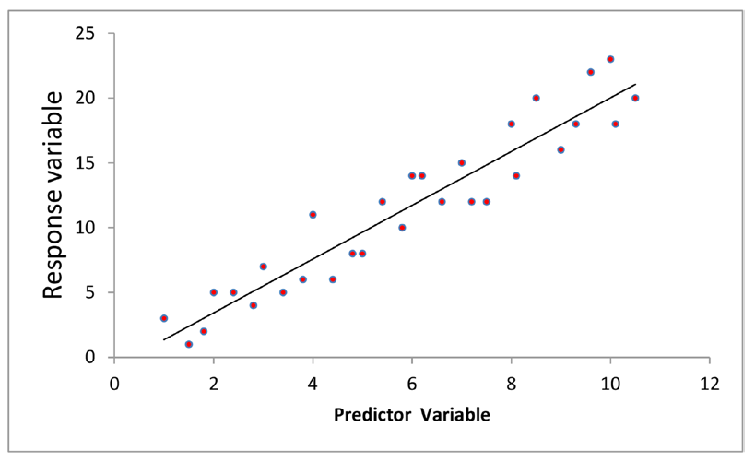
Linear Regression

Slide 8
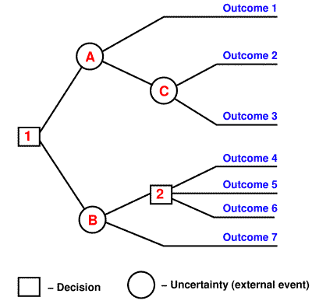
Decision Tree

Slide 9
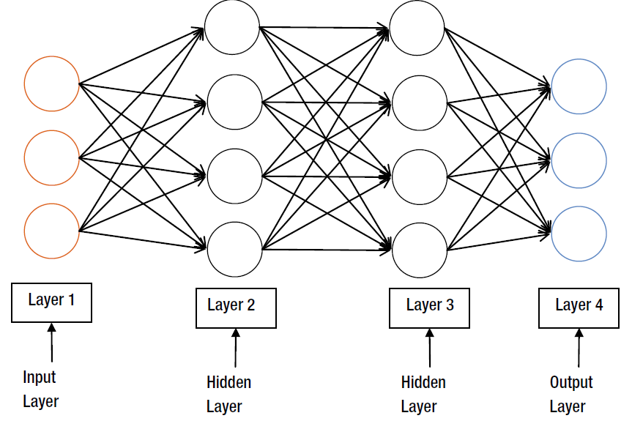
Neural Network

Slide 10
Unsupervised Algorithm
Used when dataset is unlabeled
Try to place observations in different buckets
Learning patterns inherent in data
PCA, SVD, k-means

Slide 11
Machine Learning in Spark
Two libraries
MLLib
Spark ML (Pipelines API)
MLLib is more mature
Commonly used ML algos and statistical analysis tools
Machine Learning on large datasets
Scalable, faster
Both batch and streaming data

Slide 12
Statistical Utilities
Summary stats
Correlation
Hypothesis Testing
Sampling
Random data

Slide 13
Algorithms
Regression
Linear and Logistic, SVM, Naive Bayes, Decision Tree, Random Forest
Clustering
K-means, Gaussian, LDA, PCA, SVD
Data Mining and Feature Extraction
TF-IDF, Word2Vec, Normalization, Item set mining, Association Rules, Collaborative Filtering

Slide 14
API
Data Types – MLLib operates on these data types
Vector
Indexed collection of values
LabeledPoint
Rating

Slide 15
Data Type - Vector
Represents element in n-dimensional space
Used for representing features
Vector of length n represents observation with n features
Indexed collection of Double type values
Two subtypes
Dense
import org.apache.spark.mllib.linalg._
val denseVector = Vectors.dense(1.0, 0.0, 3.0)
Sparse
import org.apache.spark.mllib.linalg._
val sparseVector = Vectors.sparse(10, Array(3, 6), Array(100.0, 200.0))

Slide 16
LabeledPoint
An observation in a labeled dataset
Contains both label and features
Primary RDD abstraction
Can represent both categorical and numerical values

Slide 17
import org.apache.spark.mllib.linalg.Vectors
import org.apache.spark.mllib.regression.LabeledPoint
val positive = LabeledPoint(1.0, Vectors.dense(10.0, 30.0, 20.0))
val negative = LabeledPoint(0.0, Vectors.sparse(3, Array(0, 2), Array(200.0, 300.0)))

Slide 18
Rating
Used with recommendation algorithms
Represents user rating
import org.apache.spark.mllib.recommendation._
val rating = Rating(100, 10, 3.0)

Slide 19
Algorithms and Models
Model represented by a class
ML algorithm also represented by a class
Two key methods
Train
Predict

Slide 20
Logistic Regression
Let us do this using a real dataset KDDCup dataset
import urllib
f = urllib.urlretrieve ("http://kdd.ics.uci.edu/databases/kddcup99/kddcup.data_10_percent.gz", "kddcup.data_10_percent.gz")
data_file = "./kddcup.data_10_percent.gz" raw_data = sc.textFile(data_file)
print "Train data size is {}".format(raw_data.count())

Slide 21
ft = urllib.urlretrieve("http://kdd.ics.uci.edu/databases/kddcup99/corrected.gz", "corrected.gz")
test_data_file = "./corrected.gz"
test_raw_data = sc.textFile(test_data_file)
print "Test data size is {}".format(test_raw_data.count())

Slide 22
from pyspark.mllib.regression import LabeledPoint
from numpy import array
def parse_interaction(line): line_split = line.split(",") # leave_out = [1,2,3,41] clean_line_split = line_split[0:1]+line_split[4:41] attack = 1.0 if line_split[41]=='normal.': attack = 0.0 return LabeledPoint(attack, array([float(x) for x in clean_line_split]))
training_data = raw_data.map(parse_interaction)
test_data = test_raw_data.map(parse_interaction)

Slide 23
Train Classifier
from pyspark.mllib.classification import LogisticRegressionWithLBFGS
from time import time
t0 = time() logit_model = LogisticRegressionWithLBFGS.train(training_data) tt = time() - t0
print "Classifier trained in {} seconds".format(round(tt,3))

Slide 24
Evaluate and predict
labels_and_preds = test_data.map(lambda p: (p.label, logit_model.predict(p.features)))
t0 = time()
test_accuracy = labels_and_preds.filter(lambda (v, p): v == p).count() / float(test_data.count())
tt = time() - t0
print "Prediction made in {} seconds. Test accuracy is {}".format(round(tt,3), round(test_accuracy,4))

Slide 25
Regression Algorithm
Train method fits a linear regression model to data
Takes RDD of LabeledPoints and returns regression model
Eg: Linear Regression with SGD
import org.apache.spark.mllib.linalg.Vectors
import org.apache.spark.mllib.regression.LabeledPoint
import org.apache.spark.mllib.regression.LinearRegressionWithSGD
val lines = sc.textFile(“D:\\Spark\\data\\lpsa.data")
// transform the raw dataset into a RDD of LabelelPoint
val labeledPoints = lines.map { line =>
// split each line into a label and features
val Array(rawLabel, rawFeatures) = line.split(',')
// extract individual features and convert them to type Double
val features = rawFeatures.split(' ').map(_.toDouble)
// create a LabeledPoint for each input line
LabeledPoint(rawLabel.toDouble, Vectors.dense(features))}

Slide 26
// cache the dataset since the training step is iterative.
labeledPoints.cache
val numIterations = 100
// train a model
val lrModel = LinearRegressionWithSGD.train(labeledPoints, numIterations)
// check the model parameters
val intercept = lrModel.intercept
val weights = lrModel.weights

Slide 27
Predict
val observedAndPredictedLabels = labeledPoints.map { observation =>
val predictedLabel = lrModel.predict(observation.features)
(observation.label, predictedLabel)}
//Calculate squared of diff betn actual and predicted
val squaredErrors = observedAndPredictedLabels.map{case(actual, predicted) =>
math.pow((actual - predicted), 2)}
val meanSquaredError = squaredErrors.mean()

Slide 28
Classification Algorithms
Train
Fits a classification model to a dataset
Eg: SVM with SGD
import org.apache.spark.mllib.linalg.Vectors
import org.apache.spark.mllib.regression.LabeledPoint
import org.apache.spark.mllib.classification.SVMWithSGD
import org.apache.spark.mllib.util.MLUtils
val labeledPoints = MLUtils.loadLibSVMFile(sc, “D:\\Spark\\data\\sample_libsvm_data.txt")
val Array(trainingData, validationData, testData) = labeledPoints.randomSplit(Array(0.6, 0.2, 0.2))

Slide 29
trainingData.cache()
val numIterations = 100
val svmModel = SVMWithSGD.train(trainingData, numIterations)
Predict
val predictedAndActualLabels = testData.map { observation =>
val predictedLabel = svmModel.predict(observation.features)
(predictedLabel, observation.label)
}
val fivePredAndActLabel = predictedAndActualLabels.take(5)

Slide 30
Clustering Algorithms
Train – similar to earlier.
Eg. KMeansModel
import org.apache.spark.mllib.clustering.KMeans
import org.apache.spark.mllib.linalg.Vectors
// Load data
val lines = sc.textFile(“D:\\Spark\\data\\kmeans_data.txt")
// Convert each text line into an array of Double
val arraysOfDoubles = lines.map{line => line.split(' ').map(_.toDouble)}
// Transform the parsed data into a RDD[Vector]
val vectors = arraysOfDoubles.map{a => Vectors.dense(a)}.cache()
val numClusters = 2
val numIterations = 20
// Train a KMeansModel
val kMeansModel = KMeans.train(vectors, numClusters, numIterations)

Slide 31
Predict
val obs1 = Vectors.dense(0.0, 0.0, 0.0)
val obs2 = Vectors.dense(9.0, 9.0, 9.0)
val clusterIndex1 = kMeansModel.predict(obs1)
val clusterIndex2 = kMeansModel.predict(obs2)

Slide 32
Recommendation Algorithm
Collaborative filtering using ALS algorithm
Train
import org.apache.spark.mllib.recommendation.ALS
import org.apache.spark.mllib.recommendation.Rating
// Create a RDD[String] from a dataset
val lines = sc.textFile("data/mllib/als/test.data")
// Transform each text line into a Rating
val ratings = lines.map {line =>
val Array(user, item, rate) = line.split(',')
Rating(user.toInt, item.toInt, rate.toDouble)
}
val rank = 10
val numIterations = 10
// Train a MatrixFactorizationModel
val mfModel = ALS.train(ratings, rank, numIterations, 0.01)

Slide 33
Predict
val userId = 1
val prodId = 1
val predictedRating = mfModel.predict(userId, prodId)

Slide 34
THANK YOU

