Slide 1
Apache Spark

Slide 2
Agenda
Introduction to Spark
Spark Architecture
Scala
Explore Spark Components
Spark SQL
Streaming
MLLib
GraphX
Blink DB
Case Study

Slide 3
Learning Objectives
You should know
Core Spark
Building blocks of Spark
Write programs in Spark
Understand Scala
How Spark fits the Big Data ecosystem
Spark SQL
Machine Learning
Streaming data analytics
Graph Exploration

Slide 4
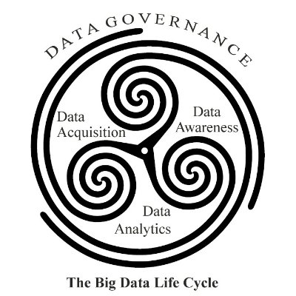
Big Data Project Lifecycle

Slide 5
Why Big Data?
Exponential growth of data
Extract value out of data
3 V
Volume
Velocity
Variety
Existing solutions not suitable

Slide 6
Big Data Tech Landscape
Hadoop
Distributed File System (HDFS)
Distributed Computing Engine (MapReduce)
Cluster Manager (YARN)
Hive
Columnar Storage (RCFile, Parquet)
Messaging Systems (Kafka, ZeroMQ)
NoSQL Databases
Distributed SQL Query Engine

Slide 7


Confusion Galore
(2007 – 2015?)
Giraph
Pregel
(2014 – ?)
(2004 – 2013)
Tez
Drill
Dremel
Mahout
Storm
S4
Impala
GraphLab
General Unified Engine
General Batch Processing
Specialized Systems
(iterative, interactive, ML, streaming, graph, SQL, etc)

Slide 8
Welcome to Spark
In-memory computing framework
Distributed Compute Engine
Scheduler
Monitor
Distributed
Attempt at unification
Easy to develop
Orders of magnitude fast
Real time analytics
Machine Learning
Language Flexibility
API to work with different tools

Slide 9
Spark can work in multiple modes
Standalone
Hadoop
Apache Mesos
Written in Scala
Close to 400,000 lines of code
Very active developer community
Parallel projects
~100 years of effort (COCOMO model)

Slide 10
Spark in Action
Ooyala
Offers analytics services to media organizations
>2 billion analytics per day to maximize revenues
Deliver real-time insights
Facebook
Uses Spark extensively
Primary user of BlinkDB
Uber
Spark Streaming to analyze data in real-time
Drives decisions such as surge pricing

Slide 11
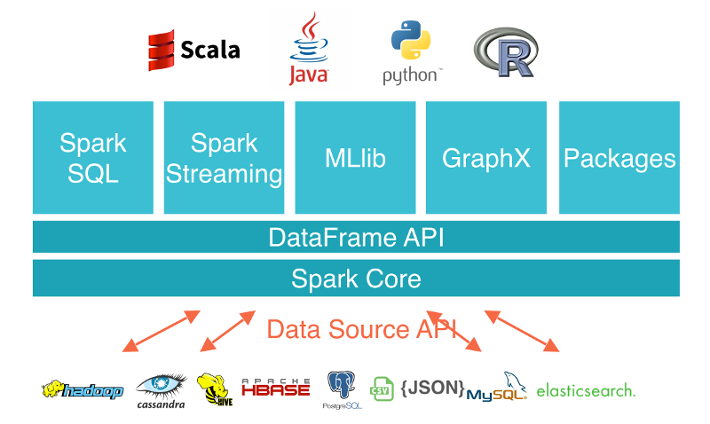
Spark Components

Slide 12











vs
YARN
Mesos
Tachyon
SQL
MLlib
Streaming

Slide 13






10x – 100x

Slide 14
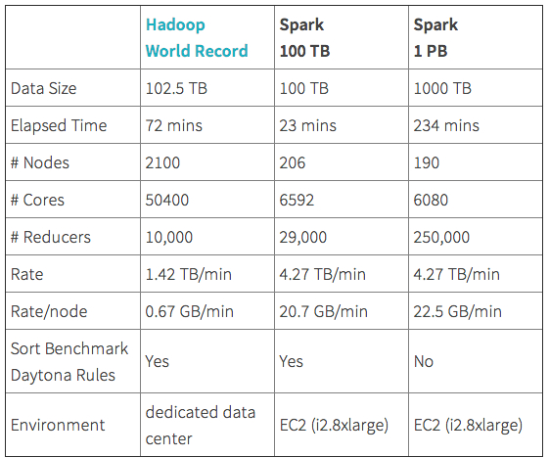
Spark MapReduce Competition

Slide 15
Spark Execution Architecture
Spark-submit script
Launch apps on a cluster
Spark applications
Run as independent processes.
Driver program coordinates

Slide 16
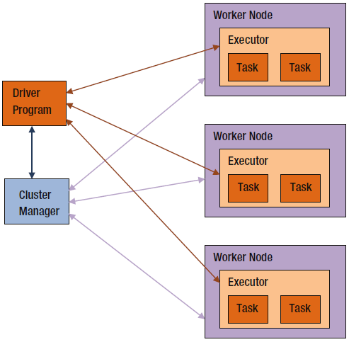
High Level Architecture

Slide 17
Code Execution
Shuffle
Redistributes data among cluster of nodes by a criteria
Groups data into bucket (partitions)
Expensive
Job
Set of computations
Application can have multiple jobs
Stage
Collection of tasks
Stages could depend on each other
Shuffle boundaries

Slide 18
Code Execution
Run Application
Connect to cluster manager & get executors on worker nodes
Spark splits jobs into stages
Executors run tasks in parallel

Slide 19
Let’s get started
Launch Spark REPL
VM Distribution comes pre-installed with Spark
Can also install Spark as standalone on Windows
For now, we will not worry much about installation
Focus on being able to program
Understand building blocks
Multiple REPL (Python, Scala)

Slide 20
Building Blocks
Driver Program
Connects to, and communicates with Spark cluster
REPL is a driver program
Pushes work to a cluster and brings back
What happens when there is no cluster?
Simulates one in JVM

Slide 21
Spark Context
Main entry point to Spark library
Connection to Spark cluster
Apps create instance of SparkContext
One instance per app
val sc = new SparkContext()

Slide 22
RDD
Abstract representation of data
Breaks data into partitions
More partition -> More parallelism
Distributed collection
Immutable, partitioned, fault tolerant, strongly typed, in-memory
Can be created in two ways
Parallelize a collection – In Memory
Read data from external data sources

Slide 23
Example
Parallelize in Python
wordsRDD = sc.parallelize([“fish", “cats“, “dogs”])
Parallelize in Scala
val wordsRDD= sc.parallelize(List("fish", "cats", "dogs"))
Read a local txt file in Python
linesRDD = sc.textFile("/path/to/README.md")
Read a local txt file in Scala
val linesRDD = sc.textFile("/path/to/README.md")

Slide 24
more partitions = more parallelism
RDD
item-1
item-2
item-3
item-4
item-5
item-6
item-7
item-8
item-9
item-10
item-11
item-12
item-13
item-14
item-15
item-16
item-17
item-18
item-19
item-20
item-21
item-22
item-23
item-24
item-25
W
W
W
Ex
Ex
Ex
RDD
RDD
RDD
RDD
RDD

Slide 25
RDD Operations
Two types
Transformations
Convert one RDD to another
Work with actual data objects
Actions
Trigger entire workflow
Present results to the driver

Slide 26


Error, ts, msg1
Warn, ts, msg2
Error, ts, msg1
Info, ts, msg8
Warn, ts, msg2
Info, ts, msg8
Error, ts, msg3
Info, ts, msg5
Info, ts, msg5
Error, ts, msg4
Warn, ts, msg9
Error, ts, msg1
logLinesRDD
(input/base RDD)
.filter( )
Error, ts, msg1
Error, ts, msg1
Error, ts, msg3
Error, ts, msg4
Error, ts, msg1
errorsRDD

Slide 27
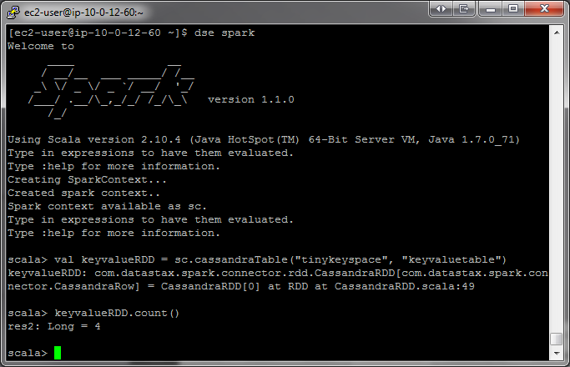
Error, ts, msg1
Error, ts, msg1
Error, ts, msg3
Error, ts, msg4
Error, ts, msg1
errorsRDD
.coalesce( 2 )
Error, ts, msg1
Error, ts, msg3
Error, ts, msg1
Error, ts, msg4
Error, ts, msg1
cleanedRDD
.collect( )
Driver

Slide 28
What happens once action is called?
Data pipelines empty
RDD could exist, but no data
If we want to save intermediate RDD?
Repeating process is wasteful
Caching is the solution

Slide 29

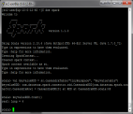
logLinesRDD
errorsRDD
.saveToCassandra( )
Error, ts, msg1
Error, ts, msg3
Error, ts, msg1
Error, ts, msg4
Error, ts, msg1
cleanedRDD
.filter( )
Error, ts, msg1
Error, ts, msg1
Error, ts, msg1
.count( )
5
errorMsg1RDD
.collect( )

Slide 30

logLinesRDD
errorsRDD
.saveToCassandra( )
Error, ts, msg1
Error, ts, msg3
Error, ts, msg1
Error, ts, msg4
Error, ts, msg1
cleanedRDD
.filter( )
Error, ts, msg1
Error, ts, msg1
Error, ts, msg1
.count( )
5
errorMsg1RDD
.collect( )

Slide 31
Putting it together – Lifecycle of Spark Program
Create RDD
Parallelize
Read data from external sources
Transform operations
Optional – Cache RDD
Actions

Slide 32
RDD Types
Similar to Java, strongly typed
Stored internally in different types.
Each type allows access to a number of methods.
HadoopRDD, PairRDD, PythonRDD, JdbcRDD

Slide 33
Commonly used Transformations
Work element by element (Most, not all)
General
Map(), filter(), flatMap(), groupBy(), sortBy()
Math
sample(), random(), union(), intersection(), distinct(), subtract(), cartesian()

Slide 34
Commonly used Actions
General
Reduce(), collect(), first(), aggregate()
Math
count(), min(), max(), stdev(), variance()
IO
saveToCassandra(), countByKey(), foreach()

Slide 35
First lines of code
Let’s discuss some commonly used transformations
Map
applies a function to each element of RDD and returns a new RDD
Python:
x = sc.parallelize([“a”,”b”,”c”])
Y = x.map(lambda z: (z,z))
Print(x.collect())
Print(y.collect())
Scala:
val x = sc.parallelize(Array(“a”,”b”,”c”))
Val Y = x.map(z => (z,z))
Print(x.collect().mkString(“, “))
Print(y.collect() .mkString(“, “))

Slide 36
Transformation - Filter
Filter
Keeps an element if condition is true.
Python
x = sc.parallelize([4,5,6,8])
Y = x.filter(lambda x:x-5==1)
Print(x.collect())
Print(y.collect())

Slide 37
Transformations - Intersection
Takes two RDD as input and returns a new RDD that has common elements
Scala
val batsman = sc.parallelize(List(“Sachin", “Virat", “Yuvraj"))
val bowler =sc.parallelize(List(“Sachin", “Yuvraj", “Zaheer"))
val allRounder = batsman.intersection(bowler)
allRounder.collect()

Slide 38
Transformations - GroupBy
Similar to groupby in SQL.
Groups the data, and creates key,value pairs
Python
x = sc.parallelize([‘Ajay’,’Amit’,’Manav’,’Manish’,’Sonam’])
Y = x.groupBy(lambda w: w[0])
Print [(key, list(value)) for (key,value) in y.collect()]
Scala
val x = sc.parallelize(Array(“Ajay”,”Amit”,”Manav”,”Manish”,”Sonam”])
val y = x.groupBy(w => w.charAt(0))
println (y.collect().mkString(“,”))

Slide 39
Actions - collect
Returns elements as array
val rdd = sc.parallelize((1 to 10000).toList)
val filteredRdd = rdd filter { x => (x % 1000) == 0 }
val filterResult = filteredRdd.collect
val total = rdd.count

Slide 40
Actions - countByValue
Returns a count of each unique value
val rdd = sc.parallelize(List(1, 5, 6, 24, 1, 5, 24, 1, 2, 1))
val counts = rdd.countByValue

Slide 41
Actions - reduce
Aggregates elements by a rule
val numbersRdd = sc.parallelize(List(1, 8, 1, 5))
val sum = numbersRdd.reduce ((x, y) => x + y)
val product = numbersRdd.reduce((x, y) => x * y)
val mean = numbersRdd.mean

Slide 42
Some example code
We will perform several exercises to obtain a better understanding of RDDs:
Create a Python collection of 10,000 integers
Create a Spark base RDD from that collection
Subtract one from each value using map
Perform action collect to view results
Perform action count to view counts
Apply transformation filter and view results with collect
Learn about lambda functions

Slide 43
Some example code
data = xrange(1, 10001)
data[0]
len(data)
xrangeRDD = sc.parallelize(data, 8)
print 'xrangeRDD id: {0}'.format(xrangeRDD.id())
xrangeRDD.getNumPartitions()

