Slide 1
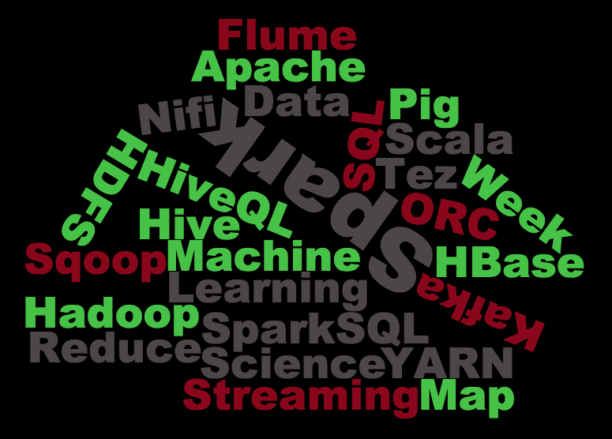

H1B VISA ANALYSIS
BIG DATA – HADOOP
SUDHARSHINI.S.K
S170030100554
NIIT

Slide 2
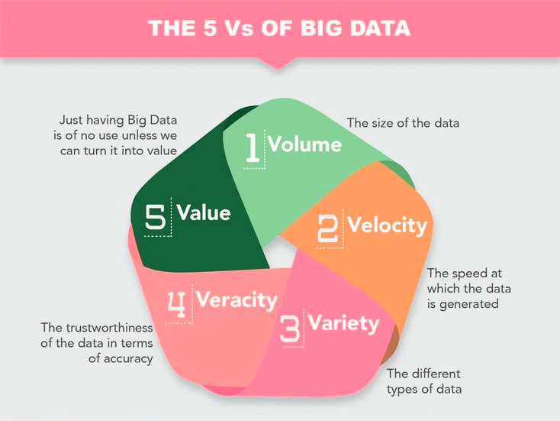
BIG DATA
-->Large volume of data
-->Relating to human behaviour and interactions.
5 V’s of big data

Slide 3





OVERVIEW
-->Hadoop(YARN)
    -HDFS
    -Mapreduce
    -Hive
    -Pig
    -Sqoop
    -Flume

Slide 4
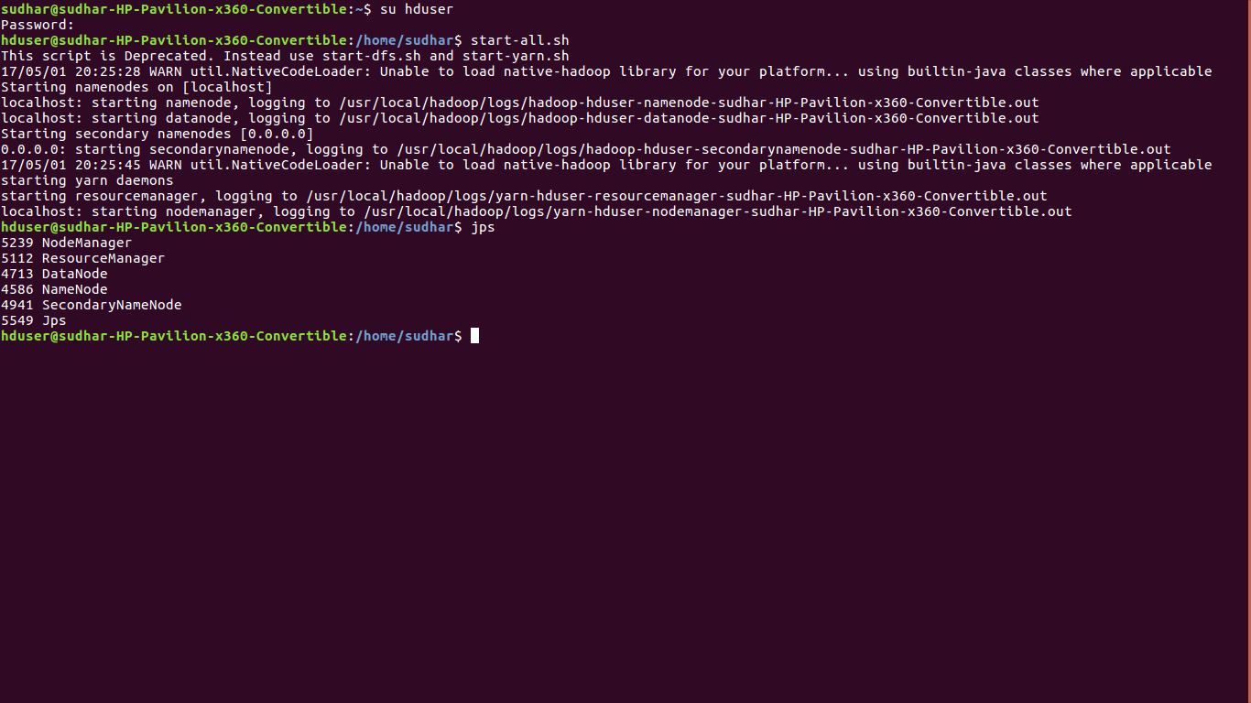
HDFS
-->Store huge data with replication.
-->JPS started nodes.

Slide 5
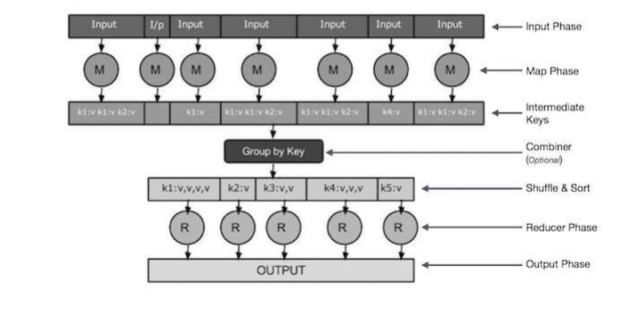
MAPREDUCE
-->Programming paradigm.
-->Easy data-processing solutions.

Slide 6
HIVE
-->Process structured data.
-->SQL types of scripts.
-->Premanent storage.
-->Few data types,
      - INT
      - STRING: CHAR, VARCHAR
      -TIMESTAMP
      -DATE
      -DOUBLE, etc.

Slide 7
PIG
-->Abstraction over MapReduce.
-->Multi-query approach.
-->Temporary storage.
-->Four types of diagnostic operators:
        - Dump operator
        - Describe operator
        - Explanation operator
        - Illustration operator

Slide 8
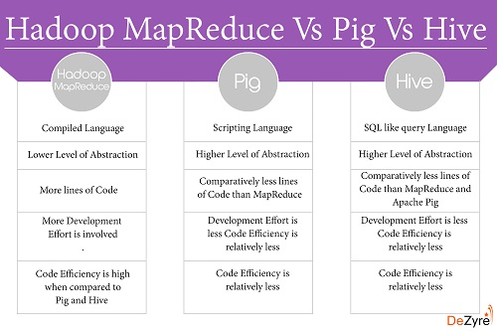

Slide 9
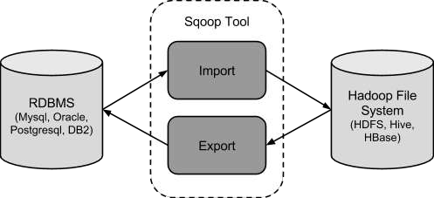
SQOOP
-->Import & Export data between HDFS & RDBMS.

Slide 10
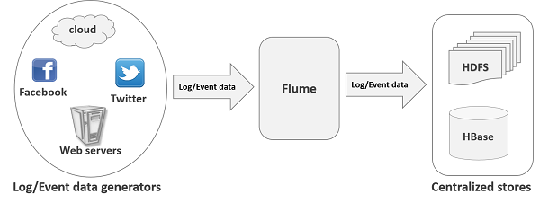
FLUME
-->Data ingestion from various data producers into Hadoop.

Slide 11
H1B VISA
The H-1B is a non-immigrant visa in the United States under the Immigration and Nationality Act.
Allows U.S. employers to temporarily employ foreign workers in specialty occupations.
The duration of stay is three years, extendable to six years.

Slide 12
PROJECT OUTLINE
Input : Sample H1B visa applicants between the years 2011-2015. ( CSV format).
Tools used : Mapreduce, Hive, Pig, Sqoop using hadoop platform.
Purpose :
  -The H1B is an employment-based, non-immigrant visa category for temporary foreign workers in the United States.
  -For a foreign national to apply for H1B visa, an US employer must offer a job and petition for H1B visa with the US immigration department.
  -This is the most common visa status applied for and held by international students once they complete college/ higher education (Masters, Ph.D.) and work in a full-time position.

Slide 13
INPUT FILE DETAIL
- s_no
- case_status
- employer_name
- soc_name
- job_title
- full_time_position
- prevailing_wage
- year
- worksite (city,state)
- longitute
- latitute

Slide 14
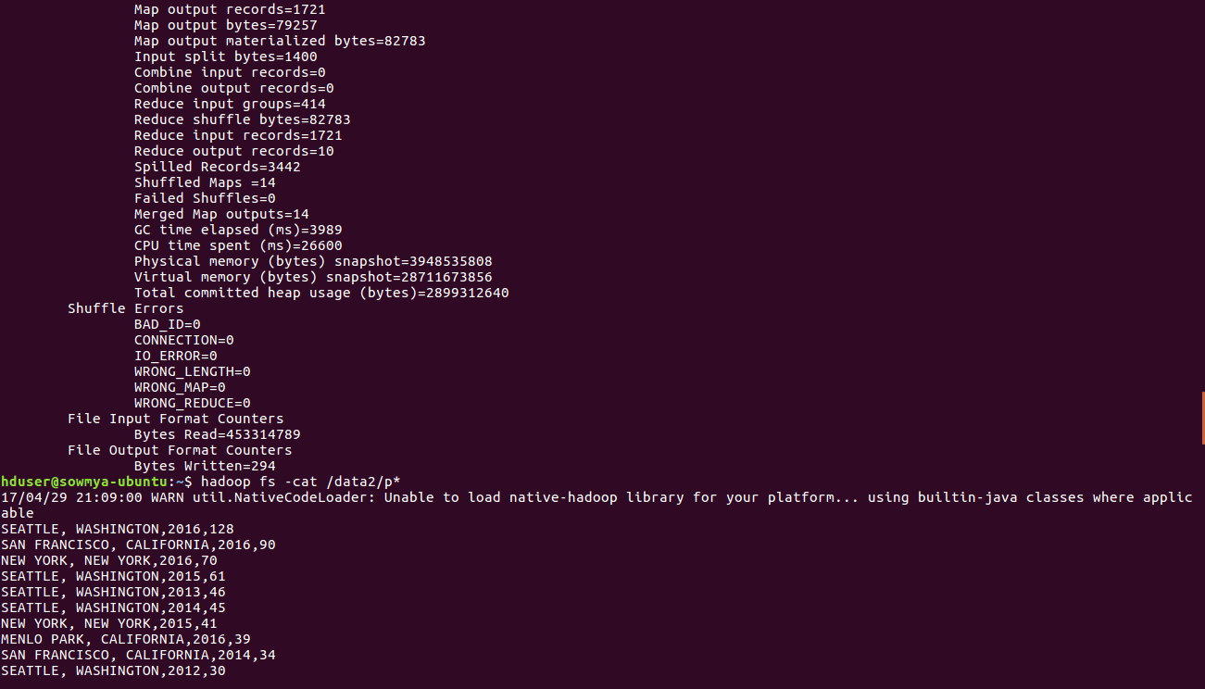
MAPREDUCE OUTPUT

Slide 15
HiveQL
-->To create a table: CREATE TABLE hb(s_no int,case_status string, employer_name string, soc_name string, job_title string, full_time_position string,prevailing_wage int,year string, worksite string, longitute double, latitute double )
ROW FORMAT SERDE 'org.apache.hadoop.hive.tserde2.OpenCSVSerde'
WITH SERDEPROPERTIES ("separatorChar" = ",","quoteChar" = "\"") STORED AS TEXTFILE;
-->To load data into a table: load data local inpath '/home/sudhar/Downloads/h1b' overwrite into table hb;
-->Query: Which industry has the most number of Data Scientist positions?
    select soc_name, count(soc_name) as name from hb where job_title="DATA SCIENTIST" group by soc_name order by name desc limit 1;

Slide 16
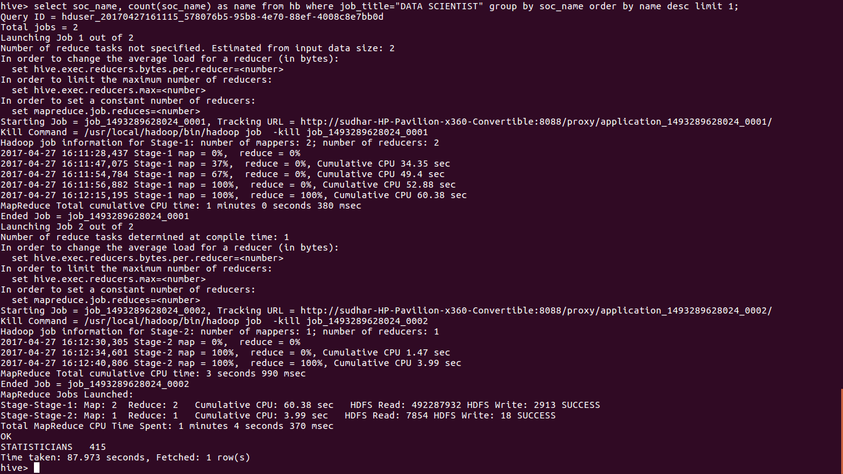
HiveQL OUTPUT

Slide 17
PIG LATIN
-->To create a table and load data---
hb= load '/home/sudhar/Desktop/Project files/000000_0' using PigStorage(',') as (s_no:int,case_status:chararray, employer_name:chararray, soc_name:chararray,job_title:chararray, full_time_position:chararray,prevailing_wage,year, worksite1:chararray,worksite2:chararray, longitute, latitute);

Slide 18
PIG LATIN (CONT):
-->Query--- Which top 5 employers file the most petitions each year?
- gp= group hb by (year, employer_name);
- cp= foreach gp generate group as year, COUNT(hb) as headcount;
- op= order cp by $1 desc;
- lp= limit op 5;
- dump lp;

Slide 19
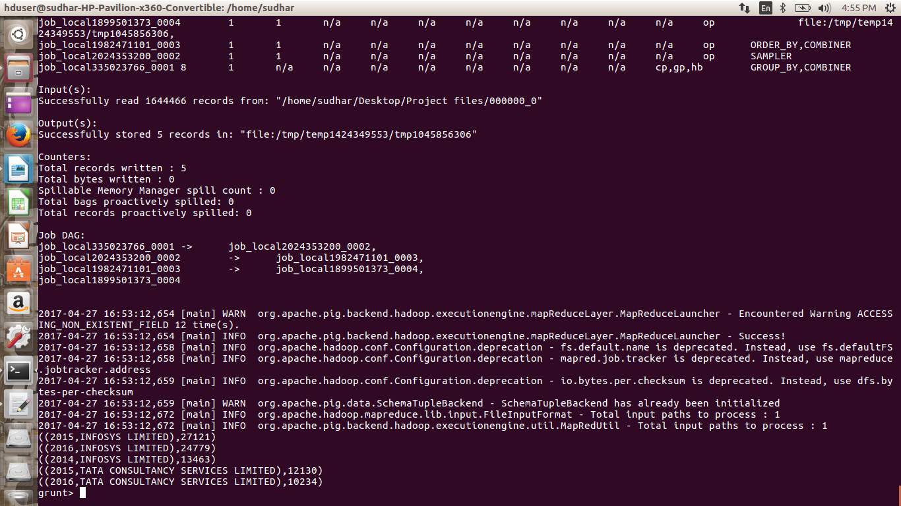
PIG LATIN OUTPUT

Slide 20
SQOOP COMMAND
-->Query: Export result for question no 10 to MySql database.
-->To export data:
sqoop export --connect jdbc:mysql://localhost/app --username root -P –table hb –update-mode allowinsert --update-key success_rate --export-dir /niit/five.txt --input-fields-terminated-by ',';
-->To create table:
create table hb(success_rate FLOAT NOT NULL, position VARCHAR(40) NOT NULL,status VARCHAR(40) NOT NULL,PRIMARY KEY(success_rate));

Slide 21
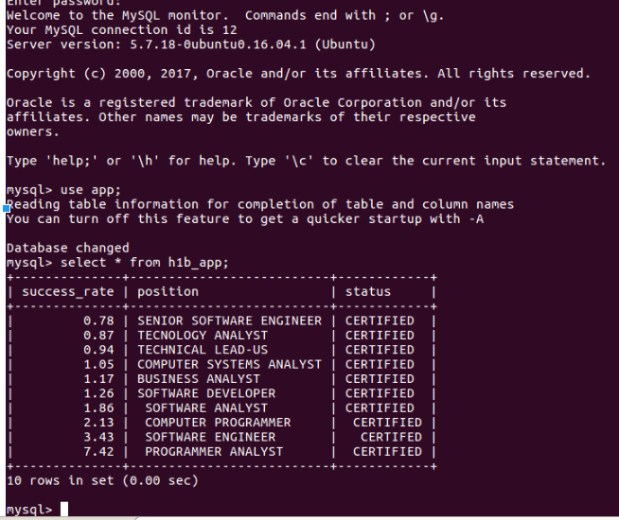
SQOOP OUTPUT

Slide 22
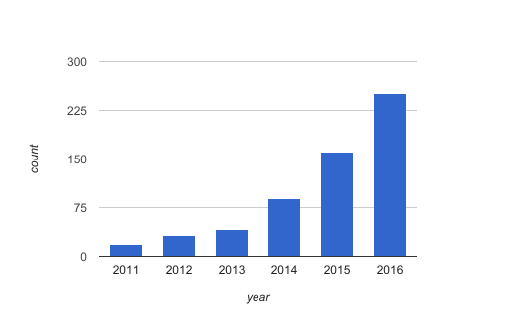
BAR GRAPH (EXCEL)
-->No.of application each year.

Slide 23
CONCLUSION
-->Analyzed top job title, locations, etc using mapreduce, hive and pig.
-->Exported data from HDFS to MySQL using sqoop.
-->Can be used for many projects for analyzing data.

Slide 24

THANK YOU

