Slide 1
SDP TOPIC:
Virtual Assistant for Desktop

Slide 2
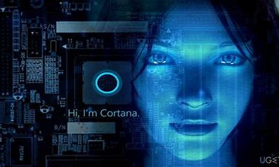
INTRODUCTION:
Voice assistant is the operating systems that can recognize human voice and respond via integrated voice.
The main purpose of this project is to automate the tasks.

Slide 3


Block diagram
Speech Recognition
Task
Text to Speech
Output
Voice Input

Slide 4
IMPORTANT LIBRARIES
import pyttsx3
import speech_recognition
import datetime
import wikipedia
import webbrowser
import os
import smtplib

Slide 5
My virtual assistant performing following task
time
searching on wikipedia
open google
play music
open youtube
open codefile
open instagram
open Facebook
open web whatsapp
News
Send Mail

Slide 6
SOFTWARE TOOLS:
Visual studio
python

Slide 7
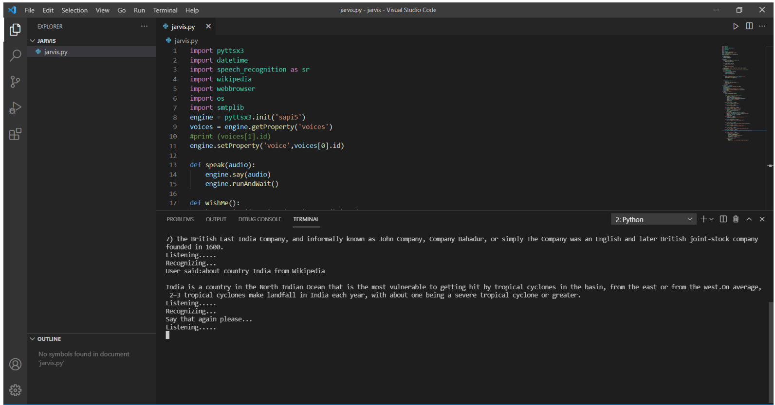
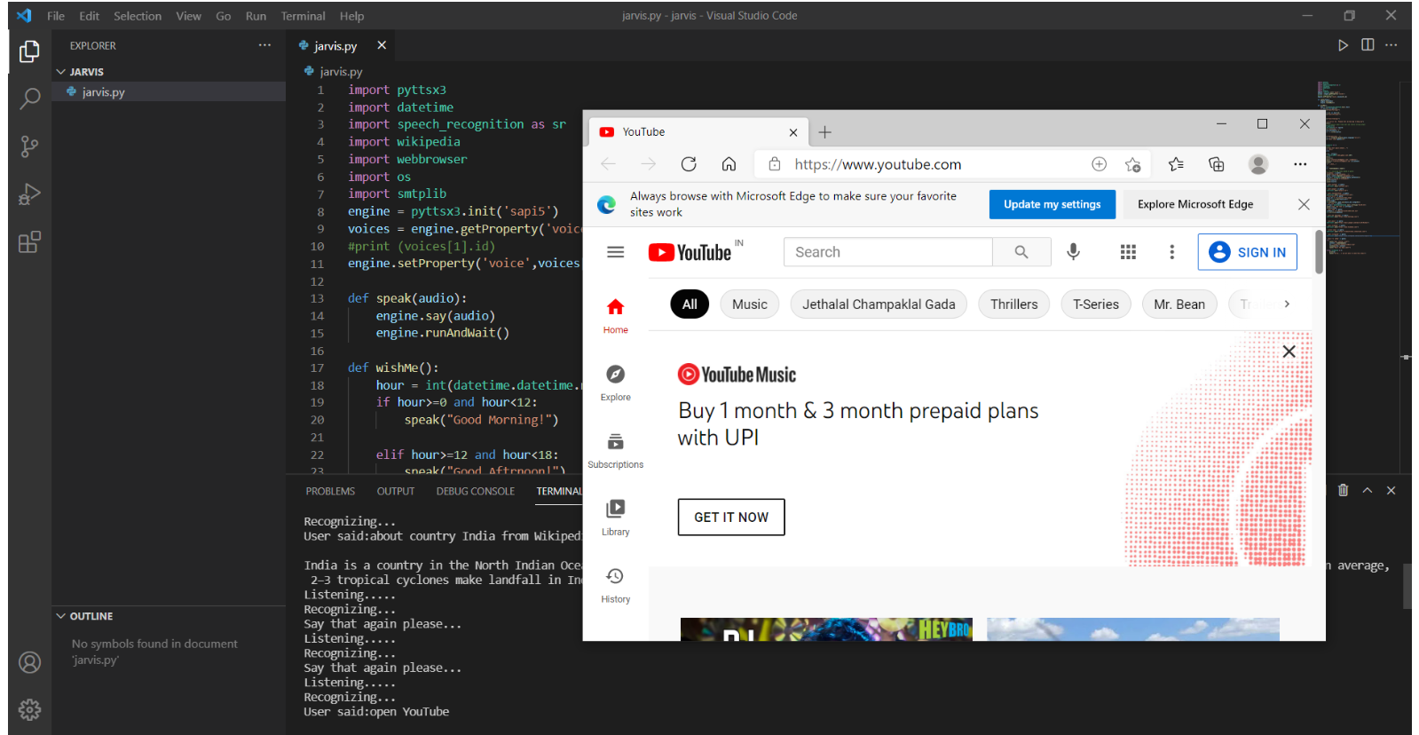
Results

Slide 8
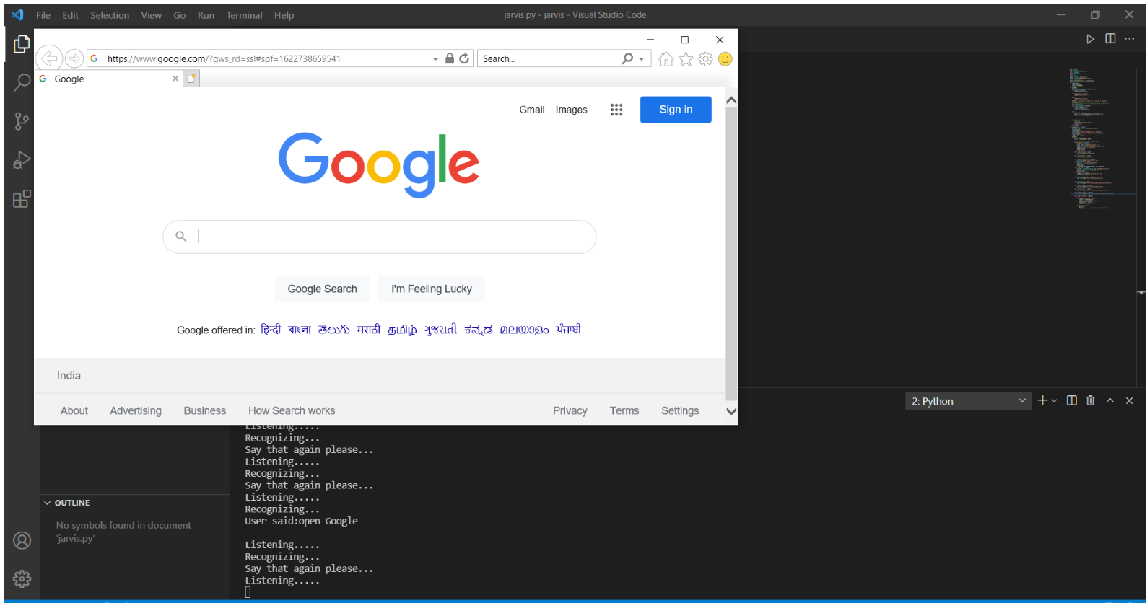
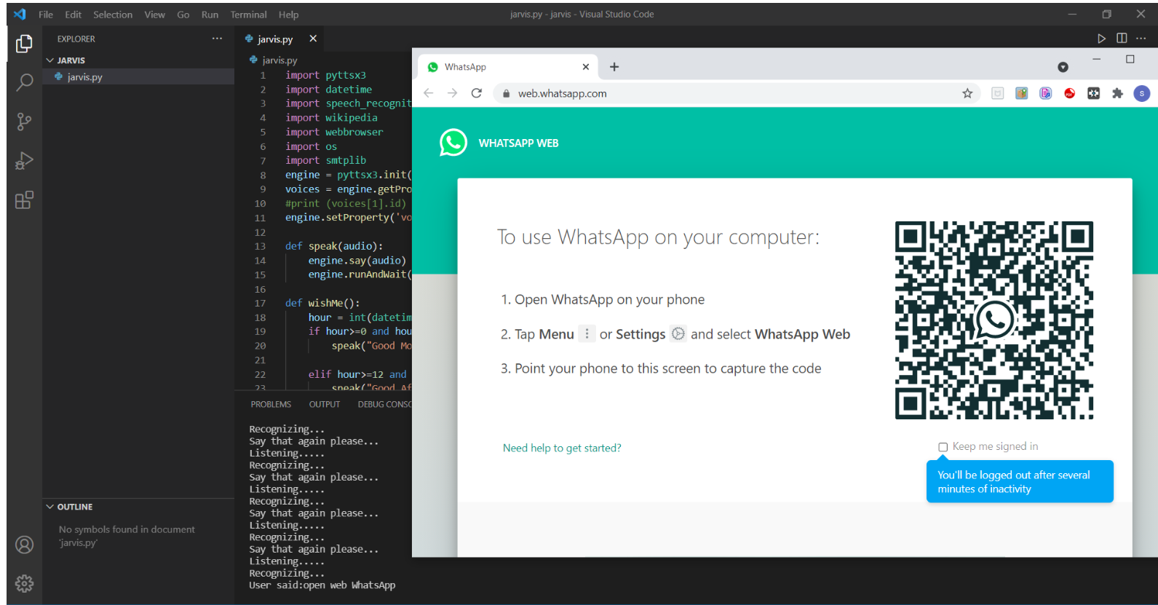
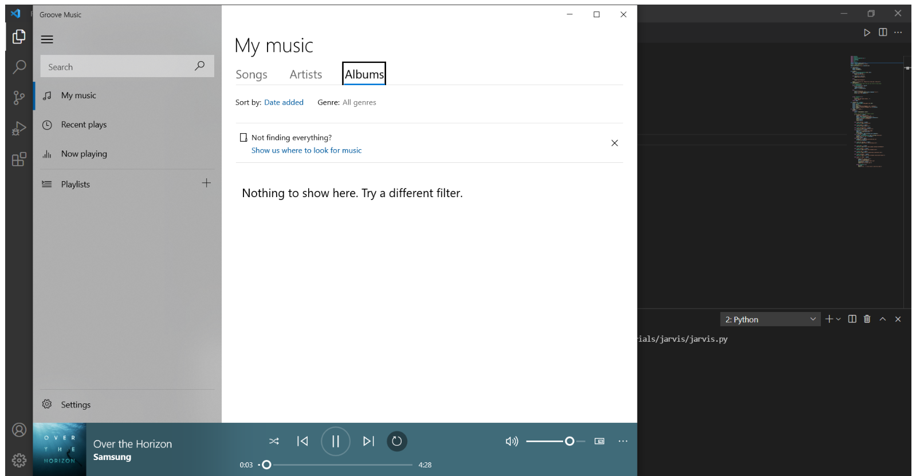

Slide 9
Thank you…

