Slide 1
PROJECT TITLE
PROGRAMMER BIODATA

Slide 2
Team members
Team name : Programmers20
Github : programmers349
e-mail : programmers349@gmail.com
Slack : programmers20
Reddit : programmers20
Quora : programmers20
Stack Overflow : programmers20
Team leader : Pournami V P (B.Com)
Team members :
Binu Pious P (B.Tech)
Athira A S (B.Com)
Anupriya A P (B.Sc)
Sudharsanan R (B.E)
Aslaf R (B.E)
Notes:
-Add team details with name and qualification,e-mail,phone no and place

Slide 3
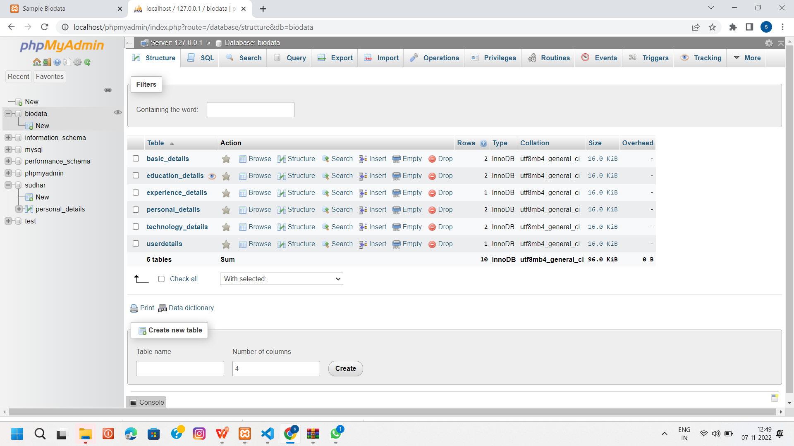
Database Design
Notes:
Get the database design from the phpmyadmin or from SRS document

Slide 4
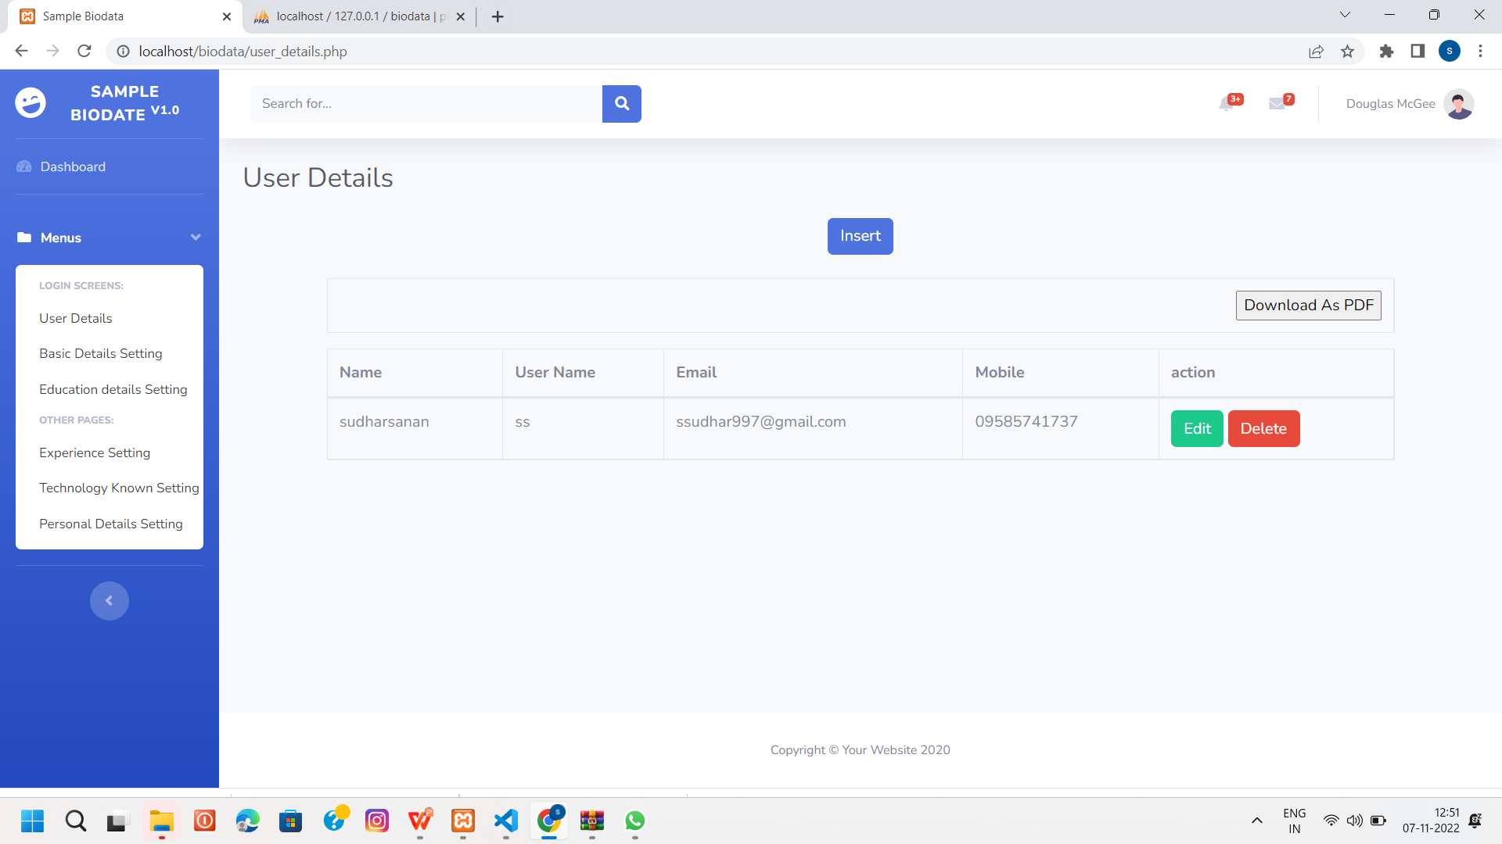
Form Design
Notes:
Get the form design from the phpmyadmin or from SRS document

Slide 5
DATABASE
BIO DATA
userdetails - id-name-username-password-email-mobile
basic_details -id-user_code-name-address-email -mobile-profile-objective-declaration
education_details -id-user_code-coursename-university-college-passyear-percentage
technology_details -id-user_code-organization_name-experience-role
experience_details-id-organization_name-experience
personal_details-id-user_code-personal_type-personal_detail

Slide 6
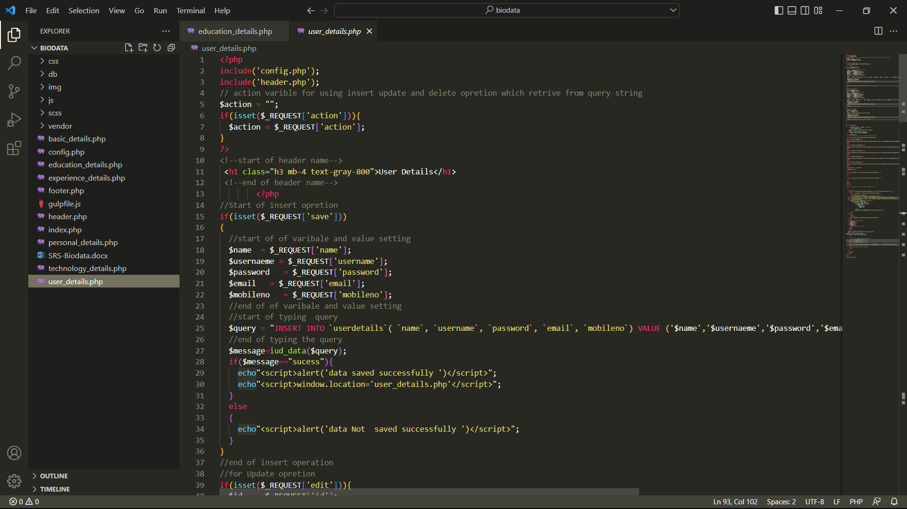
Sample Source code

Slide 7
TEAM MEMBER -1
Sudharasanan R
Binu pious P
Athira R

Slide 8
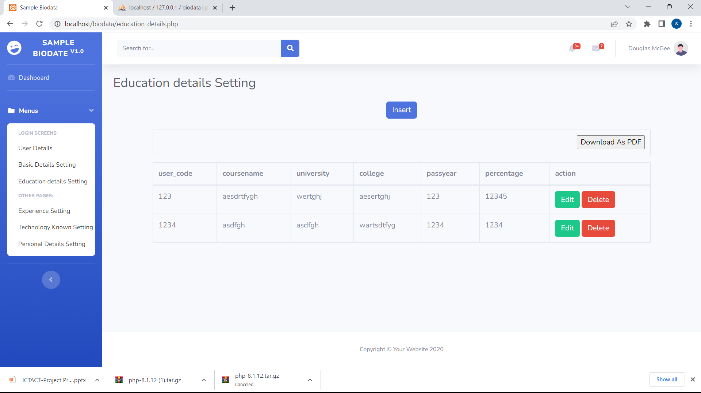
Forms & Database Design
Notes:
Explain Form and database worked with

Slide 9
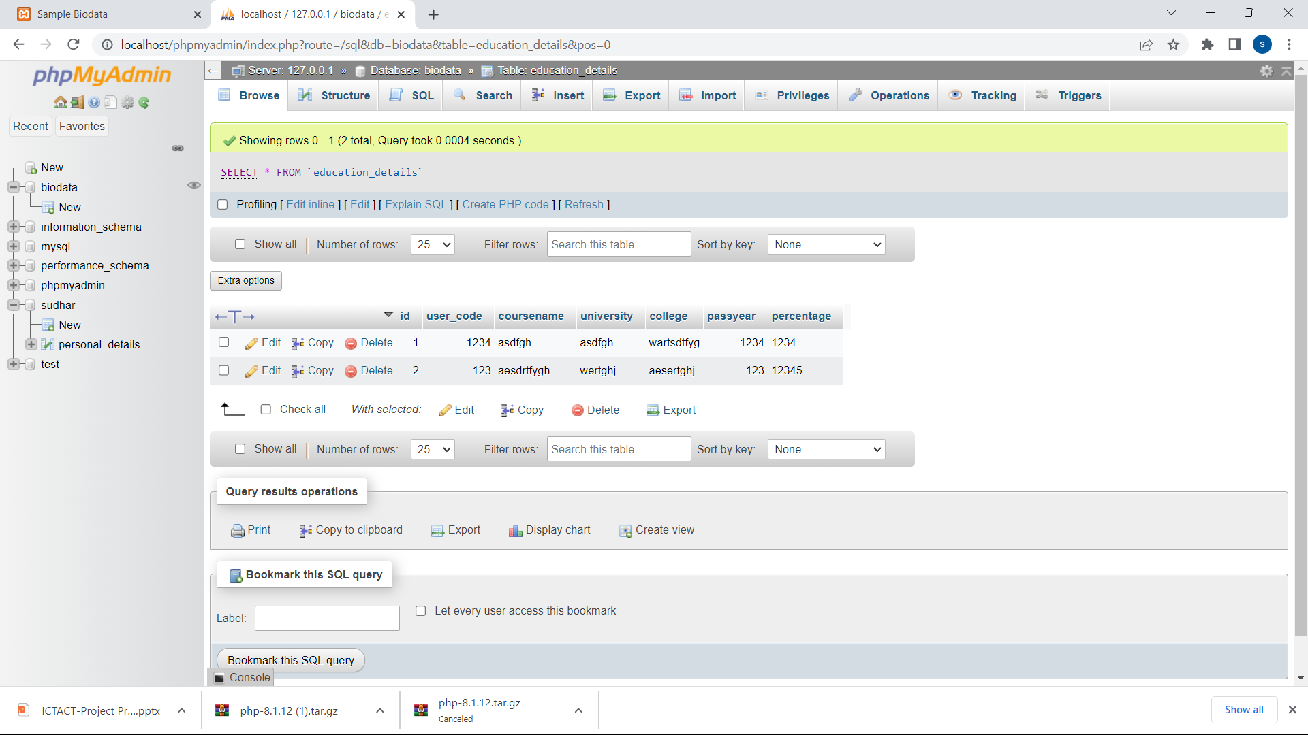

Slide 10
Problem/difficulty Faced
While doing the source code, the request is not in caps.
We faced the problem like quotation and database.
Id is not set as primary key.
Notes:
Explain problem faced

Slide 11
Solution to the problem
Finalized the request in caps.
Simplified the needed quotation and query.
We have set the id as primary key.
Notes:
Explain how attained the solution

Slide 12
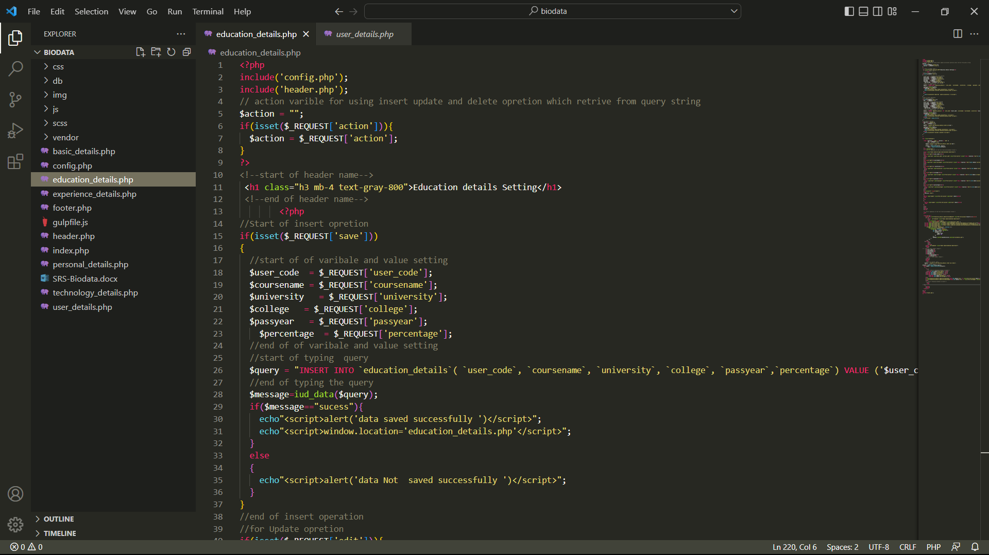
Sample Source code
Notes:
Explain how attained the solution

Slide 13
TEAM MEMBER -2
Aslaf R
Pournami VP
Anupriya A.P

Slide 14
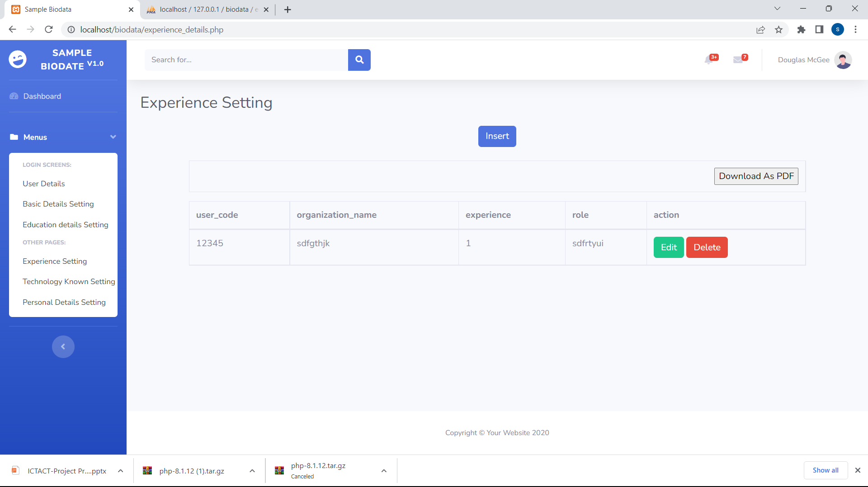
Forms & Database Design

Slide 15
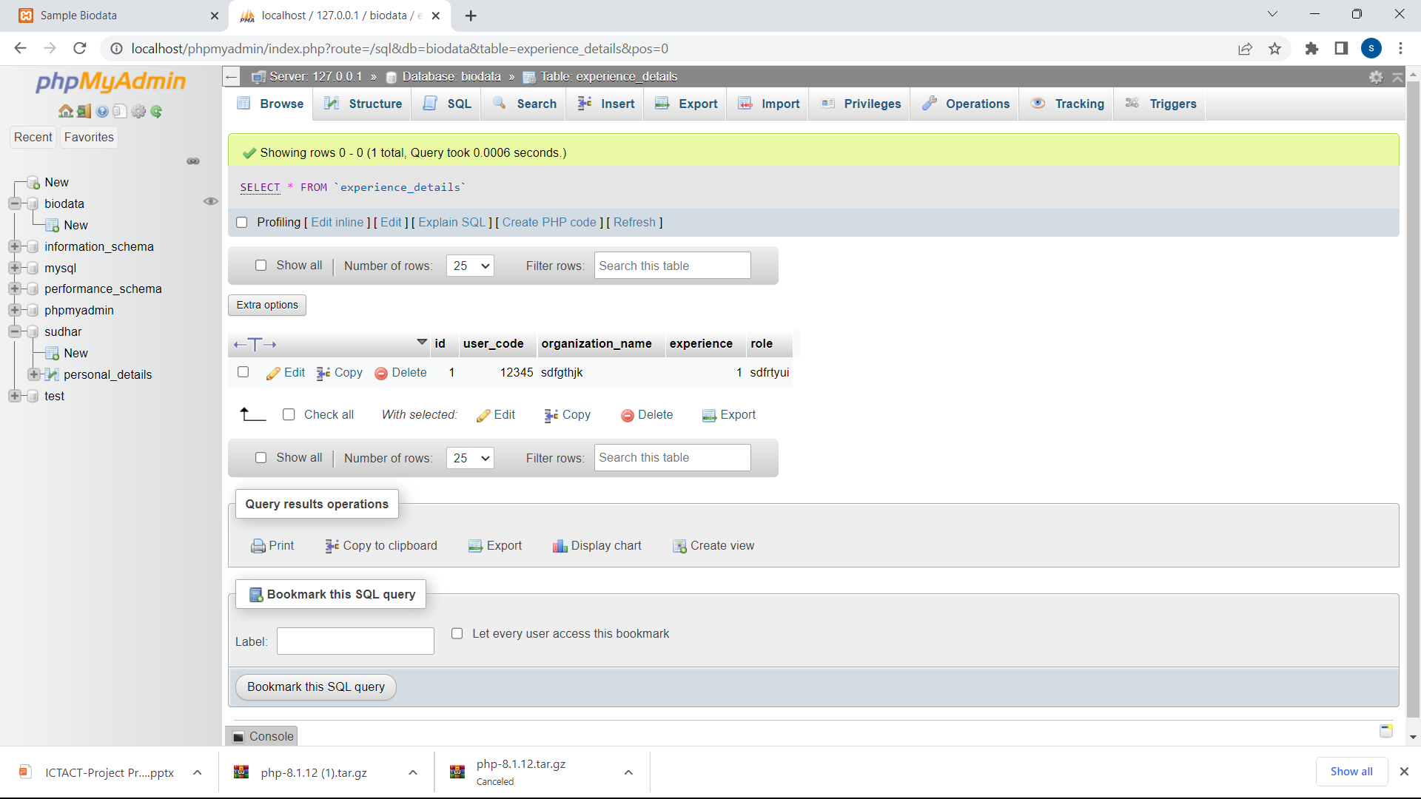

Slide 16
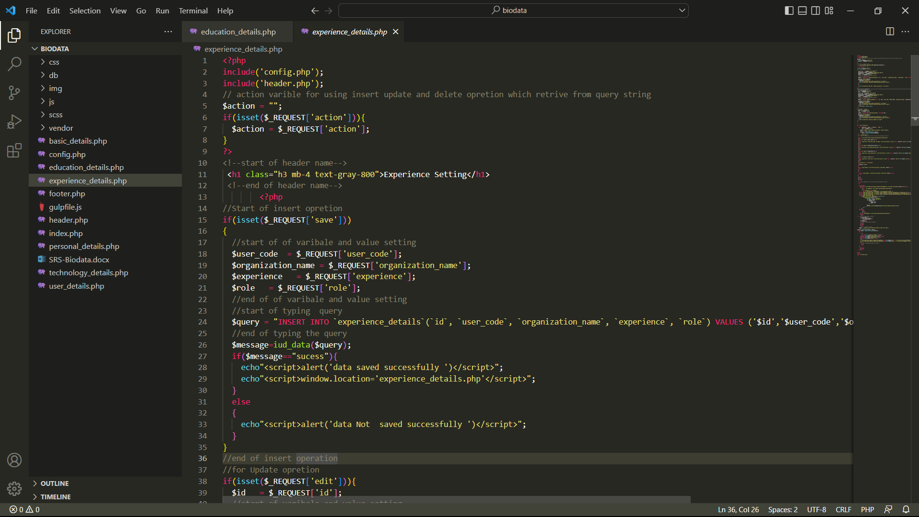
Sample Source code
Notes:
Explain how attained the solution

Slide 17
Thank You

