Slide 1


NEXT GEN EMPLOYABILITY PROGRAM
CREATING A FUTURE-READY WORKFORCE
Student Name :
SUDHARSAN S
Student ID :
College Name :
221501149
RAJALAKSHMI ENGINEERING COLLEGE
Notes:
1

Slide 2
Creating A Future-ready Workforce
CAPSTONE PROJECT SHOWCASE
Project Title
PROJECT MANAGEMENT TOOL WITH REACT AND EXPRESSJS FRAMEWORK
Abstract | Problem Statement | Project Overview | Proposed Solution | Technology Used | Modelling & Results | Conclusion | Q&A

Slide 3
Creating A Future-ready Workforce
Abstract
1
Efficient Task Management: A web-based Project Management System that allows users to create, assign, and track tasks, enhancing team collaboration and productivity.
2
Real-Time Database Integration: Utilizes Firebase for secure task storage, enabling seamless data synchronization and instant updates across all devices
3
Scalability & Accessibility: Designed to support multiple users and projects, making it adaptable for individuals, teams, and organizations.
4
User-Centric Design: Features an intuitive dashboard, structured task tracking, and a responsive UI, enhancing productivity and collaboration.

Slide 4


Creating A Future-ready Workforce
Problem Statement
The Project Management Tool is a comprehensive web-based solution designed to streamline project planning, execution, and monitoring. Developed using the MERN stack (MongoDB, ExpressJS, React, Node.js), this tool provides a scalable, efficient, and user-friendly platform for managing projects of any size. It addresses inefficiencies and communication gaps that arise from using multiple disconnected tools by integrating all project-related activities into a single platform. Key features include task management, real-time collaboration, progress tracking, and seamless project execution, ensuring improved productivity, better team coordination, and timely project delivery.

Slide 5

Creating A Future-ready Workforce
Project Overview
The Project Management Tool is a web-based application designed for efficient project tracking and team collaboration. It enables users to create, assign, and manage tasks seamlessly while ensuring real-time updates and secure access.
Key Features:
Task Management – Create, assign, and track tasks effortlessly.
User Authentication – Secure login with Firebase authentication.
Real-time Updates – Instant changes across the platform.
Intuitive UI – Clean, responsive, and easy-to-use interface.
Progress Tracking – Monitor project status with visual insights.

Slide 6
Creating A Future-ready Workforce
Proposed Solution
To address the challenges of project management, our Project Management Tool provides an integrated, efficient, and user-friendly platform that enhances collaboration, task tracking, and project monitoring in real time.
Key Aspects:
Centralized Platform – Eliminates scattered communication by bringing all tasks, projects, and team interactions into one place.
Real-time Task Updates – Ensures immediate synchronization of project changes for better coordination.
Secure & Scalable – Uses Firebase authentication and MongoDB to ensure data integrity and future scalability.
User-friendly Interface – A clean, responsive UI built with React for seamless navigation and usability.

Slide 7
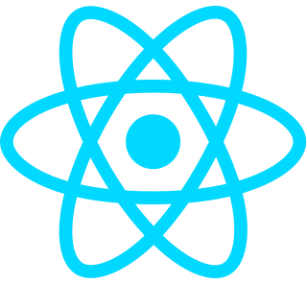
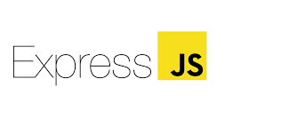


Creating A Future-ready Workforce
Technology used
Frontend: ReactJS with JavaScript, Tailwind CSS, Vite
Backend: NodeJS, ExpressJS
Database: MongoDB
Dark Mode Context : React Context API
Authentication: Firebase
Version Control: Git & GitHub

Slide 8
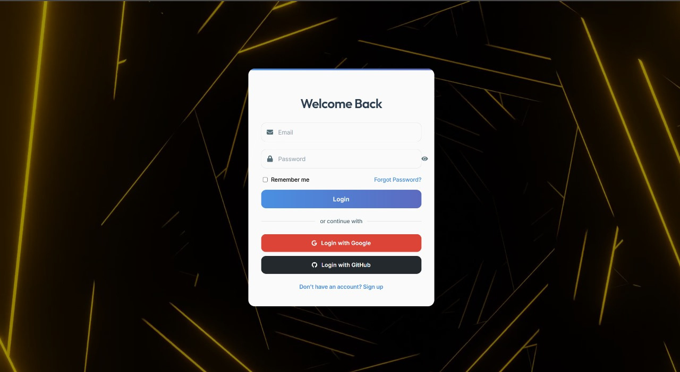
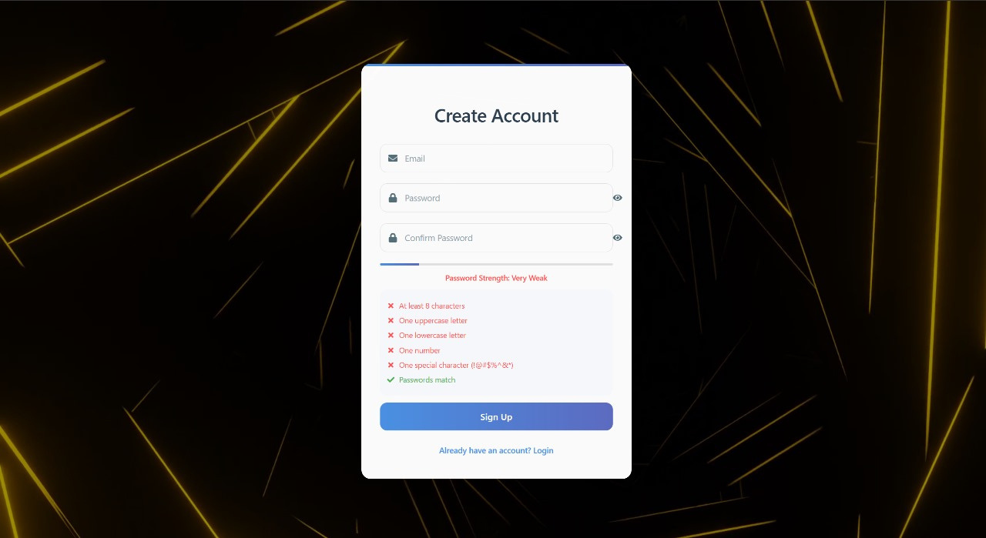
Creating A Future-ready Workforce
Modelling & Result
LOGIN PAGE
SIGNUP PAGE

Slide 9
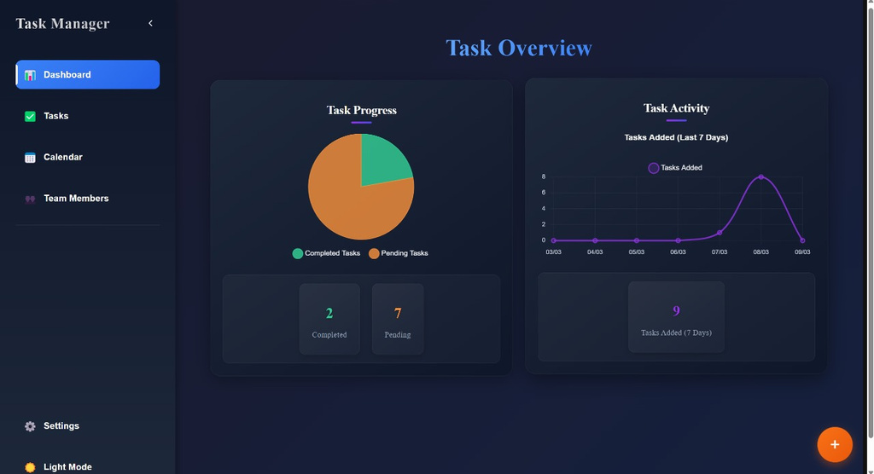
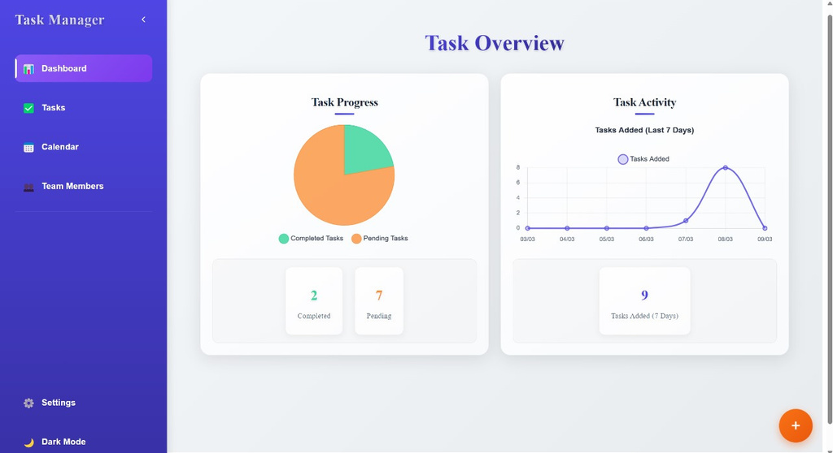
Creating A Future-ready Workforce
Modelling & Result
Light Mode
Dark Mode

Slide 10
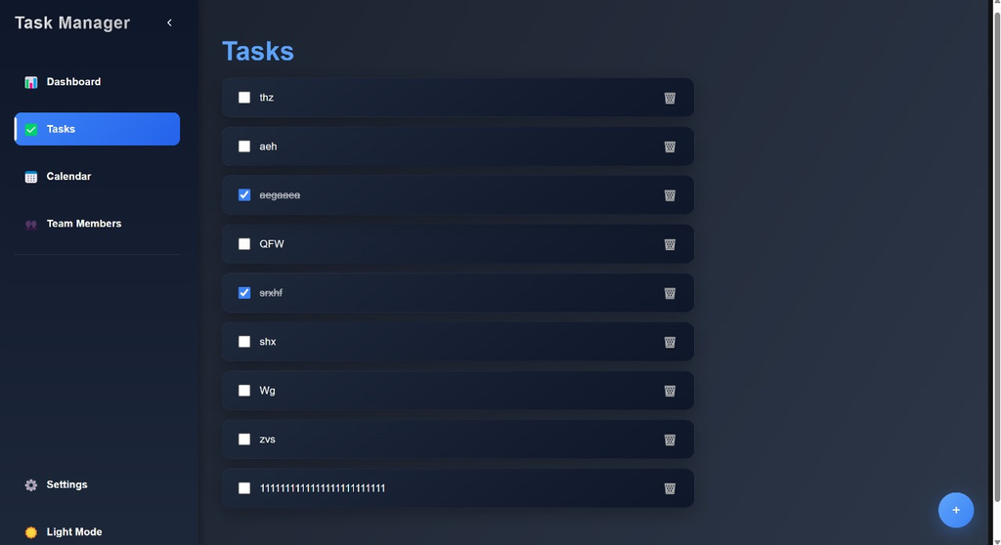
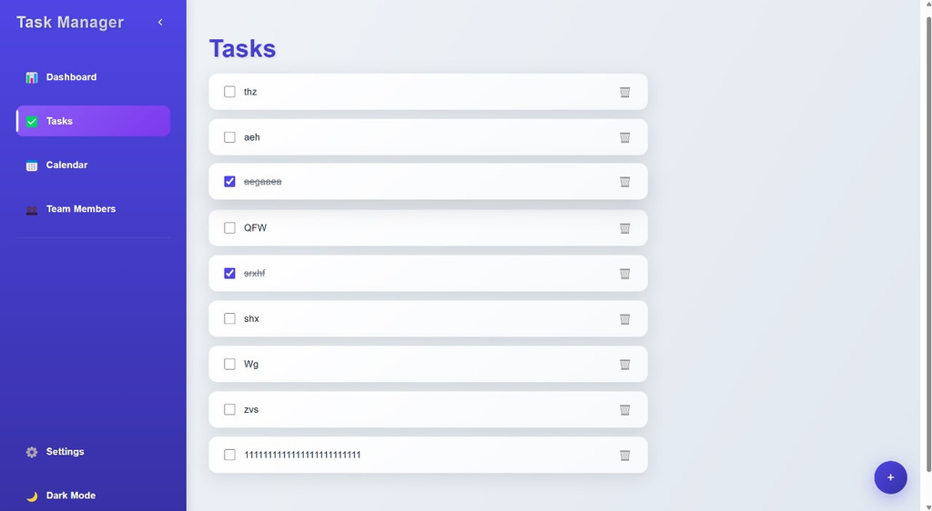
Creating A Future-ready Workforce
Modelling & Result
Light Mode
Dark Mode

Slide 11
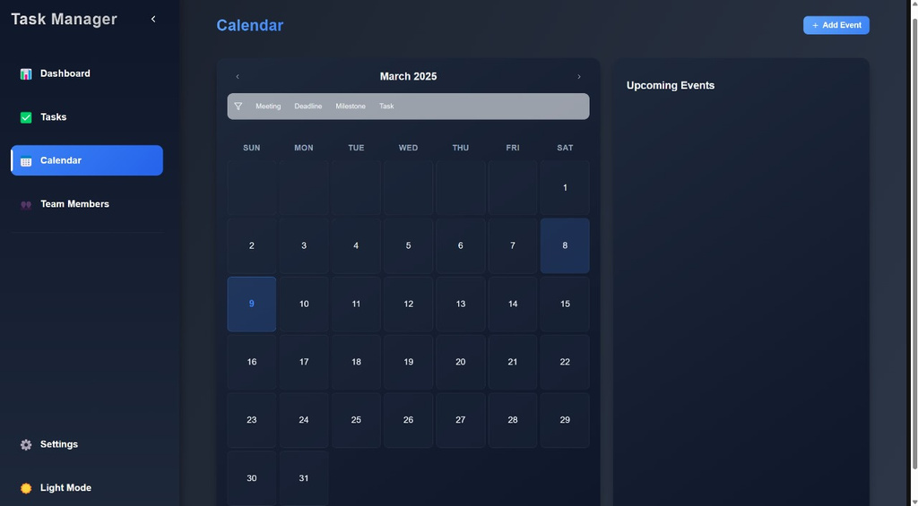
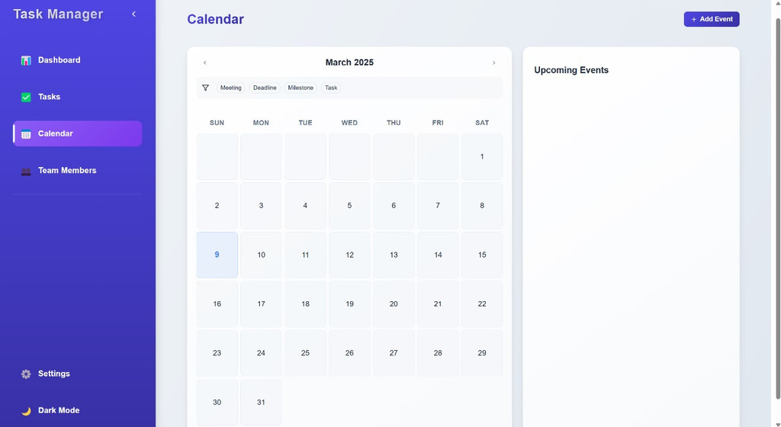
Creating A Future-ready Workforce
Modelling & Result
Light Mode
Dark Mode

Slide 12
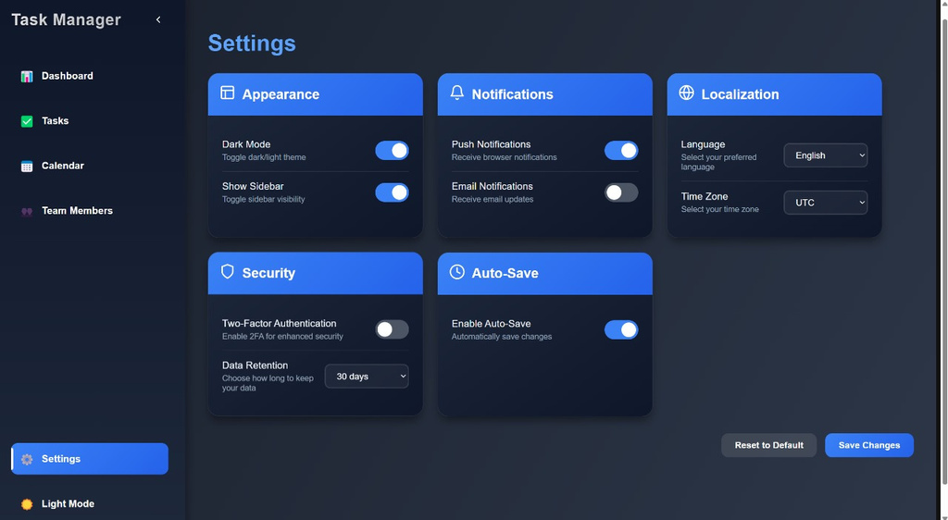
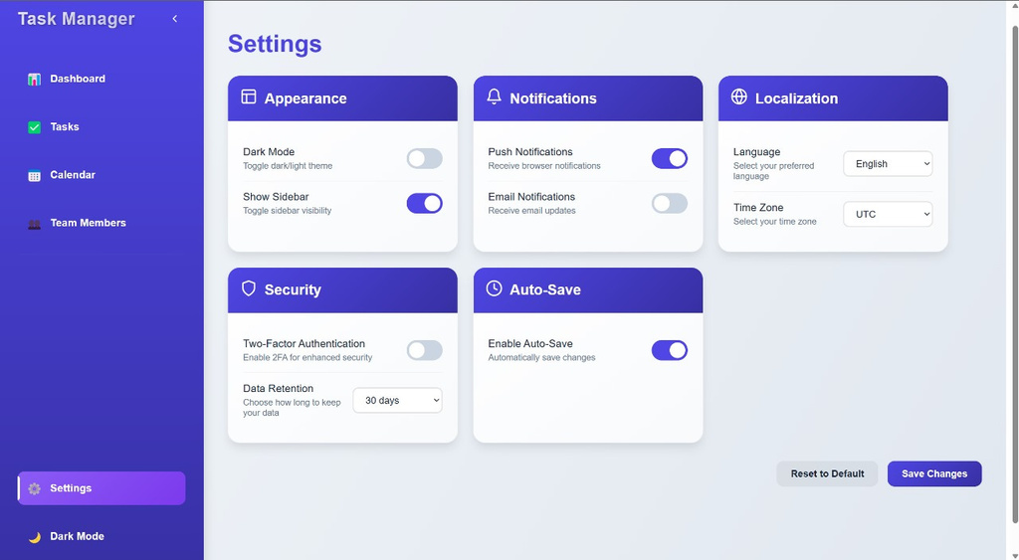
Creating A Future-ready Workforce
Modelling & Result
Light Mode
Dark Mode

Slide 13

Creating A Future-ready Workforce
Conclusion
The Project Management Tool, built with the MERN stack, enhances project tracking, task management, and collaboration.
Its real-time collaboration and workflow automation ensure efficiency, eliminating communication gaps.
The user-centric UI offers an intuitive experience, enabling seamless navigation and task execution.
With scalability and security, it is a robust solution for teams and enterprises managing complex projects.

Slide 14
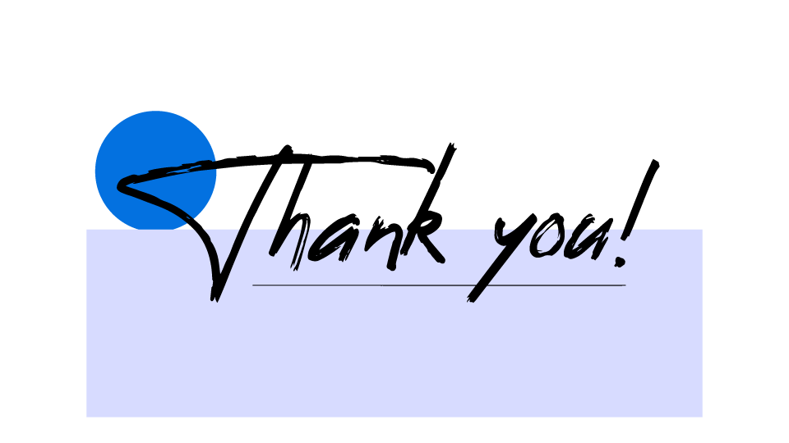
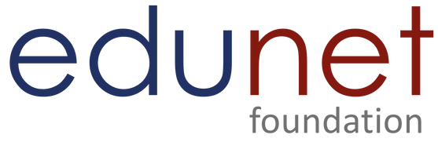
Notes:
Thank You !!

