Slide 1
2d Object detection - yolor
TRAIN MODEL WITH INFRARED IMAGE( FLIR)
SOURCE CODE :https://github.com/SudharsanamShyamsundar/FLIR_YOLOR

Slide 2
TABLE OF CONTENTS
Scope of Project
Ground Truth Extraction
Training
Detect
Testing

Slide 3
SCOPE OF PROJECT
Problem statement : The object detector is not working as expected because of the elevation of the camera with the IR images , so we focussed to test with few State of art Object detectors YOLOR and YOLOV5 . This work is based on YOLOR . YOLOR can able to perfrom additional tasks such as kernel space alignment in addition to the Object detection.

Slide 4
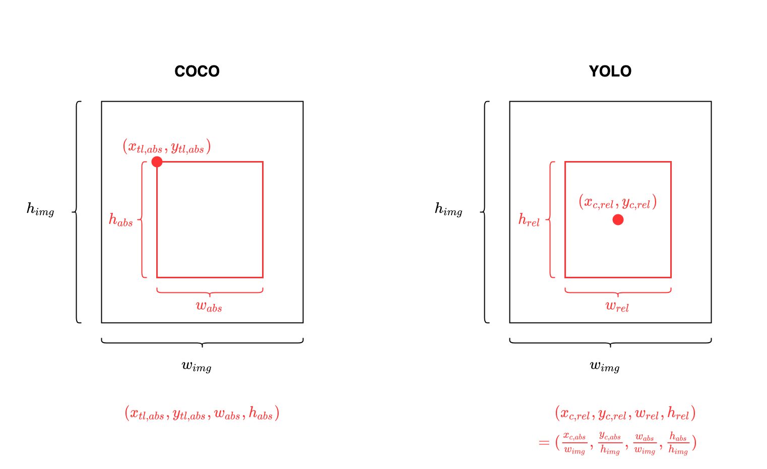
YOLO BOUNDING BOX

Slide 5
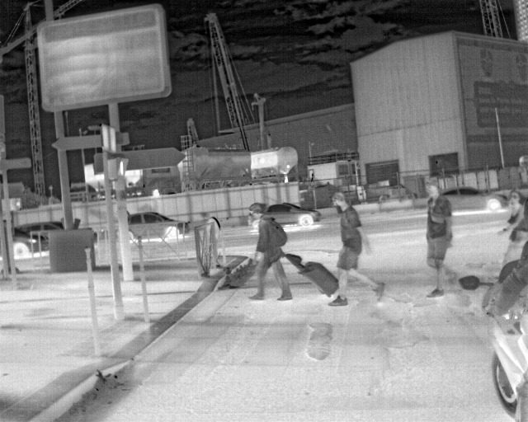
Ground Truth Extraction
YOLOR expects the bounding box and the class id as ground truth . The details are present in the COCO.JSON file where you can find the annotation details (box and class id )

Slide 6
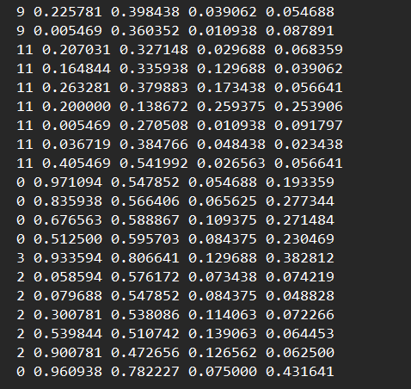
GROUND Truth Extraction
As FLIR Dataset was adapted on COCO, the class id are mapped according to that . For instance the person is COCO is labelled as 0 and hence you can see as 0 in the right image shown. In addition , the COCO dataset has 80 classes where the index position starts at 0 . In the previous slide you can see there are 4 persons and you can see it on right time ( 4 instances )
1st position value indicates class id, and consequent numbers are
Bounding Box values (center x, center y, w, h)

Slide 7
Training
Once the Ground Truth extracted, we need to create the YAML file and place the images and the lables in the separate folder for test,train and validation
Weights are not initialized to train from scratch , input image size is 1280 , epochs 10, batch size 4 , consumed all 4 TESLA T4 cores from NVIDIA
Mean average precision is 0.332

Slide 8
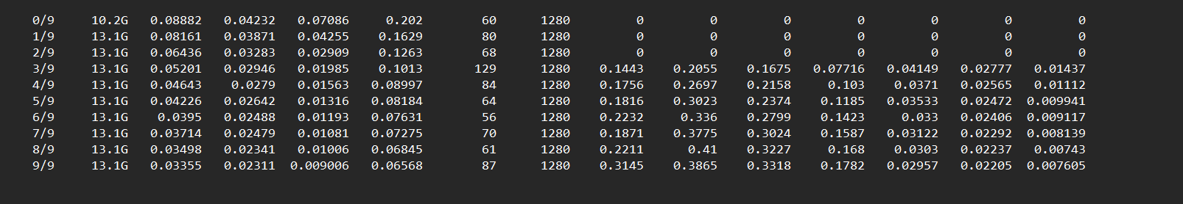
Training results – EPOCHS

Slide 9
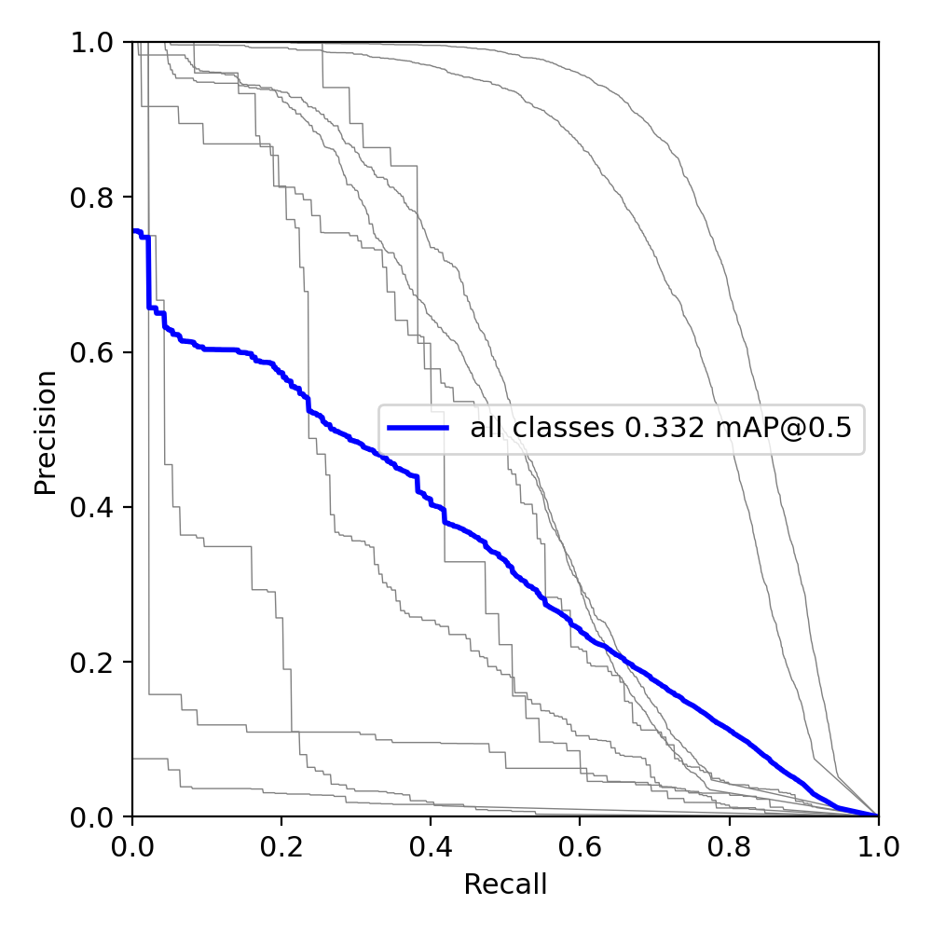
Precision-recall curve
At IOU 0.5 as threshold, the mean average precision is 0.332

Slide 10
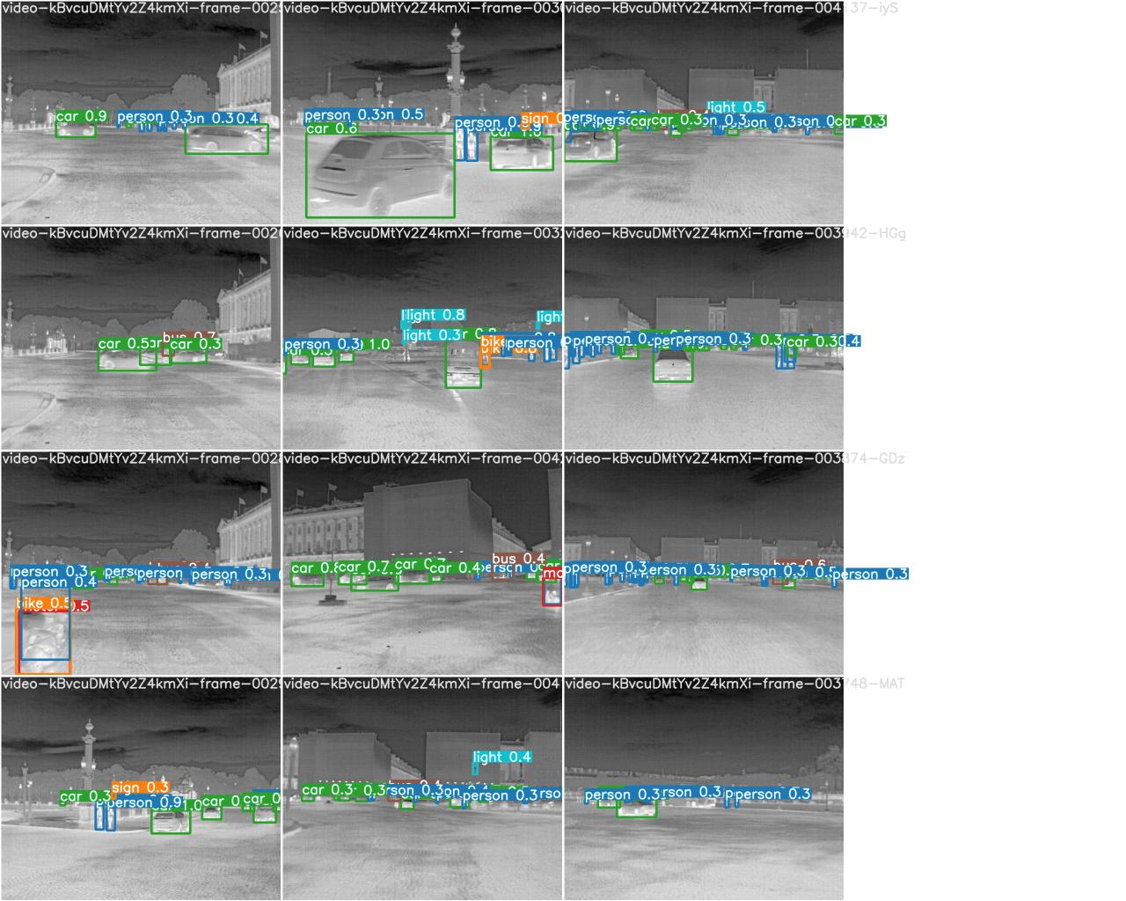
Training PREDICTION RESULTS

Slide 11
DETECTION
After the model is trained for 10 epochs , the weights are used to detect the images where it has not seen

Slide 12
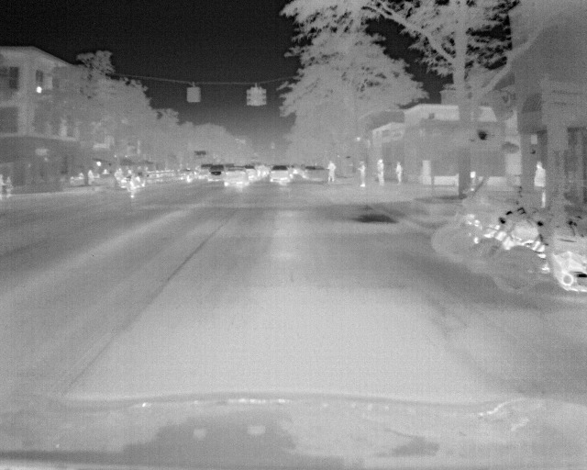
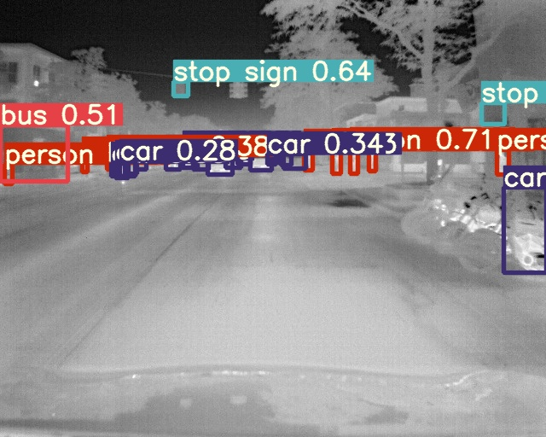
DETECTION FAILURE

Slide 13
Testing…
IOU is retained at 0.65 and all configurations was retained , the input shape of image is 1280

Slide 14
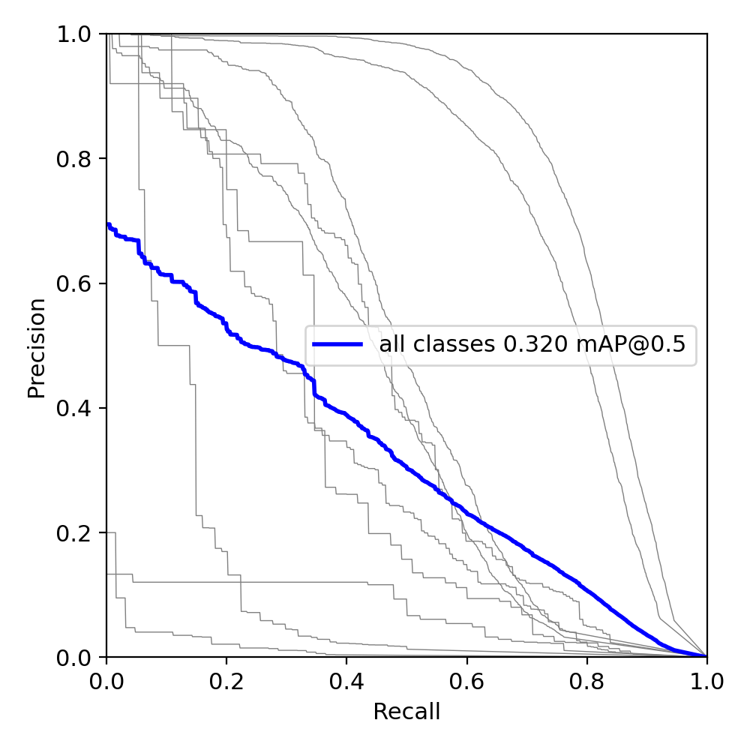
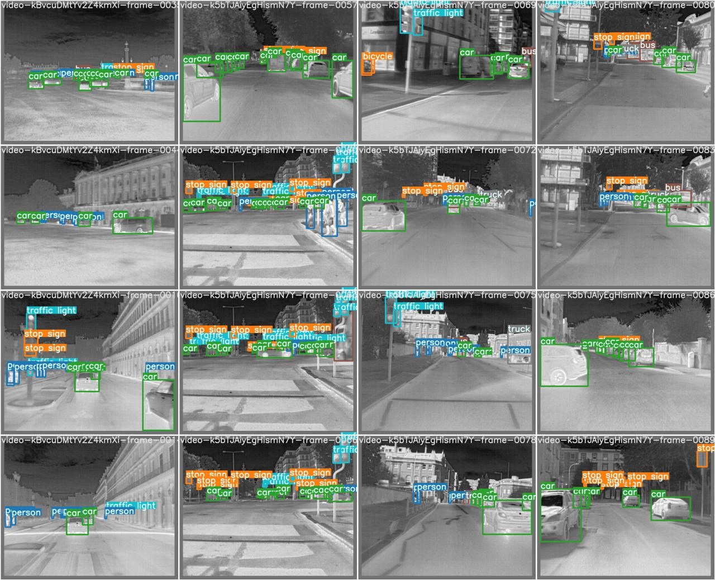
Mean average precision results a 0.320

Slide 15
Thank you
I would like to thank Marton for providing the opportunity and discussing the progress on a weekly basis and given his suggestions

