Slide 1
Multi-Class Single Image Classification German and Persian Traffic Signs
By Sudharsanam Shyamsundar and Ziad Attia

Slide 2
Introduction:
The fundamental task in computer vision is to do the image classification apart from Object detection and the segmentation. In this project, we have built the neural network model using CNN and VGG16 model to classify the German and Persian Traffic signs (separately and combined).
These methods have been used by others before, but we also try to combine the the dataset, and the two models on the combined datasets.

Slide 3
Datasets:
For the task, we chose two datasets from Kaggle.
GTSRB - German Traffic Sign Recognition: https://www.kaggle.com/datasets/meowmeowmeowmeowmeow/gtsrb-german-traffic-sign
Persian Traffic Sign Dataset:
https://www.kaggle.com/datasets/saraparsaseresht/persian-traffic-sign-dataset-ptsd
The German dataset has train set of 14405 images and a test set of 2421 images across 43 classes. The Persian dataset has test set of 39209 images and a test set of 12631 images across 43 classes.
When we trained the models, we chose 20% of the training set to be used as a validation set.

Slide 4
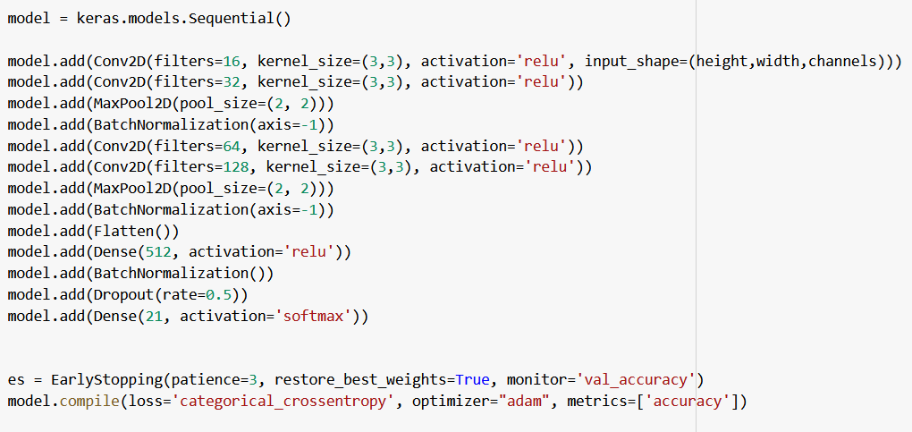
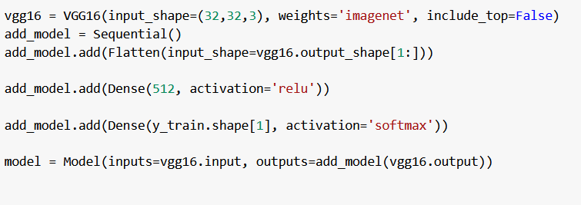
Proposed Methods:
First, we downloaded the Persian and the German datasets using a python script. We then combined them to create a third dataset with 21 classes which we will refer to as Combined dataset.
Then, we created our two models, CNN and VGG16. For VGG16, we used models available on Keras and added additional dense layers to the output for training with these datasets. However, we created the CNN from scratch.
Finally, we ran each of the three training and validation sets on our models (a total of 6 runs) and tested our trained model on the test datasets.

Slide 5
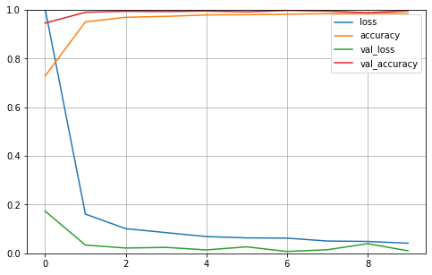
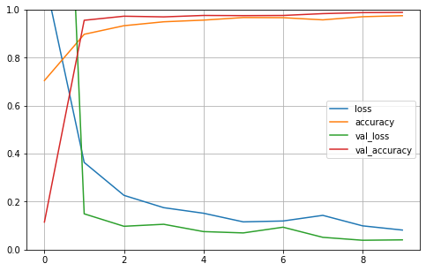
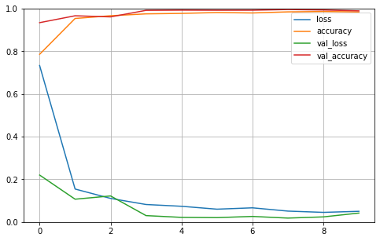
CNN Results:
For the German dataset, the validation accuracy and loss were 0.9964 and 0.0103, respectively. The test accuracy was 0.97.
For the Persian dataset, the validation accuracy and loss were 0.9889 and 0.0408, respectively. The test accuracy was 0.98.
For the Combined dataset, the validation accuracy and loss were 0.9895 and 0.0419, respectively. The test accuracy was 0.98.

Slide 6
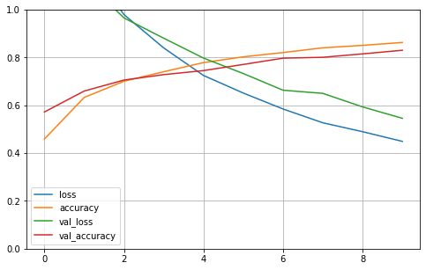
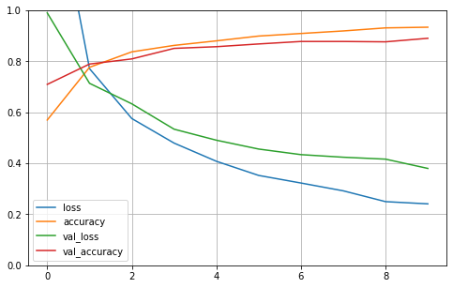
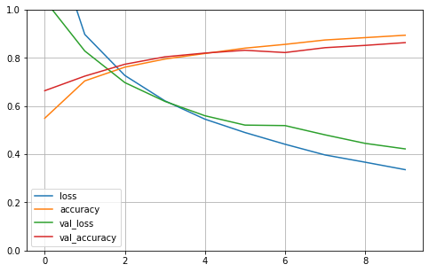
VGG16 Results:
For the German dataset, the validation accuracy and loss were 0.8301 and 0.5456, respectively. The test accuracy was 0.55.
For the Persian dataset, the validation accuracy and loss were 0.8903 and 0.3799, respectively. The test accuracy was 0.71.
For the Combined dataset, the validation accuracy and loss were 0.8634 and 0.4222, respectively. The test accuracy was 0.61.

Slide 7
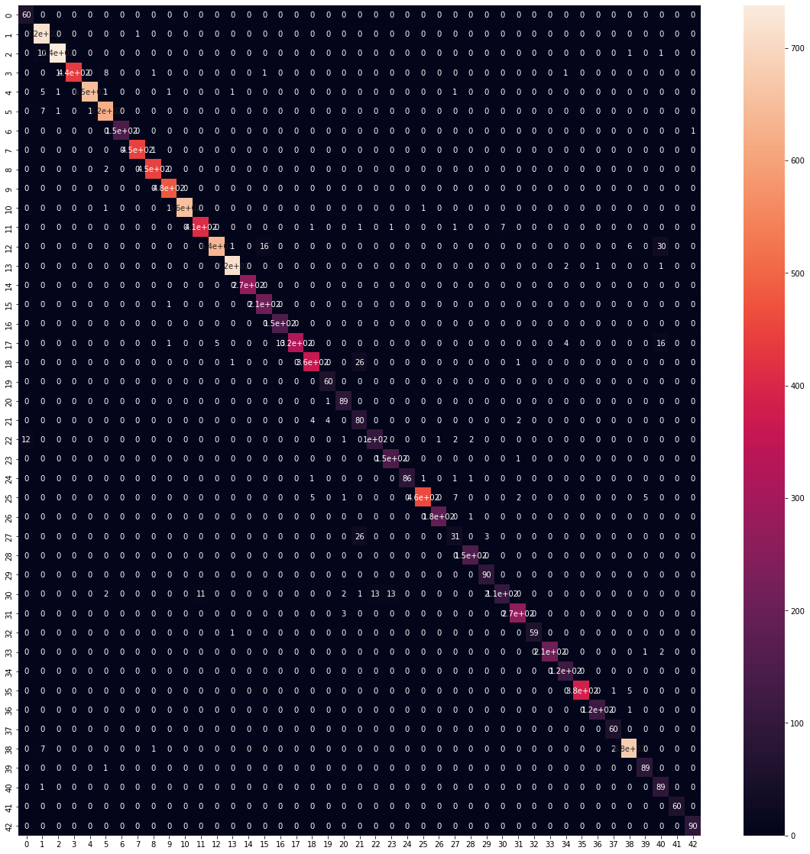

Slide 8
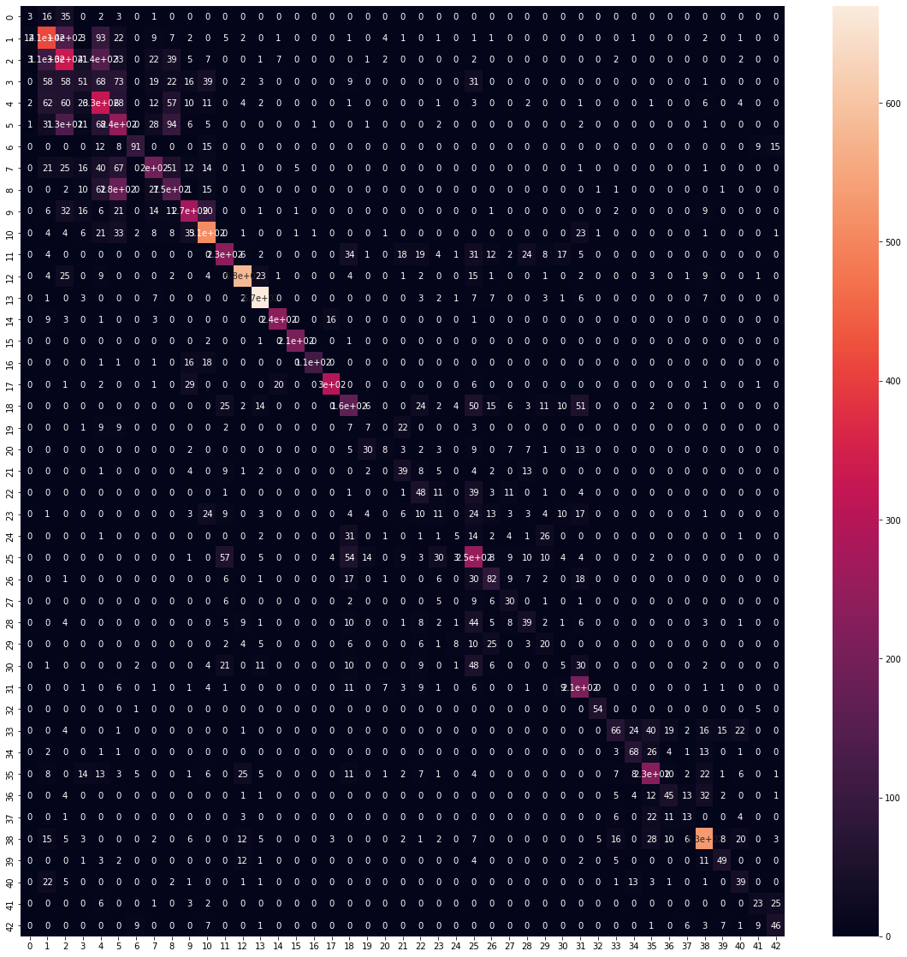
0:'Speed limit (20km/h)'
1:'Speed limit (30km/h)'
2:'Speed limit (50km/h)'
3:'Speed limit (60km/h)'
4:'Speed limit (70km/h)'
5:'Speed limit (80km/h)’
6:'End of speed limit (80km/h)'
7:'Speed limit (100km/h)’
8:'Speed limit (120km/h)'

