Slide 1
DBMS CASE STUDY · GRAPH DATABASE MODEL
Campus Connect
A Real-Time Student Relationship and Mentorship Network Using SurrealDB
SUDHARSHAN.K (CB.SC.U4CSE25763)
AKILAN.T (CB.SC.U4CSE25704)
SIVA VARDHAN.V (CB.SC.U4CSE25755)

Slide 2
The toolkit behind the network
02 · TECH STACK
DATABASE
SurrealDB graph model, the only database
BACKEND
Node.js + Express
FRONTEND
React + Vite
GRAPH VIEW
Cytoscape.js
REAL-TIME
LIVE SELECT over WebSocket pushed to the browser by SSE
API
REST + JSON

Slide 3
How a click travels, and finds its way back
03 · ARCHITECTURE
Every change flows back to the browser as a live event
React client
Cytoscape graph view
REST + JSON
Express API
routes + services
SurrealQL
SurrealDB
nodes + edges
LIVE SELECT events
SSE stream
Live hub
dedupe + sequence numbers
Requests go left to right. Live events come back through the hub to the browser.

Slide 4
Your campus is a web, not a spreadsheet
04 · WHY A GRAPH
B
Who is friends with whom
A
C
Who mentors whom
Who collaborates on what
The real questions are paths: friends of friends, mentor chains, shared skills
D
E
In a graph database each of these is one hop along an arrow.

Slide 5
Dots, and the lines that connect them
05 · GRAPH SCHEMA
student
Profile, year, department, skills, interests
NODE
activity
involves
friends_with
Friendship
EDGE
S
S
friends_with
mentorship_request
Pending, accepted, rejected or cancelled request
EDGE
mentors
Active or ended mentorship
EDGE
mentors
collaborates_with
S
collaborates_with
Project collaboration
EDGE
activity, involves
Activity feed linked to the students involved
NODE + EDGE
Seed data 14 fictional students · 18 friendships · 5 mentorships · 4 pending requests · 7 collaborations

Slide 6
Rules the database refuses to break
06 · INTEGRITY RULES
01
02
03
Edges are typed: each relation allows only student to student
No self-friendship and no self-mentoring
A mentor must be in a higher year than the mentee
04
05
06
Only one open request per pair of students
Only one active mentorship per pair
A friendship is stored once, in one fixed direction

Slide 7
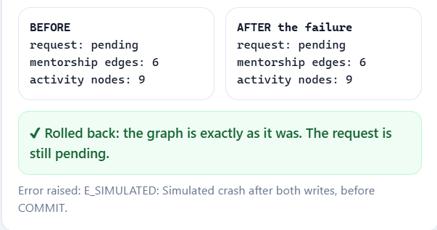
Accept it all, or accept nothing
07 · ATOMIC MENTORSHIP TRANSACTION
1
Check the request is pending and belongs to this mentor
2
Mark the request accepted
3
Create the mentors edge
4
Log the activity
Rollback demo. An error is forced after the edge is created. The edge disappears and the request stays pending.
Committed. With no error, all steps succeed together.
5
Return the result
If any step throws an error, nothing is saved.

Slide 8
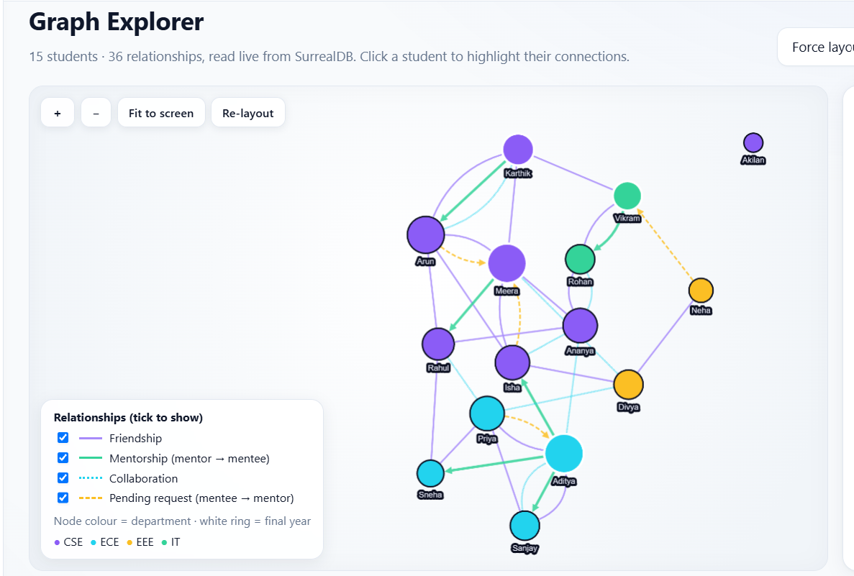
Click here, watch it appear there
08 · REAL-TIME LIVE UPDATES
1
2
3
4
LIVE SELECT watches 6 tables in SurrealDB
The Express server removes duplicates and numbers each event
Events stream to the browser
React updates the graph and shows a toast

Slide 9
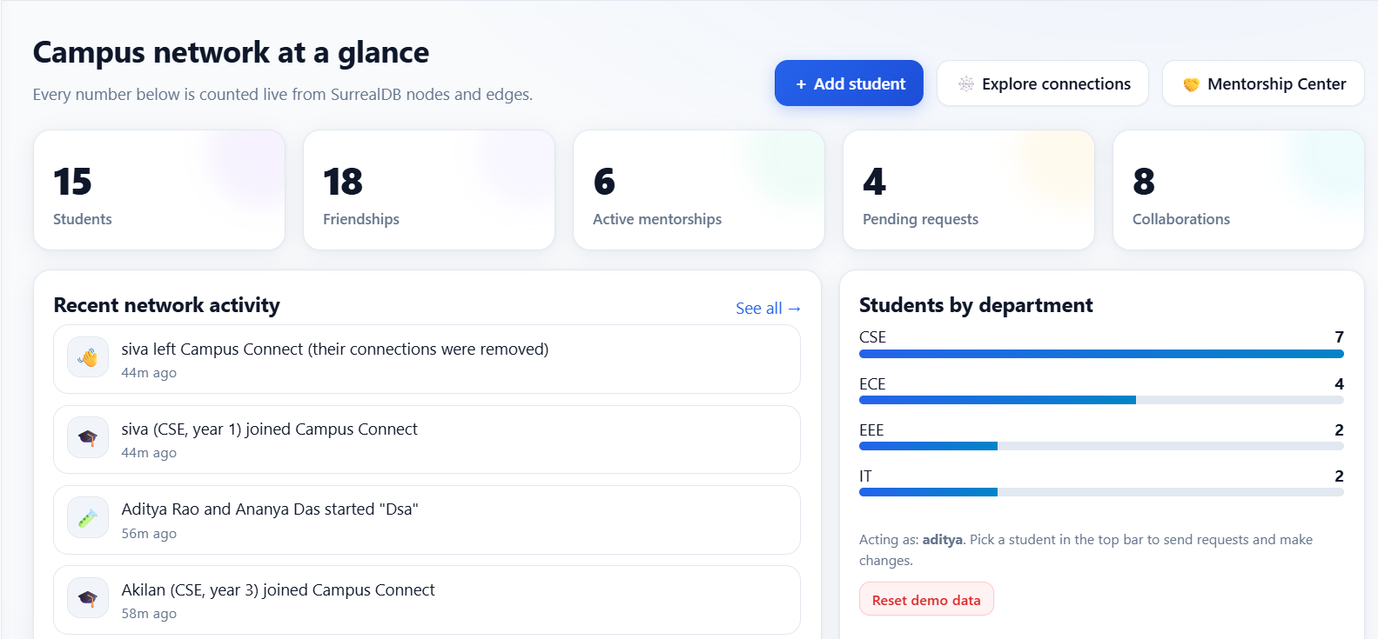
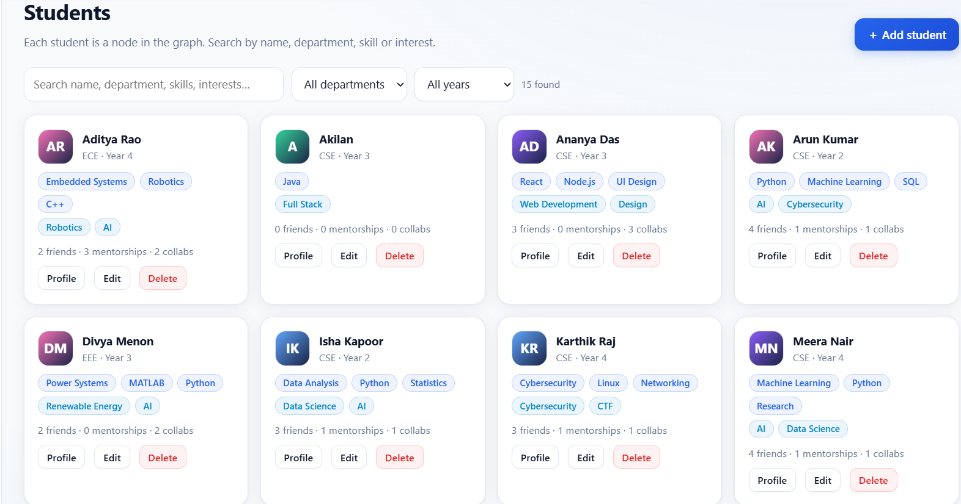
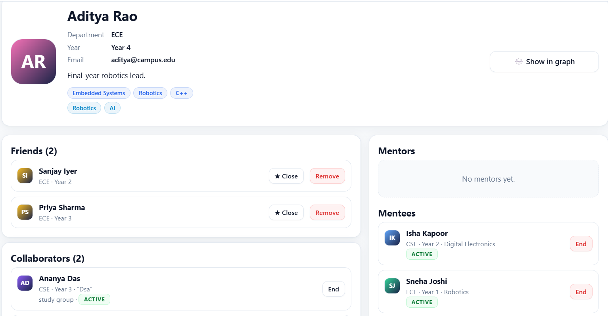
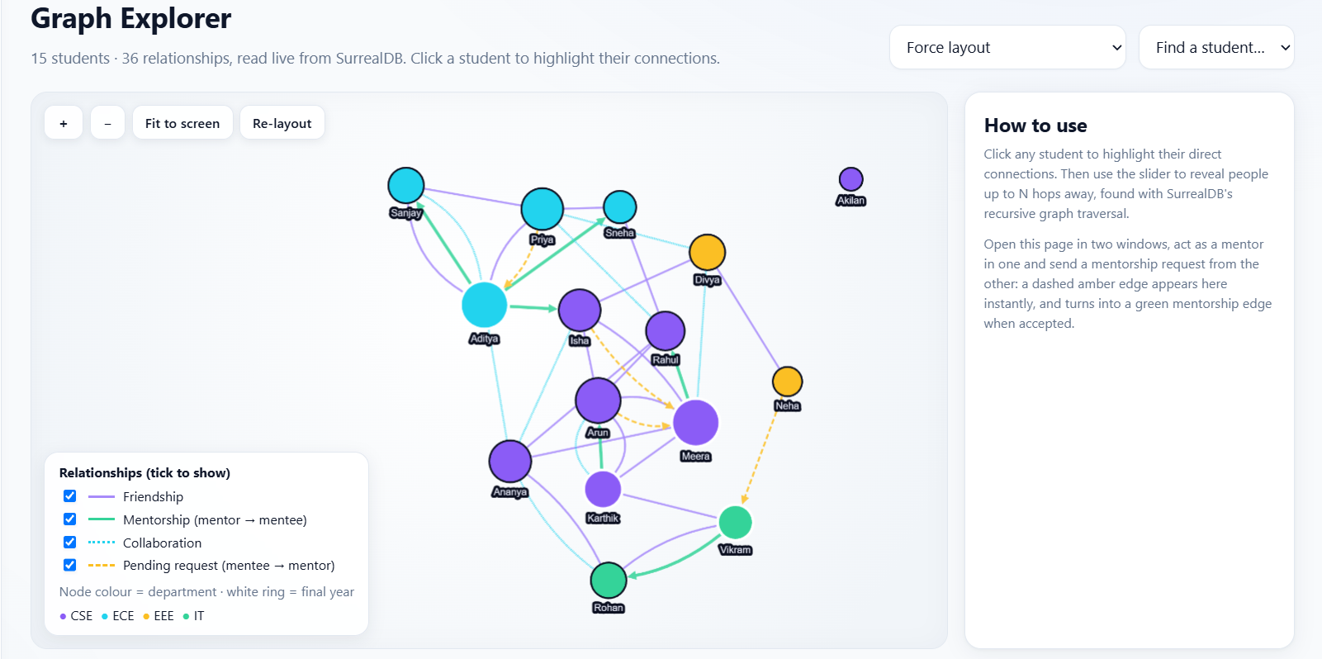
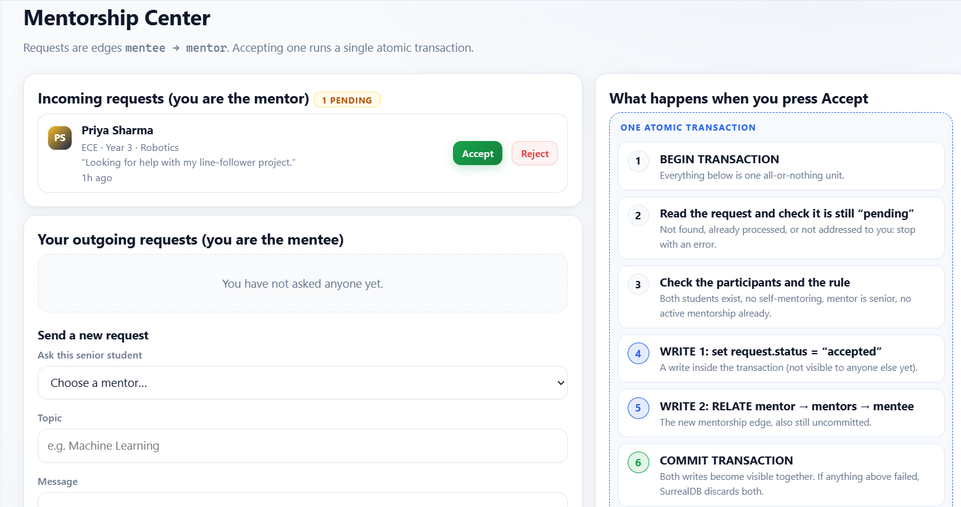
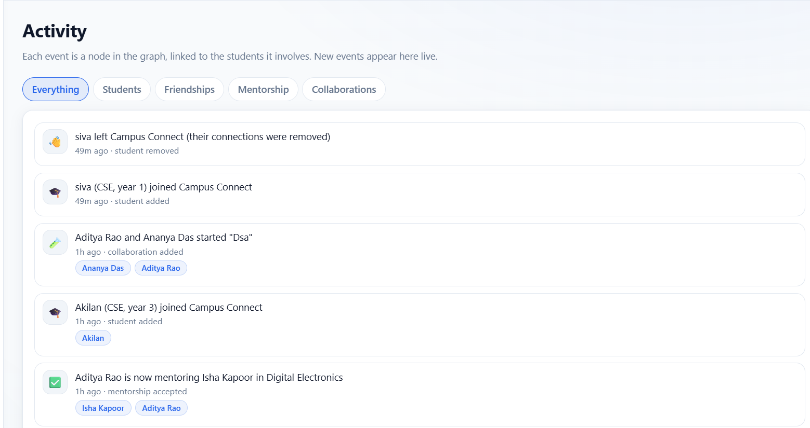
A tour of six pages
9 · THE APP
Dashboard
Counts and recent activity
Student Directory
Search, filter, add, edit, delete
Profile
One student and their connections
Graph Explorer
Interactive network with hop slider
Mentorship Center
Requests and atomic accept
Activity
Live feed of changes

Slide 10
One dataset, three ways to model it
10· GRAPH VS DOCUMENT VS RELATIONAL
Relational
Document
Graph
(this project)
RELATIONSHIPS
Foreign keys and join tables
Embedded arrays or references
Edges that carry their own fields
MULTI-HOP QUERIES
Nested JOINs
Application code
Arrow traversal
EDGE ATTRIBUTES
Extra columns
Awkward
Natural
BEST FOR
Tabular reports
Self-contained records
Connected data

Slide 11
Three databases, one honest comparison
11 · DATABASE COMPARISON
MySQL
SurrealDB
Neo4j
MODEL AND LANGUAGE
Relational, SQL
Multi-model (documents + graph), SurrealQL
Graph only, Cypher
RELATIONSHIPS
Foreign keys and join tables
Edges with their own fields
Edges with their own properties
MULTI-HOP QUERIES
Nested or recursive JOINs
Arrow traversal
Pattern matching
REAL-TIME
No built-in push; polling or extra tools
Built-in live queries
Needs extra setup
ECOSYSTEM
Very mature, widely used
Younger, smaller
Mature, large
BEST FOR
Tabular, transactional data
Apps mixing records, graph and live data
Large-scale graph analytics
We chose SurrealDB because the project requires it; we make no performance claims.

Slide 12
Ten questions, one hop at a time
12 · GRAPH TRAVERSAL QUERIES
1
Direct friends of a student
2
Mentors and mentees of a student
3
Students two relationship hops away
4
Friends two students have in common
5
Students whose skills match an interest
6
Potential mentors (skills + relationship path)
7
Students with the most connections
8
Collaboration network across departments
9
Pending mentorship requests for a mentor
10
Network within N hops

Slide 13
Where we stop, and where we go next
13 · LIMITATIONS AND FUTURE WORK
LIMITATION
FUTURE WORK
Demo identity only, no real login
Real authentication and record-level permissions
Small dataset, no benchmarks
Load testing on larger graphs
Live events go through one server
Shared message bus for several servers
Younger ecosystem than Neo4j
Graph analytics such as centrality
Traversal depth is capped
Mentor recommendations from shared skills and mutual friends

Slide 14
What we proved, and what we stood on
14 · CONCLUSION AND REFERENCES
Relationships are first-class data in a graph model
1
REFERENCES
SurrealDB gave us edges, transactions and live queries in one database
SurrealDB documentation
2
SurrealDB JavaScript SDK
Rules are enforced in the database, so invalid states cannot be saved
Cytoscape.js
3
Express
Tested: 10 backend tests pass, plus a two-window live demo
4
React

